Slide 1
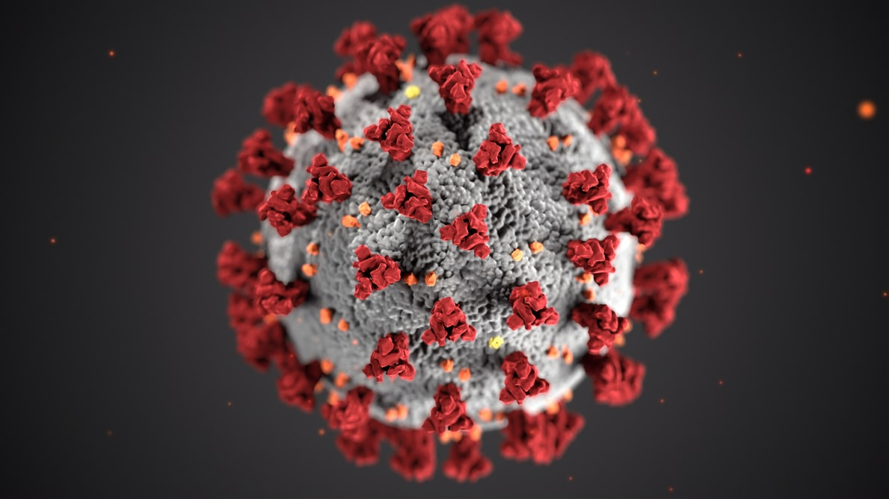
COVID-19
novel coronavirus
Prepared by:
Manisha Tanwar

Slide 2

INRODUCTION
What is COVID-19?
Coronaviruses are a family of viruses found in humans and animals. Some can infect humans and are known to cause illness ranging from the common cold to more severe diseases such as Middle East Respiratory Syndrome (MERS) and Severe Acute Respiratory Syndrome (SARS). The most recently discovered coronavirus causes coronavirus disease COVID-19.
How is COVID-19 transmitted?
Most often, spread from person-to-person happens mainly via respiratory droplets produced when an infected person coughs or sneezes, similar to how influenza spreads. These droplets can land in the mouths or noses of people who are nearby or possibly be inhaled into the lungs.

Slide 3
SYMPTOMS & PRECAUTIONS
What are the symptoms of COVID-19?
The main symptoms of COVID-19 resemble those of a bad cold or the flu, which can make detection difficult. They include: fever, cough, or shortness of breath. The Center for Disease Control and Prevention (CDC) believes that symptoms of COVID-19 may appear in as few as 2 days or as long as 14 days after exposure at this time.
Can COVID-19 be prevented? What can I do to protect myself?
Wash hands often with soap for at least 20 seconds. If soap and water are not available, use an alcohol-based hand sanitizer of at least 60% alcohol.
Avoid touching your eyes, nose, ear and mouth.
Avoid close contact with people who are sick.
Cover your cough or sneeze with a tissue, then throw the tissue in the trash.
Clean and disinfect frequently touched objects and surfaces.

Slide 4
Key OBJECTIVES
Analysis into the daily trend in terms of Active, Recovered, Deceased Cases across India.
COVID growth rate in the top 10 affected states before lockdown and after lockdown
Tracking patient’s demographics and travelling history to determine the most affected population in terms of gender, age bracket, and cause of infection.
Analyzing the most effective preventive measures taken states wise.
Using patient’s family and background information to determine the expected family members to get infected if one person gets infection in a family.
Analyzing the most affected nationality among the positive cases in India, by recording the patients’ ethnicity and nationality.
Focusing the trend of number of people in quarantine, released from quarantine and hospitalization.

Slide 5
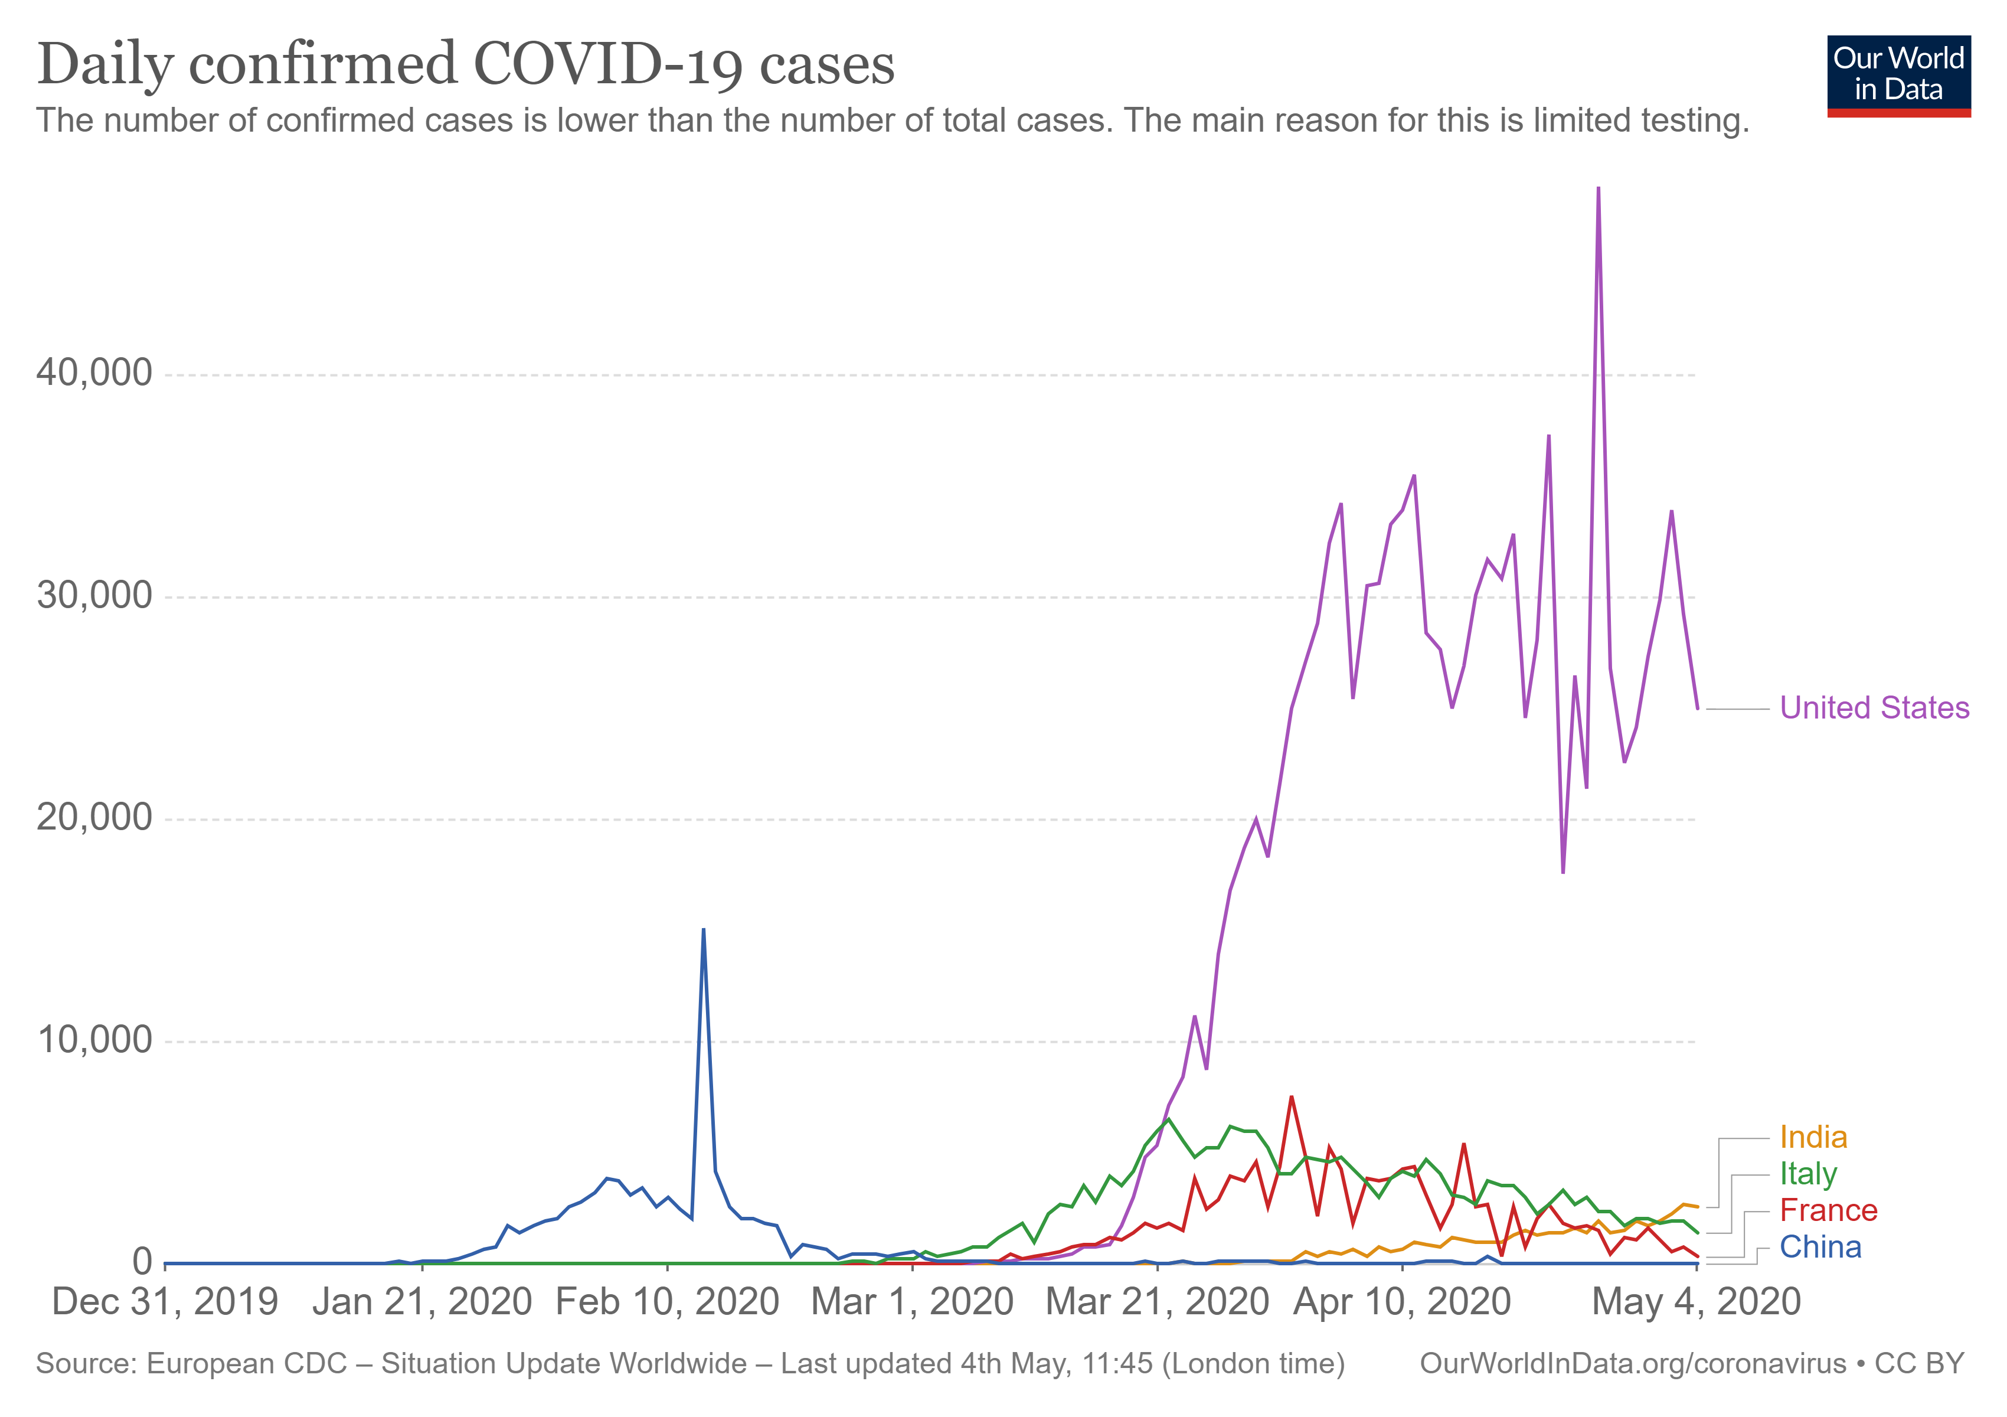
Growth factor of Daily Cases
Compared to countries like the US, Spain and France, India has begun to flatten its daily new case tally but the number of cases continues to remain high, over 42,000 on last count.
Mortality rate is 3.2% among the lowest in the world with such a huge population.
Figure 1: Daily Confirmed Cases Trend of COVID-19 in India

Slide 6
State wise Transmission rate in India
This graph shows how well different states are performing against COVID by tracking, isolating and treating infected people.
Testing has been ramped up quickly in all the states and almost a million samples have been tested throughout the country.
But still some of the states are showing high growth in the confirmed cases.
Figure 2 & 3: State wise confirmed COVID-19 cases in India

Slide 7
ACTIVE, DEATH and RECOVERED Rate
The analysis is based on district-wise case data for 717 districts and uses a simple classification to categorize districts into four buckets: districts with more than 100 confirmed cases as of mid-April (marked as red), districts reporting between 20-100 cases (orange), districts reporting less than 20 cases (yellow), and districts with no cases (green).
India moves to a district-wise and cluster-wise containment strategy to combat the virus, to bring down new cases through aggressive contact tracing, testing and physical distancing.

Slide 8
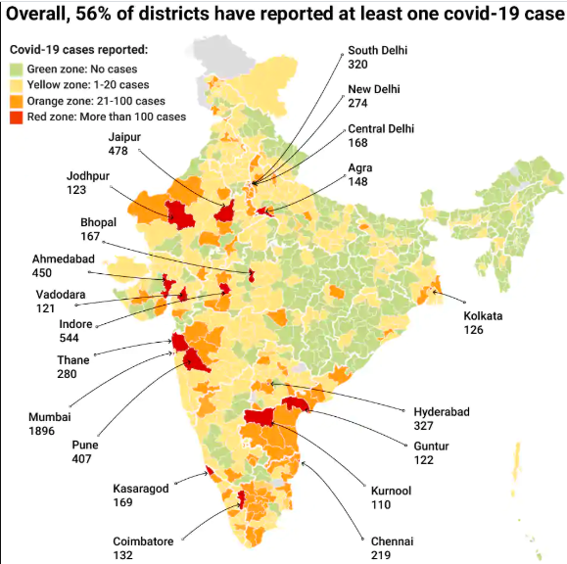
COVID Zones

Slide 9
Infection rate w.r.t Age
Govt. has further stepped up the support in strengthening ongoing surveillance and response at state, district and block levels; cluster containment activities; strengthening real-time data collection activities.
AGE FACTOR
The latest data from the Union Health Ministry has confirmed international trends regarding coronavirus deaths -- that the virus affects the elderly population disproportionately and fatally.
The age-group analysis of Covid-19 patients in India shows that the maximum 42 per cent are of 21-40 years, 33 per cent of 41-60 years, 17 per cent are above 60 years and 9 per cent are of 0-20 years.
In India's favour are its young population (65% aged <35 years). The lockdown is already having the desired effect of flattening the epidemic curve.

Slide 10
Infection rate w.r.t Gender
We can identify the effect of covid on gender. As per the analysis of the case reported : Males are more prone to get infected than females.

Slide 11
Nationality wise case distribution
Based on the traveling history and the nationality of the infected people, we can identify the % of patients belonging to different countries.

Slide 12
Testing coverage
Generally, we would expect that more testing means more reliable data on confirmed cases, for two reasons.
Firstly, a greater degree of testing provides us with a larger ‘sample’ of people for which their infection status is known.
Secondly, it may be the case that countries with a high capacity for testing do not need to ration tests as much.
Where the capacity for testing is low, tests may be reserved (or ‘rationed’) for particularly high-risk groups. Such rationing is one of the reasons that tested people are not representative of the wider population.

Slide 13
Test Conducted vs Positive case ratio
In countries like Japan, one out of 11.7 tests turns out to be positive, which is among the highest in the world. Italy tests 6.7 persons for one positive test while the USA tests 5.3 persons and the United Kingdom 3.4
In India, we are conducting 24 tests out of which one comes out to be positive. Also, we have huge population and not all people belong to vulnerable groups.

Slide 14
Government Measures in India
Clampdowns have been imposed much earlier than in many countries, including China, which failed to contain the spread of the virus. After the first lockdown announced in India started from 24th March for 21 days, the spread has been controlled to a certain extent. And now the govt has announced lockdown 3.0 for another 2 weeks, which will surely provide health care professional time to develop an antidote and govt to react appropriately.
India placed travel restrictions relatively early, and many states quickly shut off access to public places excluding the essentials commodities.

Slide 15
Categories of Measures taken in India

Slide 16
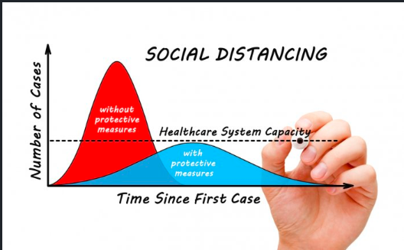
Measures
Additional health/documents requirements upon arrival
Border checks
Border closure
Economic measures
Emergency administrative structures activated or established
General recommendations
Health screenings in airports and border crossings
International flights suspension
Introduction of isolation and quarantine policies
Limit public gatherings
Partial lockdown
Schools closure
Strengthening the public health system
Testing policy
Visa restrictions

Slide 17
ER Diagram
Follow from MYSQL Workbench
Master tables: Country, State, City, District, case status (A-active, C-confirmed, D-deceased, UC-unconfimed, P-positive, N-negative) , nationality.

Slide 18
Major Challenges for India’s fight against COVID
Rates of testing have been low (0·28 per 1000 people as of April 20). Its because of the Capacity issues, absence of political will, and operational feasibility.
Mortality rate from Covid-19 infection is much higher among the elderly: it is 14.8% for those above 80, but just 0.2% for individuals below 39. In India, only 0.8% of the population is above 80 and nearly 75% are below the age of 40. An offsetting factor, however, is the poor health of even younger Indians.
India is home to many multi-generational, joint families. This structure places elderly Indians at considerable risk from catching diseases from younger family members, especially asymptomatic ones.
India may face higher transmission rates during the monsoon, which is India’s flu season.
The country’s high population density, overburdened public health infrastructure, high prevalence of non-communicable diseases and the prospect of transmission from younger people to the elderly in joint families all stack the odds against effective containment.

Slide 19
CONCLUSION
The report concludes that a strategy of "suppression" would be better than "mitigation" to reduce deaths and prevent healthcare systems being overwhelmed.
Under-investment in public health-care system poses a challenge to India's COVID 19 containment plans.
The fatality rate rises by roughly 30% if a person has cardiovascular disease, diabetes, chronic respiratory disease, or hypertension. India has roughly double the rate of heart disease as Italy, and among the highest prevalence of respiratory diseases in the world

Slide 20
CONCLUSION
India's public health-care system is chronically underfunded (at just 1·28% of GDP), leaving primary care weak. This pandemic could be the much needed wake-up call to the necessity of long-term changes to India's health system.

Slide 21
References
https://www.weforum.org/agenda/2020/03/
https://ourworldindata.org/covid-cases
https://www.mohfw.gov.in/
https://www.who.int/india/
https://www.mygov.in/covid-19/
https://economictimes.indiatimes.com/news/politics-and-nation/lockdown-stats-how-india-compares-to-other-coronavirus-hotbeds
https://www.businesstoday.in/opinion/columns/covid-19-coronavirus-lockdown-how-india-can-get-back-to-work-indian-economy-gdp/
https://www.technologyreview.com/2020/04/13/999313/kerala-fight-covid-19-india-coronavirus/
https://www.worldometers.info/coronavirus/
https://qz.com/india/1839018/why-does-india-have-so-few-coronavirus-covid-19-cases-and-deaths/

Slide 22
THANK YOU

