Slide 1
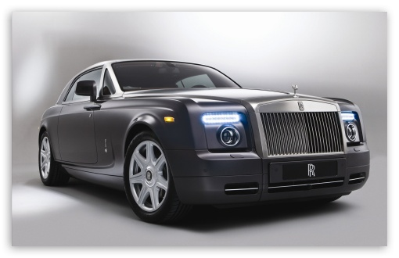




Input Image
128-Dimensional Array
. . .
128 elements
SIFT
Features

Slide 2
Features
Clusters
All Features
1M Clusters

Slide 3
Codebook
3 Closest Visual Words
1M-Dimensional Vector
. . .
d₁
New Feature
d₂
d₃

Slide 4
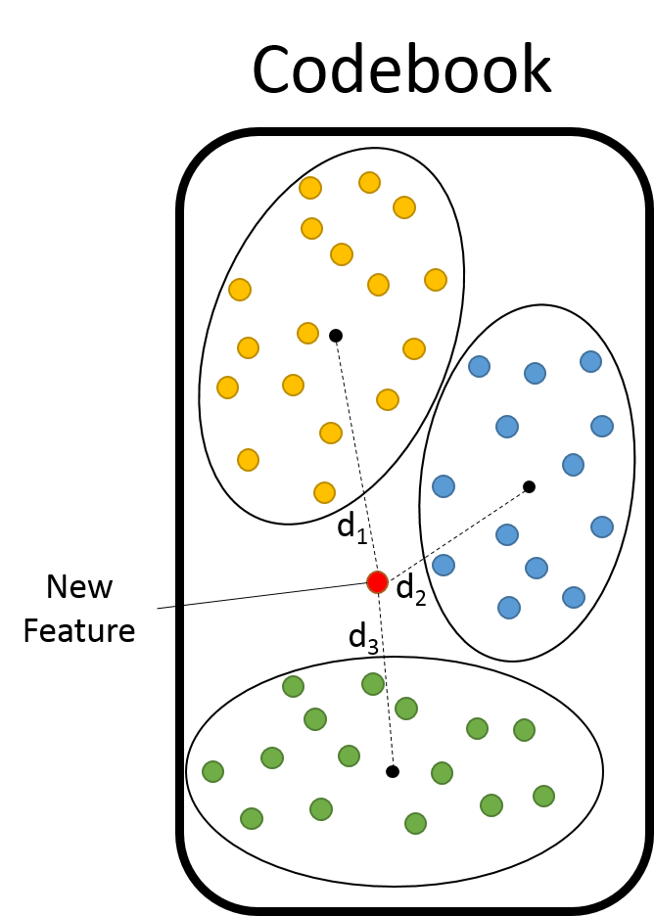
1M-Dimensional Vector
. . .
3 Closest Visual Words

Slide 5
3 Closest Visual Words
3 Closest Visual Words
Bag of Words vector of Image
. . .
1M-Dimensional Vector

Slide 6
3 Closest Visual Words
3 Closest Visual Words
3 Closest Visual Words
. . .
Bag-of-Words vector of Image
1M-Dimensional Vector

