Slide 1

FARKLE
A randomized dice game that combines strategy and luck!
Tyler Menzie
Shandon Probst
Amanda Scroggin
Adams Smith

Slide 2
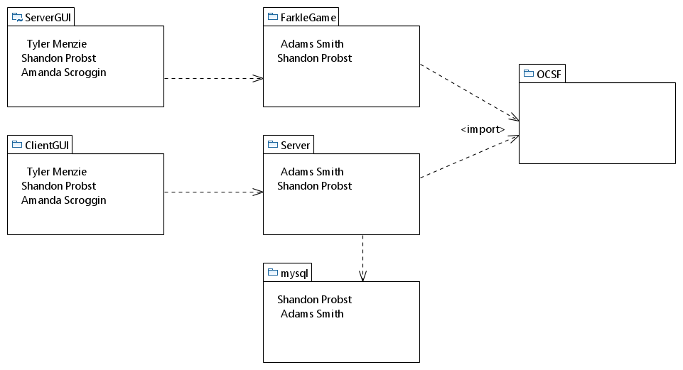
Package Diagram

Slide 3
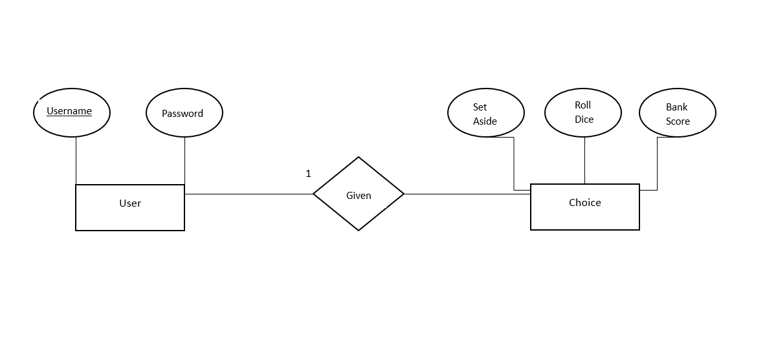
Database design diagram

Slide 4
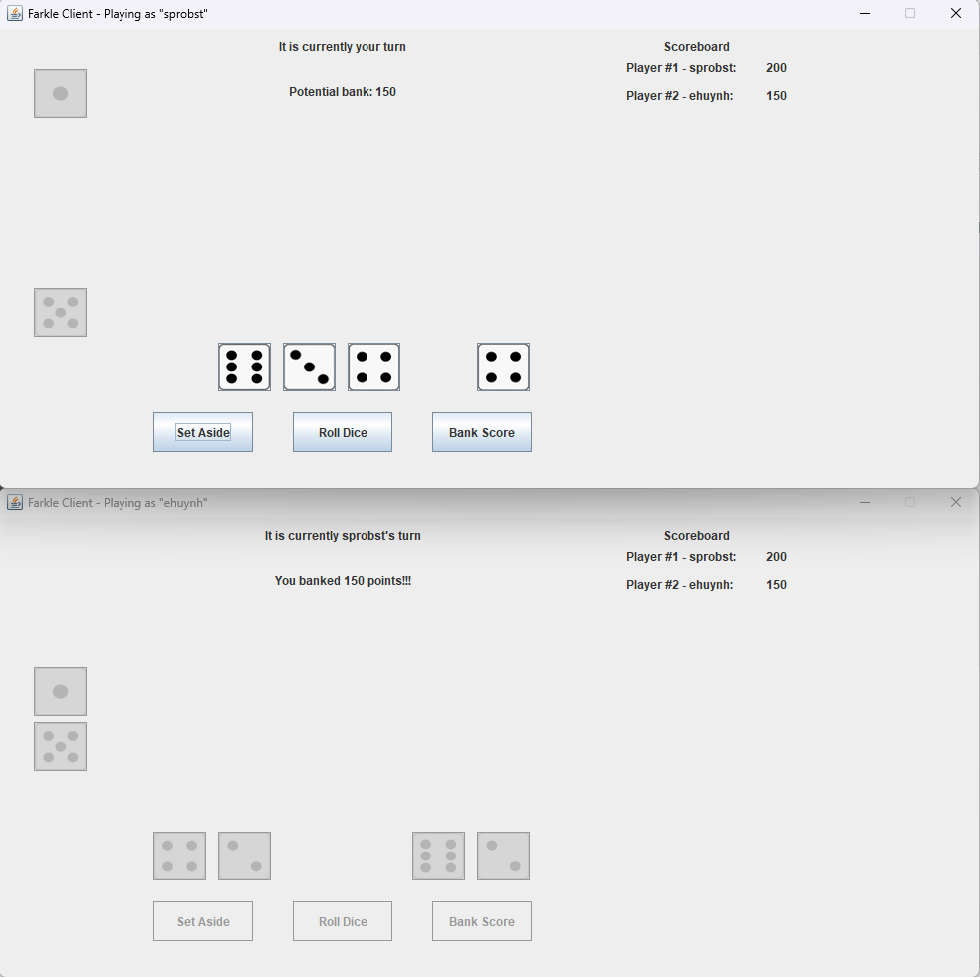
Functional Requirement
Once both users are logged in, Player 1 will select “Roll Dice”. The user then decides to “Set Aside”, “Roll Dice”, or “Bank Score” respectively.
Once “Bank Score” is selected, Player 1’s turn is over, and a message will be sent to the server to let Player 2 know it is their turn to play.

Slide 5
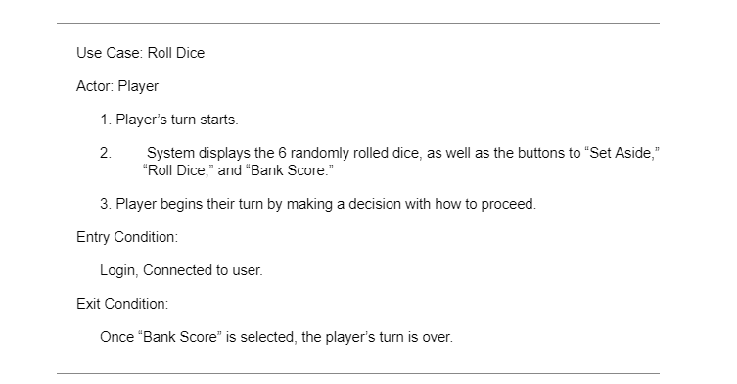
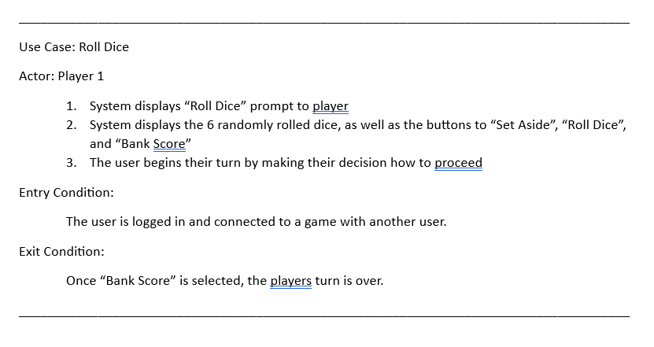
Use Case description of player 1 choices

Slide 6
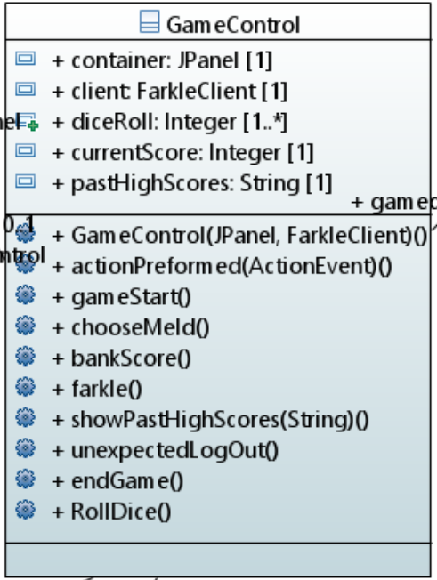
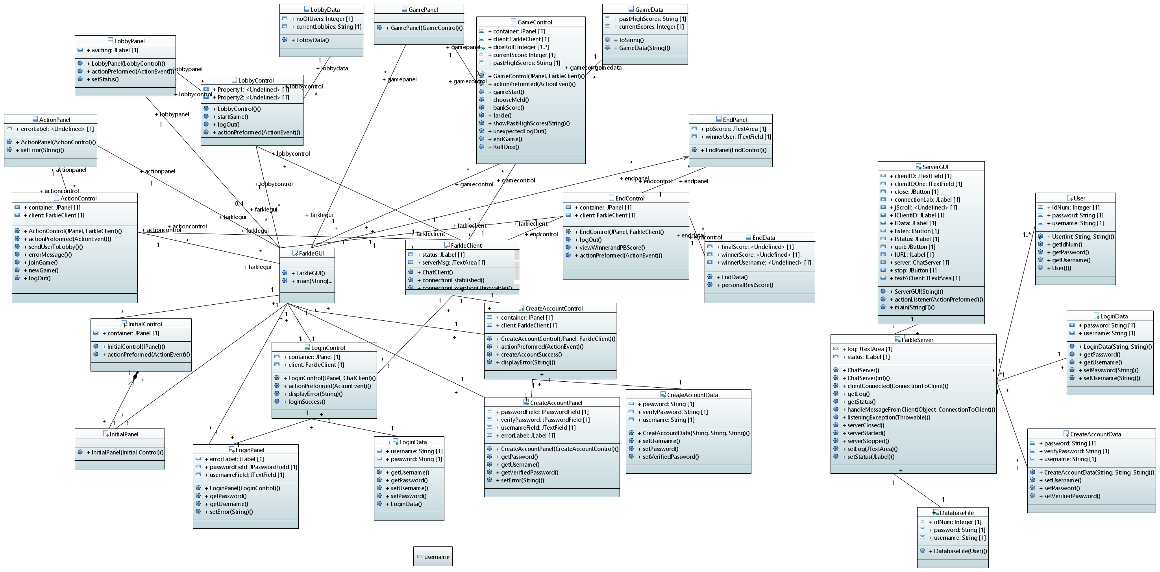
Initial class diagram

Slide 7
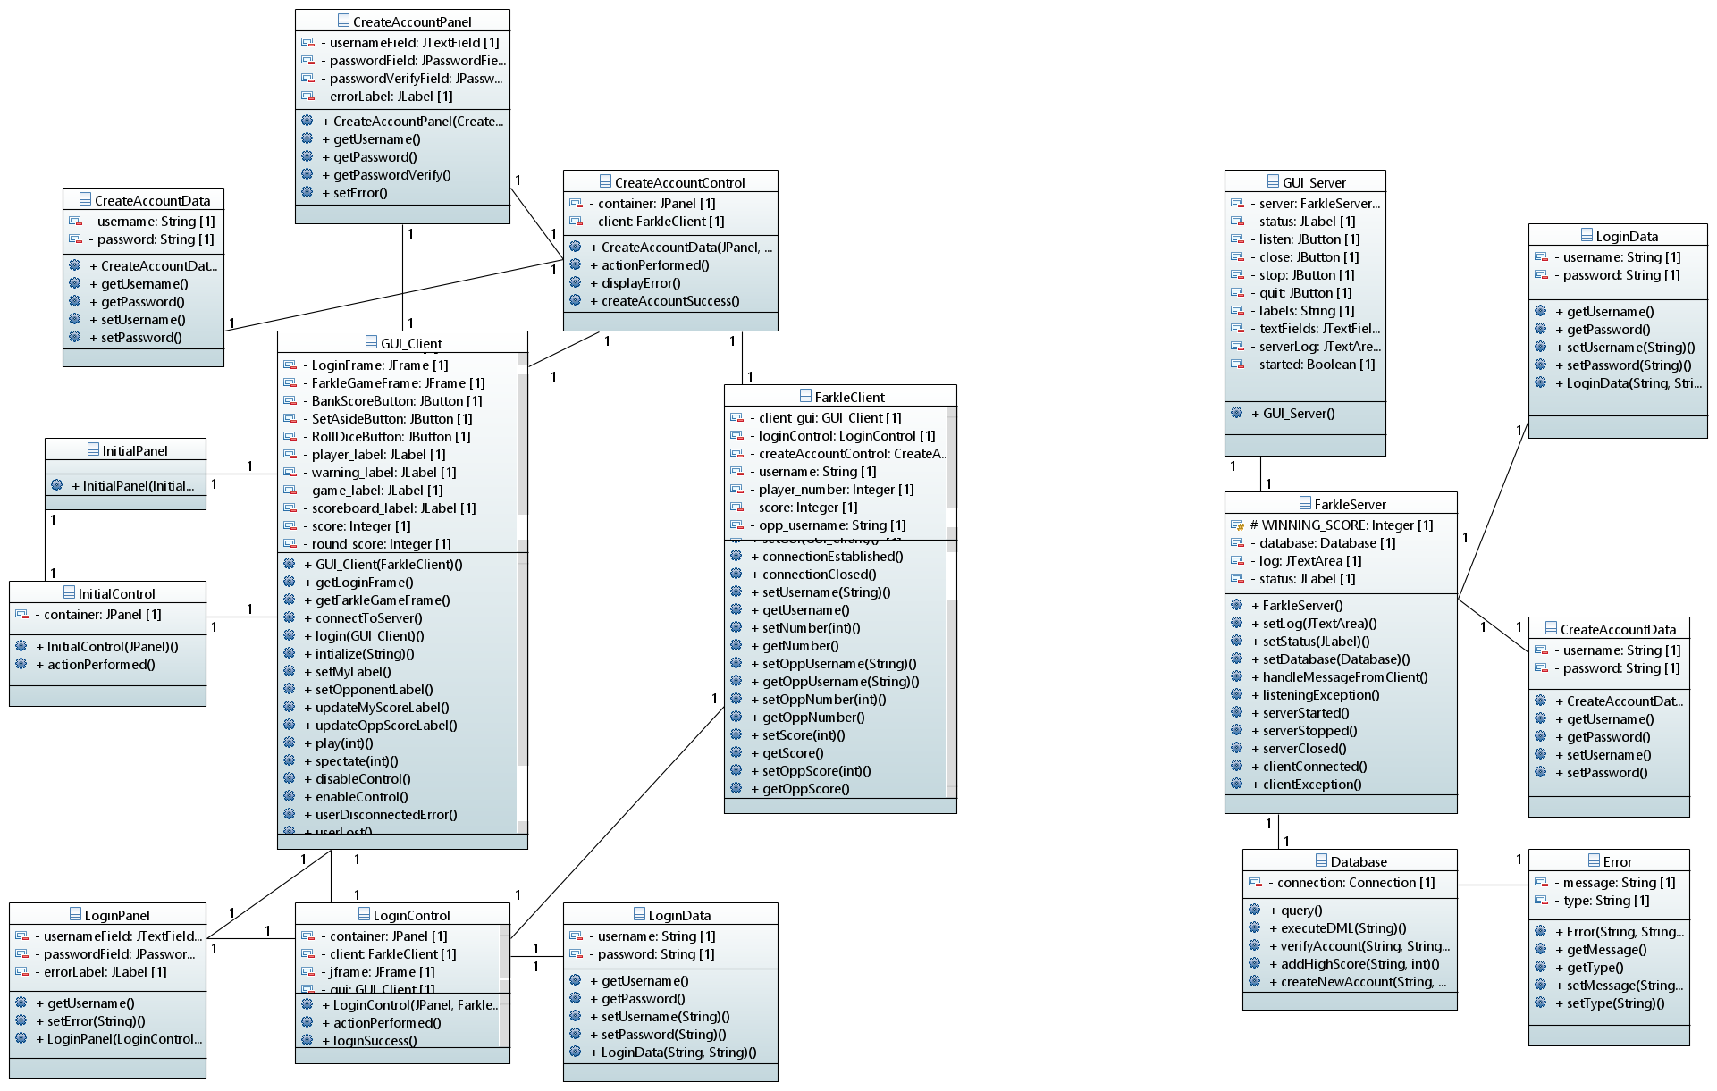
Final class diagram

