Slide 1
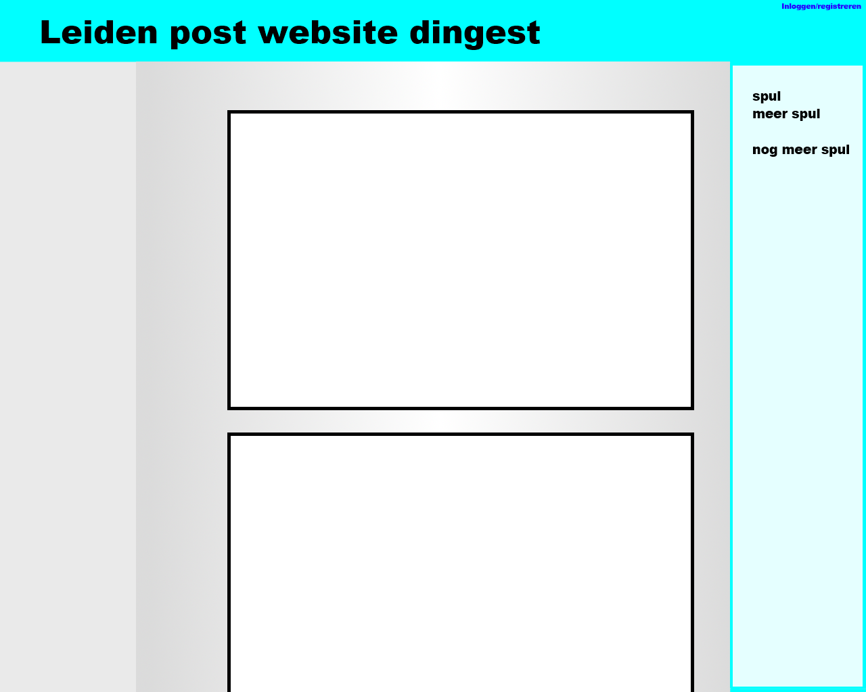
Leiden Post It

Slide 2
Content
Pictures, stories and other posts
Students in Leiden

Slide 3
Similar Work
9gag, facebook, instagram and Secrets
Aimed at students in Leiden

Slide 4
Components
Account system
Upload system
Search function
Page with the newest content
Pages with personal content

