Slide 1
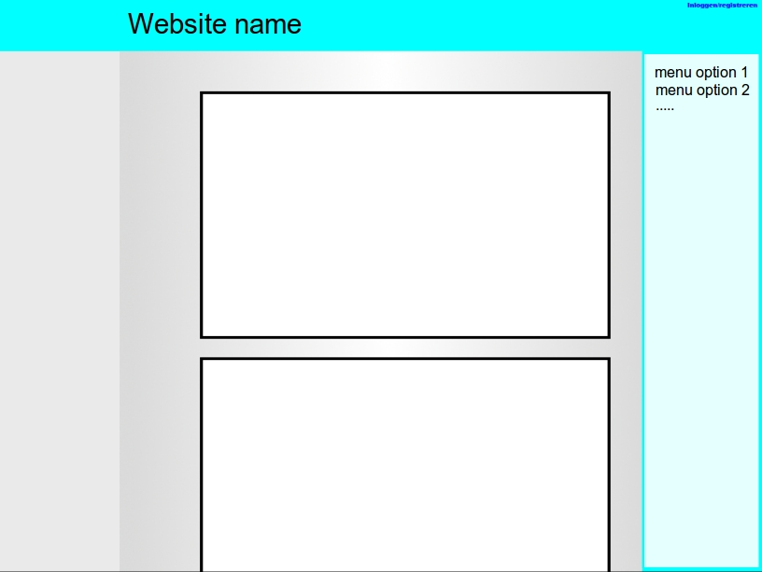
Tim Merckens
Egon Janssen
Aaron Kannangara
Taco Smits

Slide 2
Content
Pictures
Stories
News
User Uploads

Slide 3
Similar Work
9gag, facebook and instagram
Aimed at students in Leiden

Slide 4
Components
Account system
Upload system
Search function
Page with the newest content
Pages with personal content

