Slide 1
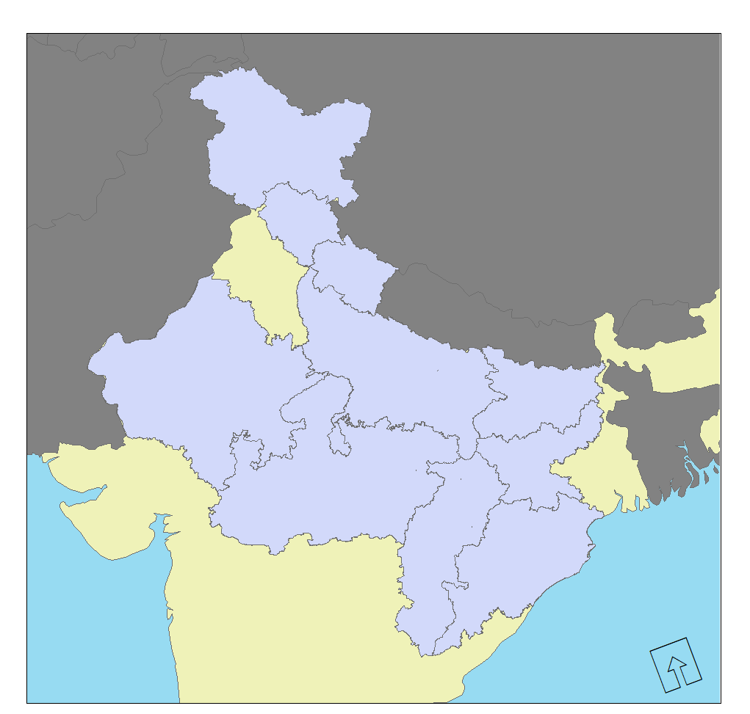
Placeholder Title Text Here
Random
Bullet Points
Here
I don’t know
If you
Even
Want this space
But india isn’t
rectangular

