Slide 1


Slide 3

Database

Slide 5
Search
Laptop
Product_code (PK)
Color (PK)
Width (PK)
Height (PK)
Depth (PK)
Weight (PK)
Id_display (PFK)
Id_cpu (PFK)
Id_ram (PFK)
Id_hdd (PFK)
Os (PFK)
Type (PFK)
File (PFK)
Imported
File
Display
OS
CPU
GPU
RAM
HDD

Slide 7

Design

Slide 9
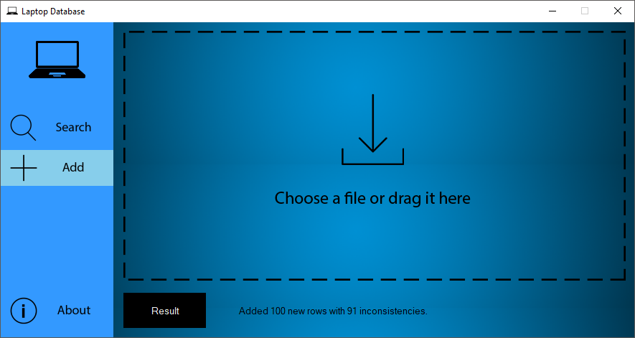

Slide 10
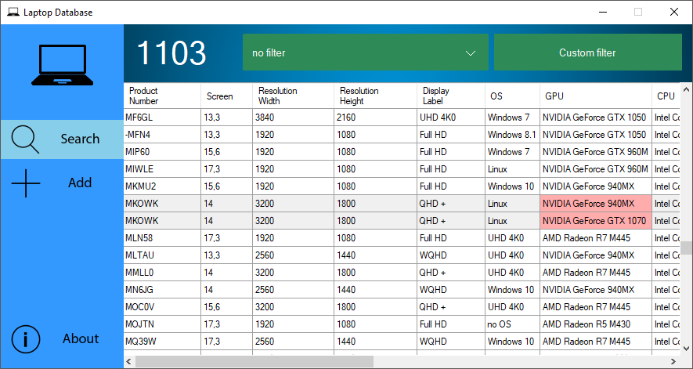

Slide 11
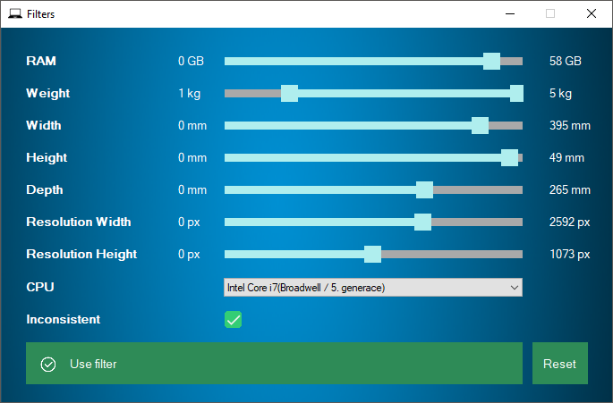

Slide 13

Code

Slide 15
IDBConnector
Application
Laptop
MSSQLConnector
Display
CPU
…
…
…
HDD
Data parser
RAM
OS
…
…
…
CSV
JSON
XML

Slide 17
Database
Václav Langr
Code
Karel Šír
Design
Tomáš Moravec

