Slide 1
Case Study - Cyclistic Bike-Share
Presented by: Tauan Oliveira
Date: 05/05/2023

Slide 2
Contents
Cyclistic - Bike-Share
Objective
Discoveries
Conclusion
Recommendations
Appendix

Slide 3
Objective

Slide 4
Objective
Identify the difference between casual users and annual members using Cyclistic’s bikes to develop a new marketing strategy to convert casual users into annual members.

Slide 5
Data
About: Historical trip data on Cyclistic
Source: Motivate International Inc.
Period: March 2022 to February 2023

Slide 6
Discoveries

Slide 7
Total number of rides by user type

Slide 8
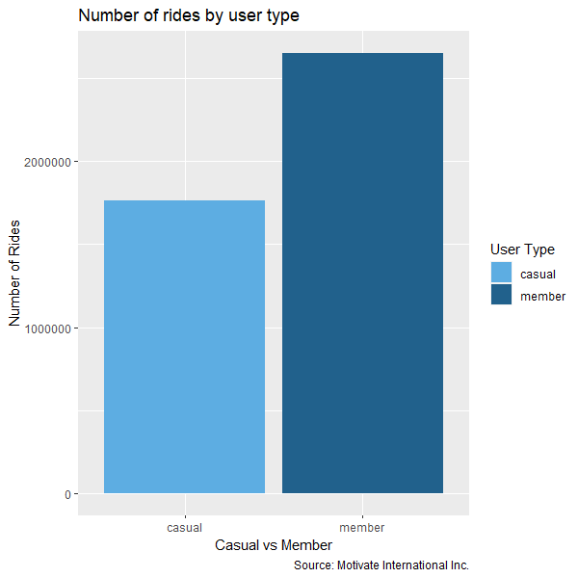
Total number of rides by user type
This historical data covers the period from March 2023 to February 2023
There are more annual members than casual users in Cyclistic
The number of annual members exceeded 2 million cyclists, while casual users exceeded 1.5 million

Slide 9
Number of rides by month

Slide 10
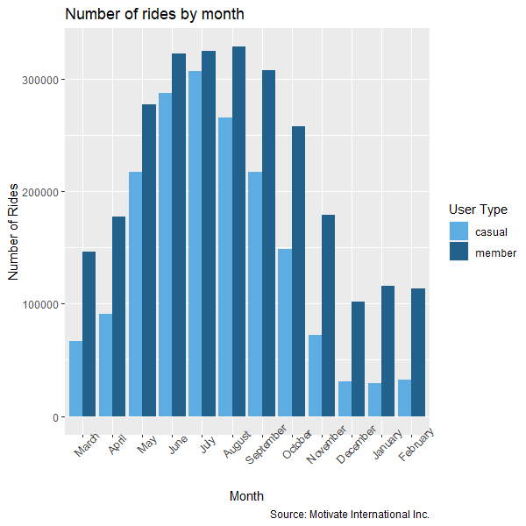
Number of rides by month
Annual members have the highest number of trips throughout all months
The highest number of rides occurred through the summer period
Casual users in the winter recorded the lowest number of rides

Slide 11
Number of rides by weekday

Slide 12
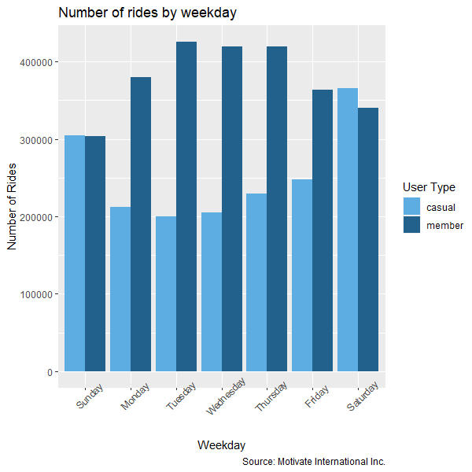
Number of rides by weekday
Annual members have used shared bikes with higher frequency during the days of the week
Tuesdays, wednesdays, and thursdays reached the highest number of rides by annual members
Casual users used shared bikes most during the weekends

Slide 13
Number of rides by start hour

Slide 14
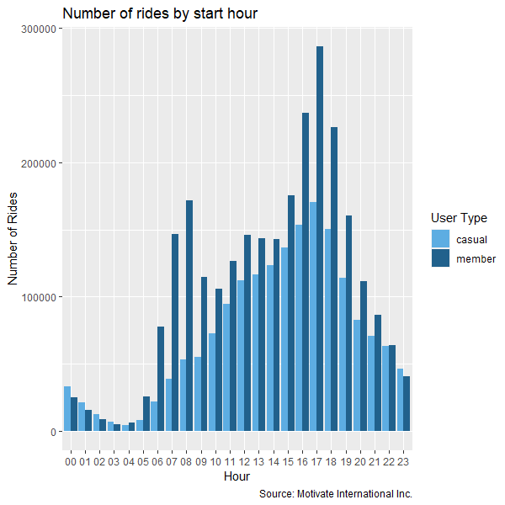
Number of rides by start hour
Annual members have a higher frequency of trips from 06:00 a.m. to 09:00 a.m. and from 03:00 p.m. to 07:00 p.m.
Annual members recorded the highest number of rides at 05:00 p.m.
Casual users outnumbered annual members from 11:00 p.m. to 03:00 a.m.

Slide 15
Average ride length by month

Slide 16
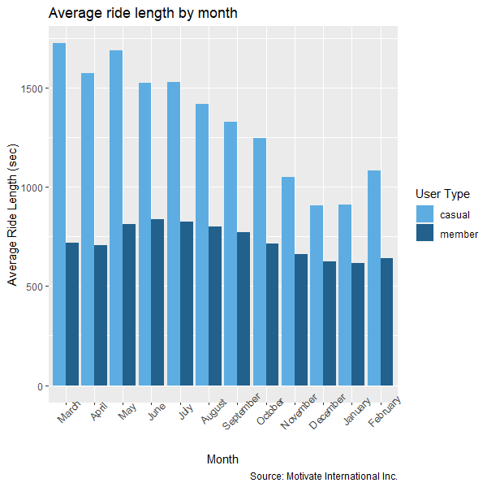
Average ride length by month
Casual users have an average length higher than annual members throughout all the months.
Casual users recorded the highest average ride length in May and March
Annual members recorded trip averages lower than 1000 seconds throughout all months

Slide 17
Average ride length by weekday

Slide 18
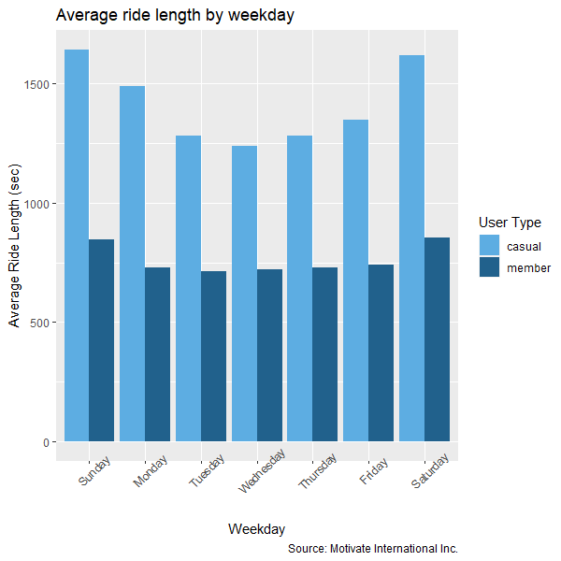
Average ride length by weekday
Casual users have used shared bikes with average trips above 1000 seconds in the whole week
Through the weekends, casual users used shared bikes with an average higher than 1.500 seconds
Annual members recorded averages below 1000 seconds in the whole week

Slide 19
Number of rides by bicycle type

Slide 20
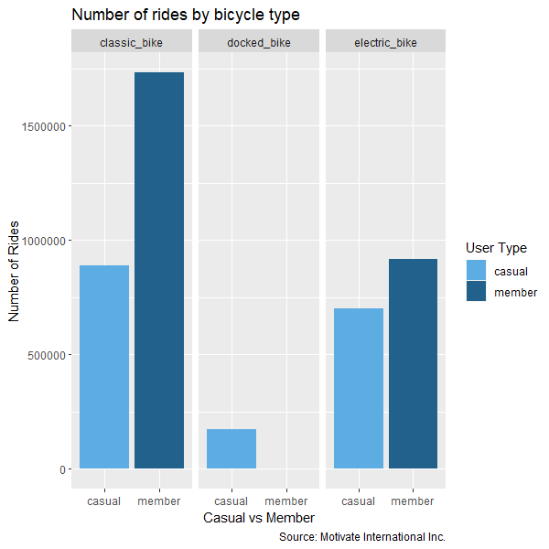
Number of rides by bicycle type
Annual members and casual users have a preference for classic bikes
Annual members haven’t used docked bikes
Electric bikes are the second most used bikes

Slide 21
Average ride length by bicycle type

Slide 22
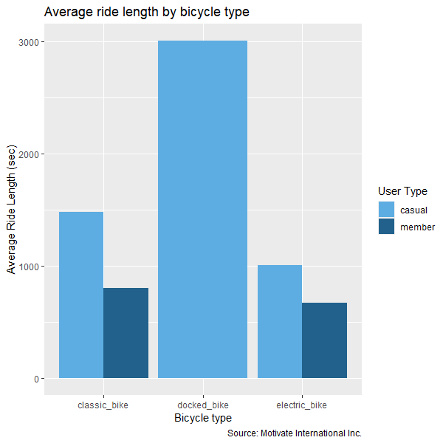
Average ride length by bicycle type
Casual users used docked bikes with an average of above 3000 seconds
Casual users exceeded annual members in trip average in all bicycle types

Slide 23
10 most used stations by casual

Slide 24
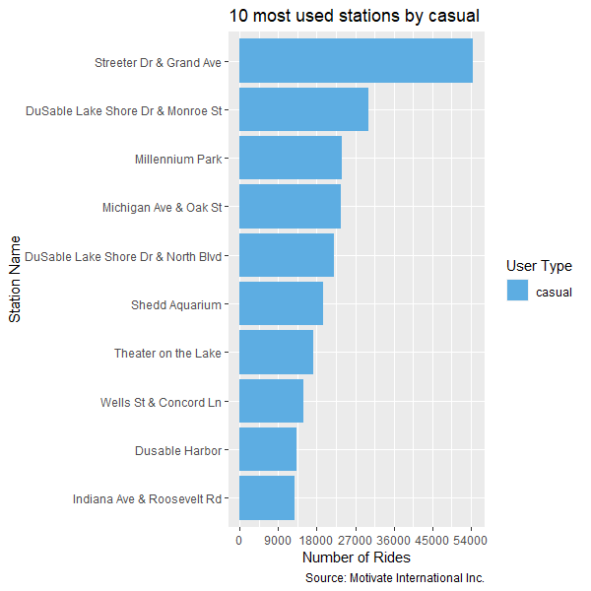
10 most used stations by casual
The ten most used stations by casual are close to tourist attractions
The Streeter Dr & Grand Ave was the most used stations by casual users exceeding 50.000 trips

Slide 25
10 most used stations by member

Slide 26
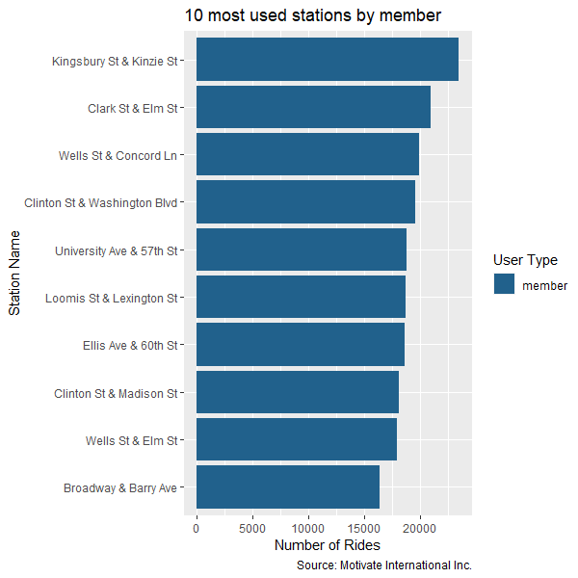
10 most used stations by member
The ten most used stations by member are close to commercial, residential, and educational areas
Kingsbury St & Kinzie St station was the most used station by members exceeding 2.500 trips

Slide 27
Conclusion

Slide 28
Conclusion
Annual members
use Cyclistic bikes during the week
from 06:00 a.m. to 09:00 a.m.
and
from 03:00 p.m. to 07:00 p.m.
at stations close to commercial, residential, and educational areas.
Casual users
take
longer trips
and ride
more frequently on weekends,
all at stations
close to
tourist attractions.
Annual members tend to use bikes to go to work, schools, universities and their homes.
Casual users tend to use bikes for tours and sightseeing.

Slide 29
Recommendations

Slide 30
Recommendations
Since casual users have two options for pricing plans: single ride passes and full day passes, the first recommendation would be to create a new weekend membership plan, as casual users tend to use Cyclistic's bikes more frequently during the weekend.
I also recommend to create another member plan for the months in the summer period, a quarterly plan, as casual users reached the highest number of rides in that period.
The third recommendation would make partnerships with hotels, restaurants, and tourist attractions during the summer period, offering benefits for casual users when becoming member.

Slide 31
Extra Recommendations
Increasing the number of classic bikes during the summer, as we know, we have a peak in the summer, and casual users and annual members prefer classic bikes.
Implement a reward program in the app, especially for members, where members earn points and accumulate them in their account for rewards to redeem later or exchange for extra time. This reward program can encourage casual users to become members as they make longer trips in the whole week.

Slide 32
Further Analysis
Gather more data: (e.g. age, gender, address, prices) will give us more complete insights.
What is the age distribution of cyclists in the data?
How does the plan price affect the choice of users?
Use external datasets: (e.g. Chicago temperature, Chicago public transportation).
May casual users be more likely to convert to annual members if Cyclistic establishes integration of cycling and public
transportation only for member plans?
Conduct a survey: Ask users relevant questions.
What is your primary reason for cycling? (e.g. commuting, exercise, leisure)?
Do you use any other modes of transportation with cycling?
How satisfied are you with the cycling infrastructure in your area?

Slide 33
Appendix

Slide 34
Appendix
Scope of Work
Changelog
Dashboard
Github repository
Kaggle

Slide 35
Thank you!

