Slide 1

Prasad V. Potluri Siddhartha Institute of Technology
Advanced ResNet50 - Autoencoder Framework for Multi-Class Eye Disease Classification
Team Members :
T. N. S. Samanvitha (22501A05H6)
T. Gayathri (22501A05H7)
V. Gnaneswari (22501A05J3)
S. Sushruth (22501A05G8)
Guide :
Mr. Bala Bhaskara Rao Emani
Assistant Professor

Slide 2
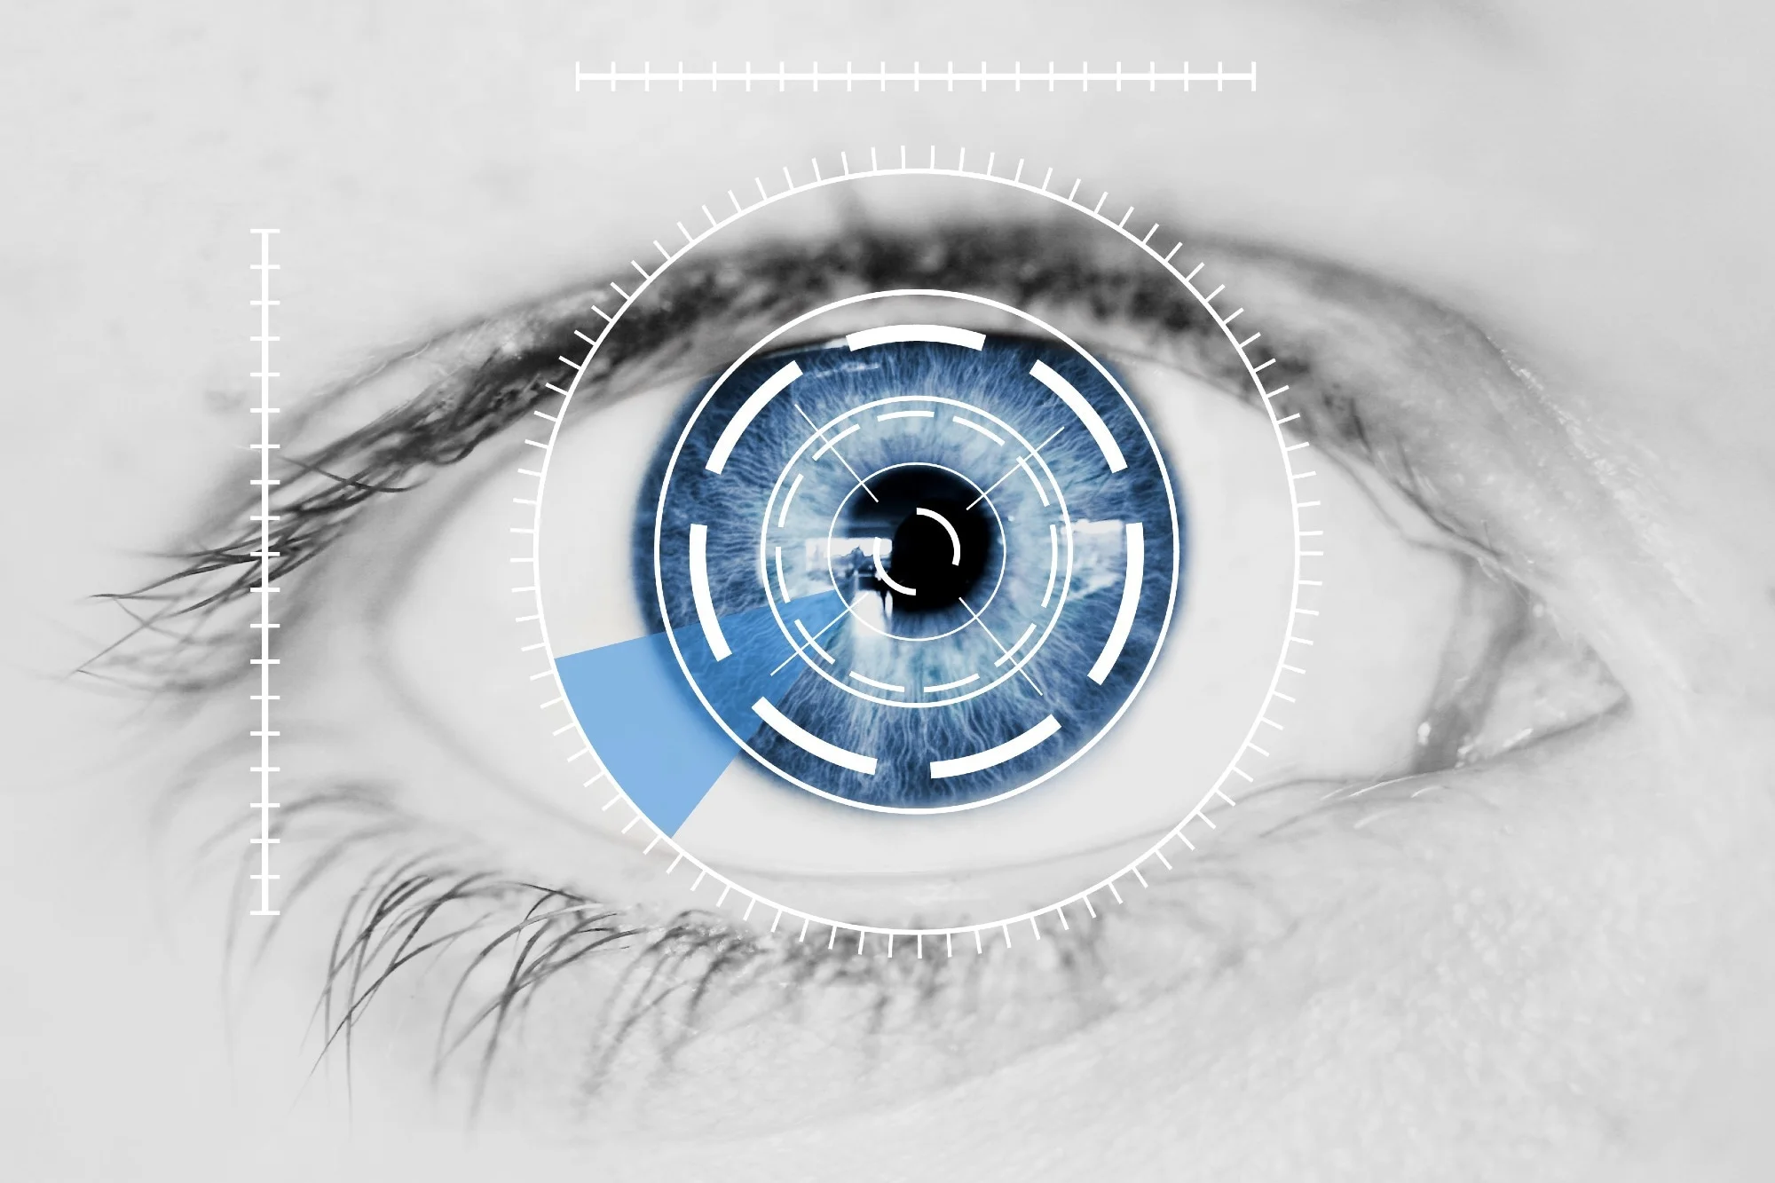
Problem Statement
Eye diseases such as Cataract, Diabetic Retinopathy, and Glaucoma require early and accurate diagnosis to prevent vision loss.
Traditional diagnosis relies on manual analysis by ophthalmologists, which is time-consuming and prone to variability.
Retinal images often suffer from noise, low contrast, and inconsistent quality, affecting diagnosis accuracy.
Existing deep learning models struggle with robust feature extraction and multi-class classification.
There is a need for a system that can handle image noise while maintaining high classification accuracy.
Current approaches lack generalization across different eye diseases in a single framework.

Slide 3
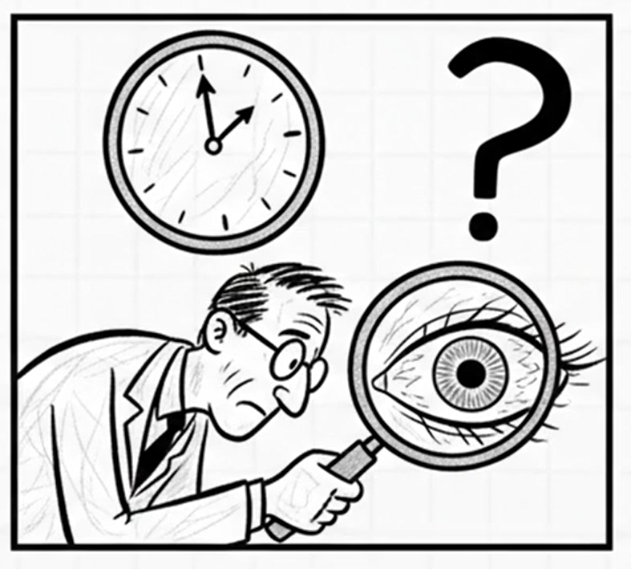
Motivation - Real Life Relevance
Eye diseases are a leading cause of vision impairment and blindness worldwide
Many conditions like Cataract, Diabetic Retinopathy, and Glaucoma are preventable if detected early
Lack of access to specialized ophthalmologists, especially in rural areas
Manual screening is time-consuming, expensive, and not scalable
Retinal image analysis requires high expertise and consistency
Automated systems can enable fast, affordable, and large-scale screening
Helps in early diagnosis, timely treatment, and reducing blindness rates

Slide 4

Objectives
Develop an automated system for eye disease classification using retinal images
Design a hybrid Autoencoder–ResNet50 framework
Enhance image quality using a residual autoencoder for denoising
Extract deep features using transfer learning (ResNet50)
Perform both binary and multi-class classification of eye diseases
Improve model performance using regularization and dropout techniques
Achieve high accuracy and robust generalization across datasets

Slide 5
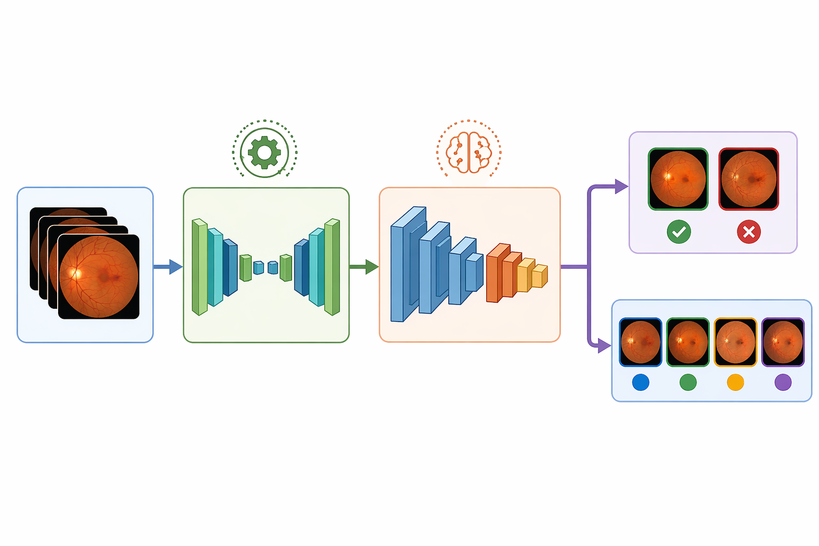
Proposed Solution
Develop a hybrid deep learning framework combining Autoencoder and ResNet50.
Use a residual Autoencoder to reduce noise and enhance retinal image quality.
Preserve important medical features using residual learning.
Apply ResNet50 (transfer learning) for effective deep feature extraction.
Perform both binary and multi-class classification of eye diseases.
Improve model performance using regularization and dropout techniques.
Achieve high accuracy and robust generalization across multiple diseases.
Input
Residual Autoencoder
ResNet50
Classification

Slide 6
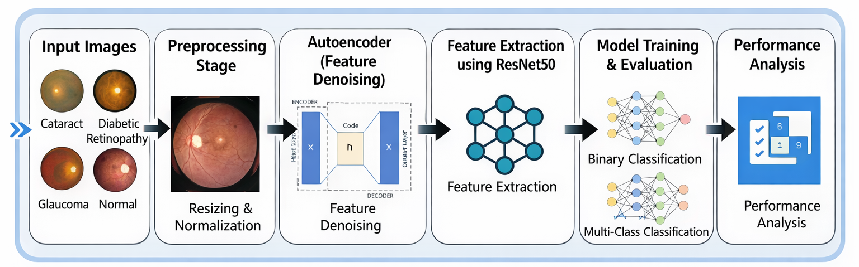
Methodology
System takes retinal fundus images as input from multiple disease classes
Images undergo preprocessing (resizing and normalization) for consistency
A residual autoencoder performs denoising and feature enhancement
Enhanced images are passed to ResNet50 for deep feature extraction
Classification is performed for both:
Binary classification (disease vs normal)
Multi-class classification (4 eye diseases)
Model is trained and evaluated using accuracy and loss metrics
Final performance is analyzed using confusion matrix and evaluation metrics

Slide 7


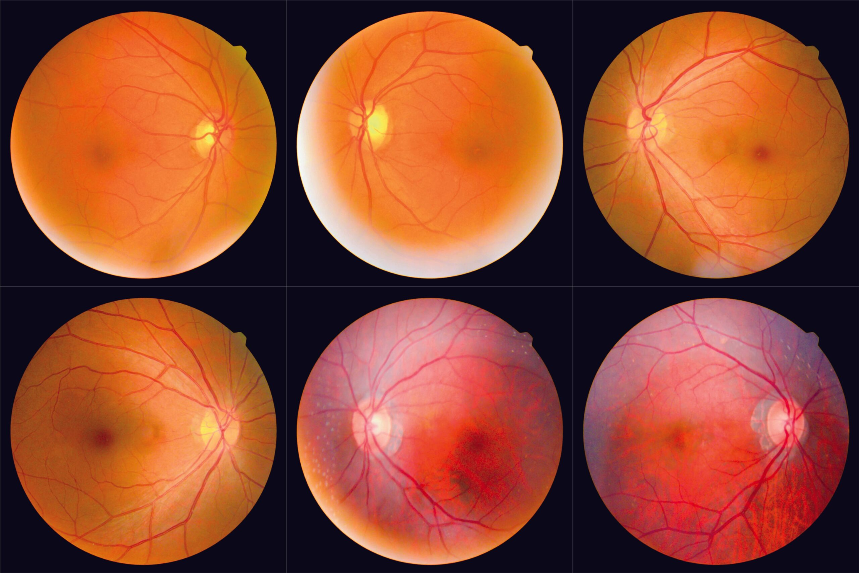
Requirement Analysis
💻 Hardware Requirements
System with internet connectivity
GPU support (via cloud platforms like Google Colab)
Minimum 8GB RAM (recommended)
🛠️ Software Requirements
Programming Language: Python
Libraries: TensorFlow, Keras
Platform: Google Colab / Jupyter Notebook
🗂️ Dataset Requirements
Retinal fundus images
Classes:
Cataract
Diabetic Retinopathy
Glaucoma
Normal

Slide 8
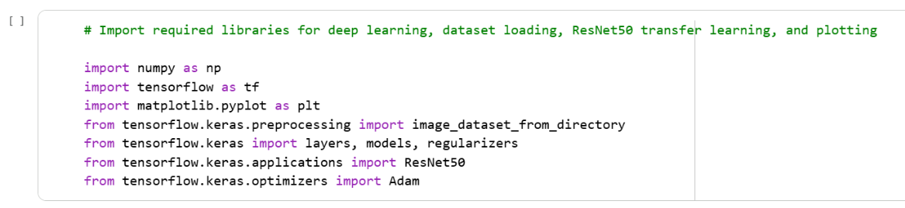
Code - Importing Required Libraries

Slide 9
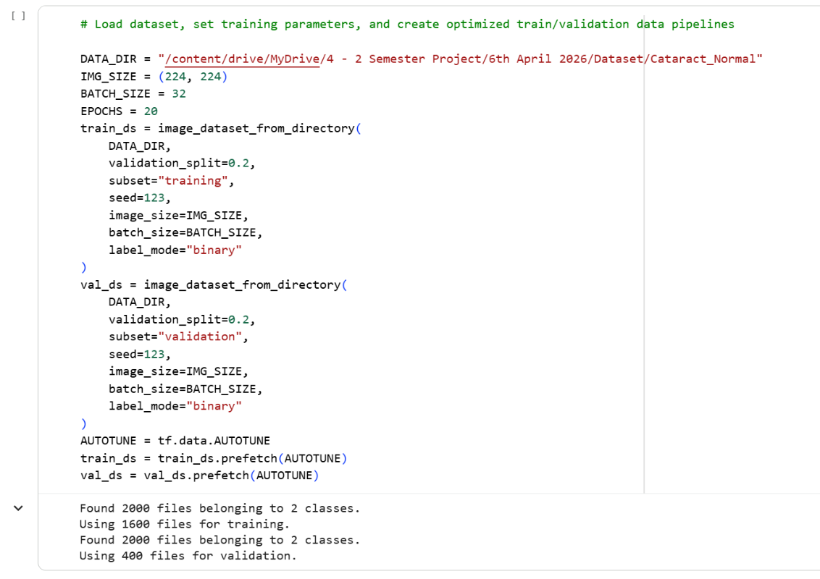
Code - Loading Dataset

Slide 10
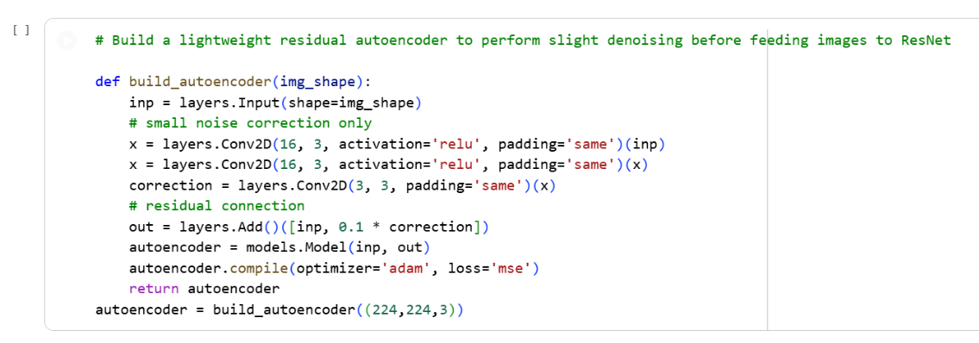
Code - Residual Autoencoder

Slide 11
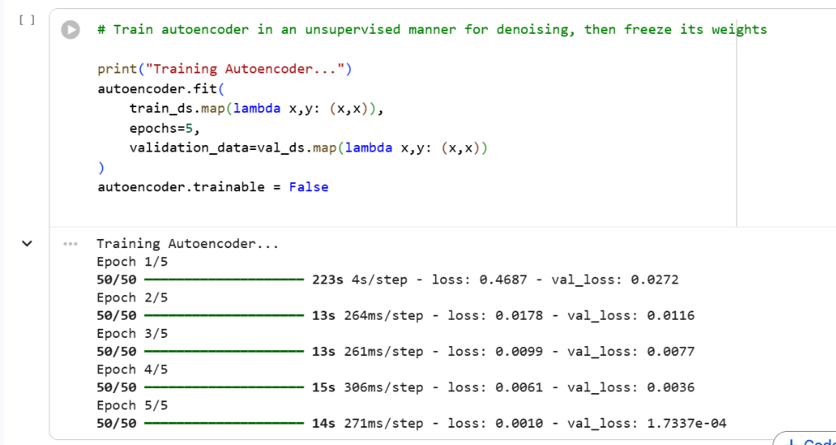
Code - Training Autoencoder

Slide 12
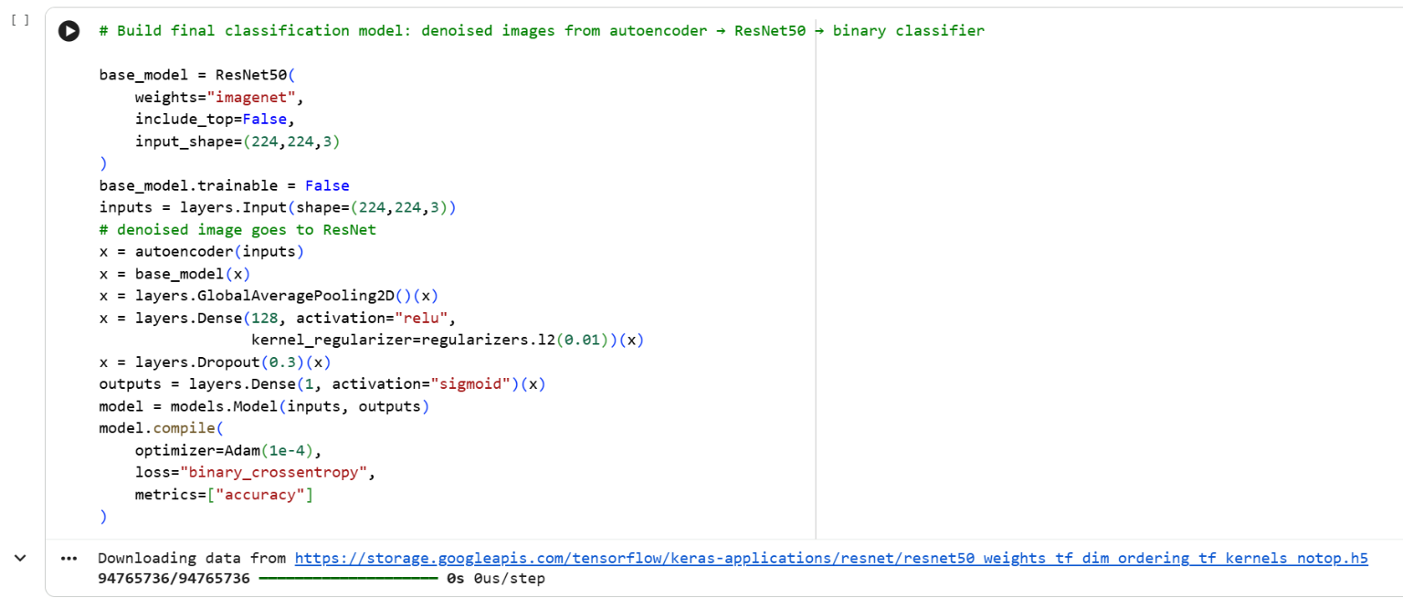
Code - Final Model (Autoencoder + ResNet50)

Slide 13
Code - Train Classifier

Slide 14
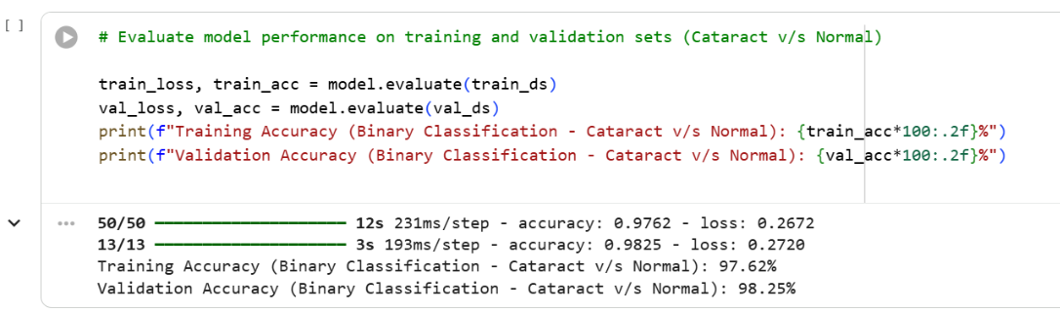
Code - Evaluate Model

Slide 15
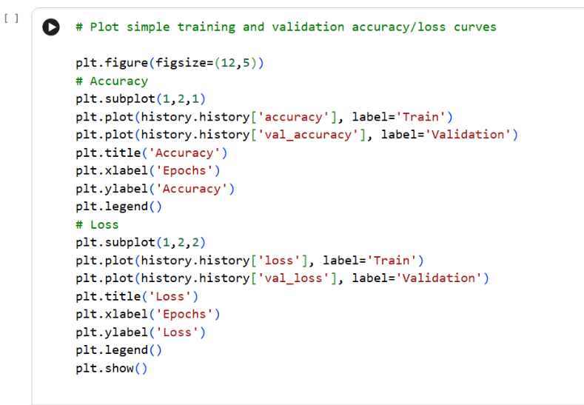
Code - Plot Training Curves

Slide 16
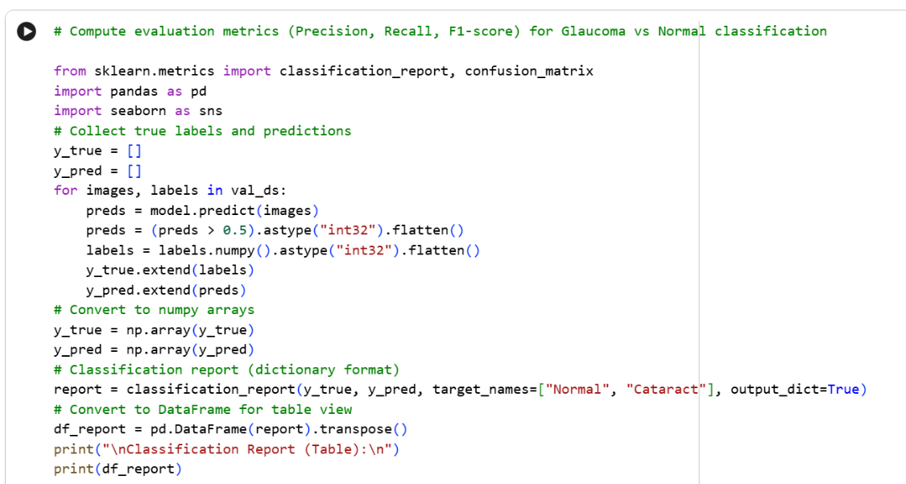
Code - Additional Metrics

Slide 17
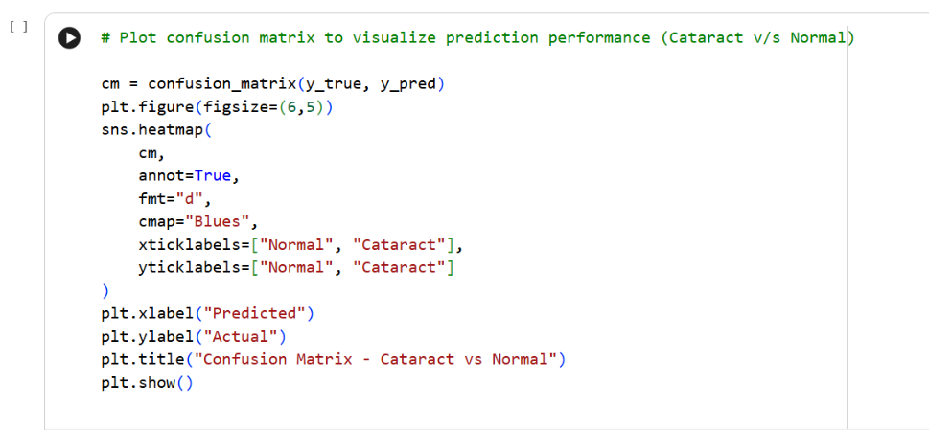
Code - Confusion Matrix

Slide 18
Results
Binary Classification Results
Disease | Class | Precision | Recall | F1-score | Train Acc (%) | Test Acc (%)
Cataract v/s Normal | Normal Cataract | 0.990 0.974 | 0.975 0.989 | 0.982 0.982 | 97.62 | 98.25
Diabetic Retinopathy v/s Normal | Normal Diabetic Retinopathy | 0.970 0.974 | 0.975 0.969 | 0.973 0.971 | 99.37 | 97.25
Glaucoma v/s Normal | Normal Glaucoma | 0.960 0.855 | 0.843 0.964 | 0.898 0.906 | 90.25 | 90.25

Slide 19
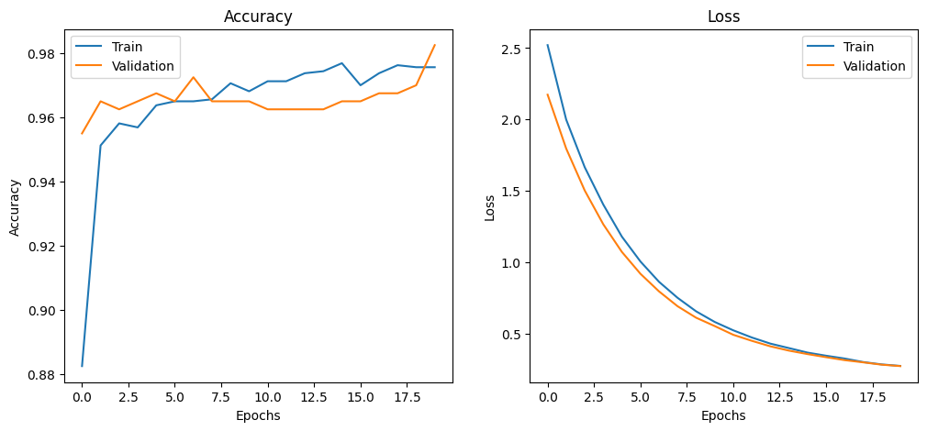
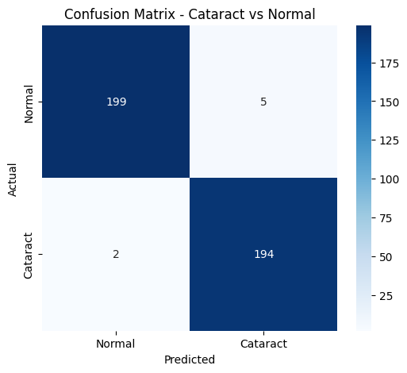
Results
Binary Classification - Cataract vs Normal
Accuracy Plot
Confusion Matrix

Slide 20
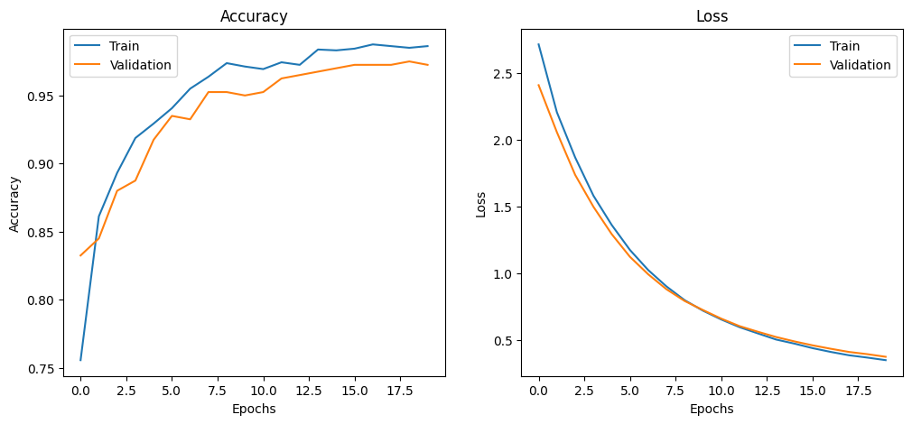
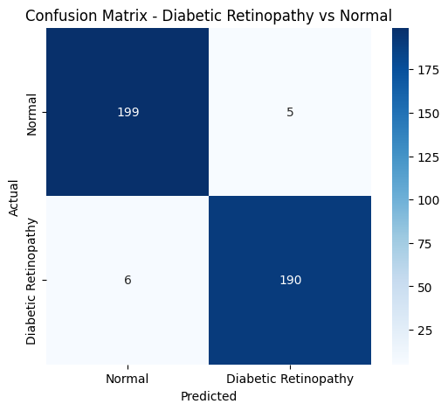
Results
Binary Classification - Diabetic Retinopathy vs Normal
Accuracy Plot
Confusion Matrix

Slide 21
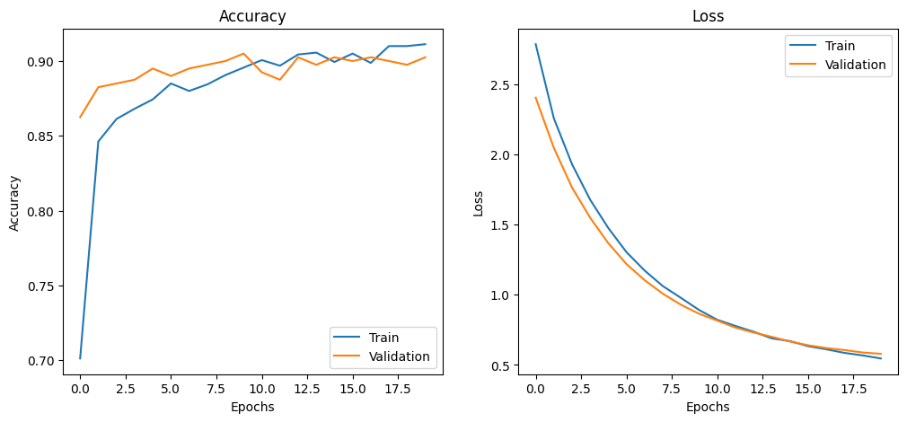
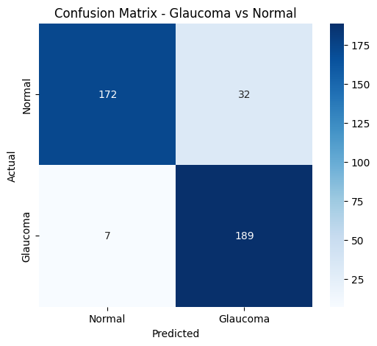
Results
Binary Classification - Glaucoma vs Normal
Accuracy Plot
Confusion Matrixc

Slide 22
Results
Multi-class Classification Results
Class | Precision | Recall | F1-score | Train Acc (%) | Test Acc (%)
Cataract Diabetic Retinopathy Glaucoma Normal | 0.96 0.99 0.81 0.89 | 0.91 0.96 0.90 0.87 | 0.94 0.98 0.85 0.88 | 93.00 | 91.00
Note : The comparatively lower glaucoma classification performance may be due to feature overlap between glaucoma and normal retinal images, which makes them harder to distinguish.

Slide 23
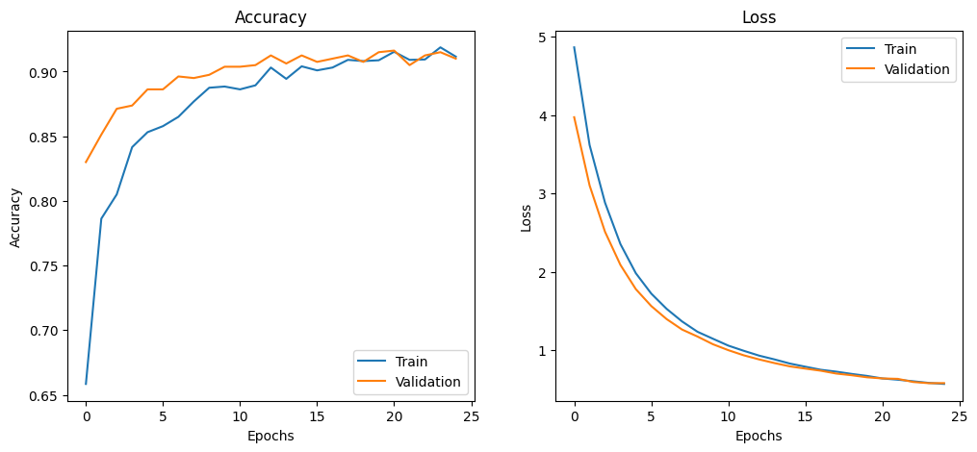
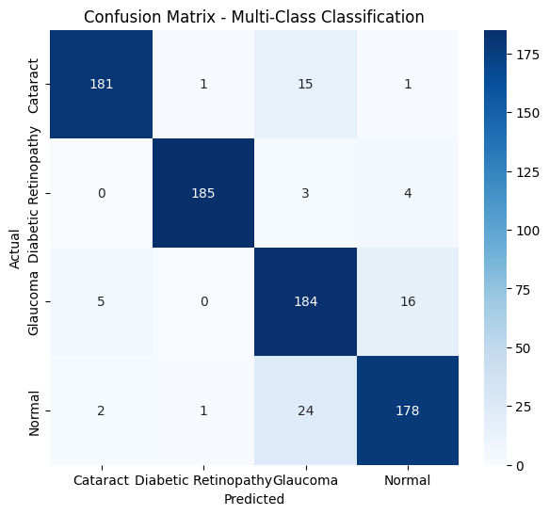
Results
Multi-class Classification
Accuracy Plot
Confusion Matrix

Slide 24

Future Scope
Extend the model to detect additional eye diseases beyond current classes
Use larger and more diverse datasets to improve generalization
Implement real-time deployment in clinical and mobile applications
Fine-tune pretrained models for further accuracy improvement
Integrate attention mechanisms for better feature learning
Develop a user-friendly interface for practical usage by healthcare professionals
Apply the system in remote and rural healthcare screening programs

Slide 25

Conclusion
Proposed a hybrid Autoencoder–ResNet50 framework for eye disease classification
Residual autoencoder effectively reduced noise while preserving important features
ResNet50 enabled robust deep feature extraction and accurate classification
Achieved high accuracy in both binary and multi-class classification tasks
Demonstrated improved performance compared to traditional and standalone models
System shows strong potential for real-world automated eye disease detection

Slide 26
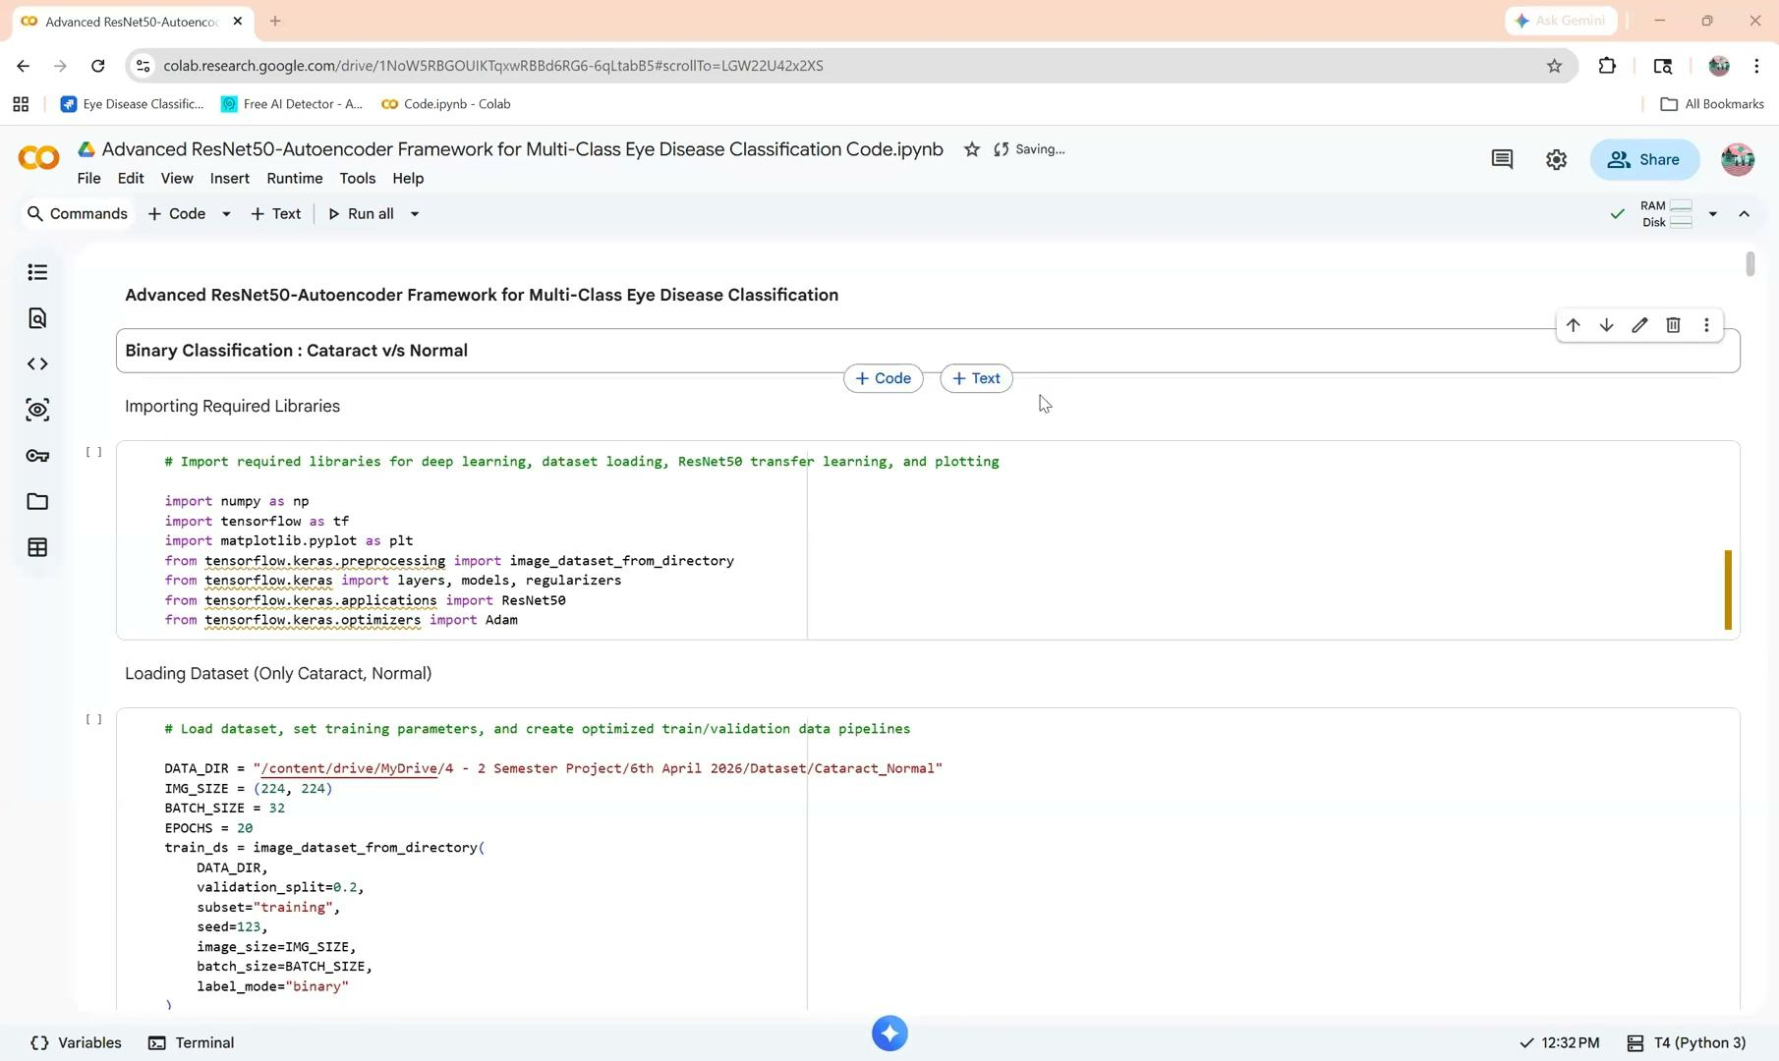
Demo

Slide 27
Thank You

