Slide 1



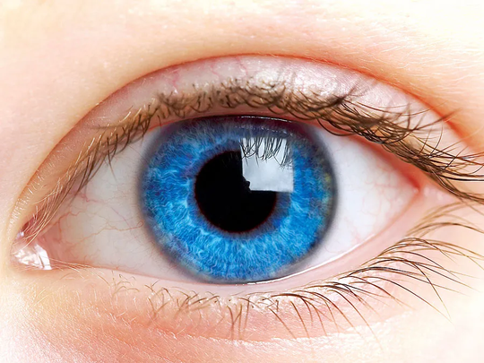
PRASAD V. POTLURI SIDDHARTHA INSTITUTE OF TECHNOLOGY
ADVANCED RESNET50 - AUTOENCODER FRAMEWORK FOR MULTI - CLASS EYE DISEASE CLASSIFICATION
TEAM MEMBERS :
T. N. S. SAMANVITHA (22501A05H6)
T. GAYATHRI (22501A05H7)
V. GNANESWARI (22501A05J3)
S. SUSHRUTH (22501A05G8)
GUIDE :
Mr. Bala Bhaskara Rao Emani
Assistant Professor

Slide 2




Contents
1
2
3
4
Abstract
Introduction
Base Paper Details
Objectives
5
6
7
8
Input Dataset
Requirements
Methodology
Plan of Action

Slide 3


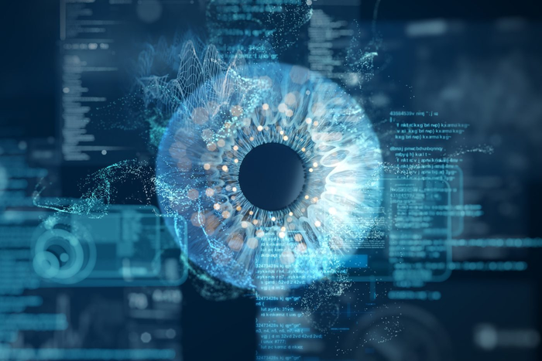
Abstract
Eye Diseases as a Crucial Focus
Eye diseases such as cataract, glaucoma, and diabetic retinopathy are among the leading causes of vision loss worldwide. Early and accurate detection plays a vital role in preventing blindness and improving quality of life. This project aims to build an automated deep learning-based system that can classify these diseases from retinal images, providing a reliable and scalable solution for clinical use.
Algorithms Used
This project uses ResNet (ImageNet-pretrained) for transfer learning, Convolutional Neural Networks (CNNs) for classification, and Autoencoders along with data augmentation techniques to enhance model robustness.

Slide 4
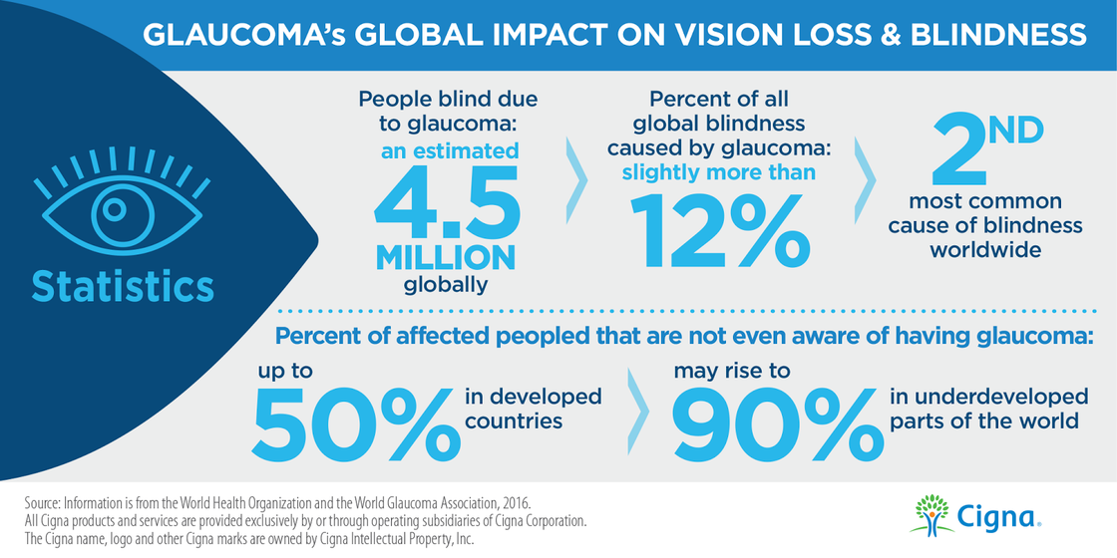
Introduction
Global Concern: Cataract and glaucoma are among the leading causes of blindness worldwide.
Need for Early Detection: Timely diagnosis can prevent vision loss and reduce healthcare costs.
Limitations of Manual Screening: Requires specialists, is time-consuming, and may vary in accuracy.
Role of AI & Deep Learning: Automates feature extraction, improves accuracy, and enables scalable screening.
Focus on Eye Health: Retinal imaging is non-invasive and ideal for early, large-scale disease detection.

Slide 5
Base Paper Details
Title : Cataract and glaucoma detection based on Transfer Learning using MobileNet
Link : https://www.sciencedirect.com/science/article/pii/S2405844024127909
Summary :
The classification of eye diseases, specifically Cataract and Glaucoma, is done using Deep Learning techniques.
The authors used Transfer learning with MobileNetV1 and MobileNetV2 models to perform classification.
The approach applies deep learning to automatically learn features from retinal images and distinguish between different eye conditions.

Slide 6

Base Paper Details
Limitations:
Limited Dataset Size: Only 500 images were used, which restricts the ability of the model to generalize and increases the risk of overfitting.
Class Imbalance: A higher number of normal images compared to cataract and glaucoma images could bias the model predictions.
Moderate Multi-Class Performance: While binary classification results were strong, the model struggled to clearly distinguish between cataract, glaucoma, and normal cases.

Slide 7

Objectives
Increase Dataset Size: Collect or use a larger dataset to improve model generalization and reduce overfitting.
Balance Class Distribution: Ensure equal number of images for each class (Normal, Cataract, Glaucoma, Diabetic Retinopathy) to avoid prediction bias.
Expand Multi-Class Classification: Add Diabetic Retinopathy as a new class, creating a more comprehensive model for early eye disease detection.
Improve Model Robustness: Train and fine-tune a CNN-based model to achieve better performance in multi-class classification.

Slide 8
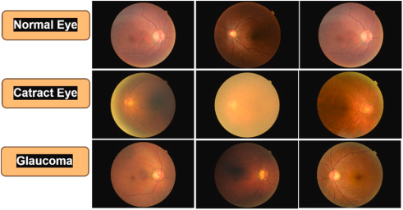
Input Dataset
The dataset consists of Retinal fundus images captured using fundus cameras.
Images belong to three categories:
Normal (Healthy) – no visible abnormality.
Cataract – cloudy or opaque lens appearance.
Glaucoma – optic disc cupping and nerve damage signs.

Slide 9
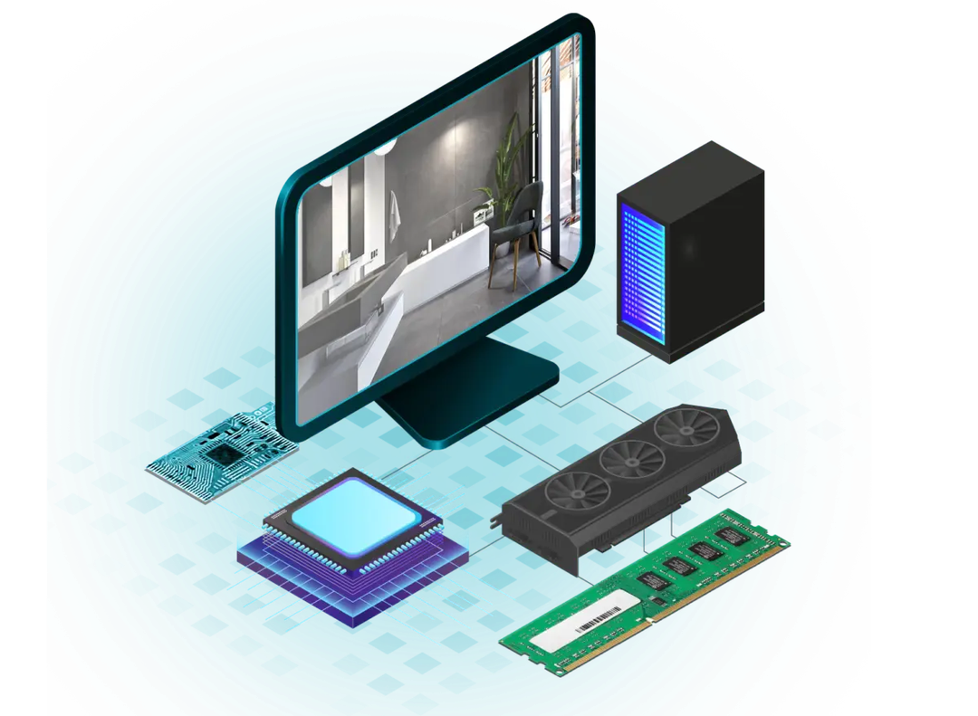
Requirements
Hardware Requirements
Processor: Intel i5 / i7 or equivalent
RAM: 8 GB or higher
GPU: Optional for small datasets, but recommended for faster deep learning training
Operating System: Windows 10/11, macOS, or Linux
Alternative: Google Colab (cloud-based, no local hardware requirement)

Slide 10
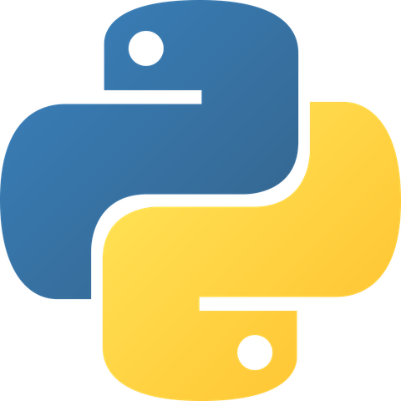
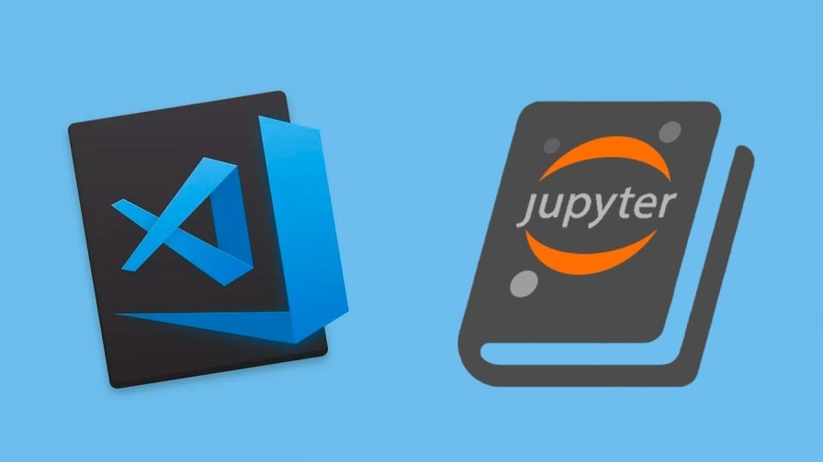
Requirements
Software Requirements
Programming Language: Python 3.x
Development Environment:
Jupyter Notebook / Google Colab / VS Code

Slide 11
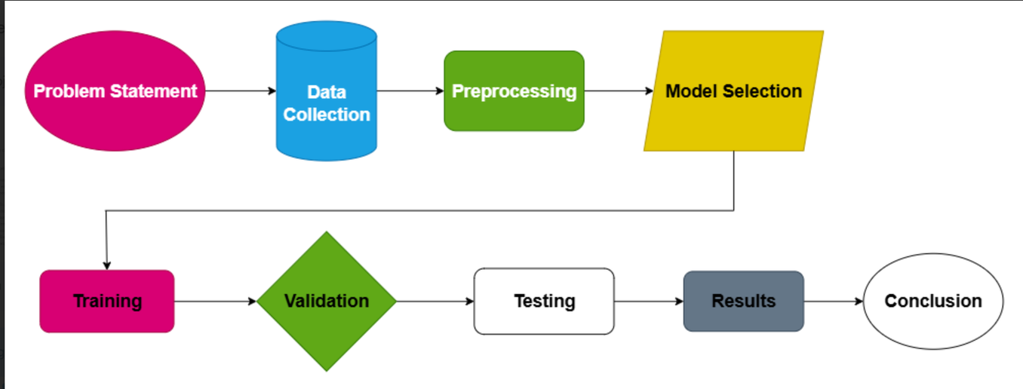
Methodology
Data Collection – Gather images for Normal, Cataract, Glaucoma, and Diabetic Retinopathy.
Preprocessing – Resize, normalize, and augment images.
Model Selection – Use ResNet (ImageNet-pretrained) and Autoencoders.
Training – Train the model on the dataset with transfer learning.
Validation – Tune hyperparameters and monitor performance.
Testing – Evaluate on unseen test images.
Result Analysis – Measure accuracy, precision, recall, and F1-score.
Conclusion – Summarize results and suggest future improvements.

Slide 12
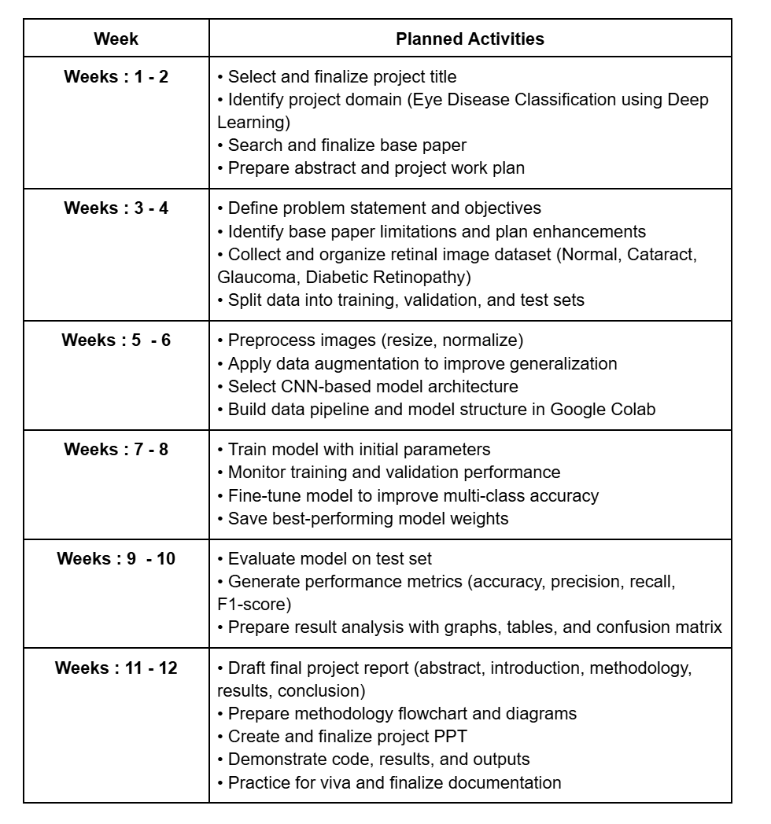


Plan of Action

Slide 13
Thank You

