Slide 1

PRASAD V. POTLURI SIDDHARTHA INSTITUTE OF TECHNOLOGY
CUSTOMER CHURN PREDICTION
Online help
P. Amulya (22501A05D7)
T. N. S. Samanvitha (22501A05H6)
T. Gayathri (22501A05H7)
S. Latheef (22501A05H4)
P. Phani Krishna (22501A05D8)

Slide 2
ABSTRACT
Customer churn prediction is essential for businesses to improve retention strategies. This study leverages machine learning models, including Logistic Regression, Decision Tree, Naïve Bayes, Random Forest, K-Nearest Neighbors, and Support Vector Machine (SVM), to analyze customer behavior and predict churn. The models were evaluated based on their performance, providing insights that help businesses take proactive measures to reduce churn and enhance customer engagement.
Help

Slide 3
PROBLEM STATEMENT
Customer churn is a significant challenge for businesses, leading to revenue loss and increased acquisition costs. Identifying customers likely to churn allows companies to take proactive measures to improve retention. This study aims to analyze customer data and apply machine learning techniques to predict churn, enabling businesses to make data-driven decisions for better customer engagement and loyalty.

Slide 4
OBJECTIVE
The objective of this study is to develop a machine learning-based model to predict customer churn using historical data. By analyzing various customer attributes, the study aims to identify patterns and factors influencing churn. The insights gained will help businesses implement targeted retention strategies, reduce customer attrition, and enhance overall customer satisfaction.

Slide 5

DATASET
The dataset used for customer churn prediction consists of 3,150 instances, each representing a customer’s historical data. These instances contain various attributes related to customer behavior, such as call usage, subscription details, and complaints, which help in predicting churn. The dataset provides valuable insights into customer engagement patterns, enabling businesses to take proactive measures for retention. This dataset was sourced from GitHub, ensuring accessibility and real-world applicability for machine learning analysis.
Dataset Attributes:
Call Failure – Number of call failures experienced by the customer.
Complains – Whether the customer has raised a complaint (0: No, 1: Yes).
Subscription Length – Duration of the customer’s subscription (in months).
Charge Amount – Total amount charged to the customer.
Seconds of Use – Total duration of calls made by the customer (in seconds).
Frequency of Use – Number of calls made by the customer.
Frequency of SMS – Number of SMS sent by the customer.
Distinct Called Numbers – Count of unique numbers the customer has contacted.
Tariff Plan – Type of plan the customer is subscribed to (categorical).
Status – Customer’s current status in the system (categorical).
Age – Age of the customer.
Customer Value – A computed value representing the customer’s worth to the business.
FN – An additional numerical feature (possibly financial or behavioral).
FP – Another numerical feature related to the customer’s data.
Churn – The target variable (0: Not Churned, 1: Churned).

Slide 6

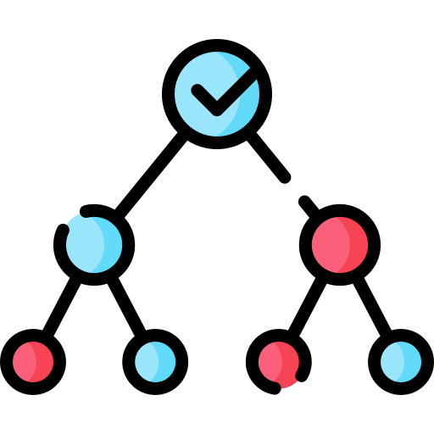


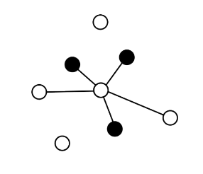
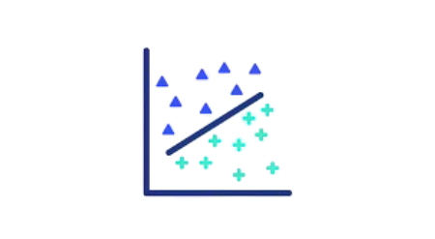
ALGORITHMS
Naive Bayes
Logistic Regression
Decision Trees
KNN
SVM
Random Forest

Slide 7
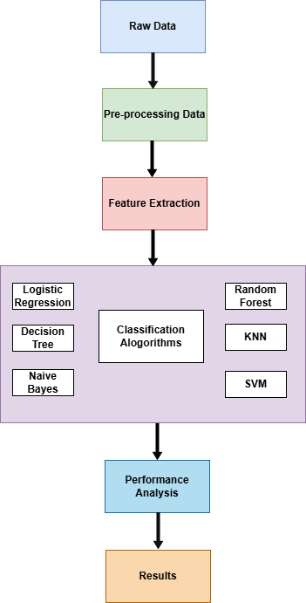
METHODOLOGY
The customer churn prediction methodology involves the following steps:
Data Collection: The dataset from GitHub includes 3,150 instances and 15 attributes, with the target variable being Churn (0: Not Churned, 1: Churned).
Data Preprocessing:
Handling Missing Values: Forward fill and median imputation were used.
Data Cleaning: Non-numeric fields were converted to numeric.
Feature Scaling: StandardScaler normalized numerical attributes.
Encoding Categorical Data: Label encoding was applied to categorical variables.
Data Splitting: The dataset was split into 80% training and 20% testing, using stratified sampling for class balance.
Model Training & Evaluation:
Models: Logistic Regression, Decision Tree, Naïve Bayes, Random Forest, KNN, and SVM were trained and evaluated on the test set.
Performance Evaluation:
Accuracy, Confusion Matrix, and Classification Report (precision, recall, F1-score) were used to assess model performance.

Slide 8
RESULTS
S.No | Used Methods | Dataset | Obtained Accuracy (%)
1. | Logistic Regression | Customer_churn_data from Github | 85
2. | Decision Tree | Customer_churn_data from Github | 90
3. | Naive Bayes | Customer_churn_data from Github | 64
4. | Random Forest | Customer_churn_data from Github | 94
5. | K - Nearest Neighbours (KNN) | Customer_churn_data from Github | 90
6. | Support Vector Machine (SVM) | Customer_churn_data from Github | 90

Slide 9
THANK YOU!

