Slide 1

Prasad V. Potluri Siddhartha Institute of Technology
Advanced ResNet50 - Autoencoder Framework for Multi-Class Eye Disease Classification
Team Members :
T. N. S. Samanvitha (22501A05H6)
T. Gayathri (22501A05H7)
V. Gnaneswari (22501A05J3)
S. Sushruth (22501A05G8)
Guide :
Mr. Bala Bhaskara Rao Emani
Assistant Professor

Slide 2
Contents
Abstract
Introduction
Problem Statement
Solution to the Problem
Research Objectives
Literature Review
System Analysis - Existing System
Proposed System
Requirement Analysis
Design of Proposed System
Methodology
Dataset Description
Implementation
Testing
Results
Discussion
Future Scope
Conclusion
References
Conference Accpetance Letter & Presentation Certificates

Slide 3
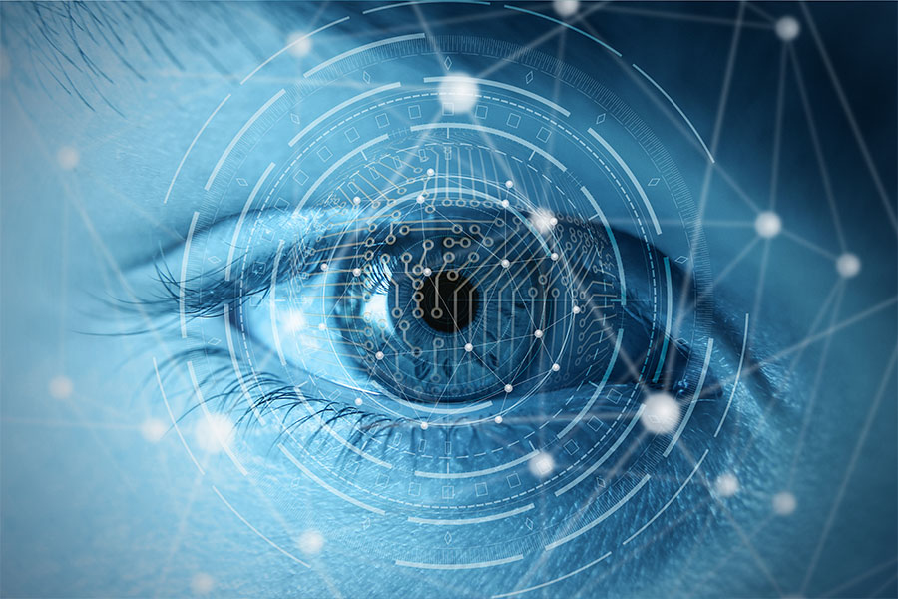
Abstract
This project presents a deep learning-based approach for automated eye disease classification using retinal fundus images. It focuses on detecting diseases such as Cataract, Diabetic Retinopathy, and Glaucoma through a hybrid framework combining a Residual Autoencoder and ResNet50. The autoencoder is used for image denoising and feature enhancement, while ResNet50 performs feature extraction and classification using transfer learning. The model supports both binary and multi-class classification and achieves high performance in terms of accuracy, precision, recall, and F1-score. This system can assist in early diagnosis and enable scalable, automated screening in real-world healthcare applications.

Slide 4
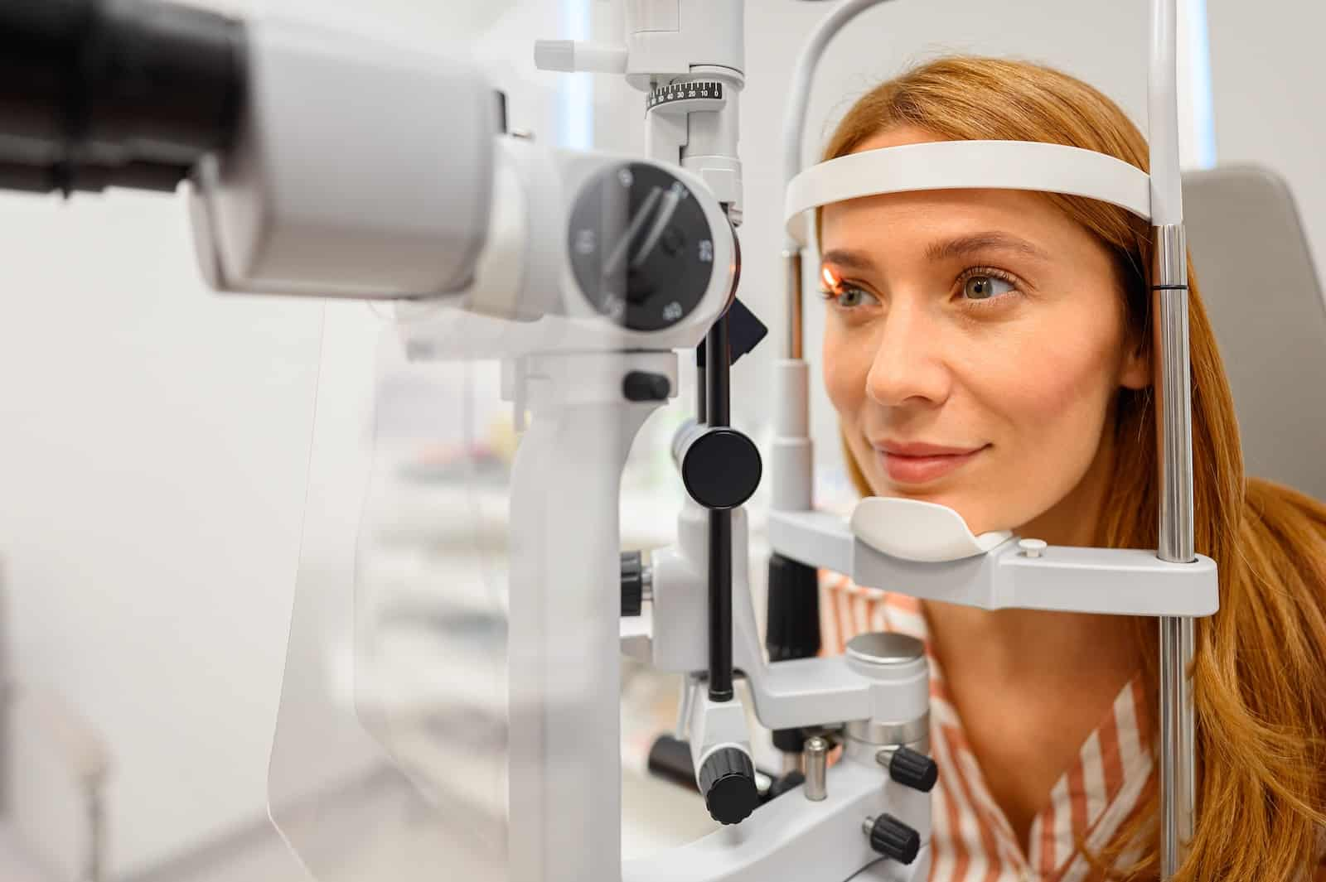
Introduction
Eye diseases such as Cataract, Diabetic Retinopathy, and Glaucoma are major causes of vision impairment worldwide.
Early and accurate detection is essential to prevent permanent vision loss.
Traditional diagnosis relies on manual retinal image examination by ophthalmologists, which is time-consuming and resource-intensive.
Deep learning techniques have shown strong potential for automated retinal image analysis and disease detection.
However, existing models may struggle with noise in retinal images and distinguishing visually similar disease patterns.

Slide 5
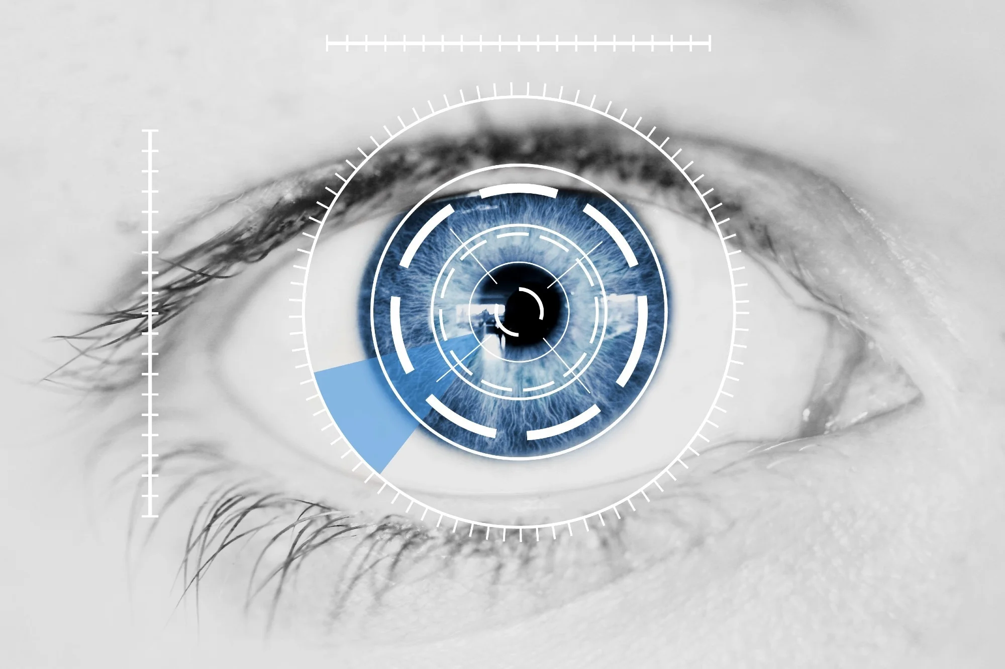
Problem Statement
Existing deep learning models often struggle with noise and variations in retinal images.
Retinal diseases such as Cataract, Diabetic Retinopathy, and Glaucoma can exhibit visually similar patterns, making accurate classification difficult.
Traditional CNN models may face overfitting and reduced generalization when applied to medical images.
Therefore, there is a need for a robust and efficient deep learning framework capable of improving retinal image classification accuracy.

Slide 6
Solution to the Problem
Propose a hybrid deep learning framework combining Residual Autoencoder and ResNet50
Use a Residual Autoencoder to reduce noise and enhance retinal image quality
Preserve important medical features using residual learning
Apply ResNet50 (transfer learning) for robust deep feature extraction
Perform binary and multi-class classification of eye diseases
Improve model performance using regularization and dropout techniques
Achieve high accuracy and better generalization across multiple eye diseases
Provide an automated, scalable solution for early diagnosis and screening

Slide 7
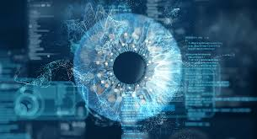
Research Objectives
Develop an automated system for eye disease classification using retinal images
Design a hybrid Autoencoder–ResNet50 framework
Enhance image quality using a residual autoencoder for denoising
Extract deep features using transfer learning (ResNet50)
Perform both binary and multi-class classification of eye diseases
Improve model performance using regularization and dropout techniques
Achieve high accuracy and robust generalization across datasets

Slide 8
Literature Review
S.No | Title of Paper | Techniques Used | Key Findings | Limitations
1 | Cataract and Glaucoma Detection Based on Transfer Learning using MobileNet | MobileNetV1, MobileNetV2, Transfer Learning | Achieved good accuracy in binary classification of cataract and glaucoma | Performance drops in multi-class classification; difficulty distinguishing similar diseases
2 | Improving Automated Detection of Cataract Disease through Transfer Learning using ResNet50 | ResNet50, CNN, VGG16, Transfer Learning | ResNet50 shows strong feature extraction and better performance compared to CNN & VGG16 | Performance depends on dataset quality and model tuning
3 | Deep Learning-Based Cataract Detection and Grading from Slit-Lamp and Retro-Illumination Photographs: Model Development and Validation Study | CNN, Specialized imaging (slit-lamp & retro-illumination) | Achieved high accuracy using controlled imaging techniques | Limited generalization to normal fundus images; depends on controlled conditions
4 | Automatic Glaucoma Classification using Color Fundus Images Based on CNN and Transfer Learning | Ensemble CNN, Inception, ResNet, Transfer Learning | High AUC and sensitivity achieved | High computational cost; not suitable for large-scale deployment

Slide 9
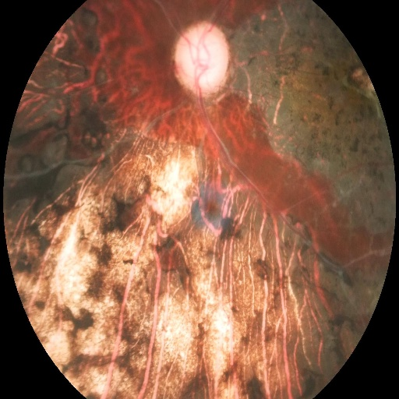
System Analysis - Existing System
Traditional eye disease diagnosis relies on manual examination by ophthalmologists
Requires high expertise and is time-consuming
Prone to human error and variability in diagnosis
Existing deep learning models like CNN, VGG, MobileNet are widely used
These models often struggle with noisy and low-quality retinal images
Difficulty in extracting robust features from complex medical images
Limited performance in multi-class classification of similar diseases
High computational cost and dependency on large datasets
Poor generalization across different datasets and conditions
Noisy Retinal Image
Existing Models
Misclassification

Slide 10
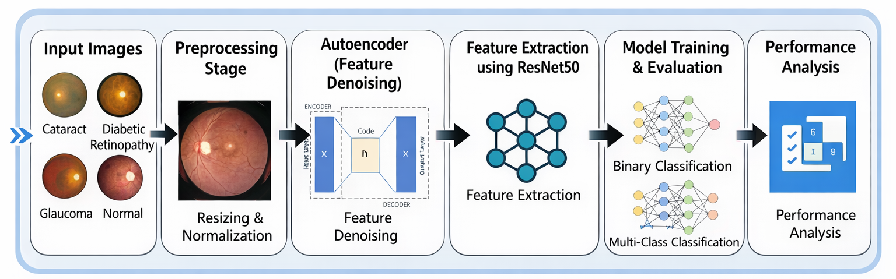
Proposed System

Slide 11



Requirement Analysis
💻 Hardware Requirements
System with internet connectivity
GPU support (via cloud platforms like Google Colab)
Minimum 8GB RAM (recommended)
🛠️ Software Requirements
Programming Language: Python
Libraries: TensorFlow, Keras
Platform: Google Colab / Jupyter Notebook
🗂️ Dataset Requirements
Retinal fundus images from Kaggle
Classes:
Cataract
Diabetic Retinopathy
Glaucoma
Normal

Slide 12
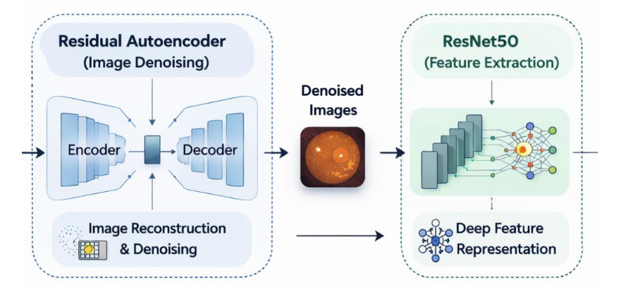
Design of Proposed System
System Architecture:

Slide 13
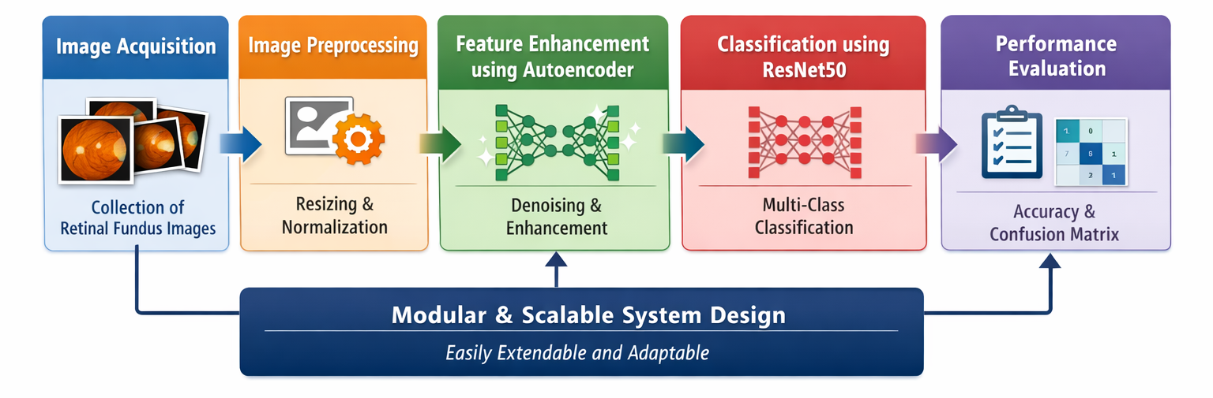
Methodology
Image Acquisition
Collection of retinal fundus images representing multiple eye disease classes
Image Preprocessing
Resizing, normalization, and enhancement to improve image quality
Feature Enhancement using Autoencoder
Residual autoencoder used to denoise images while preserving important features
Classification using ResNet50
Deep feature extraction and accurate multi-class classification using transfer learning
Performance Evaluation
Evaluation using accuracy, loss, and confusion matrix
Modular and Scalable Design
System can be easily extended to additional diseases and larger datasets

Slide 14
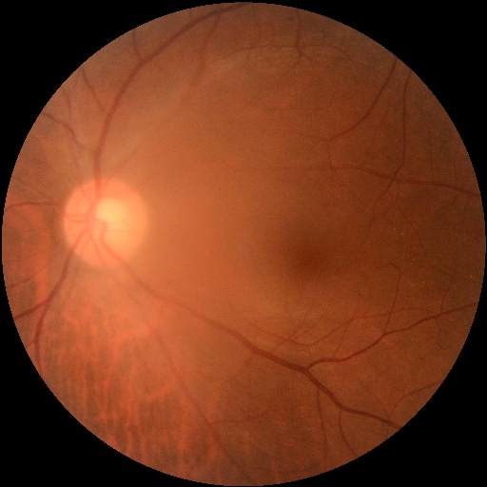
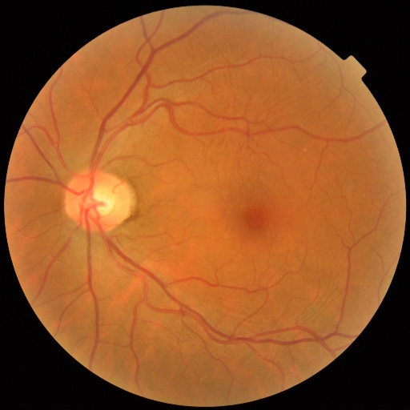
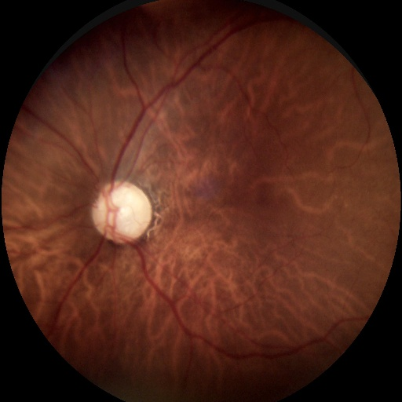
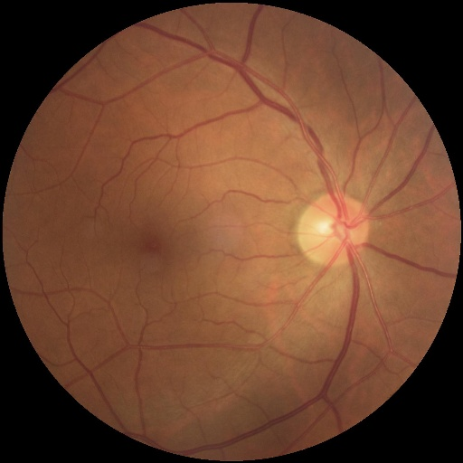
Dataset Description
The dataset used in this study consists of retinal fundus images obtained from Kaggle.
The dataset contains four categories:
Cataract : 1000 images
Diabetic Retinopathy : 1000 images
Glaucoma : 1000 images
Normal : 1000 images
All images were preprocessed and resized to 224 × 224 pixels before being used for training.
The dataset was divided into training and validation sets using an 80:20 split.
These images were used to evaluate the performance of the ResNet50-based deep learning framework for retinal disease classification.
Cataract
Diabetic Retinopathy
Glaucoma
Normal

Slide 15
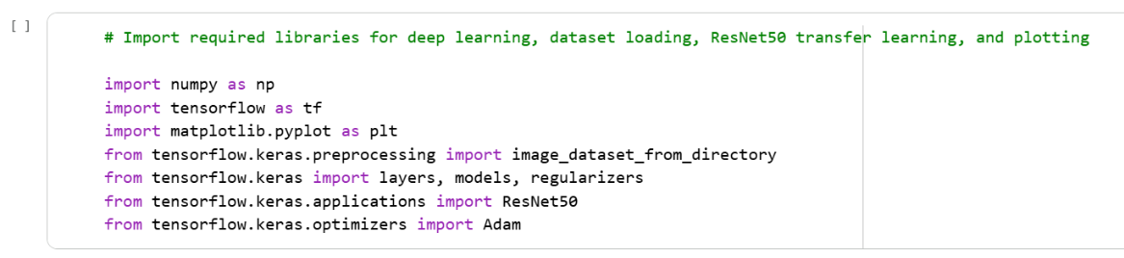
Implementation
Importing Required Libraries

Slide 16
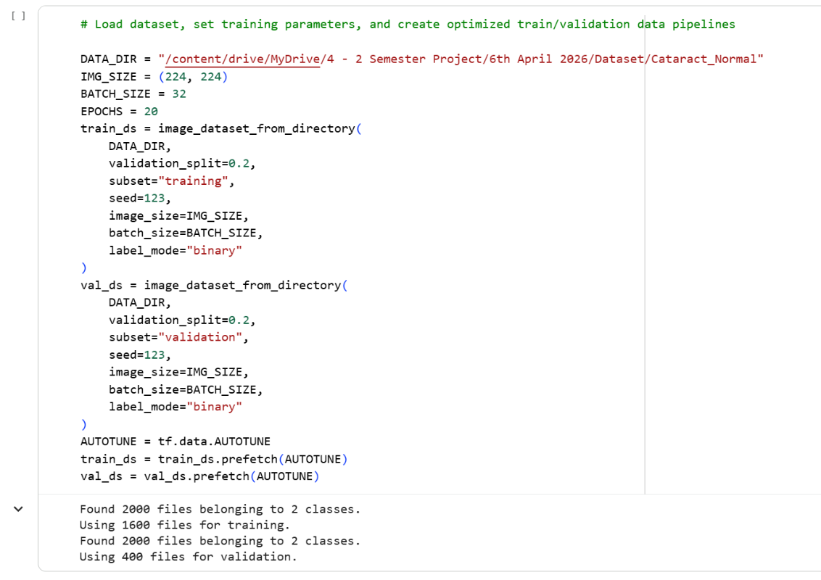
Implementation
Loading Dataset

Slide 17
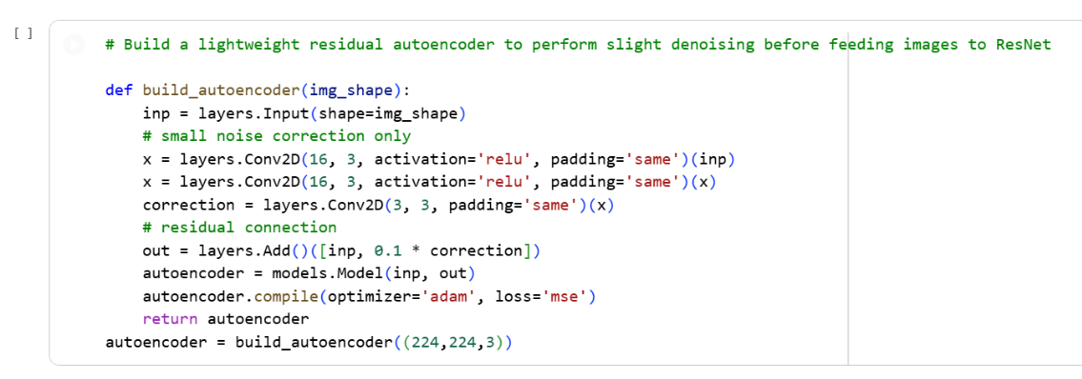
Implementation
Residual Autoencoder

Slide 18
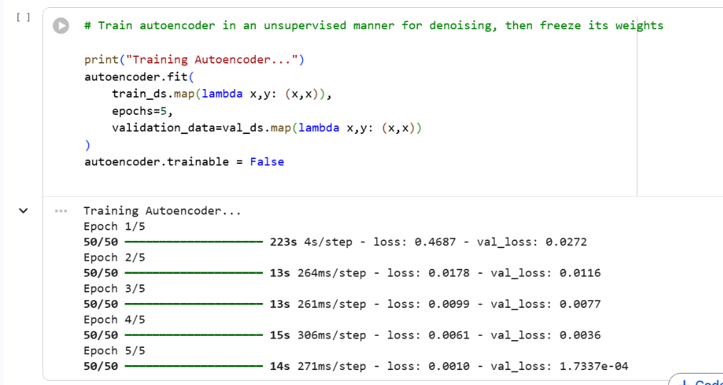
Implementation
Training Autoencoder

Slide 19
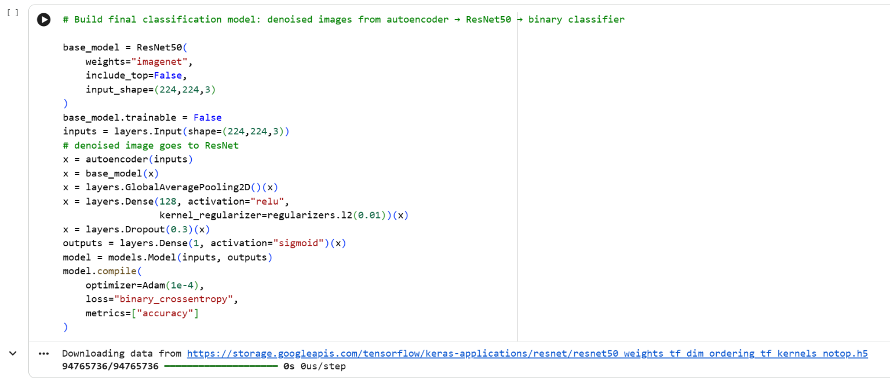
Implementation
Final Model (Autoencoder + ResNet50)

Slide 20
Implementation
Train Classifier

Slide 21
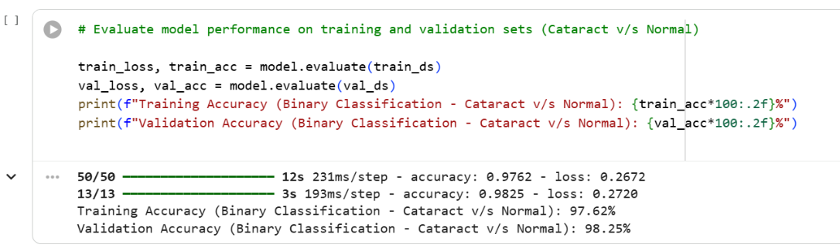
Implementation
Evaluate Model

Slide 22
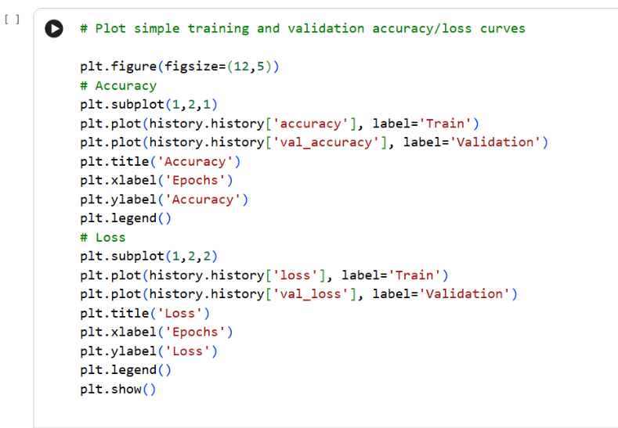
Implementation
Plot Training Curves

Slide 23
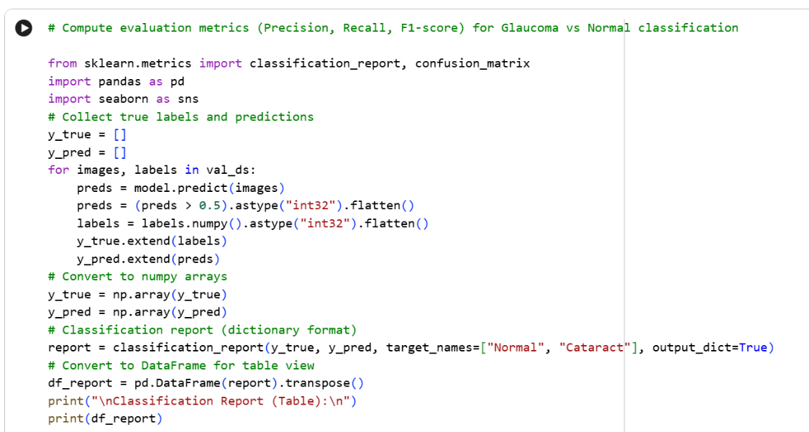
Implementation
Additional Metrics

Slide 24
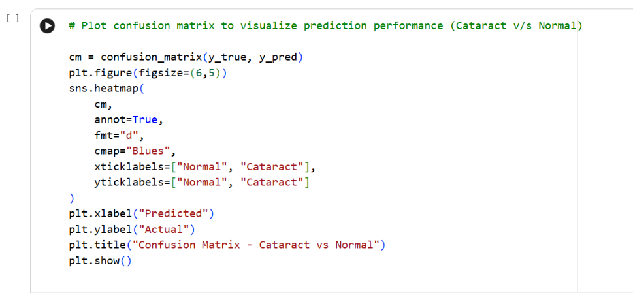
Implementation
Confusion Matrix

Slide 25
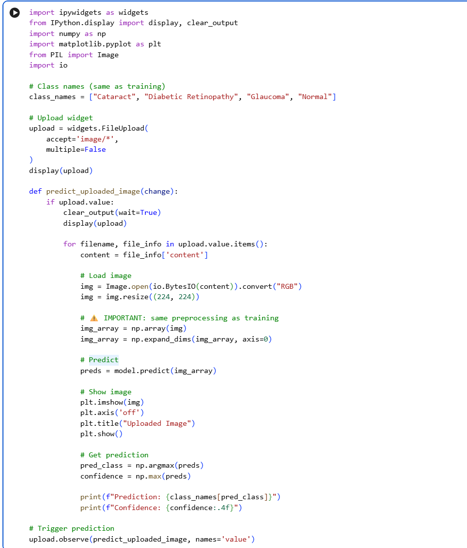
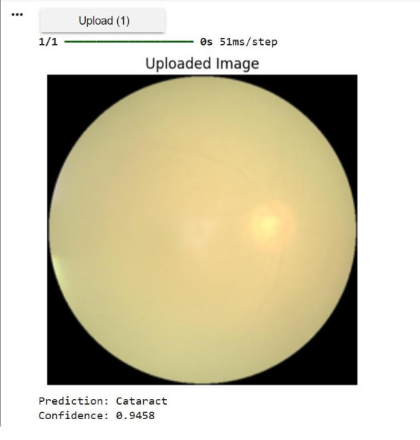
Testing

Slide 26
Results
Binary Classification Results
Disease | Class | Precision | Recall | F1-score | Train Acc (%) | Test Acc (%)
Cataract vs Normal | Normal Cataract | 0.990 0.974 | 0.975 0.989 | 0.982 0.982 | 97.62 | 98.25
Diabetic Retinopathy vs Normal | Normal Diabetic Retinopathy | 0.970 0.974 | 0.975 0.969 | 0.973 0.971 | 99.37 | 97.25
Glaucoma vs Normal | Normal Glaucoma | 0.960 0.855 | 0.843 0.964 | 0.898 0.906 | 90.25 | 90.25

Slide 27
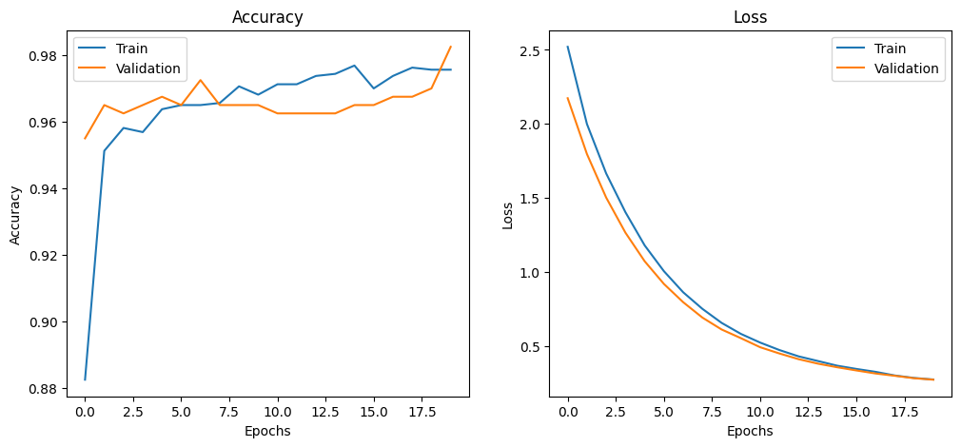
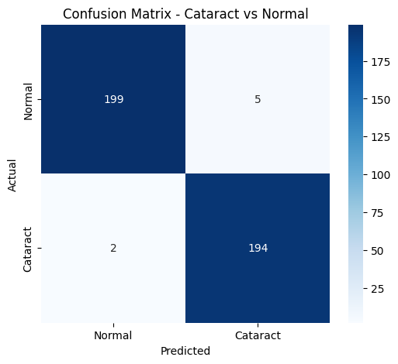
Results
Binary Classification - Cataract vs Normal
Accuracy Plot
Confusion Matrix

Slide 28
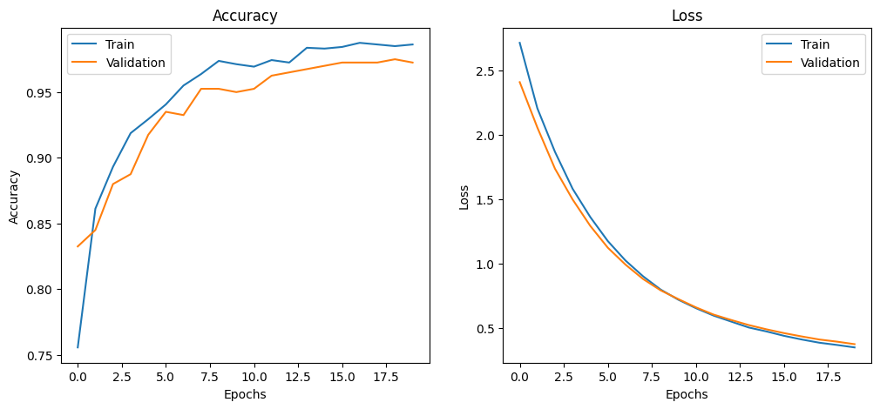
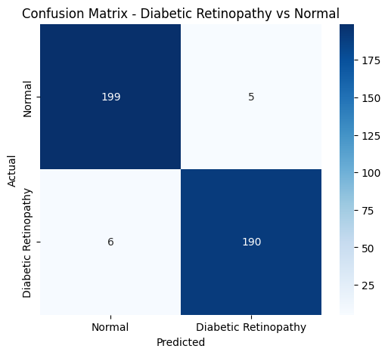
Results
Binary Classification - Diabetic Retinopathy vs Normal
Accuracy Plot
Confusion Matrix

Slide 29
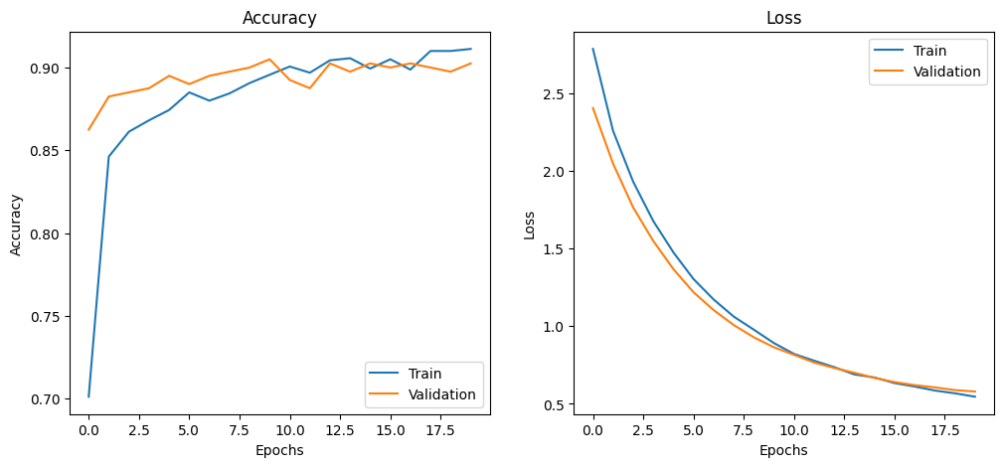
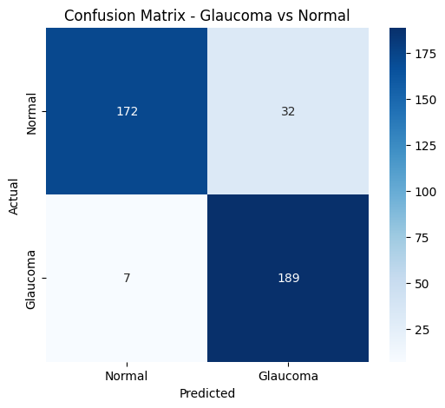
Results
Binary Classification - Glaucoma vs Normal
Accuracy Plot
Confusion Matrix

Slide 30
Results
Multi-class Classification Results
Class | Precision | Recall | F1-score | Train Acc (%) | Test Acc (%)
Cataract Diabetic Retinopathy Glaucoma Normal | 0.96 0.99 0.81 0.89 | 0.91 0.96 0.90 0.87 | 0.94 0.98 0.85 0.88 | 93.00 | 91.00
Note: The comparatively lower glaucoma classification performance may be due to feature overlap between glaucoma and normal retinal images, which makes them harder to distinguish.

Slide 31
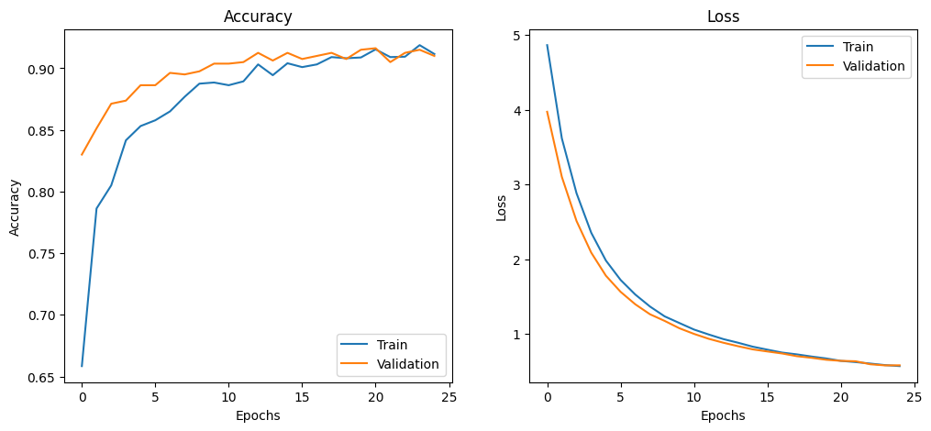
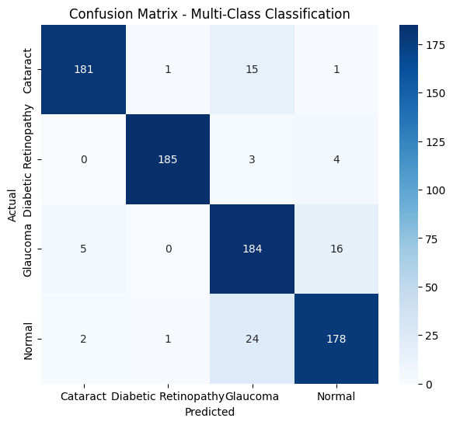
Results
Multi-class Classification
Accuracy Plot
Confusion Matrix

Slide 32
Discussion
The proposed Autoencoder–ResNet50 framework improves retinal disease classification by reducing noise and extracting robust deep features.
The autoencoder-based denoising enhances image quality, allowing the ResNet50 network to learn more discriminative features.
The model demonstrates strong performance in both binary and multi-class classification tasks.
The confusion matrices indicate that most retinal images are correctly classified across different disease categories.
The results highlight the effectiveness of combining image denoising with deep feature extraction for medical image analysis.

Slide 33

Future Scope
Extend the model to detect additional eye diseases beyond current classes
Use larger and more diverse datasets to improve generalization
Implement real-time deployment in clinical and mobile applications
Fine-tune pretrained models for further accuracy improvement
Integrate attention mechanisms for better feature learning
Develop a user-friendly interface for practical usage by healthcare professionals
Apply the system in remote and rural healthcare screening programs

Slide 34

Conclusion
This study proposed an Autoencoder–ResNet50 based deep learning framework for automated retinal disease classification.
The autoencoder module effectively reduces noise in retinal images, improving image quality before feature extraction.
The ResNet50 architecture successfully extracts deep features, enabling accurate disease classification.
Experimental results demonstrate strong performance in both binary and multi-class classification tasks.
The proposed framework shows potential for supporting automated medical image analysis and early retinal disease detection.

Slide 35
References
Saqib, Sheikh Muhammad, et al. ”Cataract and glaucoma detection based on Transfer Learning using MobileNet.” Heliyon 10.17 (2024).
Mahmood, Salwa Shakir, Sihem Chaabouni, and Ahmed Fakhfakh. ”Improving Automated Detection of Cataract Disease through Transfer Learning using ResNet50.” Engineering, Technology & Applied Science Research 14.5 (2024): 17541-17547.
Son, Ki Young, et al. ”Deep learning-based cataract detection and grading from slit-lamp and retro-illumination photographs: Model development and validation study.” Ophthalmology Science 2.2 (2022): 100147.
Mounika, Satti, and V. RaviSankar. ”Multi-Class Classification of Diabetic Retinopathy Diseases From Fundus Images Using Criss-Cross Attention Based Deep Residual Squeeze and Excitation Assisted Vision Transformer Model.” International Journal of Imaging Systems and Technology 35.5 (2025): e70199.
World Health Organization. Strategies for the prevention of blindness in national programmes: a primary health care approach. World health organization, 1997.

Slide 36
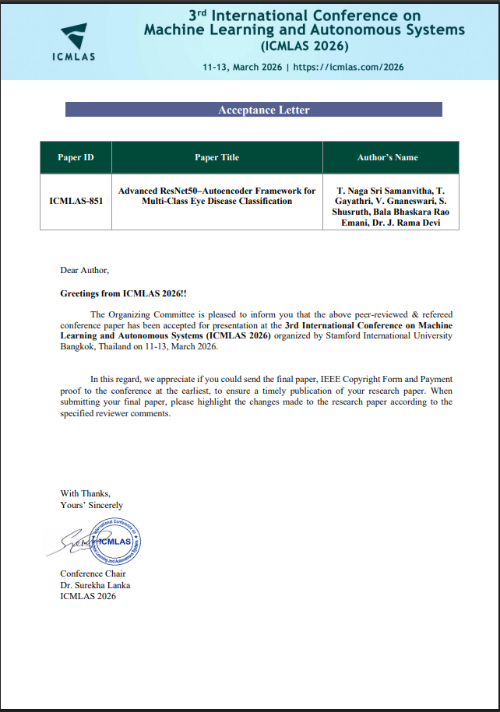
ICMLAS - 2026 Acceptance Letter

Slide 37
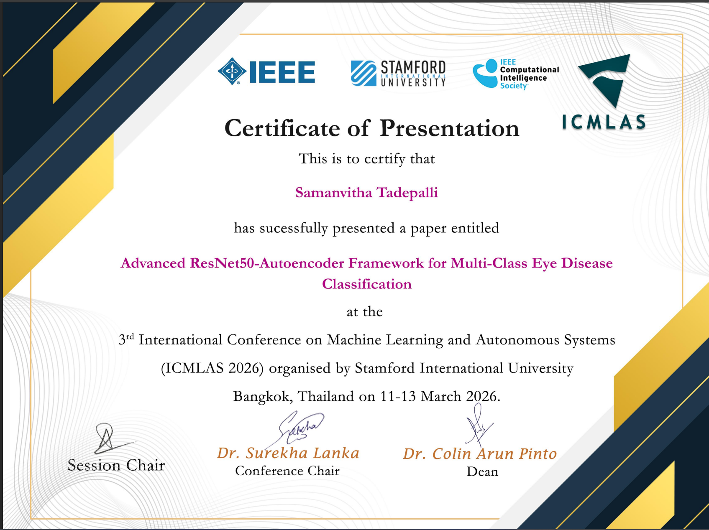
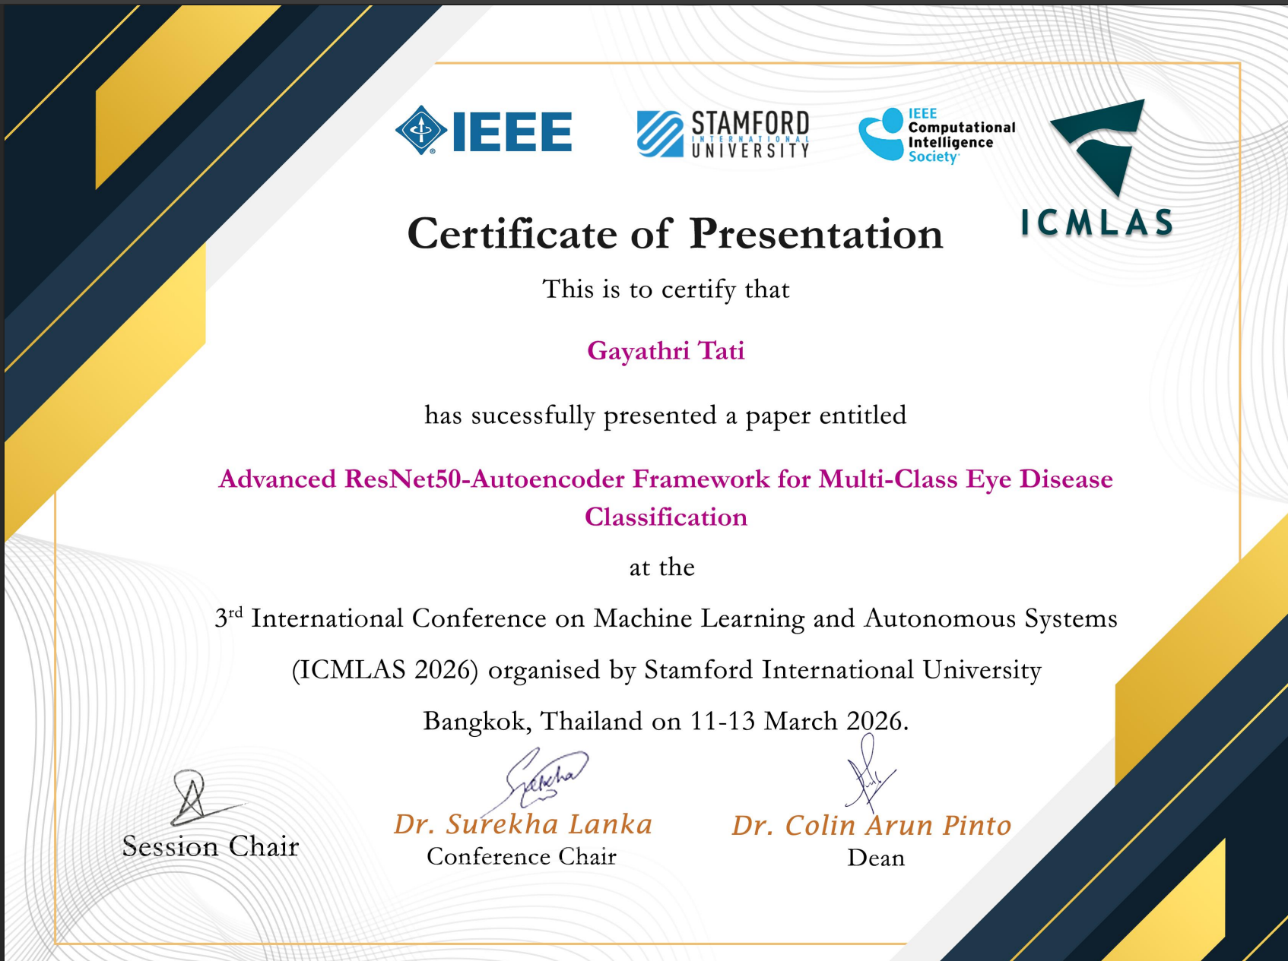
ICMLAS - 2026 Conference Presentation Certificates

Slide 38
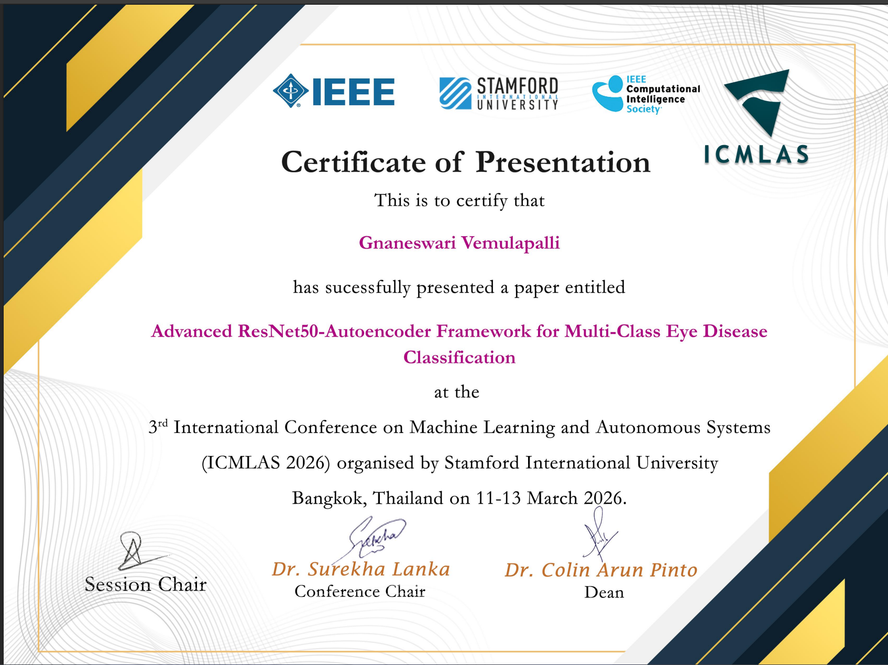

ICMLAS - 2026 Conference Presentation Certificates

Slide 39
Thank You

