Slide 1
Seizure Detection with Wearable Data
Dataset Comparison, Modeling Adaptations, and Progress
Bryan Garcia Rodriguez • FIU • SP2026

Slide 2
Motivation & Goal
Develop seizure detection models
Bridge clinical → wearable data

Slide 3
Datasets Overview
SeizeIT2: 125 pts, 886 seizures, EEG/ECG
Oregon: 7 subjects, 5 seizures, PPG + motion

Slide 4
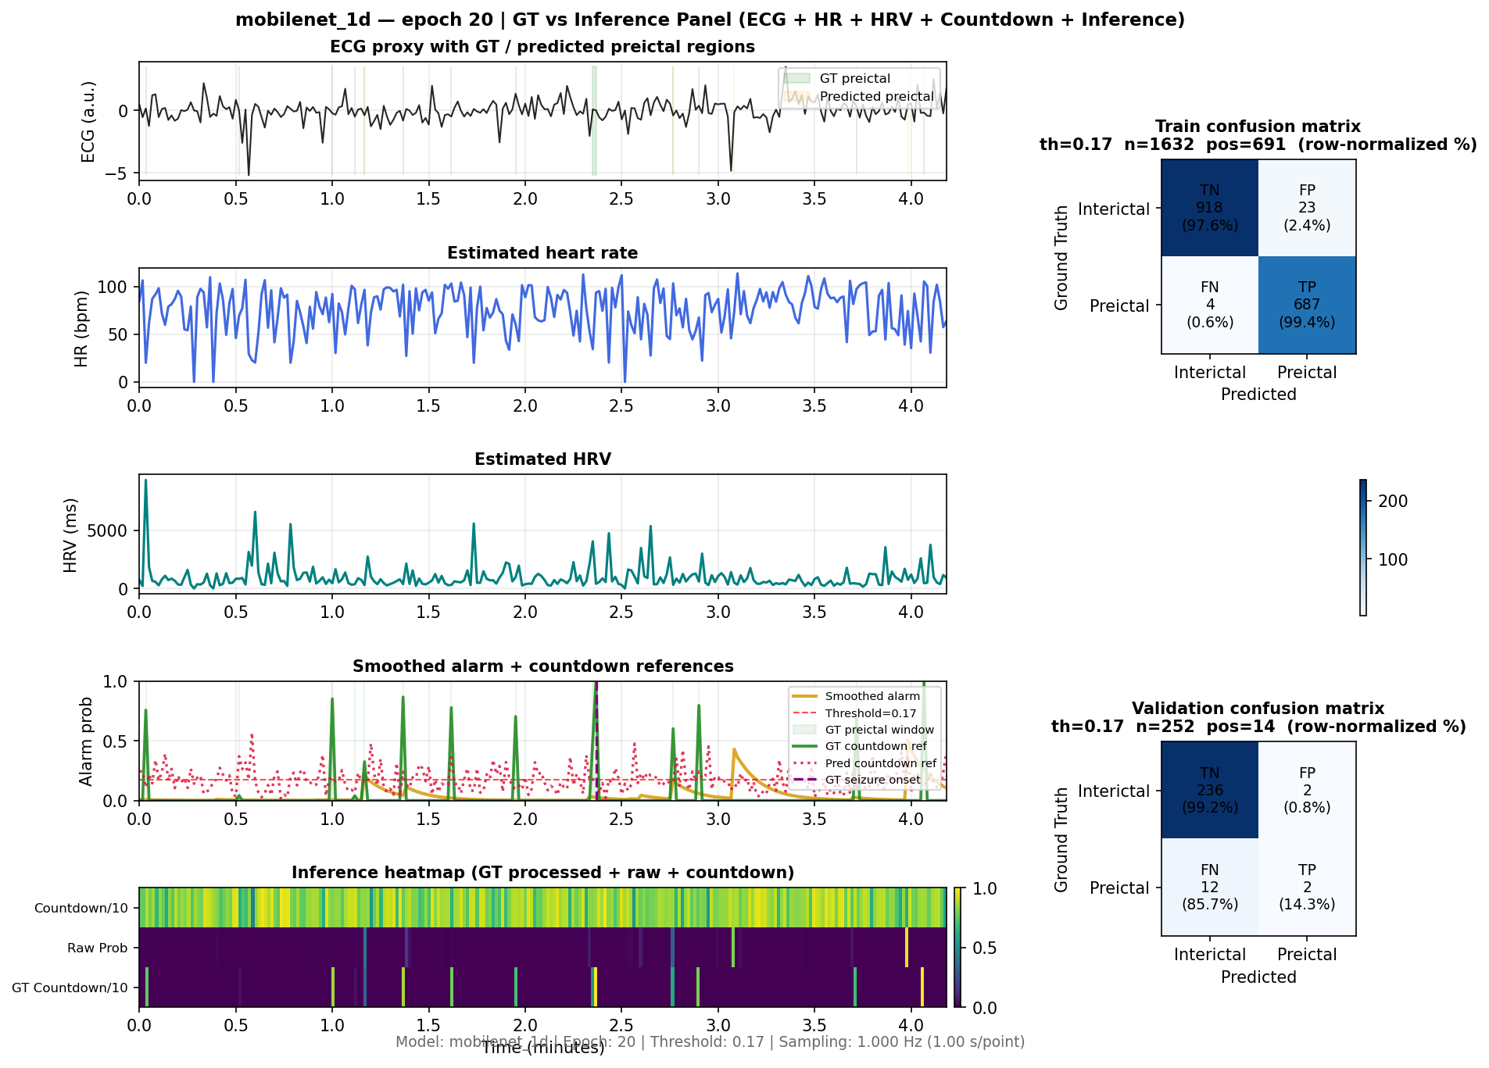
Key Realization
Wearable ≠ ECG/EEG
Reality: PPG + accelerometer only

Slide 5
Dataset Scale
SeizeIT2: large, balanced
Oregon: small, sparse seizures

Slide 6
Modeling Shift
From ECG waveform → PPG + motion features
Windowed feature tensors

Slide 7
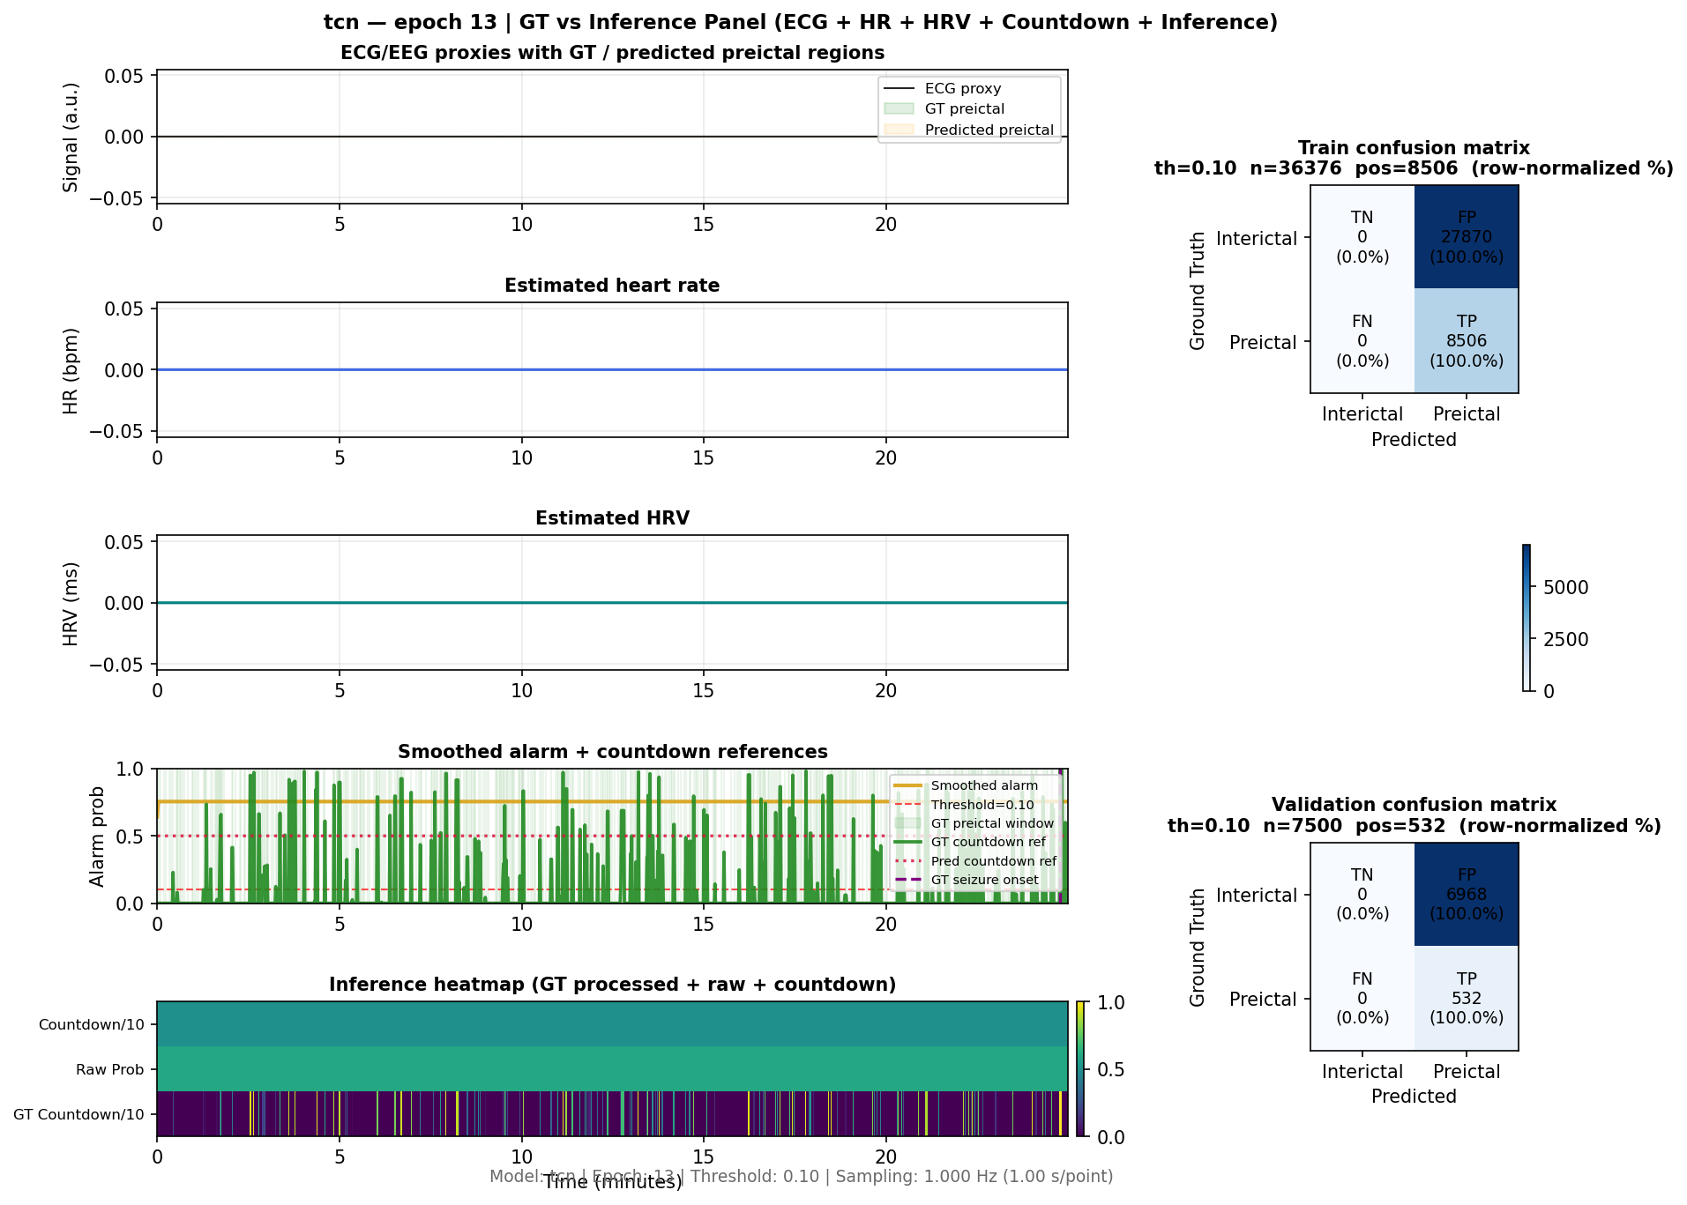
Data Quality Fix
Removed flat windows (low variance)
Improved training stability

Slide 8
Visualization Differences
Clinical: dynamic signals
Wearable: flat feature proxies

Slide 9
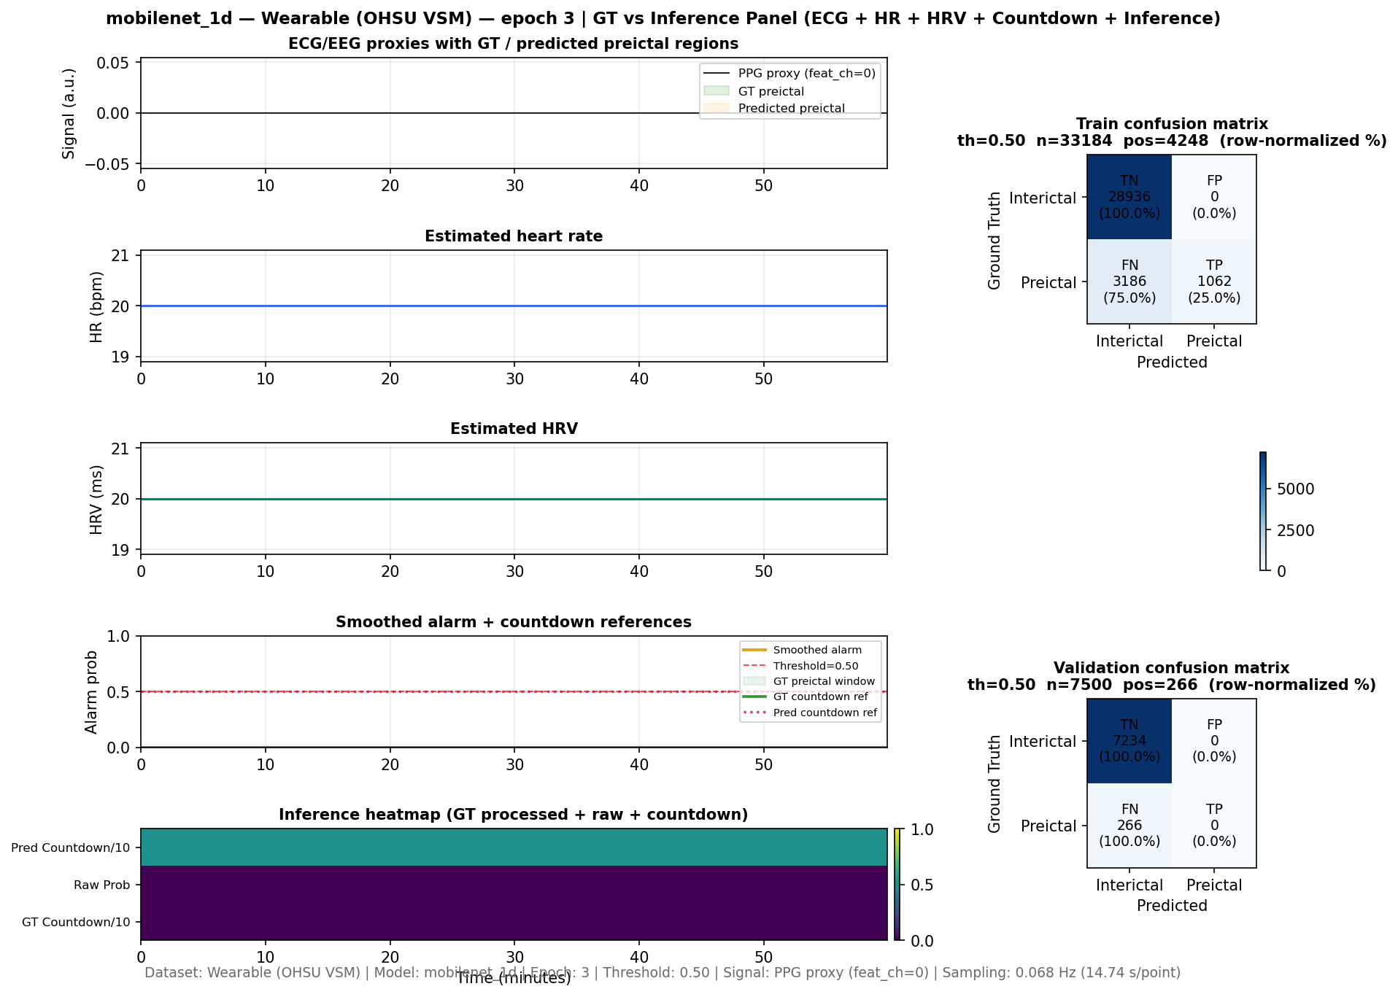
Current Hurdles
Model saturation
Visualization mismatch
Label alignment

Slide 10
Next Steps
Class balancing
Loss tuning
Better visualization

Slide 11
Deployment Reality
Smartwatch = PPG + motion only

Slide 12
Key Takeaways
Pipeline redesigned
Data limited
Model needs refinement

Slide 13
Future Work
Transfer learning
Better temporal models
Real-time alignment

Slide 14
Closing
Functional pipeline built
Next: robustness & deployment

