Slide 1
Relocation and Loading

Slide 2
Outline
Relocation
Multiple Defined Global Symbol
Archive Files (static libraries)
Executable Object Files
Loading
Suggested reading: 7.7, 7.6, 7.8, 7.9

Slide 3
ELF relocatable object file format
ELF header
.text
.rodata
.data
.bss
.symtab
Sections
.rel.txt
.rel.data
.debug
.line
Describes
object file
Sections
.strtab
Section header table

Slide 4
Relocation
For each reference to an object with unknown location
Assembler generates a relocation entry
Relocation entries for code are placed in .rel.text
Relocation entries for data are placed in .rel.data

Slide 5
Relocation
In main.o
00<main>:
00: 55 push %rbp
01: 48 89 e5 mov %rsp,%rbp
04: b8 00 00 00 00 mov $0x0,%eax
09: e8 00 00 00 00 callq e <main+0xe>
A swap R_X86_64_PC32 -4
0e: b8 00 00 00 00 mov $0x0,%eax
13: 5d pop %rbp
14: c3 retq

Slide 6
Relocation
In swap.o
00<bufp0>:
00: 00 00 00 00 00 00 00 00
0 buf R_X86_64_64 0
00<bufp1>:

Slide 7
Sections in the ELF object file
.rel.text section
relocation info for .text section
addresses of instructions that will need to be modified in the executable
.rel.data section
relocation info for .data section
addresses of pointer data that will need to be modified in the merged executable

Slide 8
Relocation
Relocation Entry
typedef struct {
long offset ;
long type:32,
symbol:32 ;
long addend;
} Elf64_Rela ;

Slide 9
Relocation
9 e8 00 00 00 00 callq e<main+0xe> swap();
There is a relocation entry in rel.text
offset symbol type addend
a swap R_X86_64_PC32 -4
Why PC32?
gcc default mode is the X86_64 small code model which assumes that the total size of the code and data in the executable object file is smaller than 2GB and thus can be accessed at run-time using 32-bit PC-relative addresses

Slide 10
Relocation
int *bufp0 = &buf[0] ;
00000000 <bufp0>:
0: 00 00 00 00 00 00 00 00
There is a relocation entry in rel.data
offset symbol type addend
0 buf R_X86_64_64 0

Slide 11
Relocation
Relocation
Merge the input modules
Assign runtime address to each symbol
Two steps
Relocating sections and symbol definitions
Relocating symbol references within sections

Slide 12
Relocation
9 e8 00 00 00 00 callq e<main+0xe> swap();
a: R_X86_64_PC32 swap relocation entry
r.offest = 0xa
r.symbol = swap
r.type = R_X86_64_PC32
r.addend = -4
ADDR(main)=ADDR(.text) = 0x4004d6
ADDR(swap)=0x4004eb
refaddr = ADDR(main)+r.offset = 0x4004e0
ADDR(r.symbol)=ADDR(swap)=0x4004eb
*refptr = (unsigned) (ADDR(r.symbol) + r.addend – refaddr)
= (unsigned) (0x4004eb + (-4) – 0x4004e0)
= (unsigned) 0x7
PC-relative

Slide 13
Relocation
00000000 <bufp0>:
0: 00 00 00 00 00 00 00 00 int *bufp0 = &buf[0];
0: R_X86_64_64 buf relocation entry
r.offest = 0x0
r.symbol = buf
r.type = R_X86_64_64
r.addend = 0
ADDR(r.symbol) = ADDR(buf) = 0x601030
*refptr = (unsigned) (ADDR(r.symbol)+ r.addend)
= (unsigned) (0x601030)
0x601038 <bufp0>:
0x601038: 30 10 60 00 00 00 00 00

Slide 14
Relocation
foreach section s {
foreach relocation entry r {
refptr = s + r.offset ; /* ptr to reference to be relocated */
/* relocate a PC-relative reference */
if (r.type == R_X86_64_PC32) {
refaddr = ADDR(s) + r.offset ; /* ref’s runtime address */
*refptr=(unsigned) (ADDR(r.symbol)+r.addend–refaddr) ;
}
/* relocate an absolute reference */
if ( r.type == R_X86_64_64 || r.type == R_X86_64_32||…)
*refptr = (unsigned) (ADDR(r.symbol) + r.addend) ;
}
}

Slide 15
Relocation
601030<buf>:
601030: 01 00 00 00 02 00 00 00
601038<bufp0>:
601038: 30 10 60 00 00 00 00 00
601048<bufp1>:

Slide 16
Relocation
601030<buf>:
601030: 01 00 00 00 02 00 00 00
601038<bufp0>:
601038: 30 10 60 00 00 00 00 00
601048<bufp1>:

Slide 17
Relocatable Object Files(swap.o)
00<swap>:
00: 55 push %rbp
01: 48 89 e5 mov %rsp,%rbp
04: 48 c7 05 00 00 00 00 movq $0x0,0x0(%rip) get bufp1
7: R_X86_64_PC32 bufp1 - 8
0b: 00 00 00 00 get &buf[1]
b: R_X86_64_32S buf + 4
0f: 48 8b 05 00 00 00 00 mov 0x0(%rip),%rax get bufp0
12: R_X86_64_PC32 bufp0 - 4
16: 8b 00 mov (%rax),%eax
18: 89 45 fc mov %eax,-0x4(%rbp)
1b: 48 8b 05 00 00 00 00 mov 0x0(%rip),%rax get bufp0
1e: R_X86_64_PC32 bufp0 - 4

Slide 18
Relocatable Object Files(swap.o)
22: 48 8b 15 00 00 00 00 mov 0x0(%rip),%rdx get bufp1
25: R_X86_64_PC32 bufp1 - 4
29: 8b 12 mov (%rdx),%edx
2b: 89 10 mov %edx,(%rax)
2d: 48 8b 05 00 00 00 00 mov 0x0(%rip),%rax get bufp1
30: R_X86_64_PC32 bufp1 - 4
34: 8b 55 fc mov -0x4(%rbp),%edx
37: 89 10 mov %edx,(%rax)
39: 90 nop
3a: 5d pop %rbp
3b: c3 retq

Slide 19
Example (Relocation)
.rel.text
7: R_X86_64_PC32 bufp1 - 8
b: R_X86_64_32S buf + 4
12: R_X86_64_PC32 bufp0 - 4
1e: R_X86_64_PC32 bufp0 - 4
25: R_X86_64_PC32 bufp1 - 4
30: R_X86_64_PC32 bufp1 - 4
ADDR(swap)=0x4004eb ADDR(buf) = 0x601030
ADDR(bufp0)=0x601038 ADDR(bufp1)=0x601048

Slide 20
Executable Object Files
00000000004004eb <swap>:
4004eb: 55 push %rbp
4004ec: 48 89 e5 mov %rsp,%rbp
4004ef: 48 c7 05 4e 0b 20 00 movq $0x601034,0x200b4e(%rip)
4004f6: 34 10 60 00 bufp1= &buf[1]
4004fa: 48 8b 05 37 0b 20 00 mov 0x200b37(%rip),%rax get bufp0
400501: 8b 00 mov (%rax),%eax
400503: 89 45 fc mov %eax,-0x4(%rbp)
400506: 48 8b 05 2b 0b 20 00 mov 0x200b2b(%rip),%rax get bufp0
40050d: 48 8b 15 34 0b 20 00 mov 0x200b34(%rip),%rdx get bufp1
400514: 8b 12 mov (%rdx),%edx
400516: 89 10 mov %edx,(%rax)
400518: 48 8b 05 29 0b 20 00 mov 0x200b29(%rip),%rax get bufp0
40051f: 8b 55 fc mov -0x4(%rbp),%edx
400522: 89 10 mov %edx,(%rax)

Slide 21
Executable Object Files
400524: 90 nop
400525: 5d pop %rbp
400526: c3 retq
601030<buf>:
601030: 01 00 00 00 02 00 00 00
601038<bufp0>:
601038: 30 10 60 00 00 00 00 00
601048<bufp1>:

Slide 22
Multiply Defined Global Symbols
Strong:
Functions and initialized global variables
Weak:
Uninitialized global variables
Rules:
Multiple strong symbols are not allowed
Given a strong symbol and multiple weak symbols, choose the strong symbol
Given multiple weak symbols, choose any of the weak symbol

Slide 23
Multiply Defined Global Symbols
/*foo1.c*/
int main()
{
return 0;
}
/*bar1.c*/
int main()
{
return 0;
}
/*foo2.c*/
int x=15213;
int main()
{
return 0;
}
/*bar2.c*/
int x=15213;
void f()
{
}

Slide 24
Multiply Defined Global Symbols
/*foo3.c*/
#include <stdio.h>
void f();
int x=15213;
int main()
{
f();
printf(“x=%d\n”,x)
return 0;
}
/*bar3.c*/
int x ;
void f()
{
x = 15212 ;
}

Slide 25
Multiply Defined Global Symbols
/*foo4.c*/
#include <stdio.h>
void f();
int x;
int main()
{
x=15213
f();
printf(“x=%d\n”,x)
return 0;
}
/*bar4.c*/
int x ;
void f()
{
x = 15212 ;
}

Slide 26
Multiply Defined Global Symbols
/*foo5.c*/
#include <stdio.h>
void f();
int x=15213;
int y=15212;
int main()
{
f();
printf(“x=0x%x y=0x%x \n”,
x, y) ;
return 0;
}
/*bar5.c*/
double x ;
void f()
{
x = -0.0 ;
}
gcc –fno-common

Slide 27
Packaging commonly used functions
How to package functions commonly used by programmers?
math, I/O, memory management, string manipulation, etc.

Slide 28
Packaging commonly used functions
Awkward, given the linker framework so far:
Option 1: Put all functions in a single source file
programmers link big object file into their programs
space and time inefficient
Option 2: Put each function in a separate source file
programmers explicitly link appropriate binaries into their programs
more efficient, but burdensome on the programmer

Slide 29
Packaging commonly used functions
Solution: static libraries (.a archive files)
concatenate related relocatable object files into a single file with an index (called an archive)
enhance linker so that it tries to resolve unresolved external references by looking for the symbols in one or more archives
If an archive member file resolves reference, link into executable
gcc main.c /usr/lib/libm.a /usr/libc.a
gcc main.c -lm

Slide 30
Example (1/3)
(a) addvec.o
int addcnt = 0 ;
void addvec(int *x, int *y, int *z, int n)
{
int i;
addcnt++;
for (i = 0; i < n; i++)
z[i] = x[i] + y[i];
}

Slide 31
Example (2/3)
(b) multvec.o
int multcnt = 0 ;
void multvec(int *x, int *y, int *z, int n)
{
int i;
multcnt++;
for (i = 0; i < n; i++)
z[i] = x[i] * y[i];
}
unix> gcc -c addvec.c multvec.c
unix> ar rcs libvector.a addvec.o multvec.o

Slide 32
Example (3/3)
/* main2.c */
#include <stdio.h>
#include "vector.h“
int x[2] = {1, 2};
int y[2] = {3, 4};
int z[2];
int main()
{
addvec(x, y, z, 2);
printf("z = [%d %d]\n", z[0], z[1]);
return 0;
}

Slide 33
Static Linked Libraries
main2.c
vector.h
libc.a
Translators(cc1, as)
libvector.a
printf.o and any other modules called by printf.o
main2.o
addvec
Linker (ld)
p2
Fully linked executable object code file
unix> gcc -O2 -c main2.c
unix> gcc -static -o prog2 main2.o ./libvector.a
Or unix> gcc -static -o prog2 main2.o -L. -lvector

Slide 34
Creating static libraries
atoi.c
printf.c
random.c
Translator
Translator
...
Translator
atoi.o
printf.o
random.o
Archiver (ar)
libc.a
C standard library
Archiver allows incremental updates:
recompile function that changes and replace .o file in archive.
ar rcs libc.a atoi.o printf.o … random.o

Slide 35
Using static libraries
E:
relocatable object files that will be merged to form the executable
U:
Unresolved symbols
D:
Symbols that have been defined in previous input files
Initially all are empty

Slide 36
Using static libraries
Scan .o files and .a files in the command line order.
When scan an object file f,
Add f to E
Updates U, D
When scan an archive file f,
Resolve U
If m is used to resolve symbol, m is added to E
Update U, D using m

Slide 37
Using static libraries
If any entries in the unresolved list at end of scan, then error
Problem:
command line order matters!
Moral: put libraries at the end of the command line.

Slide 38
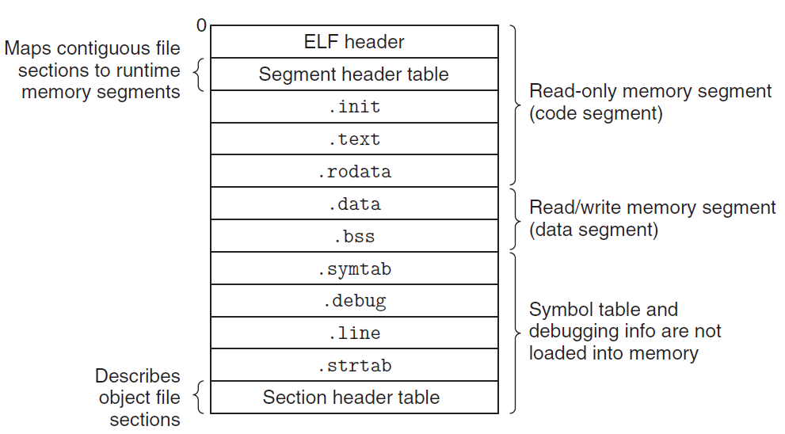
Executable Object Files

Slide 39
ELF Header
typedef struct{
unsigned char e_ident[16]; /* ELF identification */
Elf64_Half e_type; /* Object file type */
Elf64_Half e_machine; /* Machine type */
Elf64_Word e_version; /* Object file version */
Elf64_Addr e_entry; /* Entry point address */
Elf64_Off e_phoff; /* Program header offset */
Elf64_Off e_shoff; /* Section header offset */
Elf64_Word e_flags; /* Processor-specific flags */
Elf64_Half e_ehsize; /* ELF header size */
Elf64_Half e_phentsize; /* Size of program header entry */
Elf64_Half e_phnum; /* Number of program header entries */
Elf64_Half e_shentsize; /* Size of section header entry */
Elf64_Half e_shnum; /* Number of section header entries */
Elf64_Half e_shstrndx; /* Section name string table index */
} Elf64_Ehdr;

Slide 40
Executable Object File Header
ELF header
Overall information
Entry point
Program (Segment) header table information
Starting point
Size
Size of each entry
Number of entries

Slide 41
Executable Object File Segment Header Table
typedef struct {
Elf64_Word p_type; /* Entry type. */
Elf64_Word p_flags; /* Access permission flags. */
Elf64_Off p_offset; /* File offset of contents. */
Elf64_Addr p_vaddr; /* Virtual address in memory image. */
Elf64_Addr p_paddr; /* Physical address (not used). */
Elf64_Xword p_filesz; /* Size of contents in file. */
Elf64_Xword p_memsz; /* Size of contents in memory. */
Elf64_Xword p_align; /* Alignment in memory and file. */
} Elf64_Phdr;

Slide 42
Executable Object File Segment Header Table
p_type
PT_LOAD (1): loadable segment
p_offset
Offset from the beginning of the file to the first byte in the segment
p_vaddr
The virtual address of the first byte in the segment
p_paddr
Not very useful

Slide 43
Executable Object File Segment Header Table
p_filesz
Segment size in the object file (≤p_memsz)
p_memsz
Segment size in the memory (≥p_filesz)
p_flags
Run time permissions (rwx)
p_align
Alignment requirement for the beginning address of the segment
Usually 2**12 or 2**21(2M)

Slide 44
Executable Object Files

Slide 45
2⁴⁷-1
%rsp

Slide 46
ELF format
Read only code segment
LOAD off 0x0000000000000000 vaddr 0x0000000000400000
paddr 0x0000000000400000 align 2**21
filesz 0x000000000000069c memsz 0x000000000000069c
flags r-x
Read/write data segment
LOAD off 0x0000000000000df8 vaddr 0x0000000000600df8
paddr 0x0000000000000df8 align 2**21
filesz 0x0000000000000228 memsz 0x0000000000000230
flags rw
Difference between filesz and memsz means the uninitialized data in .bss
.init section contains a small function _init called by program’s initialization code

Slide 47
Startup code
_start
the entry point of the program
Defined in the crt1.o
Same for all C program
Calls
system startup function
__libc_start_main
Defined in libc.so
Initializes the execution environment
Calls the main function
Handles return value
Returns control to OS (if necessary)

Slide 48
Loading
Unix> ./p
Loader
Memory-resident operating system code
Invoked by call the execve function
Copy the code and data in the executable object file from disk into memory
Jump to the entry point
Run the program

