Slide 1
Introduction to Computer Systems

Slide 2
Outline
Teaching staffs
Textbook and Grading
Motivation

Slide 3
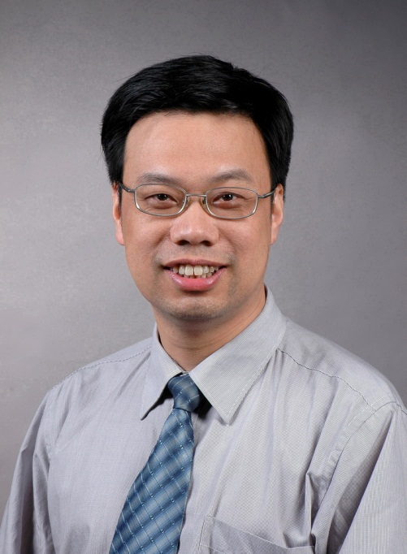

Instructor
臧斌宇
Email: byzang@sjtu.edu.cn
Office phone: 13917124245
Office hour: make an appointment
Room: 1312 software Bld.
陈榕
Email: rongchen@sjtu.edu.cn
Office phone: 13616861826

Slide 4
Teaching Assistants
刘年、易纪非、余天依、吴新月
软件楼3号楼4层（3-403）
周三
上机：18:00～20:30 软件楼机房
习题：18:00～20:00
待定
上机考试

Slide 5
Text Books & Web Site
Randy Bryant and David O’Hallaron,
Computer Systems: A Programmer’s Perspective
3rd Edition
Prentice Hall, 2016.
Brian Kernighan and Dennis Ritchie,
The C Programming Language, Second Edition
Prentice Hall, 1988
http://ipads.se.sjtu.edu.cn/courses/ics/

Slide 6
Grading
Exams(70%)
Final (42%)
Quiz (28%, 7% each)
All exams are open books/open notes.
Labs (30%)

Slide 7
计算机课程体系的演进
三个阶段（以中国文化类比）
百家争鸣阶段
七十年代中期至八十年代中期
独尊儒术阶段
八十年代中期至上世纪末
现代化阶段
本世纪初至今

Slide 8
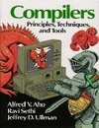
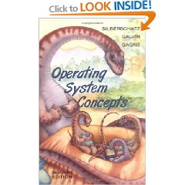
百家争鸣
七十年代中期至八十年代中期
计算机技术和理论均不成熟
百科全书式的教学内容
理论、概念为主、实践不足
中国目前的课程体系脱胎于此
导致很多学生毕业时不会编程

Slide 9
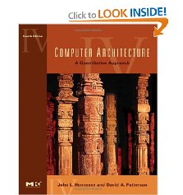
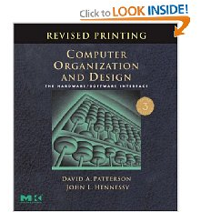
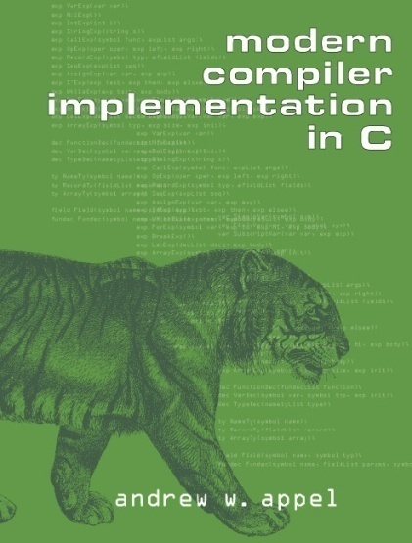

独尊儒术
八十年代中期至上世纪末
单机技术逐渐成熟
有了主流的理论和平台
以实际系统为主线的教科书
理论教学深和实验强度大
目前国内教学领先的计算机系开始采用
与互联网有较大差距

Slide 10
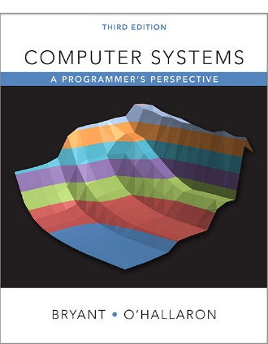
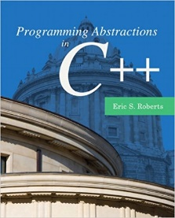
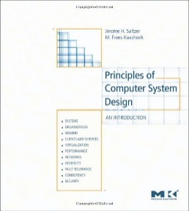
现代化
本世纪开始
互联网的兴起、并不断演化
互联网、云计算机、基于大数据分析的机器学习
MIT、CMU、Stanford开始了课程重构
三个抽象
问题抽象、系统抽象、数据抽象
典型教材
Programming Abstractions using C++
Computer Systems: A Programmer’s Perspective
Principles of Computer System Design
经典课程不再为单一系统，向更加综合方向发展

Slide 11



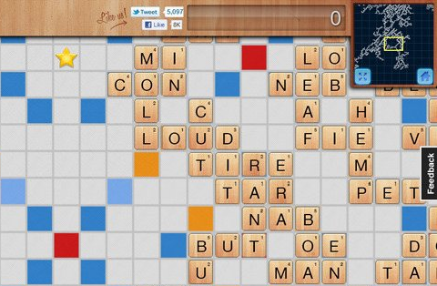
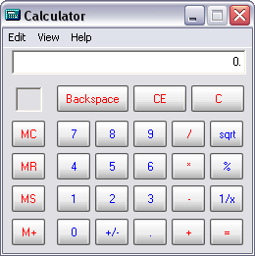
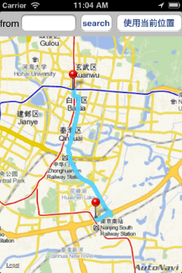
课程体系
学习美国顶尖高校的基础课
程序设计与数据结构（Stanford）
计算机系统基础（CMU）
计算机系统工程（MIT）
机器学习（MIT）
课程特点
数量少
重基础、强实践
综合性、实用性

Slide 12
System Track Courses
Operating Systems
Architecture
Digital Components
Compilers
Distributed Systems
Computer Systems Engineering
Introduction to Computer Systems

Slide 13
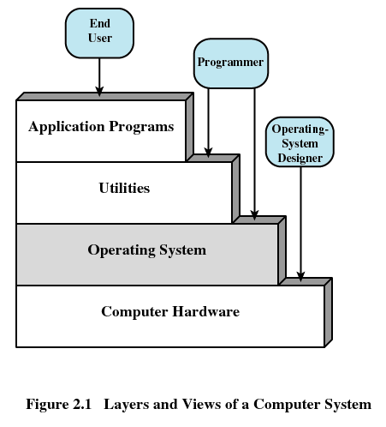
Layers of Computer Systems

Slide 14
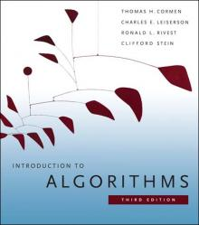
Bibles for Job Interview

Slide 15
Where are We?
Programming Lies at the Heart of Most Modern Systems
Computer systems
Embedded devices: cell phones, automobile controls, …
Electronics: DSPs, programmable controllers
Programmers Have to Understand Their Machines and Their Limitations
Correctness: computer arithmetic, storage allocation
Efficiency: memory & CPU performance

Slide 16
Where are We?
From abstractions to details (realities)
From application level to system level
From C++ to C

Slide 17
Features of This Course
Enduring Concepts
From programmer’s perspective
Actively study
Becoming the rare “power programmer”

Slide 18
Enduring concepts
Computer systems consist hardware and systems software that work together to run programs
Specific implementations of systems change over time
But the underlying concepts do not
All computer systems have similar hardware and software components that perform similar functions

Slide 19
From Programmer’s Perspective
Rather than system designer’s perspective
Few students would have the opportunity to build a computer system
It’s wasteful to teach every computer scientist how to design a microprocessor
Knowledge of how to build does not transfer to knowledge of how to use

Slide 20
From Programmer’s Perspective
It covers a topic only if it affected
correctness, performance or utility of user-level C programs
Take a broader and more realistic view of the system
What the computer hardware is
How modern computer works

Slide 21
Actively Study
New concepts are followed by practical problems
Homework problems and labs are also real
Learning by doing
Working concrete problems
Writing and running programs on real systems
Practical, concrete, hands-on and exciting

Slide 22
Becoming the Rare “Power Programmer”
Enlightened by an understanding of
the underlying computer system
and its impact on your application programs
You know
How things work and
How to fix them when they break

Slide 23
Drawbacks of This Book
This book is written by famous professors
The materials in this book are very good
However, the book is not well organized for Chinese students
Some parts are too tedious
Some important ideas are not emphasized
It should be better for you to follow my directions to read the book

Slide 24
Good luck!

Slide 25
Overview of Computer Systems

Slide 26
Outline
Layers of computer systems
Suggested reading
1.2, 1.4.1, 1.7(before 1.7.1), 1.7.3, 1.8, 1.9.2 (the first paragraph), the first 4 asides in chapter 1

Slide 27
Layers of Computer Systems

Slide 28
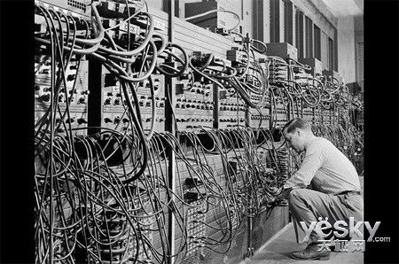
The first general purpose computer
ENIAC
Electronic Numerical Integrator And Computer
Delivered by UPenn. on Feb. 14, 1946
John Mauchly、John Eckert
ABC
Atanasoff–Berry Computer
1941

Slide 29
Computer Hardware - Von Neumann Architecture
Instructions / Program
Main
Memory
Arithmetic
Unit
Control
Unit
PC
AC
IR
SR
Addresses
Input/Output
Unit
E.g. Storage
EDVAC
Electronic Discrete Variable
Automatic Computer
en:First Draft of a Report on the EDVAC

Slide 30
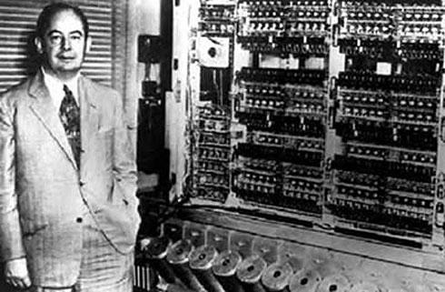
EDVAC(1944.8,1945.6,1949.8,1951-1961)

Slide 31
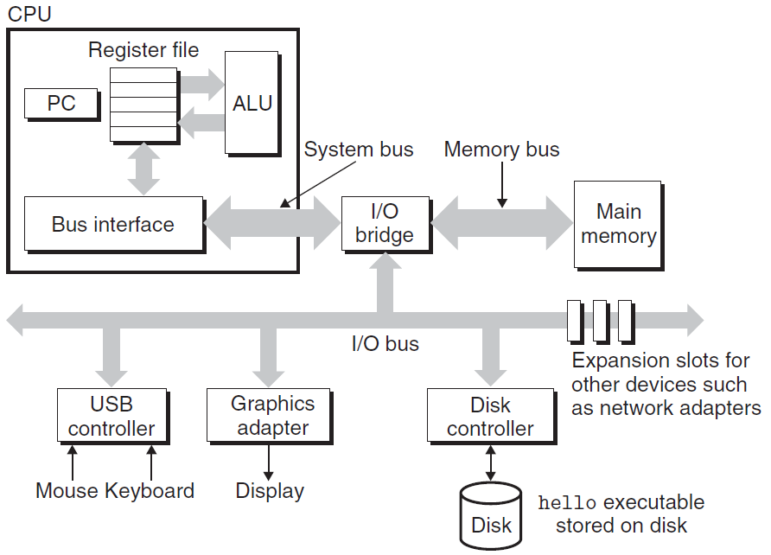
IA-32

Slide 32
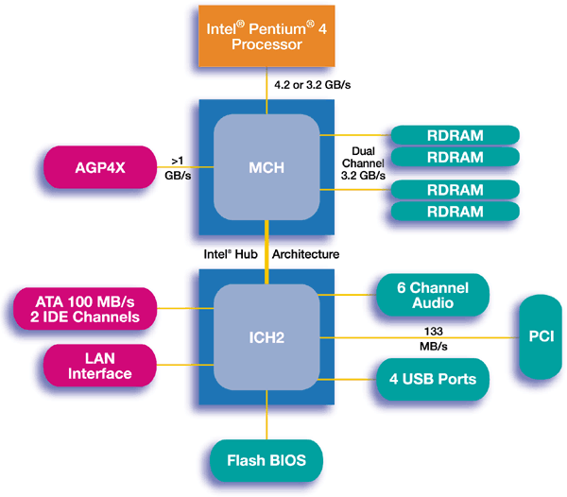
IA-32

Slide 33
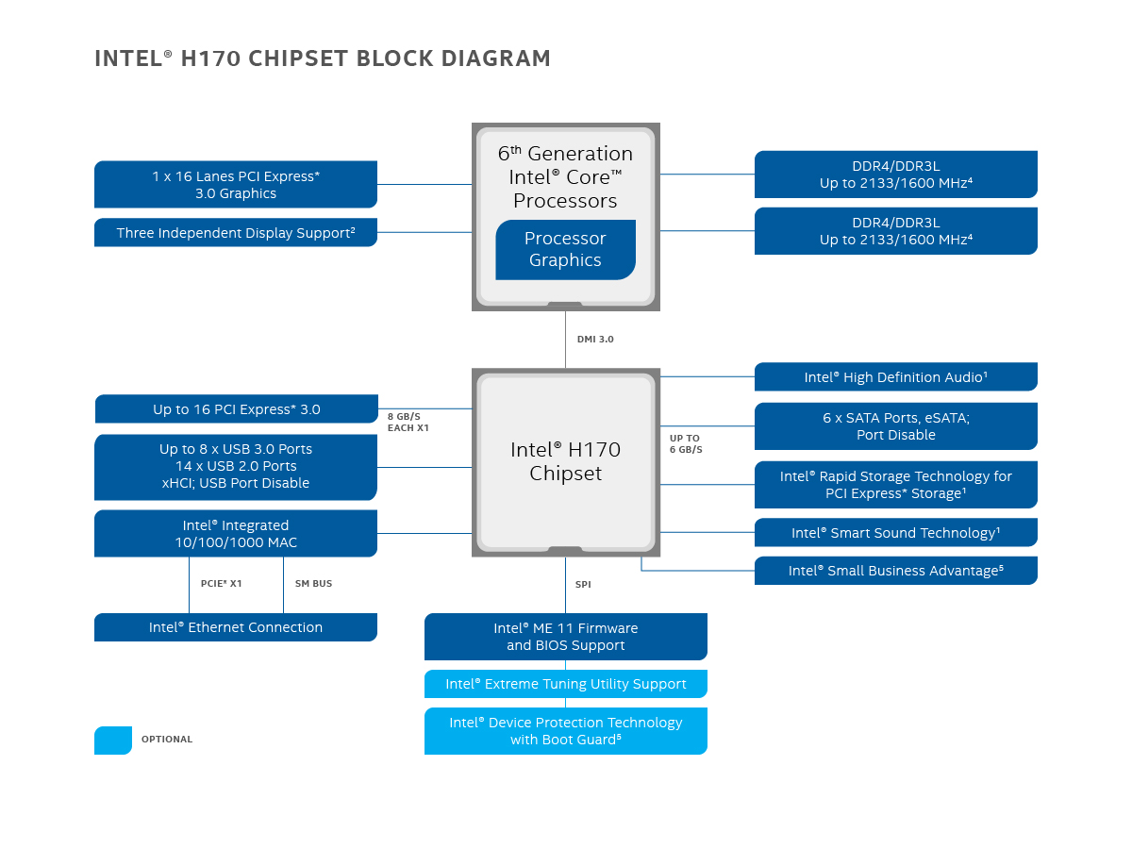
IA-32

Slide 34
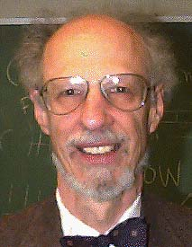
Operating Systems
1960’s
IBM OS/360, Honeywell Multics,
Fernado Jose Corbató
IEEE Computer Pioneer Award, 1982
ACM Turing Award, 1990

Slide 35
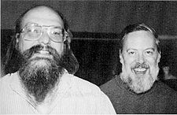
Operating Systems
Unix
Bell Lab, DEC PDP-7, 1969
Ken Thompson, Dennis Ritchie, Doug Mcllroy, Joe Ossana
1970 Brian Kernighan dubbed the system “Unix”
Rewritten in C in 1973, announced in 1974
BSD (UC, Berkeley), System V(Bell lab)
Solaris (Sun Microsystem)
Posix standard
Ken Thompson, Dennis Ritchie
ACM Turing Award, 1983

Slide 36
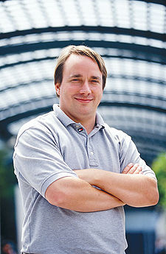

Linux
1991, Linus Torvalds
Unix-like operating systems
386(486)AT, bash(1.08), gcc(1.40)
Posix complaint version of Unix operating system
Available on a wide array of computers
From handheld devices to mainframe computers
wristwatch

Slide 37











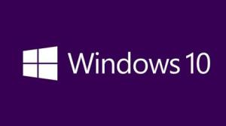
We have seen a bunch of Operating Systems

Slide 38












We have seen a bunch of Operating Systems

Slide 39
Utilities
Programming language
ANSI C
Compiler
GNU-gcc
Tools
GNU tool chain

Slide 40
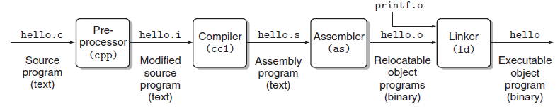
Compilation

Slide 41
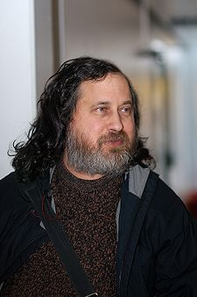

GNU
Free software
Richard Stallman, 1984
A complete Unix-like system with source code
An environment
All major components of a Unix operating system
Except for kernel

Slide 42
The C Programming Language
C was developed
in 1969 to 1973
by Dennis Ritchie of Bell Laboratories.
The American National Standards Institute (ANSI)
ratified the ANSI C standard in 1989.
The standard defines
the C language
and a set of library functions known as the C standard library.

Slide 43
The C Programming Language
Kernighan and Ritchie describe ANSI C in their classic book
which is known affectionately as “K&R” .
In Ritchie’s words, C is
quirky,
flawed,
and an enormous success.
Why the success?

Slide 44
The C Programming Language
C was closely tied with the Unix operating system
C was developed from the beginning as the system programming language for Unix.
Most of the Unix kernel, and all of its supporting tools and libraries, were written in C.

Slide 45
The C Programming Language
C was closely tied with the Unix operating system
As Unix became popular in universities in the late 1970s and early 1980s, many people were exposed to C and found that they liked it.
Since Unix was written almost entirely in C, it could be easily ported to new machines, which created an even wider audience for both C and Unix.

Slide 46
The C Programming Language
C is a small, simple language.
The design was controlled by a single person, rather than a committee, and the result was a clean, consistent design with little baggage.
The K&R book describes the complete language and standard library, with numerous examples and exercises, in only 261 pages.
The simplicity of C made it relatively easy to learn and to port to different computers.

Slide 47
The C Programming Language
C was designed for a practical purpose.
C was designed to implement the Unix operating system.
Later, other people found that they could write the programs they wanted, without the language getting in the way.

Slide 48
The C Programming Language
C is the language of choice for system-level programming
There is a huge installed base of application-level programs as well.

Slide 49
The C Programming Language
However, it is not perfect for all programmers and all situations
C pointers are a common source of confusion and programming errors
C also lacks explicit support for useful abstractions such as classes and objects
Newer languages such as C++ and Java address these issues for application-level programs

Slide 50
Standardization of C
The original Bell Labs version of C
the 1st edition of the book K&R
The ANSI C standard in 1989
The American National Standards Institute
Modify the way functions are declared
the 2nd edition of the book K&R
ISO C90 (The International Standards Organization)

Slide 51
Standardization of C
ISO C99
Introduced some new data types
Provided support for text strings requiring characters not found in the English language
Gcc supporting
Unix> gcc -std=c99 prog.c
-ansi and -std=c89 have the same effect

Slide 52
Standardization of C
C version gcc | command line option
GNU 89 | none, -std=gnu89
ANSI, ISO C90 | -ansi, -std=c89
ISO C99 | -std=c99
GNU 99 | -std=gnu99
ISO 11 | -std=c11
GNU 11 | -std=gnu11
ACM:
Association of Computing Machinery
IEEE:
Institute of Electrical and Electronics Engineers

Slide 53
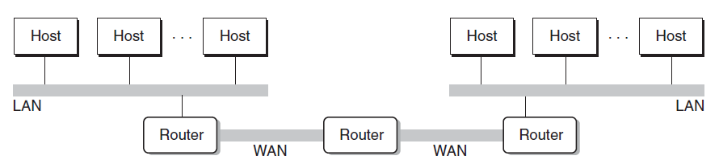
Networking
Computers are connected by networks

Slide 54


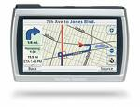
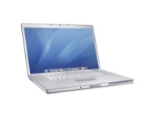
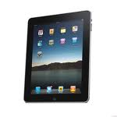
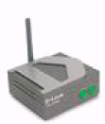

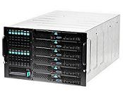

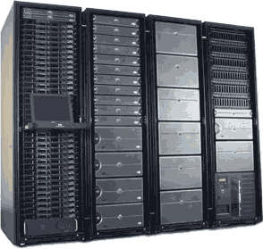
Cloud
Computer Systems support the cloud computing
Wireless
Ethernet

Slide 55
Platforms
Hardware platform
Intel IA-64
Operating system
Linux
Programming language
ANSI C
Utility
GNU
Networking
TCP/IP, Sockets

Slide 56
Important Themes
Concurrency an Parallelism
Concurrency: multiple, simultaneous activities
Parallelism: the use of concurrency to make a system run faster
abstraction

Slide 57
