Slide 1
Representing Information (2)

Slide 2
Outline
Byte ordering
Representing Strings and Code
Encodings
  Unsigned and two’s complement
Suggested reading
  Chap 2.1.3, 2.1.4, 2.1.5, 2.2

Slide 3
Virtual Memory
The memory introduced in previous slides
  is only an conceptual object and
  does not exist actually
It provides the program with what appears to be a monolithic byte array
It is a conceptual image presented to the machine-level program

Slide 4
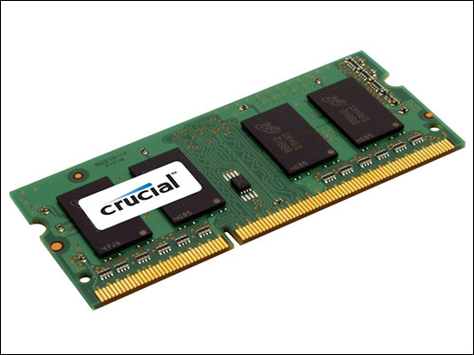
Virtual Memory
The actual implementation uses a combination of
  Hardware
  Software
Hardware
  random-access memory (RAM) (physical)
  disk storage (physical)
  special hardware (performing the abstraction )
Software
  and operating system software (abstraction)

Slide 5
Way to the Abstraction
Taking something physical and abstract it logical
Virtual memory
WRITE
(vadd value)
Operating
System
Special
hardware
RAM
Chips
Disk
storage
WRITE
(padd value)
READ(vadd)
READ(padd)
Abstraction
layer
Physical
layer

Slide 6
Subdivide Virtual Memory into More Manageable Units
One task of
  a compiler and
  the run-time system
To store the different program objects
  Program data
  Instructions
  Control information

Slide 7
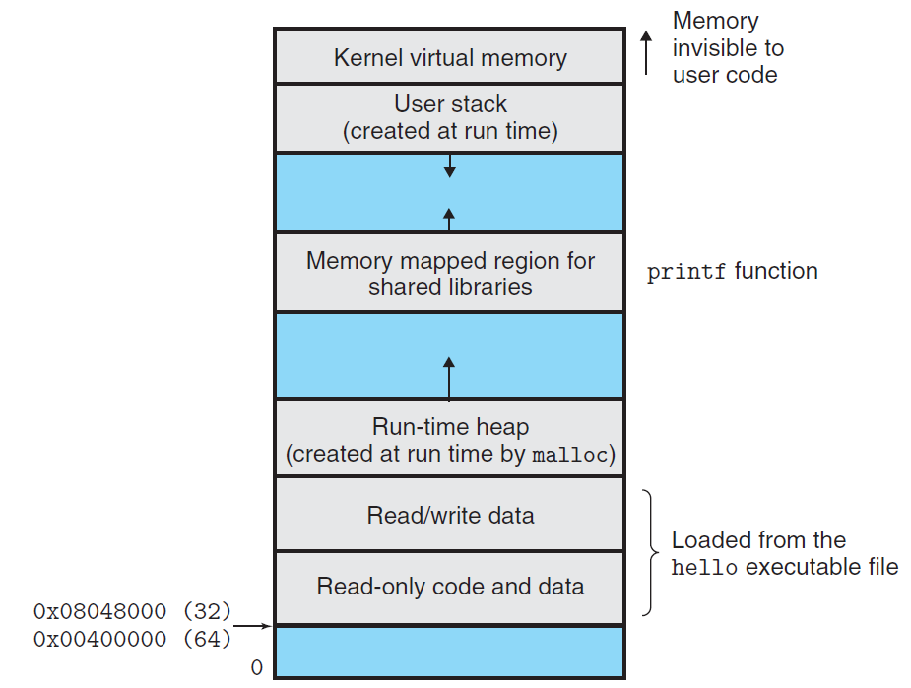

Slide 8
Byte Ordering
How should a large object be stored in memory?
For program objects that span multiple bytes
  What will be the address of the object?
  How will we order the bytes in memory?
A multi-byte object is stored as
  a contiguous sequence of bytes
  with the address of the object given by the smallest address of the bytes used

Slide 9
Byte Ordering
Little Endian
  Least significant byte has lowest address
  Intel
Big Endian
  Least significant byte has highest address
  Sun, IBM
Bi-Endian
  Machines can be configured to operate as either little- or big-endian
  Many recent microprocessors

Slide 10
Big Endian (0x1234567)
0x100
0x101
0x102
0x103
01
23
45
67

Slide 11
Little Endian (0x1234567)
0x100
0x101
0x102
0x103
67
45
23
01

Slide 12
How to Access an Object
The actual machine-level program generated by C compiler
  simply treats each program object as a block of bytes
The value of a pointer in C
  is the virtual address of the first byte of the above block of storage

Slide 13
How to Access an Object
The C compiler
  Associates type information with each pointer
  Generates different machine-level code to access the pointed value
    stored at the location designated by the pointer depending on the type of that value
The actual machine-level program generated by C compiler
  has no information about data types

Slide 14
Code to Print Byte Representation
typedef unsigned char *byte_pointer;
void show_bytes(byte_pointer start, int len)
{
int i;
for (i = 0; i < len; i++)
printf("0x%p\t0x%.2x\n",
start+i, start[i]);
printf("\n");
}

Slide 15
Code to Print Byte Representation
void show_int(int x) {
show_bytes((byte_pointer) &x, sizeof(int));
}
void show_float(float x) {
show_bytes((byte_pointer) &x, sizeof(float));
}
void show_pointer(void *x) {
show_bytes((byte_pointer) &x, sizeof(void *));
}

Slide 16
Features in C
typedef
  Giving a name of type
  Syntax is exactly like that of declaring a variable
printf
  Format string: %d, %c, %x, %f, %p
sizeof
  sizeof(T) returns the number of bytes required to store an object of type T
  One step toward writing code that is portable across different machine types

Slide 17
Features in C
Pointers and arrays
  start is declared as a pointer
  It is referenced as an array start[i]
Pointer creation and dereferencing
  Address of operator &
  &x
Type casting
  (byte_pointer) &x

Slide 18
Code to Print Byte Representation
void test_show_bytes(int val) {
int ival = val;
float fval = (float) ival;
int *pval = &ival;
show_int(ival);
show_float(fval);
show_pointer(pval);
}

Slide 19
Example
Linux 32: Intel IA32 processor running Linux
Windows: Intel IA32 processor running Windows
Sun: Sun Microsystems SPARC processor running Solaris
Linux 64: Intel x86-64 processor running Linux
With argument 12345 which is 0x3039

Slide 20
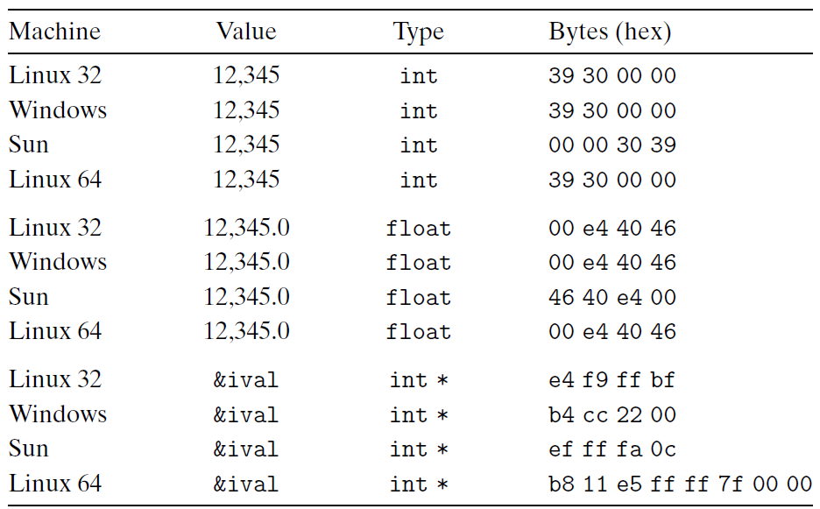
Example
Linux 32: Intel IA32 processor running Linux
Windows: Intel IA32 processor running Windows
Sun: Sun Microsystems SPARC processor running Solaris
Linux 64: Intel x86-64 processor running Linux

Slide 21
Representing Codes
int sum(int x, int y) {
return x + y;
}
Linux 32: 55 89 e5 8b 45 0c 03 45 08 c9 c3
Windows: 55 89 e5 8b 45 0c 03 45 08 5d c3
Sun: 81 c3 e0 08 90 02 00 09
Linux 64: 55 48 89 e5 89 7d fc 89 75 f8 03 45 fc c9 c3

Slide 22
Byte Ordering Becomes Visible
Circumvent the normal type system
  Casting
  Reference an object according to a different data type from which it was created
  Strongly discouraged for most application programming
  Quite useful and even necessary for system-level programming
Disassembler
  80483bd: 01 05 64 94 04 08->add %eax, 0x8049464
Communicate between different machines

Slide 23
Representing Strings
Strings in C
  Represented by array of characters
  Each character encoded in ASCII format
  String should be null-terminated Final character = 0
  \a \b \f \n \r \t \v
  \\ \? \’ \” \000 \xhh
char S[6] = "12345";
Linux S
Sun S
31
31
32
32
33
33
34
34
35
35
00
00

Slide 24
Representing Strings
Compatibility
  Byte ordering not an issue
    Data are single byte quantities
  Text files generally platform independent
    Except for different conventions of line termination character!
char S[6] = "12345";
Linux S
Sun S
31
31
32
32
33
33
34
34
35
35
00
00

Slide 25
Representing Strings
  /* strlen: return length of string s */
  int strlen(char *s)
  {
  char *p = s ;
  while (*p != ‘\0’)
  p++ ;
  return p-s ;
  }
  <string.h>

Slide 26
Representing Strings
  /* trim: remove trailing blanks, tabs, newlines */
  int trim(char s[])
  {
  int n;
  for (n = strlen(s)-1; n >= 0; n--)
  if ( s[n] != ‘ ‘ && s[n] != ‘\t’ && s[n] != ‘\n’)
  break;
  s[n+1] = ‘\0’;
  return n
  }

Slide 27
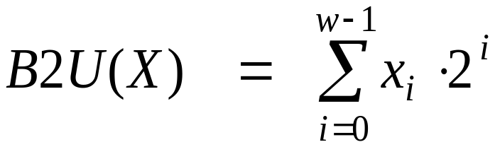
Unsigned Representation
Binary (physical)
  Bit vector [x_{w-1},x_{w-2},x_{w-3},…x₀]
Binary to Unsigned (logical)

Slide 28
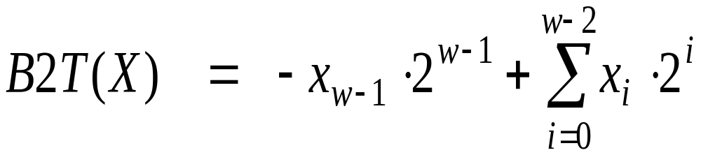
Two’s Complement
Binary (physical)
  Bit vector [x_{w-1},x_{w-2},x_{w-3},…x₀]
Binary to Signed (logical)
2’s complement
Sign
Bit

Slide 29
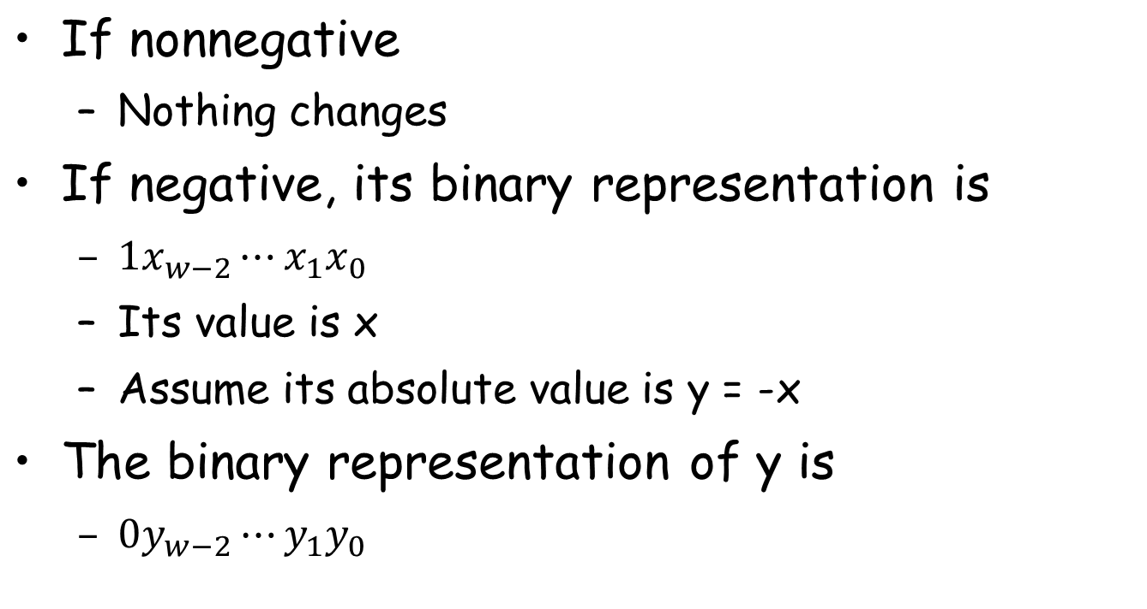
From Two’s Complement to Binary

Slide 30
Two’s Complement
Binary (physical)
  Bit vector [x_{w-1},x_{w-2},x_{w-3},…x₀]
Binary to Signed (logical)
2’s complement
Sign
Bit

Slide 31
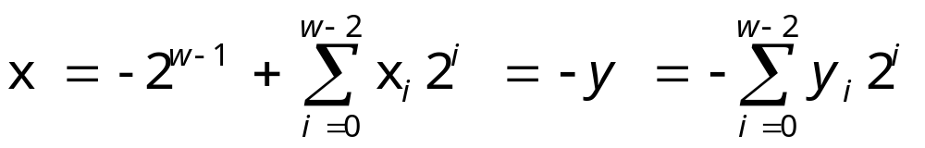
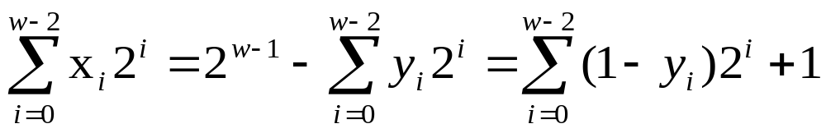
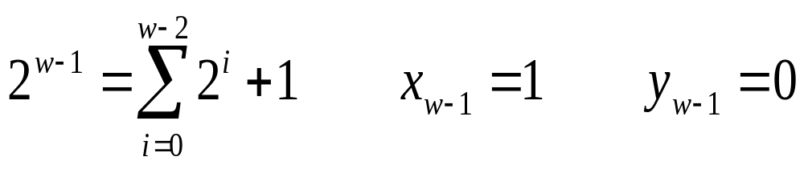
From Two’s Complement to Binary

Slide 32
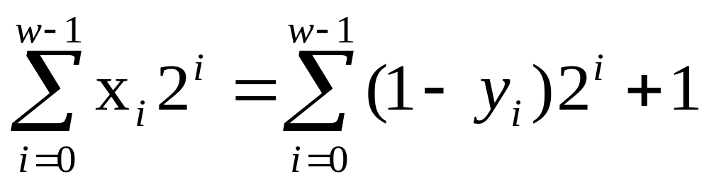
Two’s Complement
What does it mean?
  Computing the negation of x into binary with w-bits
  Complementing the result
  Adding 1

Slide 33
From a Number to Two’s Complement
-5
  5
  0101 (binary for 5)
  1010 (after complement)
  1011 (add 1)

Slide 34
Two’s Complement Encoding Examples
Binary/Hexadecimal Representation for -12345
Binary: 0011 0000 0011 1001 (12345)
Hex: 3 0 3 9
Binary: 1100 1111 1100 0110 (after complement)
Hex: C F C 6
Binary: 1100 1111 1100 0111 (add 1)
Hex: C F C 7

Slide 35
Numeric Range
Unsigned Values
  Umin=0
  Umax=2^{w}-1
Two’s Complement Values
  Tmin = -2^{w-1}
  Tmax = 2^{w-1}-1

Slide 36
Numeric Range
Relationship
  |TMin| = TMax + 1
  Umax = 2*TMax + 1
  -1 has the same bit representation as Umax,
    a string of all 1s
  Numeric value 0 is represented as
    a string of all 0s in both representations

Slide 37
Alternative representations of signed numbers
Ones’ Complement:
  The most significant bit has weight 2^{w-1}-1
Sign-Magnitude
  The most significant bit is a sign bit
    that determines whether the remaining bits should be given negative or positive weight

Slide 38
X
B2U(X)
B2T(X)
0000
0
0
0001
1
1
0010
2
2
0011
3
3
0100
4
4
0101
5
5
0110
6
6
0111
7
7
1000
8
–8
1001
9
–7
1010
10
–6
1011
11
–5
1100
12
–4
1101
13
–3
1110
14
–2
1111
15
–1

Slide 39
Mappings between logical and physical
Uniqueness
  Every bit pattern represents unique integer value
  Each representable integer has unique bit encoding

Slide 40
Mappings between logical and physical
Invert Mappings (from logical to physical)
  U2B(x) = B2U⁻¹(x)
    Bit pattern for unsigned integer
  T2B(x) = B2T⁻¹(x)
    Bit pattern for two’s comp integer

Slide 41
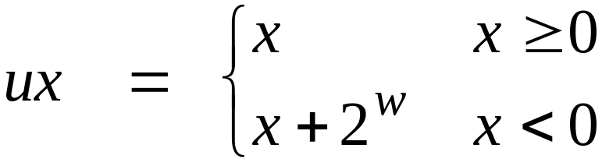
Relation Between 2’s Comp. & Unsigned
Two’s Complement
T2U
Unsigned
x
T2B
B2U
ux
X
Maintain Same Bit Pattern
w–1
0
ux
+
+
+
• • •
+
+
+
-
x
-
+
+
• • •
+
+
+
+2^{w–1} – –2^{w–1} = 2*2^{w–1} = 2^{w}

Slide 42
Conversion between two Representations
UMax
UMax – 1
TMax + 1
Unsigned
Range
TMax
TMax
2’s Comp.
Range
0
0
–1
–2
TMin

Slide 43
Casting among Integral Data Type

Slide 44
Outline
Conversions
  Signed vs. unsigned
  Long vs. short
Suggested reading
  Chap 2.2

Slide 45
Integral data type in C
Signed type (for integer numbers)
  char, short [int], int, long [int]
Unsigned type (for nonnegative numbers)
  unsigned char, unsigned short [int], unsigned [int], unsigned long [int]
Java has no unsigned data type
  Using byte to replace the char

Slide 46
Typical Ranges for C integral data types 32
C declaration | Typical 32-bit
 | minimum | maximum
char unsigned char | -128 0 | 127 255
short [int] unsigned short | -32,768 0 | 32,767 65,535
int unsigned [int] | -2,147,483,648 0 | 2,147,483,647 4,294,967,295
long [int] unsigned long | -2,147,483,648 0 | 2,147,483,647 4,294,967,295
int32_t uint32_t | -2,147,483,648 0 | 2,147,483,647 4,294,967,295
int64_t uint64_t | -9,223,372,036,854,775,800 0 | 9,223,372,036,854,775,800 18,446,744,073,709,551,615

Slide 47
Typical Ranges for C integral data types 64
C declaration | Typical 32-bit
 | minimum | maximum
char unsigned char | -128 0 | 127 255
short [int] unsigned short | -32,768 0 | 32,767 65,535
int unsigned [int] | -2,147,483,648 0 | 2,147,483,647 4,294,967,295
long [int] unsigned long | -9,223,372,036,854,775,800 0 | 9,223,372,036,854,775,800 18,446,744,073,709,551,615
int32_t uint32_t | -2,147,483,648 0 | 2,147,483,647 4,294,967,295
int64_t uint64_t | -9,223,372,036,854,775,800 0 | 9,223,372,036,854,775,800 18,446,744,073,709,551,615

Slide 48
Guaranteed Ranges for C integral data types
C declaration | Typical 32-bit
 | minimum | maximum
char unsigned char | -127 0 | 127 255
short [int] unsigned short | -32,767 0 | 32,767 65,535
int unsigned [int] | -32,767 0 | 32,767 65,535
long [int] unsigned long | -2,147,483,648 0 | 2,147,483,647 4,294,967,295
int32_t uint32_t | -2,147,483,648 0 | 2,147,483,647 4,294,967,295
int64_t uint64_t | -9,223,372,036,854,775,800 0 | 9,223,372,036,854,775,800 18,446,744,073,709,551,615

Slide 49
Casting among Signed and Unsigned in C
C Allows a variable of one type to be interpreted as other data type
  Type conversion (implicitly)
  Type casting (explicitly)

Slide 50
Signed vs. Unsigned in C
Casting
  Explicit casting between signed & unsigned
  same as U2T and T2U
    int tx, ty;
    unsigned ux, uy;
    tx = (int) ux;
    uy = (unsigned) ty;

Slide 51
Signed vs. Unsigned in C
Conversion
  Implicit casting also occurs via assignments and procedure calls
    int tx, ty;
    unsigned ux, uy;
    tx = ux;
    uy = ty;

Slide 52
Casting from Signed to Unsigned
short int x = 12345;
unsigned short int ux = (unsigned short) x;
short int y = -12345;
unsigned short int uy = (unsigned short) y;
Resulting Value
  No change in bit representation
  Nonnegative values unchanged
    ux = 12345
  Negative values change into (large) positive values
    uy = 53191

Slide 53
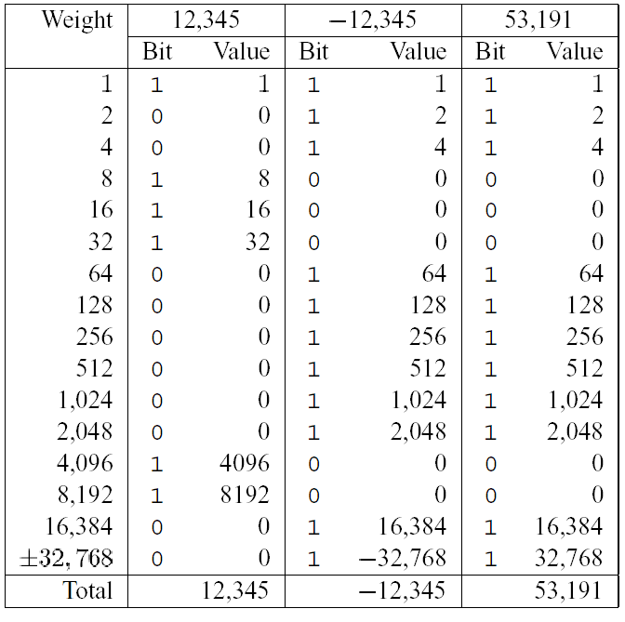
back

Slide 54
Unsigned Constants in C
By default
  constants are considered to be signed integers
Unsigned if have “U” as suffix
  0U, 4294967259U

Slide 55
Casting Convention
Expression Evaluation
  If mix unsigned and signed in single expression
    signed values implicitly cast to unsigned
  Including comparison operations <, >, ==, <=, >=
  Examples for W = 32

Slide 56
Casting Convention
Constant1 Constant2 Relation Evaluation
  0 0U == unsigned
  -1 0 < signed
  -1 0U > unsigned
  2147483647 -2147483648 > signed
  2147483647U -2147483648 < unsigned
  -1 -2 > signed
  (unsigned)-1 -2 > unsigned

Slide 57
From short to long
short int x = 12345;
int ix = (int) x;
short int y = -12345;
int iy = (int) y;
We need to expand the data size
Casting among unsigned types is normal
Casing among signed types is trick

Slide 58
Expanding the Bit Representation
Zero extension
  Add leading 0s to the representation
Sign extension
  [x_{w-1},x_{w-2},x_{w-3},…x₀]
w
X
• • •
X
-
• • •
• • •
X ′
X ′
• • •
• • •
-
+
• • •
w+1

Slide 59
From short to long
short int sx = 12345; ：0x0309
int x = (int) sx; : 0x00000309
short int sy =-12345;: 0xcfc7
int y = (int) sy; : 0xffffcfc7
usinged ux = sy; : 0xffffcfc7

Slide 60
From short to long
int fun1(unsigned word) {
return (int) ((word << 24) >> 24);
}
int fun2(unsigned word) {
return ((int) word << 24) >> 24;
}
w fun1(w) fun2(w)
0x00000076
0x87654321
0x000000C9
0xEDCBA987
Describe in words the useful computation each of these functions performs.
00000076 00000076
00000021 00000021
000000C9 FFFFFFC9
00000087 FFFFFF87

Slide 61
From long to short
int x = 53191;
short int sx = x;
int y = -12345;
Short int sy = y;
We need to truncate the data size
Casing from long to short is trick

Slide 62
Truncating Numbers
 | Decimal | Hex | Binary
x | 53191 | 00 00 CF C7 | 00000000 00000000 11001111 11000111
sx | -12345 | CF C7 | 11001111 11000111
y | -12345 | FF FF CF C7 | 11111111 11111111 11001111 11000111
sy | -12345 | CF C7 | 11001111 11000111
X ′
• • •
• • •
X
• • •

Slide 63
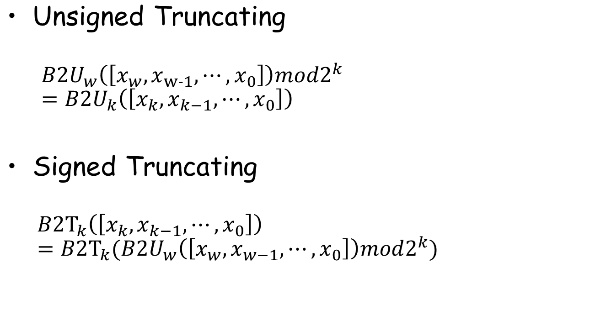
Truncating Numbers

Slide 64
Advice on Signed vs. Unsigned
Non-intuitive Features
float sum_elements ( float a[], unsigned length )
{
int i ;
for ( i = 0; i <= length – 1; i++)
result += a[i] ;
}

Slide 65
Advice on Signed vs. Unsigned
/* Prototype for library function strlen */
size_t strlen(const char *s); /*size_t is usigned */
/* Determine whether string s is longer than string t */
/* WARNING: This function is buggy */
int strlonger(char *s, char *t) {
return strlen(s) - strlen(t) > 0;
}

Slide 66
Advice on Signed vs. Unsigned
1 /*
2 * Illustration of code vulnerability similar to that found in
3 * FreeBSD’s implementation of getpeername()
4 */
5
6 /* Declaration of library function memcpy */
7 void *memcpy(void *dest, void *src, size_t n);
8

Slide 67
Advice on Signed vs. Unsigned
9 /* Kernel memory region holding user-accessible data */
10 #define KSIZE 1024
11 char kbuf[KSIZE];
12
13 /* Copy at most maxlen bytes from kernel region to user buffer */
14 int copy_from_kernel(void *user_dest, int maxlen) {
15 /* Byte count len is minimum of buffer size and maxlen */
16 int len = KSIZE < maxlen ? KSIZE : maxlen;
17 memcpy(user_dest, kbuf, len);
18 return len;
19 }
Invoking copy_from_kernel() with a negative maxlen

Slide 68
Advice on Signed vs. Unsigned
Collections of bits
  Bit vectors
  Masks
Addresses
Multiprecision Arithmetic
  Numbers are represented by arrays of words

