Slide 1
Exceptional Control Flow Ⅳ

Slide 2
Outline
Suggested reading Signals
  Signal Terminology
  Sending Signals
  Receiving Signals
  Blocking and Unblocking Signals
  Writing Signal Handlers
  Nasty Concurrency Bugs
  Explicitly waiting for signals
Suggested reading 8.5

Slide 3
Signals

Slide 4
Signals
Unix signal
  A higher-level software form of exception
  That allows processes and the kernel to interrupt other processes

Slide 5
The kill Program
Kill program
  is located in directory /bin/
  sends an arbitrary signal to another process
e.g. unix> kill -9 15213
  sends signal 9 (SIGKILL) to process 15213.

Slide 6
Signals Type
Signal is a message that notifies a process
  an event of some type has occurred in the system.
Each type corresponds to some kind of system event
  Low-level hardware exceptions
    are processed by the kernel’s exception handlers would not normally be visible to user processes.
    Signals provide a mechanism for exposing the occurrence of such exceptions to user processes.
  Higher-level software events
    in the kernel
    in other user processes

Slide 7
Hardware Events
SIGFPE signal (number 8)
  If a process attempts to divide by zero, then the kernel sends it a SIGFPE signal
SIGILL signal (number 4)
  If a process executes an illegal instruction, the kernel sends it a SIGILL signal.
SIGSEGV signal (number 11)
  If a process makes an illegal memory reference, the kernel sends it a SIGSEGV signal.

Slide 8
Software Events
SIGINT signal (number 2)
  While a process is running in the foreground
  if you type a ctrl-c
  then the kernel sends a SIGINT signal to the process
SIGKILL signal (number 9)
  A process can forcibly terminate another process
  by sending it a SIGKILL signal
SIGCHLD signal (number 17)
  When a child process terminates or stops,
  the kernel sends a SIGCHLD signal to the parent.

Slide 9
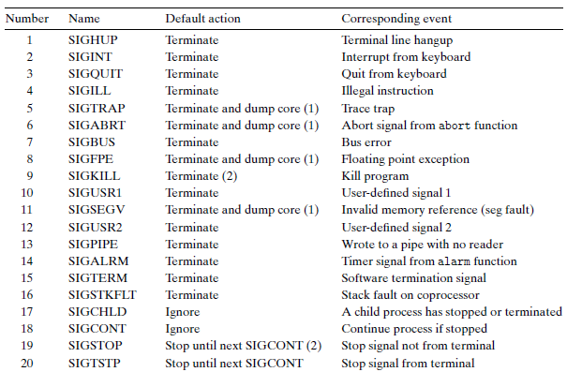
Linux Signals
> man signal

Slide 10
Signal Terminology
Two steps to transfer a signal to a destination process
  Sending a signal
  Receiving a signal

Slide 11
Sending a signal
The kernel
  sends (delivers) a signal to a destination process
    by updating some state in the context of the destination process.
The signal is delivered for one of two reasons
  The kernel has detected a system event
    Divide by zero, termination of a child process
  A process has invoked the kill function
    to explicitly request the kernel to send a signal to the destination process.
    A process can send a signal to itself.

Slide 12
Receiving a signal
A destination process receives a signal
  when it is forced by the kernel to react in some
  way to the delivery of the signal
The process can
  Ignore the signal
  Terminate
  Catch the signal
    by executing a user-level function called a signal handler

Slide 13
Pending Signal
Pending signal
  A signal that has been sent but not yet received
Only one
  At any point in time,
  there can be at most one pending signal of a particular type
Not queued
  If a process has a pending signal of type k
  then any subsequent signals of type k sent to that process are not queued
  they are simply discarded.
A pending signal is received at most once.

Slide 14
Blocking a Signal
A process can selectively block the receipt of certain signals.
When a signal is blocked
  it can be delivered
  but the resulting pending signal will not be received
  until the process unblocks the signal

Slide 15
Internal Data Structures
For each process, the kernel maintains
  the set of pending signals in the pending bit vector
  the set of blocked signals in the blocked bit vector
The kernel sets bit k in pending
  whenever a signal of type k is delivered
The kernel clears bit k in pending
  whenever a signal of type k is received.

Slide 16
Sending Signals

Slide 17
Process Groups
To send signals to processes
  Unix systems provide a number of mechanisms for sending signals to processes
  All of them rely on the notion of a process group
Every process belongs to exactly one process group
  which is identified by a positive integer (process group ID).
By default, a child process belongs to the same process group as its parent.

Slide 18
Process Groups
  #include <unistd.h>
  pid_t getpgrp(void);
  returns: process group ID of calling process
  #include <unistd.h>
  pid_t setpgid(pid_t pid, pid_t pgid);
  returns: 0 on success, -1 on error
Changes the process group of process pid to pgid
If pid is zero, the PID of the current process is used
If pgid is zero, the PID of the process specified by pid is used for the process group ID

Slide 19
setgpid Function
e.g. setpgid(0, 0);
  Suppose process 15213 is the calling process,
  then this function call
    creates a new process group whose process group ID is 15213
    adds process 15213 to this new group.

Slide 20
The kill Program
Kill program
  is located in directory /bin/
  sends an arbitrary signal to another process
e.g. unix> kill -9 15213
  sends signal 9 (SIGKILL) to process 15213.

Slide 21
The kill Program
Sending signals to process group by kill
  Using a negative PID
  Which causes the signal to be sent to every process in process group PID
e.g. unix> kill -9 -15213
  sends a SIGKILL signal to every process in process group 15213.

Slide 22
Sending Signals from the Keyboard
Job
  An abstraction used by Unix shells
  To represent the processes
    that are created as a result of evaluating a single cmdline
  At any point, there is at most one foreground job and zero or more background jobs
  e.g. unix> ls | sort
  a foreground job consisting of two processes connected by a pipe

Slide 23
Sending Signals from the Keyboard
The shell creates a separate process group for each job
  Typically, the process group ID is taken from one of the parent processes in the job

Slide 24
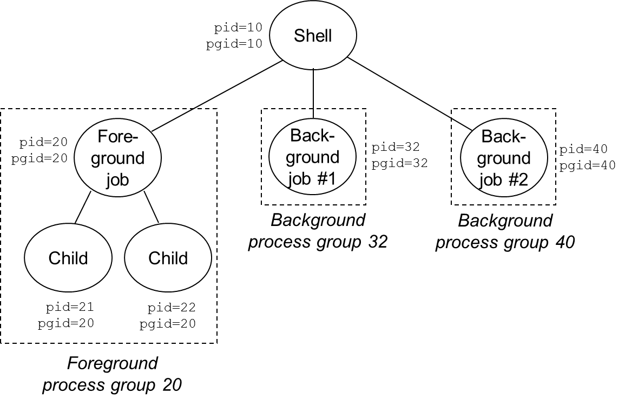
Sending Signals from the Keyboard

Slide 25
Sending Signals from the Keyboard
Typing ctrl-c at the keyboard
  causes a SIGINT signal to be sent to the shell
  The shell catches the signal
  Then sends a SIGINT to every process in the foreground process group
  The result is to terminate the foreground job (default)

Slide 26
Sending Signals from the Keyboard
Typing crtl-z
  sends a SIGTSTP signal to the shell
  The shell catches the signal
  Sends a SIGTSTP signal to every process in the foreground process group
  The result is to stop (suspend) the foreground job (default)

Slide 27
Sending Signals with kill Function
#include <sys/types.h> #include <signal.h> int kill(pid_t pid, int sig); returns: 0 if OK, -1 on error
If pid is greater than zero,
  then the kill function sends signal number sig to process pid
If pid is less than zero
  then kill sends signal sig to every process in process group abs(pid)

Slide 28
1 #include "csapp.h"
2
3 int main()
4 {
5 pid_t pid;
6
7 /* child sleeps until SIGKILL signal received */
8 if ((pid = Fork()) == 0) {
9 Pause(); /* wait for a signal to arrive */
10 printf("control should never reach here!\n");
11 exit(0);
12 }
13
14 /* parent sends a SIGKILL signal to a child */
15 Kill(pid, SIGKILL);
16 exit(0);
17 }

Slide 29
Sending Signals With the alarm Function
#include <unistd.h> unsigned int alarm(unsigned int secs); returns: remaining secs of previous alarm, or 0 if no previous alarm
Arranges for the kernel to send a SIGALRM signal to the calling process in secs seconds.
If secs is zero
  then no new alarm is scheduled.
The call to alarm
  cancels any pending alarms
  returns the number of seconds remaining until any pending alarm was due to be delivered
  returns 0 if there were no pending alarms.

Slide 30
Receiving Signals

Slide 31
Receiving a Signal
Preconditions
  When the kernel is returning from an exception handler
  and is ready to pass control to process p

Slide 32
Receiving a Signal
Actions
  kernel checks the set of unblocked pending signals (pending & ˜blocked)
  If this set is empty (the usual case)
    then the kernel passes control to the next instruction (I_{next})in the logical control flow of p.
  However, if the set is nonempty
    then the kernel chooses some signal k in the set (typically the smallest k)
    and forces p to receive signal k.

Slide 33
Receiving a Signal
The receipt of the signal triggers some action by the process.
Once the process completes the action, then control passes back to the next instruction (I_{next}) in the logical control flow of p.
(1) Signal received by process
(2) Control passes
to signal handler
I_{curr}
I_{next}
(3) Signal handler runs
(4) Signal handler
returns to
next instruction

Slide 34
Receiving a Signal
Each signal type has a predefined default action, which is one of the following:
  The process terminates.
  The process terminates and dumps core.
  The process stops until restarted by a SIGCONT signal.
  The process ignores the signal.

Slide 35
Receiving a Signal
SIGKILL
  The default action is to terminate the receiving process
SIGCHLD
  The default action is to ignore the signal.

Slide 36
Receiving a Signal
A process can modify the default action associated with a signal
  by using the signal function
  The only exceptions are SIGSTOP and SIGKILL, whose default actions cannot be changed.

Slide 37
Signal Function
#include <signal.h> typedef void handler_t(int) handler_t *signal(int signum, handler_t *handler) returns: ptr to previous handler if OK, SIG_ERR on error (does not set errno)
Three ways to change default actions:
  If handler is SIG_IGN, then signals of type signum are ignored.
  If handler is SIG_DFL, then the action for signals of type signum reverts to the default action.
  Otherwise, change action to handler (called signal handler)

Slide 38
Signal Function
Installing the handler
  Changing the default action by passing the address of a handler to the signal function
Catching the signal
  The invocation of the handler
Handling the signal
  The execution of the handler

Slide 39
1 #include "csapp.h"
2
3 void handler(int sig) /* SIGINT handler */
4 {
5 printf("Caught SIGINT\n");
6 exit(0);
7 }
8
9 int main()
10 {
11 /* Install the SIGINT handler */
12 if (signal(SIGINT, handler) == SIG_ERR)
13 unix_error("signal error");
14
15 pause(); /* wait for the receipt of a signal */
16
17 exit(0);
18 }

Slide 40
Signal Function
Handling the signal
  When a process catches a signal of type k,
  the handler installed for signal k is invoked
    with a single integer argument set to k.
  When the handler executes its return statement,
    control (usually) passes back to the instruction in the control flow
      where the process was interrupted by the receipt of the signal.
      in some systems, interrupted system calls return immediately with an error.

Slide 41
Signal Function
Normal program flow
Signal handler
return code on
the stack
do_signal()
handle_signal()
setup_frame()
system_call()
sys_sigreturn()
restore_sigcontext()

Slide 42
Signal Function
The same handler function can be used to catch different types of signals
  By setting different signal numbers as the argument to the signal handler

Slide 43
Blocking and Unblocking Signals

Slide 44
Signal Handlers can be interrupted
(1) Program catches signal s
(2) Control passes
to handler S
I_{curr}
(3) Program catches signal t
(4) Control passes
to handler T
I_{next}
(5) Handler T
returns to handler S
(7) Main program resumes
(6) Handler S
returns to main programm
s ≠ t

Slide 45
Blocking and Unblocking Signals
Implicit blocking mechanism
  Kernel blocks any pending signals of the type currently being processed by a handler
Explicit blocking mechanism
  sigprocmask function and its helpers

Slide 46
Blocking and Unblocking Signals
#include <signal.h> int sigprocmask(int how, const sigset_t *set, sigset_t *oldset) int sigemptyset(sigset_t *set) ; int sigfillset(sigset_t *set); int sigaddset(sigset_t *set, int signum); int sigdelset(sigset_t *set, int signum); Return: 0 if OK, -1 on error Int sigismember(const sigset_t *set, int signum); Returns: 1 if member, 0 if not, -1 on error

Slide 47
Explicitly Blocking Signals
sigprocmask
  Changes the set of currently blocked signals
  SIG_BLOCK: add the signals in set to blocked (blocked = blocked | set )
  SIG_UNBLOCK: Remove the signals in set from blocked (blocked = blocked & ~set)
  SIG_SETMASK: blocked = set
  If oldset is non-NULL, the previous value of the blocked bit vector is stored in oldset

Slide 48
Explicitly Blocking Signals
Signal set
  Set manipulations are provided by the rest of the functions
    sigemptyset
    sigfillset
    sigaddset
    sigdelset

Slide 49
Safe Signal Handling

Slide 50
Main Program and Signal Handlers are Concurrent
(1) Program catches signal s
(2) Control passes
to handler S
I_{curr}
(3) Program catches signal t
(4) Control passes
to handler T
I_{next}
(5) Handler T
returns to handler S
(7) Main program resumes
(6) Handler S
returns to main programm
s ≠ t

Slide 51
Concurrent Bugs
Concurrent bugs
  Tricky and subtle
  A program works correctly most the time
  When it fails, it fails in unpredictable and unrepeatable ways that are horrendously difficult to debug

Slide 52
Guidlines
G0 keep handlers as simple as possible
  Might simply set a global flag and return immediately
  all processing associated with the receipt of the signal is performed by the main program
    which periodically checks (and reset) the flag

Slide 53
Guidlines
G1 call only asyn-signal-safe functions in your handler
  Reentrant or cannot be interrupted
  printf, sprintf, malloc, exit are not safe

Slide 54
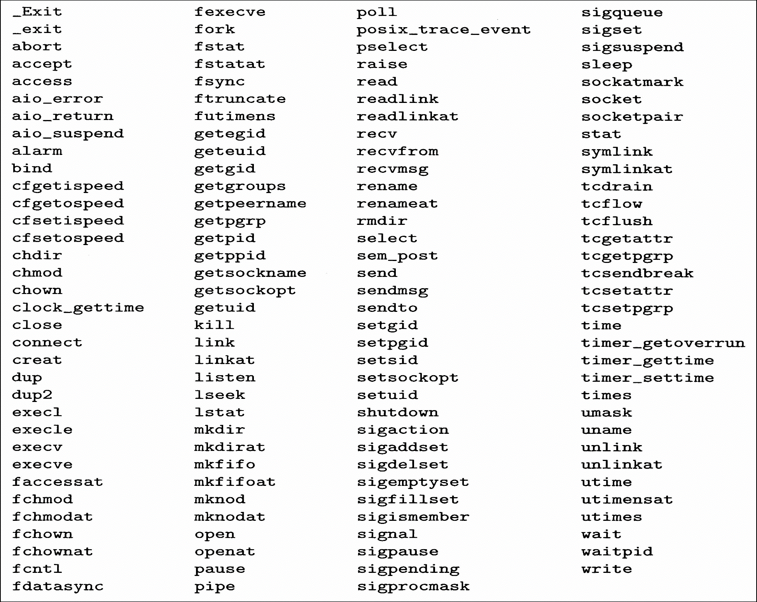
Guidlines

Slide 55
Safe I/O Package
#include <csapp.h> ssize_t sio_putl(long v); ssize_t sio_puts(char s[]); Returns: number of bytes transferred if OK, -1 on error void sio_error(long v); Returns: nothing
_exit is an asyn_signal_safe variant of exit

Slide 56
Safe I/O Package
ssize_t sio_puts(char s[]) /* Put string */
{
return write(STDOUT_FILENO, s, sio_strlen(s));
}
ssize_t sio_putl(long v) /* Put long */
{
char s[128];
sio_ltoa(v, s, 10); /* Based on K&R itoa() */
return sio_puts(s);
}
void sio_error(char s[]) /*Put error message and exit */
{
sio_puts(s);
_exit(1);
}

Slide 57
Guidlines
G2 Save and restore errno
  Many async_signal_safe functions set errno when they return with an error
  Calling such functions inside a handler might interfere with other parts of the program that rely on errno

Slide 58
Correct Signal Handling

Slide 59
14 int main()
15 {
16 int i, n; char buf[MAXBUF];
17 if (signal(SIGCHLD, handler1) == SIG_ERR)
18 unix_error("signal error");
19
20 /* parent creates children */
21 for (i = 0; i < 3; i++) {
22 if (Fork() == 0) {
23 printf("Hello from child %d\n", (int)getpid());
25 exit(0);
26 }
27 }
28 /* parent waits for term. input and then processes it */
29 if ((n = read(STDIN_FILENO, buf, sizeof(buf))) < 0)
30 unix_error("read");
31
32 printf("Parent processing input\n");
33 while (1) ;
34
35 exit(0);
36 }

Slide 60
1 #include "csapp.h"
2
3 void handler1(int sig)
4 {
5 int olderrno = errno;
6
7 if ((pid = waitpid(-1, NULL, 0)) < 0)
8 sio_error("waitpid error");
9 sio_puts("Handler reaped child %d\n");
sleep(1);
errno = olderrno ;
12 }
13

Slide 61
linux> ./signal1
Hello from child 14073
Hello from child 14074
Hello from child 14075
Handler reaped child
Handler reaped child
<cr>
Parent processing input
<ctrl-z>
Suspended
linux> ps t
PID TTY STAT TIME COMMAND
...
14072 pts/3 T 0:02 ./signal1
14075 pts/3 Z 0:00 [signal1] <defunct>
14076 pts/3 R 0:00 ps t

Slide 62
Signal Handling Issues
Pending signals can be blocked
  Unix signal handlers typically block pending signals of the type currently being processed by the handler
Pending signals are not queued
  There can be at most one pending signal of any particular type
  then the second same type of pending signal is simply discarded

Slide 63
1 void handler2(int sig)
2 {
3 int olderrno = errno;
4
5 while ((pid = waitpid(-1, NULL, 0)) > 0) {
6 sio_puts("Handler reaped child %d\n");
7 }
8 if (errno != ECHILD)
9 sio_error("waitpid error");
10 sleep(1);
11 errno = olderrno ;
12 }

Slide 64
linux> ./signal2
Hello from child 10378
Hello from child 10379
Hello from child 10380
Handler reaped child
Handler reaped child
Handler reaped child
<cr>
Parent processing input

Slide 65
Portable Signal Handling

Slide 66
Different Signal-handling Semantics
Slow system calls
  read, write, wait, accept
  can potentially block the process for a long period of time
Some older Unix systems
  restore the action for signal k to its default after signal k has been caught by a handler
  return to the user immediately after a slow system call is interrupted (do not return to slow system call itself)

Slide 67
solaris> ./signal2
Hello from child 18906
Hello from child 18907
Hello from child 18908
Handler reaped child
Handler reaped child
Handler reaped child
read: Interrupted system call

Slide 68
15 int main()
16 {
17 int i, n; char buf[MAXBUF];
18 if (signal(SIGCHLD, handler2) == SIG_ERR)
19 unix_error("signal error");
20
21 /* parent creates children */
22 for (i = 0; i < 3; i++) {
23 if (Fork() == 0) {
24 printf("Hello from child %d\n", (int)getpid());
25 Sleep(1);
26 exit(0);
27 }
28 }
29 /* Manually restart the read if it is interrupted */
30 while ((n = read(STDIN_FILENO, buf, sizeof(buf))) < 0)
31 if (errno != EINTR)
32 unix_error("read");
33
34 printf("Parent processing input\n");
35 while (1) ;
36 exit(0);
37 }

Slide 69
solaris> ./signal3
Hello from child 19571
Hello from child 19572
Hello from child 19573
Handler reaped child 19571
Handler reaped child 19572
Handler reaped child 19573
<cr>
Parent processing input

Slide 70
sigaction Function
#include <signal.h> int sigaction(int signum, struct sigaction *act, struct sigaction *oldact); returns: 0 if OK, -1 on error struct sigaction { void (*sa_handler)(); /* addr of signal handler, or SIG_IGN, or SIG_DFL */ sigset_t sa_mask; /* additional signals to block */ int sa_flags; /* signal options */ } ;

Slide 71
1 handler_t *Signal(int signum, handler_t *handler)
2 {
3 struct sigaction action, old_action;
4
5 action.sa_handler = handler;
/* block sigs of type being handled */
6 sigemptyset(&action.sa_mask);
/* restart syscalls if possible */
7 action.sa_flags = SA_RESTART;
8
9 if (sigaction(signum, &action, &old_action) < 0)
10 unix_error("Signal error");
11 return (old_action.sa_handler);
12 }

Slide 72
Signal Function
Only signals of the type currently being processed by the handler are blocked
As with all signal implementations, signals are not queued
Interrupted system calls are automatically restarted whenever possible
Once the signal handler is installed, it remains installed until Signal is called with a handler argument of either SIG_IGN or SIG_DEF

Slide 73
A Nasty Concurrency Bug

Slide 74
Nasty Concurrency Bugs
1 /* WARNING: This code is buggy */
2 void handler(int sig)
3 {
4 int olderrno = errno ;
5 pid_t pid ;
6
7 while ( (pid = waitpid(-1, NULL, 0) > 0)) > 0) { /*reap a zombie child */
8 deletejob(pid); /*delete the child from the job list*/
9 }
10 if (errno != ECHILD)
11 sio_error(“waitpid error”) ;
12 errno = olderrno ;
13 }

Slide 75
A Nasty Concurrency Bug
14 int main(int argc, char **argv)
15 {
16 int pid;
17
18 Signal(SIGCHLD, handler);
19 initjobs(); /* initialize the job list */
20
21 while(1) {
22 if ((pid = Fork()) == 0) { /*Child process */
23 Execve(“/bin/ls”, argv, NULL);
24 }
25 addjob(pid) ; /* Parent process adds the child to the job list */
26 }
27 exit(0)
28 }

Slide 76
Guidlines
G3 Protect accesses to shared global data structures by blocking all signals

Slide 77
A Nasty Concurrency Bug
19 int main(int argc, char **argv)
20 {
21 int pid;
sigset_t mask_all, prev_all ;
Sigfillset(&mask_all);
Signal(SIGCHLD, handler);
26 initjobs(); /* initialize the job list */
27
28 while(1) {
29 if ((pid = Fork()) == 0) { /*Child process */
30 Execve(“/bin/ls”, argv, NULL);
}
/* parent process */
32 Sigprocmask(SIG_BLOCK, &mask_all, &prev_all);
33 addjob(pid) ; /* Add the child to the job list */
34 Sigprocmask(SIG_SETMASK, &prev_all, NULL);
35 }
36 exit(0)
37 }

Slide 78
Nasty Concurrency Bugs
1 /* WARNING: This code is buggy */
2 void handler(int sig)
3 {
4 int olderrno = errno ;
5 sigsret_t mask_all, prev_all;
6 pid_t pid ;
7
8 Sigfillset(&mask_all) ;
/*reap a zombie child */
9 while ( (pid = waitpid(-1, NULL, 0) > 0)) > 0) {
10 SigProcmask(SIG_BLOCK, &mask_all, &prev_all);
11 deletejob(pid); /*delete the child from the job list*/
12 SigProcmask(SIG_SETMASK, &prev_all, NULL);
13 }
14 if (errno != ECHILD)
15 sio_error(“waitpid error”) ;
16 errno = olderrno ;
17 }

Slide 79
Nasty Concurrency Bugs
Incorrectly sequence of events
  Parent executes fork and kernel schedules the newly created child
  Child terminates and kernel delivers a SIGCHLD signal to parent
  Parent receives the SIGCHLD signal and runs the signal handler
  Signal handler calls deletejob
  Parent return from fork and calls addjob

Slide 80
A Nasty Concurrency Bug
18 int main(int argc, char **argv)
19 {
20 int pid;
21 sigset_t mask_all, mask_one, prev_one ;
22
23 Sigfillset(&mask_all);
24 Sigemptyset(&mask_one);
25 Sigaddset(&mask_one, SIGCHLD);
26 Signal(SIGCHLD, handler);
27 initjobs(); /* initialize the job list */
28
29 while(1) {
30 Sigprocmask(SIG_BLOCK, &mask_one, &prev_one)/*
31 if ((pid = Fork()) == 0) { /*Child process */
32 Sigprocmask(SIG_SETMASK, &prev_one, NULL);
33 Execve(“/bin/ls”, argv, NULL);
34 }
Block SIGCHLD
Unblock SIGCHLD

Slide 81
A Nasty Concurrency Bug
/* parent process */
35 Sigprocmask(SIG_BLOCK, &mask_all, NULL);
36 addjob(pid) ; /* Add the child to the job list */
37 Sigprocmask(SIG_SETMASK, &prev_one, NULL);
38 }
38 exit(0)
40 }

Slide 82
Explicitly Waiting for Signals

Slide 83
Guidlines
G4 Declare global variables with volatile
G5 Declare flags with sig_atomic_t
  atomic read/write is guaranteed among the main program and signal handlers
  Compound operations are not guaranteed to be atomic such as flag++ or flag+=10

Slide 84
A Nasty Concurrency Bug
1 #include "csapp.h"
2
3 volatile sig_atomic_t pid;
4
5 void sigchld_handler(int s)
6 {
7 int olderrno = errno;
8 pid = waitpid(-1, NULL, 0);
9 errno = olderrno;
10 }
11
12 void sigint_handler(int s)
13 {
14 }
15

Slide 85
A Nasty Concurrency Bug
16 int main(int argc, char **argv)
17 {
18 sigset_t mask, prev;
19
20 Signal(SIGCHLD, sigchld_handler);
21 Signal(SIGINT, sigint_handler);
22 Sigemptyset(&mask);
23 Sigaddset(&mask, SIGCHLD);
24
25 while (1) {
26 Sigprocmask(SIG_BLOCK, &mask, &prev); /* Block SIGCHLD */
27 if (Fork() == 0) /* Child */
28 exit(0);
29

Slide 86
A Nasty Concurrency Bug
30 /* Parent */
31 pid = 0;
32 Sigprocmask(SIG_SETMASK, &prev, NULL);/* Unblock SIGCHLD */
33
34 /* Wait for SIGCHLD to be received (wasteful) */
35 while (!pid)
36 ;
37
38 /* Do some work after receiving SIGCHLD */
39 printf(".");
40 }
41 exit(0);
42 }

Slide 87
Eliminate the Spin Loop
The spin loop is wasteful for CPU resources
inserting a pause in the body of the spin loop:
  while (!pid) /* Race! */
  pause();
Still need a loop because pause might be interrupted by the receipt of one or more SIGINT signals
This code has a serious race condition:
  if the SIGCHLD is received after the while test but before the pause
  the pause will sleep forever

Slide 88
Eliminate the Spin Loop
Replace the pause with sleep:
  while (!pid) /* Too slow! */
  sleep(1);
This code is too slow
  If the signal is received after the while and before the sleep
  the program must wait a (relatively) long time before it can check the loop termination condition again

Slide 89
Eliminate the Spin Loop
Using a higher-resolution sleep function such as nanosleep isn’t acceptable
  because there is no good rule for determining the sleep interval.
Make it too small
  the loop is too wasteful.
Make it too high
  the program is too slow.

Slide 90
signalsuspend Function
#include <signal.h> int sigsuspend(const sigset_t *mask); returns: −1
temporarily replaces the current blocked set with mask
suspends the process until the receipt of a signal whose action is either to run a handler or to terminate the process
If the action is to terminate, then the process terminates without returning from it.
If the action is to run a handler, then it returns after the handler returns, restoring the blocked set to its state when it was called.

Slide 91
Eliminate the Spin Loop
The sigsuspend function is equivalent to an atomic version of the following:
  1 sigprocmask(SIG_BLOCK, &mask, &prev);
  2 pause();
  3 sigprocmask(SIG_SETMASK, &prev, NULL);
The atomic (uninterruptible) property guarantees that
  the calls to sigprocmask (line 1) and pause (line 2) occur together, without being interrupted

Slide 92
A Nasty Concurrency Bug
1 #include "csapp.h"
2
3 volatile sig_atomic_t pid;
4
5 void sigchld_handler(int s)
6 {
7 int olderrno = errno;
8 pid = waitpid(-1, NULL, 0);
9 errno = olderrno;
10 }
11
12 void sigint_handler(int s)
13 {
14 }
15

Slide 93
A Nasty Concurrency Bug
16 int main(int argc, char **argv)
17 {
18 sigset_t mask, prev;
19
20 Signal(SIGCHLD, sigchld_handler);
21 Signal(SIGINT, sigint_handler);
22 Sigemptyset(&mask);
23 Sigaddset(&mask, SIGCHLD);
24
25 while (1) {
26 Sigprocmask(SIG_BLOCK, &mask, &prev); /* Block SIGCHLD */
27 if (Fork() == 0) /* Child */
28 exit(0);
29

Slide 94
A Nasty Concurrency Bug
30 /* Wait for SIGCHLD to be received */
31 pid = 0;
32 while (!pid)
33 sigsuspend(&prev);
34
35 /* Optionally unblock SIGCHLD */
36 Sigprocmask(SIG_SETMASK, &prev, NULL);
37
38 /* Do some work after receiving SIGCHLD */
39 printf(".");
40 }
41 exit(0);
42 }

