Slide 1
Example
For a 2-level 32-bit memory systems (10-10-12)
What is the skeleton of the page table for a process that has
  a code segment of 48K starting at address 0x1000000,
  a data segment of 600K starting at address 0x80000000
  and a stack segment of 64K starting at address 0xf0000000 and growing upward (towards higher addresses)?

Slide 2
Example
1 000 000
00 0000 0100 | 00 0000 0000 | 0000 0000 0000
80 000 000
10 0000 0000 | 00 0000 0000 | 0000 0000 0000
f0 000 000
11 1100 0000 | 00 0000 0000 | 0000 0000 0000
48K=4K*12, 600K=4K*150, 64K=4K*16
3ff
…
16
…
0
3ff
…
3c0
…
200
…
4
…
0
3ff
…
96
…
…
0
3ff
…
12
…
0

Slide 3
Linux organizes VM as a collection of “areas”
vm_area_struct
process virtual memory
task_struct
mm_struct
vm_end
mm
pgd
vm_start
vm_prot
mmap
vm_flags
shared libraries
vm_next
0x40000000
vm_flags
  shared with other processes or private to this process
vm_end
vm_start
data
vm_prot
vm_flags
0x0804a020
vm_next
text
vm_end
vm_start
0x08048000
vm_prot
vm_flags
vm_next
0

Slide 4
Shared Object
Shared Object
  An object which is mapped into an area of virtual memory of a process
  Any writes that the process makes to that area are visible to any other processes that have also mapped the shared object into their virtual memory
  The changes are also reflected in the original object on disk
Shared Area
  A virtual memory area that a shared object is mapped

Slide 5
Sharing a Shared Object
Process 1
virtual memory
Physical
memory
Process 2
virtual memory
Process 1 maps the shared object
Shared
object

Slide 6
Sharing a Shared Object
Process 1
virtual memory
Physical
memory
Process 2
virtual memory
Process 2 maps the shared object
Notice how the virtual addresses can be different
Shared
object

Slide 7
Exec() revisited
process-specific data
structures
(page tables,
task and mm structs
Kernal stack)
To run a new program p in the current process using exec():
  create new vm_area_structs
  and page tables for
  new areas.
    text, data, bss and stack area are private areas
    Shard libs are shared areas.
physical memory
same for each process
kernel code/data
kernel
VM
0xc0000000
demand-zero
%esp
stack
process
VM
Memory mapped region
for shared libraries
.data
.text
libc.so
brk
runtime heap (via malloc)
demand-zero
uninitialized data (.bss)
initialized data (.data)
.data
program text (.text)
.text
forbidden
p
0

Slide 8
Private object
Private Object
  As oppose to shared object
  Changes made to an area mapped to a private object are not visible to other processes
  Any writes that the process makes to the area are not reflected back to the object on disk.
Private Area
  Similar to shared area

Slide 9
User-level memory mapping
void *mmap(void *start, int len, int prot,
int flags, int fd, int offset)
Map len bytes starting at offset offset of the
file specified by file description fd, preferably at address start (usually 0 for don’t care).
  prot: MAP_READ, MAP_WRITE
  flags: MAP_PRIVATE, MAP_SHARED
Return a pointer to the mapped area

Slide 10
User-level memory mapping
void *mmap(void *start, int len,
int prot, int flags, int fd, int offset)
len bytes
start
len bytes
(or address
chosen by kernel)
offset
(bytes)
0
0
Process virtual memory
Disk file specified by
file descriptor fd

Slide 11
User-level memory mapping
Example: fast file copy
  Useful for applications like Web servers that need to quickly copy files.
  mmap allows file transfers without copying into user space.

Slide 12
mmap() example: fast file copy
/*
* mmapcopy - uses mmap to copy file fd to stdout
*/
void mmapcopy(int fd, int size)
{
char *bufp;
/* map the file to a new VM area */
bufp = mmap(0, size, PROT_READ,
MAP_PRIVATE, fd, 0);
/* write the VM area to stdout */
write(1, bufp, size);
return ;
}

Slide 13
mmap() example: fast file copy
int main(int argc, char **argv)
{
struct stat stat;
/* check for required command line argument */
if ( argc != 2 ) {
printf(“usage: %s <filename>\n”, argv[0]);
exit(0) ;
}
/* open the file and get its size*/
fd = open(argv[1], O_RDONLY, 0);
fstat(fd, &stat);
mmapcopy(fd, stat.st_size);
}

Slide 14
Example
下列程序运行在Pentium/Linux存储系统下
#define PAGE_SIZE 4 * 1024
int main(void) {
char *p = NULL;
int i;
A: p = mmap(0, 128 * PAGE_SIZE, PROT_READ |
PROT_WRITE, MAP_PRIVATE | MAP_ANON, 0, 0);
printf("buffer start: %p\n", p);
for(i = 0; i < BUF_SIZE; i += PAGE_SIZE)
p[i] = 1;
B: munmap(p, BUF_SIZE);
return;
}

Slide 15
Example
当程序到达标号A时，页表如下。块中的数字表示PDE/PTE的偏移值。函数printf的输出值是 “buffer start: 0xb7bdf000”。
请画出程序到达标号B时页表的形状。
  注意: 没有数字的白色块意味着空的PDE/PTE，填写了数字的白色块表示PDE/PTE被使用，黑色块表示连续多个PDE/PTEs被使用，灰色块表示一个有数据/代码的页）

Slide 16
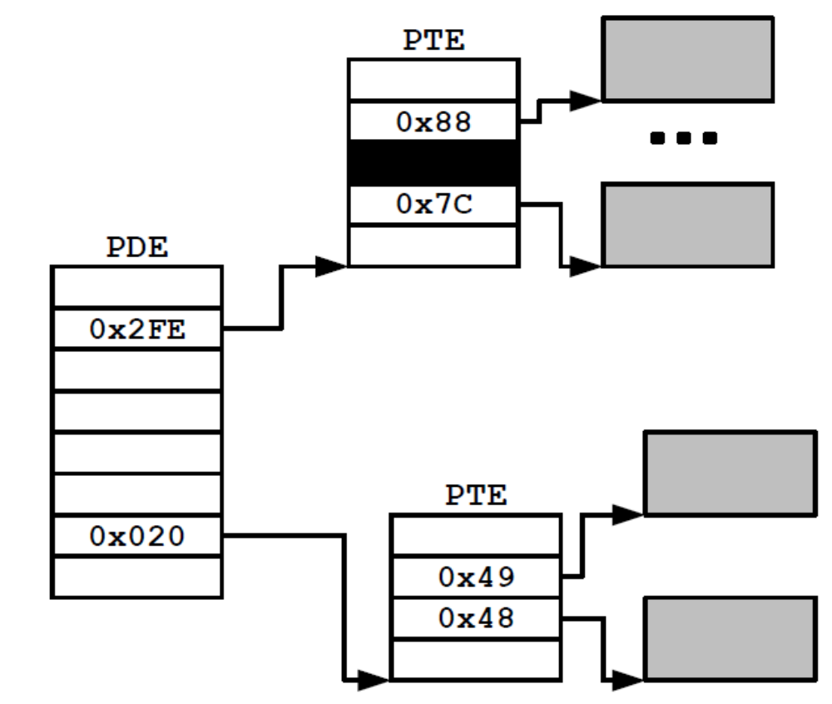
Example

Slide 17
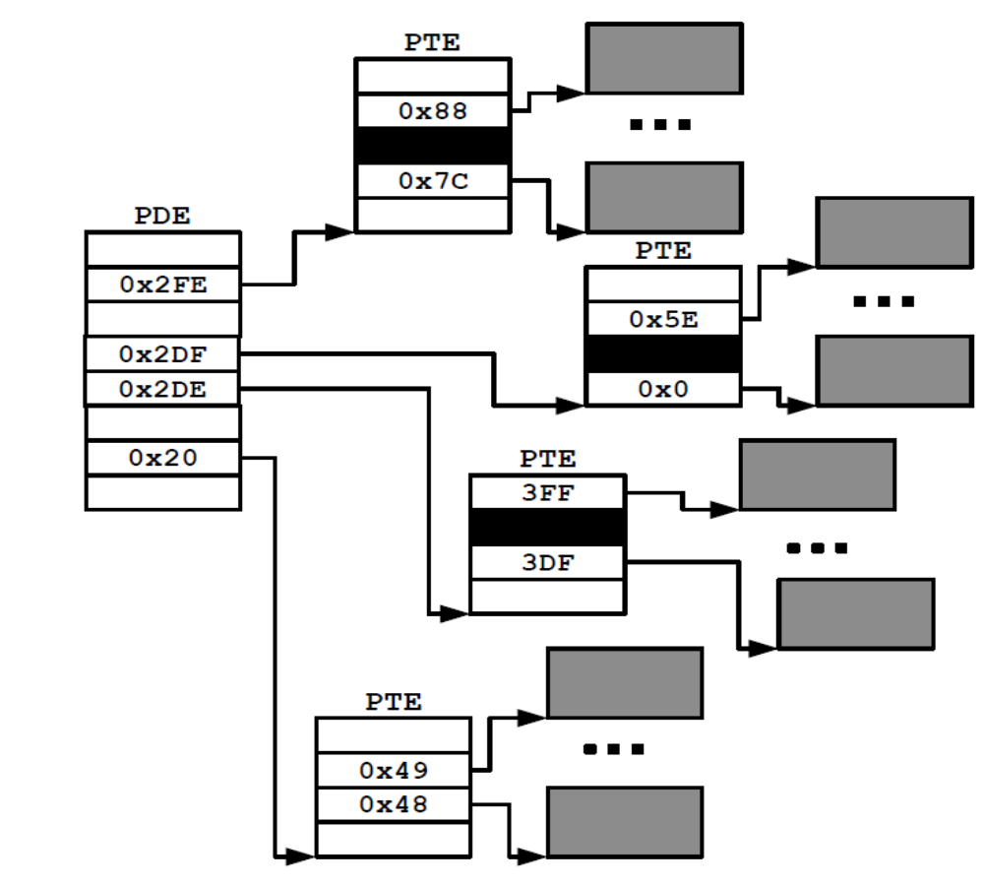
A sample from exam papers
b7bdf 1011 0111 10 11 1101 1111

Slide 18
Fork() revisted
To create a new process using fork:
  make copies of the old process’s mm_struct, vm_area_struct, and page tables
    Two processes are sharing all of their pages
    (At this point)
    How to get separate spaces without copying all the virtual pages from one space to another?
      “Copy On Write” (COW) technique.

Slide 19
Copy-on-Write
For each process that maps the private object
  The page table entries for the corresponding private area are flagged as read-only
  The area struct is flagged as private copy-on-write
  So long as neither process attempts to write to its respective private area, they continue to share a single copy of the object in physical memory.

Slide 20
Sharing a Private COW Object
Process 1
virtual memory
Physical
memory
Process 2
virtual memory
Private
copy-on-write
area
Private
copy-on-write object

Slide 21
Copy-on-Write
For each process that maps the private object
  As soon as a process attempts to write to some page in the private area, the write triggers a protection fault
  The fault handler notices that the protection exception was caused by the process trying to write to a page in a private copy-on-write area

Slide 22
Copy-on-Write
For each process that maps the private object
  The fault handler
    Creates a new copy of the page in physical memory
    Updates the page table entry to point to the new copy
    Restores write permissions to the page

Slide 23
Sharing Revisited: Private COW Objects
Process 1
virtual memory
Physical
memory
Process 2
virtual memory
Copy-on-write
Write to private
copy-on-write
page
Private
copy-on-write object

Slide 24
Sharing Revisited: Private COW Objects
Process 1
virtual memory
Physical
memory
Process 2
virtual memory
Copy-on-write
Write to private
copy-on-write
page
Private
copy-on-write object

Slide 25
Sharing Revisited: Private COW Objects
Process 1
virtual memory
Physical
memory
Process 2
virtual memory
Copy-on-write
Write to private
copy-on-write
page
Private
copy-on-write object

Slide 26
Fork() revisted
To create a new process using fork:
  Net result:
    copies are deferred until absolutely necessary
    (i.e., when one of the processes tries to modify a shared page).

Slide 27
Core i7 Summery
Core i7
  The 64-bit Nehalem microarchitecture
  Current support 48-bit (256 TB) virtual address space and 52-bit (4 PB) physical address space
  Compatibility mode support 32-bit (4 GB) virtual and physical address spaces

Slide 28
Core i7 Memory System
Registers
Instruction fetch
MMU
(addr translation)
L1 d-cache 32 KB,8-way
L1 i-cache
32 KB,8-way
L1 d-TLB
64 entries, 4-way
L1 i-TLB
128 entries, 4-way
Processor package
L2 unified TLB
512 entries, 4-way
L2 unified cache
256 KB, 8-way
QuickPath interconnect
To other
cores
To I/O
bridge
L3 unified cache
8 MB, 16-way
(shared by all cores)
DDR3 memory controller
(shared by all cores)
Main memory

Slide 29
Review of Address Translation
Basic Parameters
  N = 2^{n} = Virtual address limit
  M = 2^{m} = Physical address limit
  P = 2^{p} = page size (bytes).
Components of the virtual address (VA)
  VPO: Virtual page offset
  VPN: Virtual page number
Components of the physical address (PA)
  PPO: Physical page offset (same as VPO)
  PPN: Physical page number

Slide 30
Review of Address Translation
n–1
p
p–1
0
virtual page number
page offset
virtual address
TLB tag
TLB index
address translation
m–1
p
p–1
0
physical page number
page offset
physical address
Cache tag
Cache index
Cache offset

Slide 31
Review of Address Translation
Components of the virtual address (VA)
  VPO: Virtual page offset
  VPN: Virtual page number
  TLBI: TLB index
  TLBT: TLB tag
Components of the physical address (PA)
  PPO: Physical page offset (same as VPO)
  PPN: Physical page number
  CO: Byte offset within cache line
  CI: Cache index
  CT: Cache tag

Slide 32
Core i7 Address Translation
CPU
32/64
L2, L3, and
main memory
result
Virtual address (VA)
36
12
VPN
VPO
L1 hit
L1 miss
32
4
TLBT
TLBI
L1 d-cache
(64 sets, 8 lines/set)
TLB
hit
TLBmiss
...
...
L1 TLB (16 sets, 4 entries/set)
9
9
9
9
VPN1
VPN2
VPN3
VPN4
40
12
40
6
6
PPN
PPO
CT
CI
CO
CR3
physical
address
(PA)
PTE
PTE
PTE
PTE
Page Tables

Slide 33
Level 1, Level 2 and Level 3 Page Table Entry
63
62
52
51
12
11
9
8
7
6
5
4
3
2
1
0
XD
Unused
Page table physical base addr
Unused
G
PS
A
CD
WT
U/S
R/W
P=1
Available for OS (page table location in secondary storage)
P=0
XD Disable or enable instruction fetches
Base addr 40 most significant bits of base address of child page
table (forces page tables to be 4KB aligned)
G global page (don’t evict from TLB on task switch)
PS Page size either 4K or 2M or 1G(may set to 1 only for
Level 2 or level 3 PTEs)
A Reference bit (set by MMU on reads and writes, cleared
by software)
CD Cache disabled(1) or enabled(0) for child page table
WT Write-through or write-back cache policy
U/S User or supervisor(kernel) mode access permission
R/W Read-only or read-write access permissiom
P Child page table present in memory(1) or not(0)

Slide 34
Level 4 Page Table Entry
63
62
52
51
12
11
9
8
7
6
5
4
3
2
1
0
XD
Unused
Page table physical base addr
Unused
G
D
A
CD
WT
U/S
R/W
P=1
Available for OS (page table location in secondary storage)
P=0
XD Disable or enable instruction fetches
Base addr 40 most significant bits of base address of child page
table (forces page tables to be 4KB aligned)
G global page (don’t evict from TLB on task switch)
D Dirty bit (Set by MMU on writes, cleared by software)
A Reference bit (set by MMU on reads and writes, cleared
by software)
CD Cache disabled(1) or enabled(0) for child page table
WT Write-through or write-back cache policy
U/S User or supervisor(kernel) mode access permission
R/W Read-only or read-write access permissiom
P Child page table present in memory(1) or not(0)

Slide 35
Page tables Translation (4K)
9
9
9
9
12
VPN 1
VPN 2
VPN 3
VPN 4
VPO
L1 PT
Page global
directory
L2 PT
Page upper
directory
L3 PT
Page middle
directory
L4 PT
Page
directory
Virtual address
9
9
9
9
CR3
Physical
address
of L1 PT
40
40
40
40
Offset into
physical and
virtual page
L1 PTE
L1 PTE
L1 PTE
L1 PTE
physical
address
of page
12
512 GB
region
per entry
1 GB
region
per entry
2 MB
region
per entry
4 KB
region
per entry
40
40
12
Physical address
PPO
PPO

Slide 36
Cute Trick for Speeding Up L1 Access
CT
Tag Check
36
6
6
Physical
address
(PA)
CT
CI
CO
PPN
PPO
Address
Translation
No
Change
Virtual
address
(VA)
CI
VPN
VPO
L1 Cache
Observation
  Bits that determine CI identical in virtual and physical address
  Can index into cache while address translation taking place
  Generally we hit in TLB, so PPN bits (CT bits) available next
  “Virtually indexed, physically tagged”
  Cache carefully sized to make this possible
36
12

Slide 37
Page tables Translation (2M)
9
9
9
21
VPN 1
VPN 2
VPN 3
VPO
VPO
L1 PT
Page global
directory
L2 PT
Page upper
directory
L3 PT
Page middle
directory
L4 PT
Page
directory
Virtual address
9
9
9
CR3
Physical
address
of L1 PT
40
40
40
Offset into
physical and
virtual page
31
L1 PTE
L1 PTE
L1 PTE
physical
address
of page
21
512 GB
region
per entry
1 GB
region
per entry
2 MB
region
per entry
31
31
21
Physical address
PPO
PPO
PPO

Slide 38
Garbage Collect

Slide 39
Implicit Memory Management
Garbage collection
  automatic reclamation of heap-allocated storage
  application never has to free
void foo() {
int *p = malloc(128);
return; /* p block is now garbage */
}

Slide 40
Garbage Collection
Common in many dynamic languages:
  Python, Ruby, Java, Perl, ML, Lisp, Mathematica
“conservative” garbage collectors
  Variants
  Exist for C and C++
  However, cannot necessarily collect all garbage

Slide 41
Garbage Collection
How does the memory manager know when memory can be freed?
  In general we cannot know what is going to be used in the future since it depends on conditionals
  But we can tell that certain blocks cannot be used if there are no pointers to them

Slide 42
Garbage Collection
Must make certain assumptions about pointers
  Memory manager can distinguish pointers from non-pointers
  All pointers point to the start of a block
  Cannot hide pointers
  (e.g., by coercing them to an int, and then back again)

Slide 43
Example
typedef struct list_{
struct list_ *link;
int key;
} *list ;
typedef struct tree_ {
int key;
struct tree_ *left;
struct tree_ *right;
} *tree;
tree maketree( ) ;
void showtree( ) ;

Slide 44
Example
void func( )
{
list x = malloc(sizeof(struct list_));
list y = malloc(sizeof(struct list_));
x->link = y ; x->key = 7;
y->link = x; y->key = 9;
}
Garbage
after func
●
7
●
9

Slide 45
Example
12
●
●
main( )
{
tree p, r ;
int q;
func();
p = maketree();
r = p.right;
q = r.key;
showtree(r); /* garbage collection here */
}
15
●
●
p
q
r
37
●
7
37
●
●
59
●
●
●
9
20
●
●

Slide 46
Memory as a Graph
12
●
●
We view memory as a directed graph
  Each block is a node in the graph
  Each pointer is an edge in the graph
  Locations not in the heap that contain pointers into the heap are called root nodes (e.g. local and global variables)
15
●
●
p
q
r
37
37
●
●
●
7
59
●
●
●
9
20
●
●

Slide 47
Memory as a Graph
Root nodes
Heap nodes
reachable
Not-reachable
(garbage)
A node (block) is reachable if there is a path from any root to that node.
Non-reachable nodes are garbage (cannot be needed by the application)

Slide 48
Mark and Sweep Collecting
Can build on top of malloc/free package
  Allocate using malloc until you “run out of space”
When out of space:
  Use extra mark bit in the head of each block
  Mark: Start at roots and set mark bit on each reachable block
  Sweep: Scan all blocks and free blocks that are not marked

Slide 49
Mark and Sweep Collecting
root
Note: arrows here denote memory refs, not free list ptrs.
Before mark
After mark
Mark bit set
After sweep
free
free

Slide 50
Assumptions For a Simple Implementation
Application
  new(n): returns pointer to new block with all locations cleared
  read(b,i): read location i of block b into register
  write(b,i,v): write v into location i of block b
Each block will have a header word
  addressed as b[-1], for a block b
  Used for different purposes in different collectors

Slide 51
Assumptions For a Simple Implementation
Instructions used by the Garbage Collector
  is_ptr(p): determines whether p is a pointer
  length(b): returns the length of block b, not including the header
  get_roots(): returns all the roots

Slide 52
Mark and Sweep (cont.)
Mark using depth-first traversal of the memory graph
ptr mark(ptr p)
{
if (!is_ptr(p)) return; // do nothing if not pointer
if (markBitSet(p)) return; // check if already marked
setMarkBit(p); // set the mark bit
for (i=0; i < length(p); i++) // call mark on all words
mark(p[i]); // in the block
return;
}

Slide 53
Mark and Sweep (cont.)
Sweep using lengths to find next block
ptr sweep(ptr p, ptr end)
{
while (p < end) {
if markBitSet(p)
clearMarkBit();
else if (allocateBitSet(p))
free(p);
p += length(p);
}

Slide 54
New Textbooks
Operating Systems: Three Easy Pieces
http://pages.cs.wisc.edu/~remzi/OSTEP/

