Slide 1
Process Scheduling

Slide 2
Outline
Proportional-Share Scheduler
Suggested reading: 9

Slide 3
Proportional-Share Scheduler
A scheduler might try to guarantee that each job obtain a certain percentage of CPU time
  Fair-share
Lottery Scheduling
  every so often, hold a lottery to determine which process should get to run next;
  processes that should run more often should be given more chances to win the lottery

Slide 4
Tickets Represent Your Share
Tickets
  represent the share of a resource that a process (or user or whatever) should receive
The percent of tickets that a process has
  represents its share of the system resource in question
An example
  two processes, A and B
  A has 75 tickets while B has only 25
  what we would like is for
    A to receive 75% of the CPU
    and B the remaining 25%

Slide 5
Lottery Scheduler
Lottery scheduling achieves this probabilistically
  not deterministically
  by holding a lottery every so often
    say, every time slice
Holding a lottery is straightforward:
  the scheduler must know how many total tickets there are
    in the above example, there are 100
  The scheduler then picks a winning ticket
    which is a number from 0 to 99 in the above example

Slide 6
Example
Assuming
  A holds tickets 0 through 74 and B 75 through 99
The winning ticket simply determines whether A or B runs.
  The scheduler then loads the state of that winning process and runs it
Here is an example output of a lottery scheduler’s winning tickets
Here is the resulting schedule
the longer these two jobs compete, the more likely they are to achieve the desired percentages

Slide 7
Ticket Currency
Currency allows a user with a set of tickets
  to allocate tickets among their own jobs in whatever currency they would like
  the system then automatically converts said currency into the correct global value
Example
  users A and B have each been given 100 tickets
  User A is running two jobs, A1 and A2, and gives them each 500 tickets (out of 1000 total) in User A’s own currency
  User B is running only 1 job and gives it 10 tickets (out of 10 total)

Slide 8
Ticket Transfer
A process can temporarily hand off its tickets to another process
In a client/server setting
  a client sends a message to a server asking it to do some work on the client’s behalf
  the client can pass the tickets to the server and thus try to maximize the performance of the server while the server is handling the client’s request
  When finished, the server then transfers the tickets back to the client and all is as before

Slide 9
Ticket Inflation
A process can temporarily raise or lower the number of tickets it owns
Make little sense in a competitive scenario with processes that do not trust one another
Can be applied in an environment where a group of processes trust one another
  A process knows it needs more CPU time
  it can boost its ticket value as a way to reflect that need to the system,
  all without communicating with any other processes

Slide 10
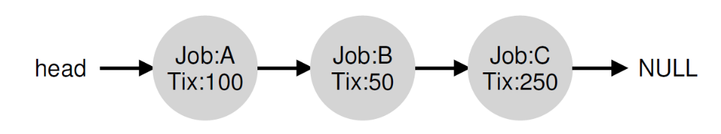
Lottery Implementation
Simple
  a good random number generator to pick the winning ticket
  a data structure to track the processes of the system (e.g., a list),
  the total number of tickets
Example
  Pick the number 300

Slide 11
1 // counter: used to track if we’ve found the winner yet
2 int counter = 0;
3
4 // winner: use some call to a random number generator to
5 // get a value, between 0 and the total # of tickets
6 int winner = getrandom(0, totaltickets);
7
8 // current: use this to walk through the list of jobs
9 node_t *current = head;
10
11 // loop until the sum of ticket values is > the winner
12 while (current) {
13 counter = counter + current->tickets;
14 if (counter > winner)
15 break; // found the winner
16 current = current->next;
17 }
18 // ’current’ is the winner: schedule it...

Slide 12
Lottery Implementation
It might generally be best to organize the list in sorted order
  from the highest number of tickets to the lowest
  the ordering does not affect the correctness of the algorithm
  it does ensure in general that the fewest number of list iterations are taken,
    especially if there are a few processes that possess most of the tickets

Slide 13
Fairness Study
Example
  two jobs competing against one another
  each with the same number of tickets (100)
  each with same run time R which we will vary
unfairness metric U
  the time the first job completes
  divided by
  the time the second job completes
  If R = 10, and the first job finishes at time 10 and the second job at 20
    U =10/20= 0.5
  When both jobs finish at nearly the same time, U will be quite close to 1 (our goal)

Slide 14
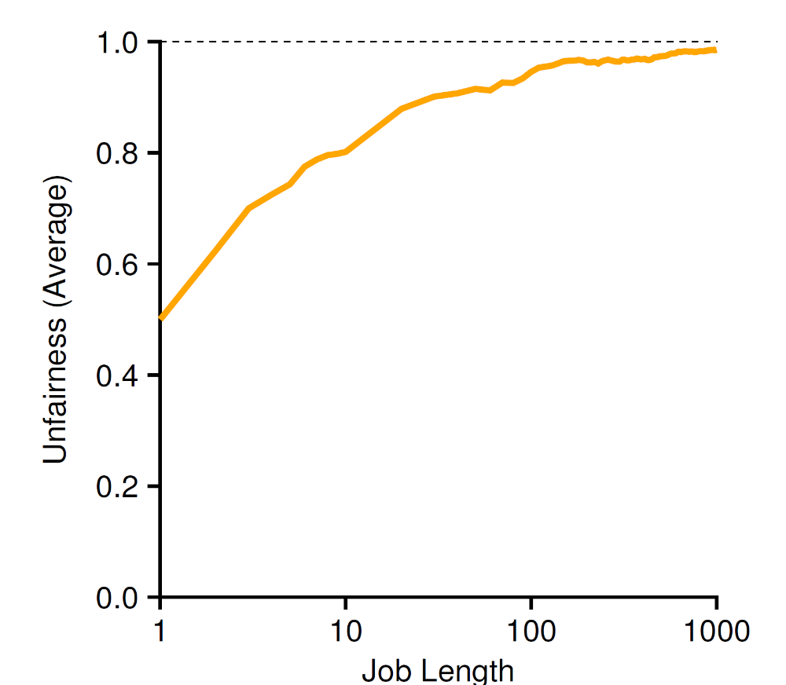
Fairness Study

Slide 15
Fairness Study
the average unfairness as the length of the two jobs
  R is varied from 1 to 1000 over thirty trials
When the job length is not very long,
  average unfairness can be quite severe
As the jobs run for a significant number of time slices
  the lottery scheduler approaches the desired outcome

Slide 16
How To Assign Tickets?
This problem is a tough one
One approach is to assume that the users know best
  each user is handed some number of tickets
  a user can allocate tickets to any jobs they run as desired
Given a set of jobs,
  the “ticket-assignment problem” remains open

Slide 17
Stride Scheduling
a deterministic fair-share scheduler
Each job in the system has a stride
  inverse in proportion to the number of tickets it has
Tickets number of jobs A, B, and C
  100, 50, and 250
Stride values for A, B, and C
  100, 200, and 40
  by 10,000

Slide 18
Stride Scheduling
Pass value
  Each job has a counter initialized as 0
  It is increased by its stride, every time the job runs
The scheduler uses the stride and pass to schedule processes
  pick the process to run that has the lowest pass value so far
Pseudo code
  current = remove_min(queue); // pick client with minimum pass
  schedule(current); // use resource for quantum
  current->pass += current->stride; // compute next pass using stride
  insert(queue, current); // put back into the queue

Slide 19
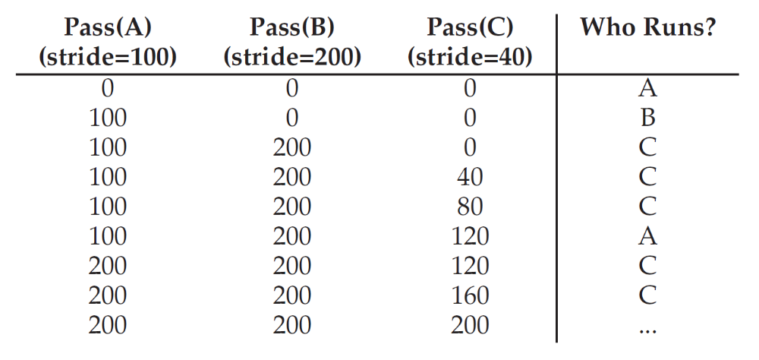
Stride Scheduling
Deterministic as desired

Slide 20
Why Use Lottery Scheduling
No global state!
What should the pass value will be
  when a new job enters in the middle of our stride scheduling example above
Lottery makes it much easier to incorporate new processes in a sensible manner

Slide 21
Multiprocessor Scheduler

Slide 22
Outline
Multiprocessor(Multicore) Scheduler
Suggested reading: 10

Slide 23
Multiprocessor(Multicore) Scheduling
New issues
  Cache Coherence
  Synchronization
  Cache Affinity

Slide 24
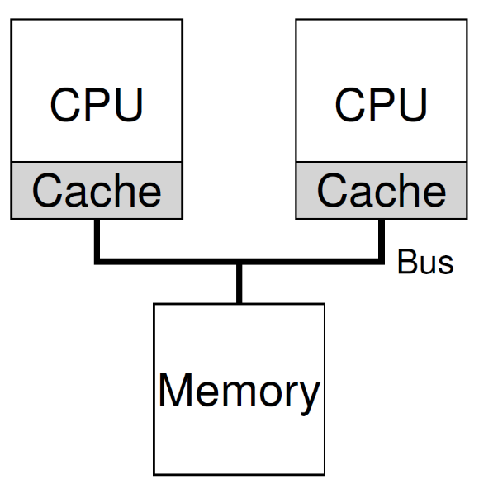
Cache Coherence
CPU1
  Read the data D from address A
  Copied D to its cache
  Updated D to D’ in its cache
CPU2
  Read the data from address A
  The data should be D’
  However the value in the memory with the address A is still D (write back policy)

Slide 25
Cache Coherence
Bus snooping
  Monitoring memory access
  Each cache pays attention to memory updates by observing the bus
  It will notice the change
  Either invalidate its copy or updates it
The basic idea applies to the write back cache also

Slide 26
Synchronization
1 typedef struct __Node_t {
2 int value;
3 struct __Node_t *next;
4 } Node_t;
5
6 int List_Pop() {
7 Node_t *tmp = head; // remember old head ...
8 int value = head->value; // ... and its value
9 head = head->next; // advance head to next pointer
10 free(tmp); // free old head
11 return value; // return value at head
12 }

Slide 27
Synchronization
Threads on two CPUs enter this routine at the same time
  Thread 1 executes the first line
    it will have the current value of head stored in its private tmp variable
  Thread 2 then executes the first line as well
    it also will have the same value of head stored in its own private tmp variable
Instead of each thread removing an element from the head of the list,
  each thread will try to remove the same head element
  leading to all sorts of problems
    double free, returning the same data value twice

Slide 28
Cache Affinity
A process, when run on a particular CPU,
  builds up a fair bit of state in the caches (and TLBs) of the CPU
The next time the process runs,
  it is often advantageous to run it on the same CPU,
  as it will run faster if some of its state is already present in the caches on that CPU
If the process runs on a different CPU
  the performance of the process will be worse
  as it will have to reload the state each time it runs

Slide 29
Single-Queue Scheduling
single-queue multiprocessor scheduling
  SQMS for short
  put all jobs that need to be scheduled into a single queue
Pro (simplicity)
  do not require much work to
    take an existing policy that picks the best job to run next
    adapt it to work on more than one CPU
      where it might pick the best two jobs to run if there are two CPUs, for example

Slide 30
Single-Queue Scheduling
CON
  Poor scalability
    Must use lock to ensure the correctness
    Lock increases contention when number of cores grows
      More and more time must spend on lock acquiring
  Not cache affinity

Slide 31
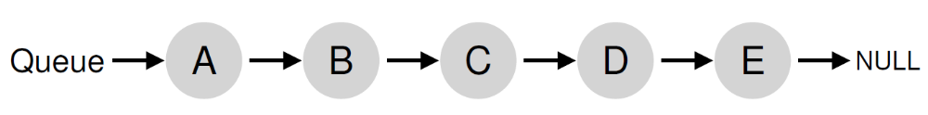
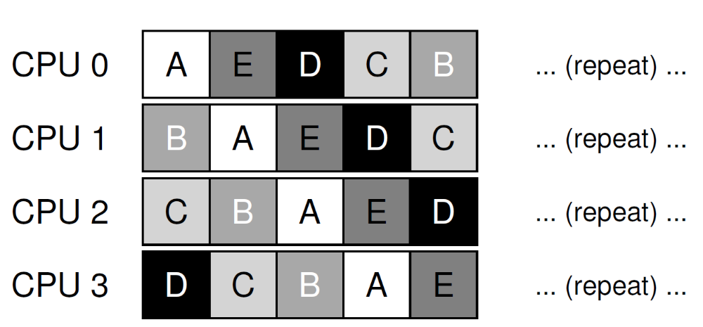
Not Cache Affinity
Example

Slide 32
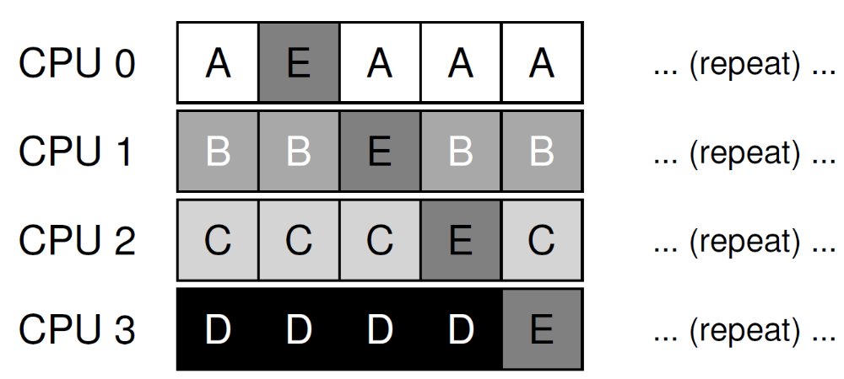
Cache Affinity
Try an affinity mechanism
  to make it more likely that
  process will continue to run on the same CPU if possible
  Implementing such a scheme can be complex

Slide 33
Multi-Queue Scheduling
multi-queue multiprocessor scheduling (MQMS)
  Using multiple queues(e.g., one per CPU)
  Each queue follows a particular scheduling discipline
  Each job is placed on exactly one scheduling queue
    according to some heuristic
      Random
      Picking one with fewer jobs than others
  Each queue is scheduled essentially independently
    avoid the synchronization problem

Slide 34
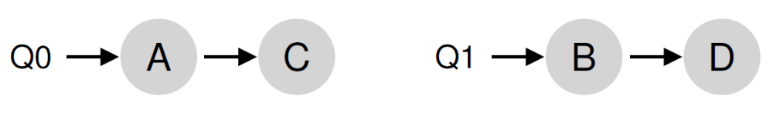
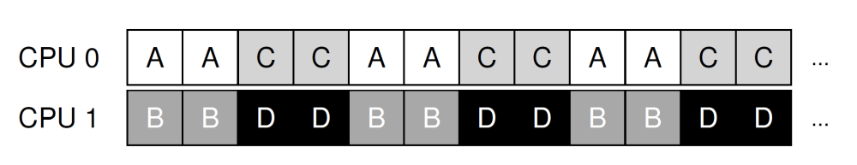
Example
There are two CPUs (labeled CPU0 and CPU1)
  Each queue uses round-robin policy

Slide 35
Multi-Queue Scheduling
Pros
  It should be inherently more scalable
    As the number of CPUs grows
      so too does the number of queues
      lock and cache contention should not become a central problem
  It intrinsically provides cache affinity
    jobs stay on the same CPU
    thus reap the advantage of reusing cached contents therein

Slide 36
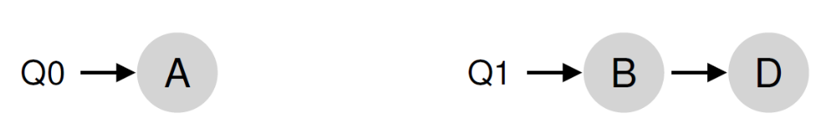
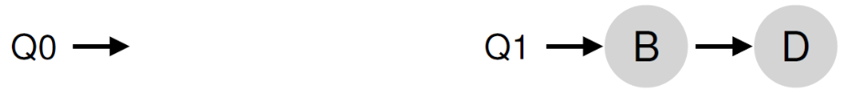
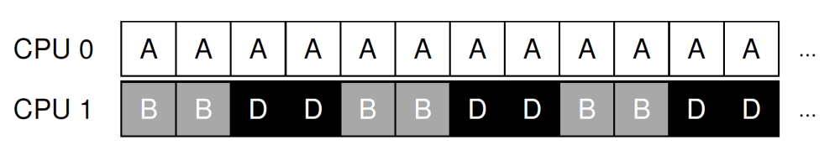
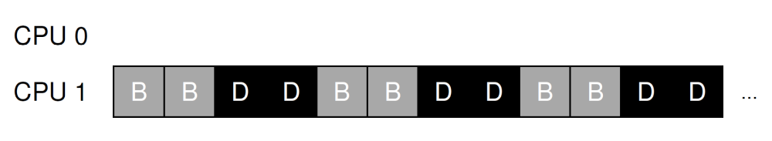
Multi-Queue Scheduling
Cons
  It is load imbalance
Example
  Two CPUs: CPU0, CPU1
  Four jobs: A,B, C,D with C finished
  A gets twice as much CPU time as B and D
  Even worse, if A finished, CPU0 becomes idle

Slide 37
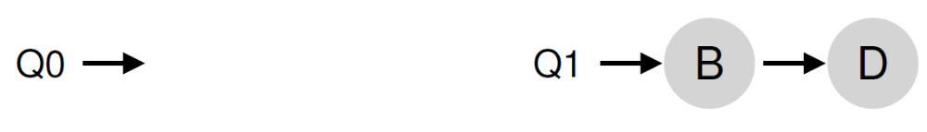
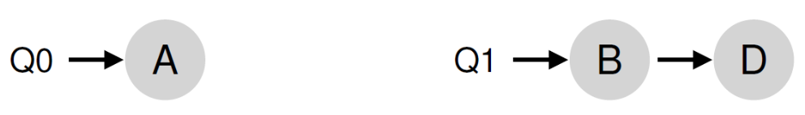
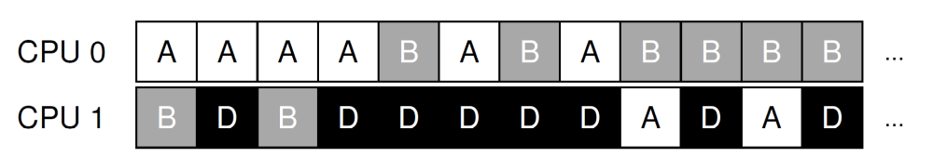
Job Migration
Migrate a job from one CPU to another
  True load balance can be achieved
Example
  Migrate B or D to another queue
  continuous migration of one or more jobs

Slide 38
Work Stealing
Source queue
  that is low on jobs
Source queue occasionally peeks at another (target) queue if
  the target is notably more full than the source,
  if yes, the source “steals” one or more jobs from the target
How often do the source peak the target?
  Too often, suffer from high overhead and have trouble scaling
  Not too often, suffer from severe load imbalances

Slide 39
Linux Multiprocessor Schedulers
The O(1) scheduler
  multiple queues
  priority-based scheduler
The Completely Fair Scheduler (CFS)
  multiple queues
  a deterministic proportional-share approach
the BF Scheduler (BFS)
  single-queue
  proportional-share based on a more complicated scheme known as
    Earliest Eligible Virtual Deadline First (EEVDF)

Slide 40
I/O Performance

Slide 41

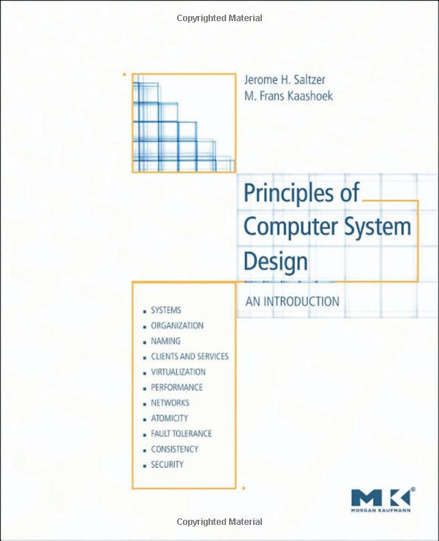
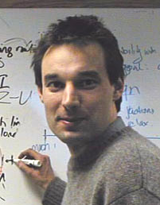
Suggestion Reading 6.3
Jerome H. Saltzer
MIT教授
美国工程院院士
Frans Kaashoek

Slide 42
Disk Scheduling
Goal
  Minimize time spent waiting on disk mechanisms
    Moving the disk arm
    Waiting for sector to rotate under disk heads
  Fairness
    Should not make requests wait too long

Slide 43
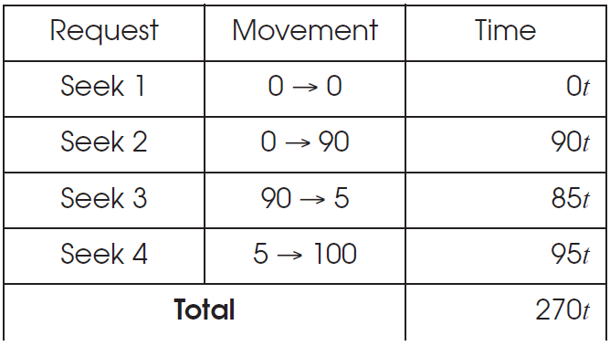
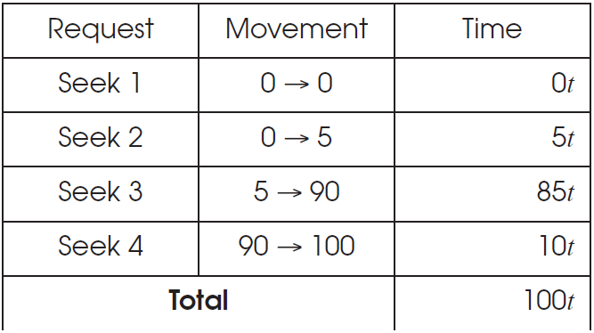
Disk Scheduling Goals

Slide 44
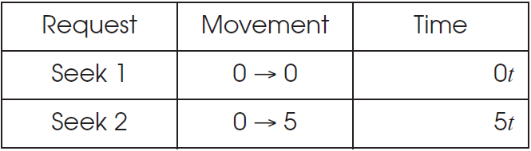
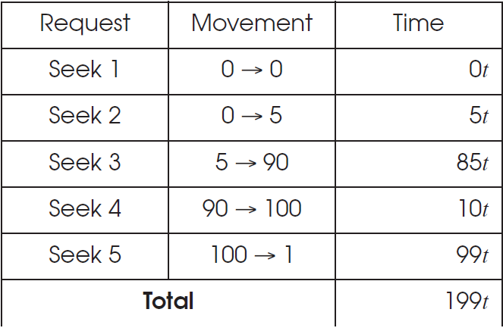
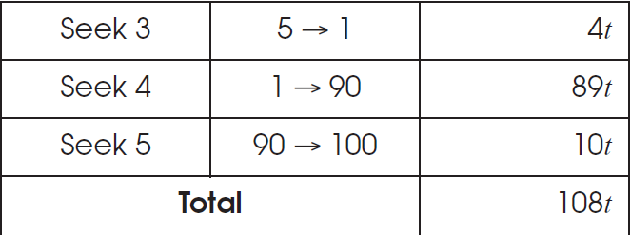
Disk Scheduling Goals
Shortest-Seek-First
Elevator Algorithm

Slide 45
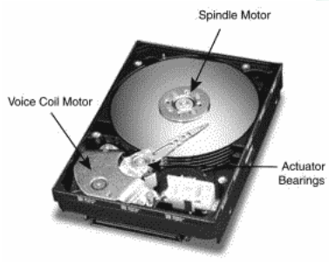
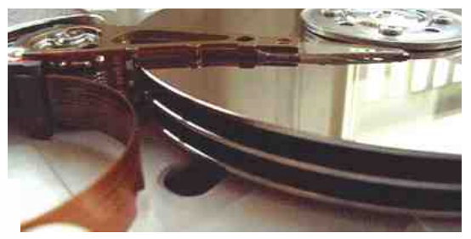
The I/O Bottleneck
Bits read from a disk encounter two potential transfer rate limits
  The rate at which bits spin under the heads on their way to a buffer
  The rate at which the I/O channel or I/O bus can transfer the contents

Slide 46
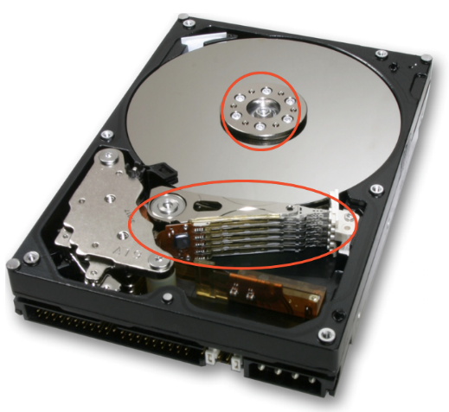
The I/O Bottleneck
The average seek latency: about 8 milliseconds
  - The time to move the head over 1/3 of the disk
The average rotational latency: 4.17 milliseconds
  - The disks spin at 7200 rotations/minute
  - One rotation every 8.33 milliseconds
  - On average, the disk has to wait a half rotation for the desired block to be under the disk head

Slide 47
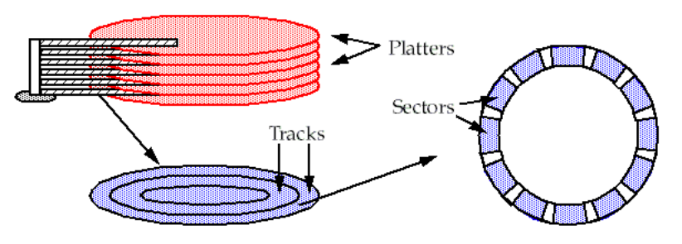
A typical modern 400 gigabyte disk
Has 16,383 cylinders, or about 24 megabytes per cylinder
Would have 8 two-sided platters and thus 16 read/write heads
Would be 24/16 = 1.5 megabytes per track
When rotating at 7200 revolutions per minute
The bits will go by a head at 180 megabytes per second

Slide 48
Bottleneck
The Integrated Device Electronics (IDE) bus: 66 MB/S is common
The Serial ATA-3 bus: 6 Gbps
With IDE bus: The electronics would be the bottleneck at 66 MB/S
With SATA-3 bus: The mechanics would be the bottleneck at 180 MB/S

Slide 49
Latency of 4-KB Data Accessing (Using IDE)
Read a 4 kilobyte block chosen at random takes:
avg seek time + avg rotation latency + transmission of 4 kilobytes
= 8 + 4.17 + (4 / (66 × 1024)) × 1000 milliseconds
= 8 + 4.17 + 0.06 milliseconds
= 12.23 milliseconds
The throughput for reading randomly-chosen blocks one by one is:
= 1000/12.23 × 4 kilobytes per second
= 327 kilobytes/second

Slide 50
Round-1
1 in ← OPEN (“in”, READ) // open “in” for reading
2 out ← OPEN (“out”, WRITE) // open “out” for reading
3
4 while not ENDOFFILE (in) do
5 block ← READ (in, 4096) // read 4 kilobyte block from in
6 block ← COMPUTE (block) // compute for 1 millisecond
7 WRITE (out, block, 4096) // write 4 kilobyte block to out
8 CLOSE (in)
9 CLOSE (out)
reading 4 kilobyte + 1 millisecond of computation + writing 4 kilobyte
= 12.23 + 1+ 12.23 milliseconds
= 25.46 milliseconds

Slide 51
Round-2
Modify the file system
  - to layout the blocks of a file contiguously
  - to prefetch an entire track of data on each read
Average seek time + 1 rotational delay
= 8 + 8.33 milliseconds = 16.33 milliseconds

Slide 52
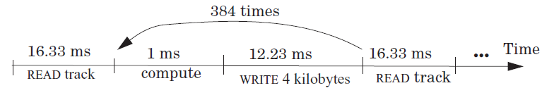
Round-2
File system issues 1 read request per 384 (1.5 MB per track / 4 KB) loop iterations
The average time for 384 iterations is:
  reading 1536 kilobyte + 384× (1 millisecond of computation + writing 4 kilobyte)
  = 16.33 + 384 × (1 + 12.23) millisecond
  = 16.33 + 5080.32 milliseconds
  = 5096.65 milliseconds.
Thus, the average time for a loop iteration is 5096.65/384 = 13.27 milliseconds

Slide 53
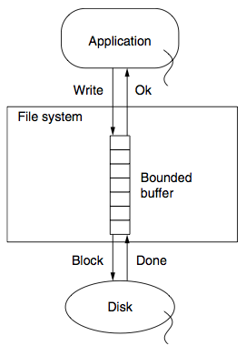
Round-3
Improve by dallying & batching write requests
Write to buffer in RAM and flush when buffer is full
Latency = (16.33 + 384 + 16.33)/384 milliseconds
= 1.09 milliseconds

Slide 54
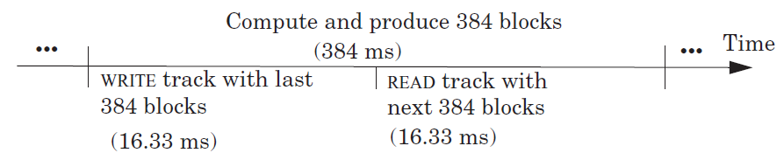
Round-4
Prefetch the next track before the appliction calls the 385th READ
Overlap computation and I/O completely
The average time around the loop is 1 millisecond
The bottleneck now is the CPU

Slide 55
Tradeoff between Reliability and Performance
A buffer without write-through
  - can provide substantial performance improvements
  - but can lose on reliability
    - If the computer system fails before the file system has written out data to the disk, some data is lost
How long to delay writes, the longer means:
  - the larger the opportunity for higher performance
  - but the greater the probability that data will be lost
    - if, for example, the power fails and the volatile RAM resets

Slide 56
Suggested Reading
Operating Systems: Three Easy Pieces
Chapter: 22, 28-32

