Slide 1
Conditional Variables

Slide 2
Conditional Variables
Locks are not the only primitives that are needed to build concurrent programs
  A thread wishes to check whether a condition is true before continuing its execution
1 void *child(void *arg) {
2 printf("child\n");
3 // XXX how to indicate we are done?
4 return NULL;
5 }
6

Slide 3
Conditional Variables
7 int main(int argc, char *argv[]) {
8 printf("parent: begin\n");
9 pthread_t c;
10 Pthread_create(&c, NULL, child, NULL); // create child
11 // XXX how to wait for child?
12 printf("parent: end\n");
13 return 0;
14 }
Desired output
parent: begin
child
parent: end

Slide 4
Spin-based Approach
1 volatile int done = 0;
2
3 void *child(void *arg) {
4 printf("child\n");
5 done = 1;
6 return NULL;
7 }
8
9 int main(int argc, char *argv[]) {
10 printf("parent: begin\n");
11 pthread_t c;
12 Pthread_create(&c, NULL, child, NULL); // create child
13 while (done == 0)
14 ; // spin
15 printf("parent: end\n");
16 return 0;
17 }
Spin-based Approach

Slide 5
Conditional Variables
This solution will generally work,
  but it is hugely inefficient as the parent spins and wastes CPU time.
What we would like here instead is
  some way to put the parent to sleep until
  the condition we are waiting for (e.g., the child is done executing) comes true.

Slide 6
Definition
A condition variable is an explicit queue that threads can put themselves on
  when some state of execution (i.e., some condition) is not as desired (by waiting on the condition)
Some other thread, when it changes said state, can then wake one (or more) of those waiting threads and thus allow them to continue (by signaling on the condition)

Slide 7
Posix Interfaces
Declare a condition variable:
  pthread cond t c;
  proper initialization is also required
A condition variable has two operations associated with it: wait() and signal()
  wait(): a thread wishes to put itself to sleep
  signal(): a thread has changed something in the program and thus wants to wake a sleeping thread waiting on this condition

Slide 8
Posix Interfaces
pthread_cond_wait(pthread_cond_t *c, pthread_mutex_t *m);
pthread_cond_signal(pthread_cond_t *c);
wait() call
  Takes a mutex as a parameter
  This mutex is locked when wait() is called
  The responsibility of wait() is to release the lock and put the calling thread to sleep (atomically)
When the thread wakes up (after some other thread has signaled it), it must re-acquire the lock before returning to the caller

Slide 9
Example
1 int done = 0;
2 pthread_mutex_t m = PTHREAD_MUTEX_INITIALIZER;
3 pthread_cond_t c = PTHREAD_COND_INITIALIZER;
4
5 void thr_exit() {
6 Pthread_mutex_lock(&m);
7 done = 1;
8 Pthread_cond_signal(&c);
9 Pthread_mutex_unlock(&m);
10 }
11

Slide 10
Example
12 void *child(void *arg) {
13 printf("child\n");
14 thr_exit();
15 return NULL;
16 }
17
18 void thr_join() {
19 Pthread_mutex_lock(&m);
20 while (done == 0)
21 Pthread_cond_wait(&c, &m);
22 Pthread_mutex_unlock(&m);
23 }
24

Slide 11
Example
25 int main(int argc, char *argv[]) {
26 printf("parent: begin\n");
27 pthread_t p;
28 Pthread_create(&p, NULL, child, NULL);
29 thr_join();
30 printf("parent: end\n");
31 return 0;
32 }
Parent runs first at line 29, done is 0, releases the lock and goes to sleep, will be woken by child
Child runs first at line 29, done set to 1, parent runs later without sleeping

Slide 12
Broken Implementation (wo done)
1 void thr_exit() {
2 Pthread_mutex_lock(&m);
3 Pthread_cond_signal(&c);
4 Pthread_mutex_unlock(&m);
5 }
6
7 void thr_join() {
8 Pthread_mutex_lock(&m);
9 Pthread_cond_wait(&c, &m);
10 Pthread_mutex_unlock(&m);
11 }

Slide 13
Broken Implementation (wo lock)
1 void thr_exit() {
2 done = 1;
3 Pthread_cond_signal(&c);
4 }
5
6 void thr_join() {
7 if (done == 0)
8 Pthread_cond_wait(&c);
9 }

Slide 14
Producer/Consumer (Broken)
1 int buffer;
2 int count = 0; // initially, empty
3
4 void put(int value) {
5 assert(count == 0);
6 count = 1;
7 buffer = value;
8 }
9
10 int get() {
11 assert(count == 1);
12 count = 0;
13 return buffer;
14 }

Slide 15
Producer/Consumer (Broken)
1 void *producer(void *arg) {
2 int i;
3 int loops = (int) arg;
4 for (i = 0; i < loops; i++) {
5 put(i);
6 }
7 }
8
9 void *consumer(void *arg) {
10 int i;
11 while (1) {
12 int tmp = get();
13 printf("%d\n", tmp);
14 }
15 }

Slide 16
Producer/Consumer (Still Broken)
1 cond_t cond;
2 mutex_t mutex;
3
4 void *producer(void *arg) {
5 int i;
6 for (i = 0; i < loops; i++) {
7 Pthread_mutex_lock(&mutex); // p1
8 if (count == 1) // p2
9 Pthread_cond_wait(&cond, &mutex); // p3
10 put(i); // p4
11 Pthread_cond_signal(&cond); // p5
12 Pthread_mutex_unlock(&mutex); // p6
13 }
14 }

Slide 17
Producer/Consumer (Still Broken)
15
16 void *consumer(void *arg) {
17 int i;
18 for (i = 0; i < loops; i++) {
19 Pthread_mutex_lock(&mutex); // c1
20 if (count == 0) // c2
21 Pthread_cond_wait(&cond, &mutex); // c3
22 int tmp = get(); // c4
23 Pthread_cond_signal(&cond); // c5
24 Pthread_mutex_unlock(&mutex); // c6
25 printf("%d\n", tmp);
26 }
27 }

Slide 18
Producer/Consumer (Why Broken)
Tc1 State | Tc2 State | Tp State | Count | Comment
c1 Running | Ready | Ready | 0
c2 Running | Ready | Ready | 0
c3 Sleep | Ready | Ready | 0 | Nothing to get
Sleep | Ready | p1 Running | 0
Sleep | Ready | p2 Running | 0
Sleep | Ready | p4 Running | 1 | Buffer now full
Ready | Ready | p5 Running | 1 | Tc1 awoken
Ready | Ready | p6 Running | 1
Ready | Ready | p1 Running | 1
Ready | Ready | p2 Running | 1
Ready | Ready | p3 Sleep | 1 | Buffer full; sleep

Slide 19
Producer/Consumer (Why Broken)
Tc1 State | Tc2 State | Tp State | Count | Comment
Ready | c1 Running | Sleep | 1 | Tc2 sneaks in --
Ready | c2 Running | Sleep | 1
Ready | c4 Running | Sleep | 0 | --and grabs data
Ready | c5 Running | Ready | 0 | Tp awoken
Ready | c6 Running | Ready | 0
c4 Running | Ready | Ready | 0 | Oh oh! No data

Slide 20
Different semantics
Mesa Semantics
  Signaling a thread only wakes it up
  the state of the world has changed
  there is no guarantee that when the woken thread runs, the state will still be as desired
Hoare semantics
  provides a stronger guarantee that the woken thread will run immediately upon being wok
  hard to implement
Virtually every system ever built employs Mesa semantics

Slide 21
Producer/Consumer (Still Broken)
1 cond_t cond;
2 mutex_t mutex;
3
4 void *producer(void *arg) {
5 int i;
6 for (i = 0; i < loops; i++) {
7 Pthread_mutex_lock(&mutex); // p1
8 while (count == 1) // p2
9 Pthread_cond_wait(&cond, &mutex); // p3
10 put(i); // p4
11 Pthread_cond_signal(&cond); // p5
12 Pthread_mutex_unlock(&mutex); // p6
13 }
14 }

Slide 22
Producer/Consumer (Still Broken)
15
16 void *consumer(void *arg) {
17 int i;
18 for (i = 0; i < loops; i++) {
19 Pthread_mutex_lock(&mutex); // c1
20 while (count == 0) // c2
21 Pthread_cond_wait(&cond, &mutex); // c3
22 int tmp = get(); // c4
23 Pthread_cond_signal(&cond); // c5
24 Pthread_mutex_unlock(&mutex); // c6
25 printf("%d\n", tmp);
26 }
27 }

Slide 23
Producer/Consumer (Why Broken)
Tc1 State | Tc2 State | Tp State | Count | Comment
c1 Running | Ready | Ready | 0
c2 Running | Ready | Ready | 0
c3 Sleep | Ready | Ready | 0 | Nothing to get
Sleep | c1 Running | Ready | 0
Sleep | c2 Running | Ready | 0
Sleep | c3 Sleep | Ready | 0 | Nothing to get
Sleep | Sleep | p1 Running | 0
Sleep | Sleep | p2 Running | 0
Sleep | Sleep | p4 Running | 1 | Buffer full now
Ready | Sleep | p5 Running | 1 | Tc1 awoken
Ready | Sleep | p6 Running | 1

Slide 24
Producer/Consumer (Why Broken)
Tc1 State | Tc2 State | Tp State | Count | Comment
Ready | Sleep | p1 Running | 1
Ready | Sleep | p2 Running | 1
Ready | Sleep | p3 Sleep | 1 | Must Sleep(full)
c2 Running | Sleep | Sleep | 1 | Recheck condition
c4 Running | Sleep | Sleep | 0 | Tc1 graps data
c5 Running | Ready | Sleep | 0 | Oops! Woke Tc2
c6 Running | Ready | Sleep | 0
c1 Running | Ready | Sleep | 0
c2 Running | Ready | Sleep | 0
c3 Sleep | Ready | Sleep | 0 | Nothing to get
Sleep | c2 Running | Sleep | 0
Sleep | c3 Sleep | Sleep | 0 | Everyone asleep

Slide 25
Producer/Consumer (Single buffer)
1 cond_t empty, fill;
2 mutex_t mutex;
3
4 void *producer(void *arg) {
5 int i;
6 for (i = 0; i < loops; i++) {
7 Pthread_mutex_lock(&mutex);
8 while (count == 1)
9 Pthread_cond_wait(&empty, &mutex);
10 put(i);
11 Pthread_cond_signal(&fill);
12 Pthread_mutex_unlock(&mutex);
13 }
14 }

Slide 26
Producer/Consumer (Single buffer)
15
16 void *consumer(void *arg) {
17 int i;
18 for (i = 0; i < loops; i++) {
19 Pthread_mutex_lock(&mutex);
20 while (count == 0)
21 Pthread_cond_wait(&fill, &mutex);
22 int tmp = get();
23 Pthread_cond_signal(&empty);
24 Pthread_mutex_unlock(&mutex);
25 printf("%d\n", tmp);
26 }
27 }

Slide 27
Producer/Consumer (more buffer slot)
1 int buffer[MAX];
2 int fill_ptr = 0;
3 int use_ptr = 0;
4 int count = 0;
5
6 void put(int value) {
7 buffer[fill_ptr] = value;
8 fill_ptr = (fill_ptr + 1) % MAX;
9 count++;
10 }
11
12 int get() {
13 int tmp = buffer[use_ptr];
14 use_ptr = (use_ptr + 1) % MAX;
15 count--;
16 return tmp;
17 }

Slide 28
Covering Conditions
1 // how many bytes of the heap are free?
2 int bytesLeft = MAX_HEAP_SIZE;
3
4 // need lock and condition too
5 cond_t c;
6 mutex_t m;
7
8 void *
9 allocate(int size) {
10 Pthread_mutex_lock(&m);
11 while (bytesLeft < size)
12 Pthread_cond_wait(&c, &m);
13 void *ptr = ...; // get mem from heap
14 bytesLeft -= size;
15 Pthread_mutex_unlock(&m);
16 return ptr;
17 }
18
19 void free(void *ptr, int size) {
20 Pthread_mutex_lock(&m);
21 bytesLeft += size;
22 Pthread_cond_signal(&c);
23 Pthread_mutex_unlock(&m);
24 }
Pthread_cond_broadcast()

Slide 29
Semaphore

Slide 30
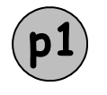




The Dining Philosophers
f2
p2
while (1) {
think();
getforks();
eat();
putforks();
}
f1
f3
p3
f0
f4
p4

Slide 31
The Dining Philosophers
int left(int p) { return p; }
int right(int p) { return (p + 1) % 5; }
1 void getforks() {
2 sem_wait(forks[left(p)]);
3 sem_wait(forks[right(p)]);
4 }
5
6 void putforks() {
7 sem_post(forks[left(p)]);
8 sem_post(forks[right(p)]);
9 }
Deadlock
when each philosopher gets only one fork and waits for another
1 void getforks() {
2 if (p == 4) {
3 sem_wait(forks[right(p)]);
4 sem_wait(forks[left(p)]);
5 } else {
6 sem_wait(forks[left(p)]);
7 sem_wait(forks[right(p)]);
8 }
9 }

Slide 32
Implement Semaphore with Locks and CVs
1 typedef struct __Zem_t {
2 int value;
3 pthread_cond_t cond;
4 pthread_mutex_t lock;
5 } Zem_t;
6
7 // only one thread can call this
8 void Zem_init(Zem_t *s, int value) {
9 s->value = value;
10 Cond_init(&s->cond);
11 Mutex_init(&s->lock);
12 }
13

Slide 33
Implement Semaphore with Locks and CVs
14 void Zem_wait(Zem_t *s) {
15 Mutex_lock(&s->lock);
16 while (s->value <= 0)
17 Cond_wait(&s->cond, &s->lock);
18 s->value--;
19 Mutex_unlock(&s->lock);
20 }
21
22 void Zem_post(Zem_t *s) {
23 Mutex_lock(&s->lock);
24 s->value++;
25 Cond_signal(&s->cond);
26 Mutex_unlock(&s->lock);
27 }

Slide 34
Concurrency Bugs

Slide 35
Bugs in Modern Applications
Find common bugs in typical applications
  MySQL, Apache, Mozilla, OpenOffice
  Non-Deadlock Bugs:
    atomicity violation, order violation
Application | What it does | Non-Deadlock | Deadlock
MySQL | Database Server | 14 | 9
Apache | Web Server | 13 | 4
Mozilla | Web Browser | 41 | 16
OpenOffice | Office Suite | 6 | 2
Total |  | 74 | 31

Slide 36
Atomicity-Violation Bugs
1 Thread 1::
2 if (thd->proc_info) {
3 ...
4 fputs(thd->proc_info, ...);
5 ...
6 }
7
8 Thread 2::
9 thd->proc_info = NULL;
In fputs
thd->proc_info
may be NULL

Slide 37
Spin-based Approach
1 pthread_mutex_t proc_info_lock = PTHREAD_MUTEX_INITIALIZER;
2
3 Thread 1::
4 pthread_mutex_lock(&proc_info_lock);
5 if (thd->proc_info) {
6 ...
7 fputs(thd->proc_info, ...);
8 ...
9 }
10 pthread_mutex_unlock(&proc_info_lock);
11
12 Thread 2::
13 pthread_mutex_lock(&proc_info_lock);
14 thd->proc_info = NULL;
15 pthread_mutex_unlock(&proc_info_lock);

Slide 38
Order-Violation Bugs
1 Thread 1::
2 void init() {
3 ...
4 mThread = PR_CreateThread(mMain, ...);
5 ...
6 }
7
8 Thread 2::
9 void mMain(...) {
10 ...
11 mState = mThread->State;
12 ...
13 }
mThread seems already initialized

Slide 39
Order-Violation Bugs
1 pthread_mutex_t mtLock = PTHREAD_MUTEX_INITIALIZER;
2 pthread_cond_t mtCond = PTHREAD_COND_INITIALIZER;
3 int mtInit = 0;
4
5 Thread 1::
6 void init() {
7 ...
8 mThread = PR_CreateThread(mMain, ...);
9
10 // signal that the thread has been created...
11 pthread_mutex_lock(&mtLock);
12 mtInit = 1;
13 pthread_cond_signal(&mtCond);
14 pthread_mutex_unlock(&mtLock);
15 ...
}

Slide 40
Order-Violation Bugs
17
18 Thread 2::
19 void mMain(...) {
20 ...
21 // wait for the thread to be initialized...
22 pthread_mutex_lock(&mtLock);
23 while (mtInit == 0)
24 pthread_cond_wait(&mtCond, &mtLock);
25 pthread_mutex_unlock(&mtLock);
26
27 mState = mThread->State;
28 ...
29 }

Slide 41
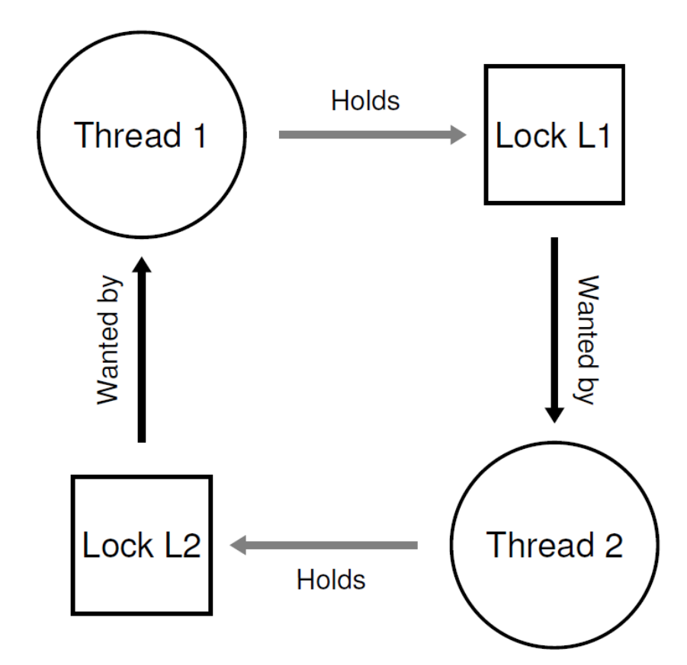
Deadlock Bugs
Thread 1: Thread 2:
lock(L1); lock(L2);
lock(L2); lock(L1);

Slide 42
Why Do Deadlocks Occur
In large code bases,
  complex dependencies arise between components
The operating system
  The virtual memory system might need to access the file system in order to page-in a block from disk
  The file system might subsequently require a page of memory to read the block into and thus contact the virtual memory system.
  You must be careful to avoid deadlock in the case of circular dependencies that may occur naturally in the code

Slide 43
Why Do Deadlocks Occur
The nature of encapsulation
  some modularity does not mesh well with locking
For example
  vector v1, v2;
  Thread 1::
  v1.AddAll(v2);
  Thread 2::
  v2.AddAll(v1);
To thread safe
  In thread 1, it may lock v1 first then lock v2
  Deadlock may occur

Slide 44
Conditions for Deadlock
Four conditions need to hold for a deadlock to occur
  Mutual exclusion: Threads claim exclusive control of resources that they require (e.g., a thread grabs a lock).
  Hold-and-wait: Threads hold resources allocated to them(e.g., locks that they have already acquired) while waiting for additional resources (e.g., locks that they wish to acquire).

Slide 45
Conditions for Deadlock (cont.)
Four conditions need to hold for a deadlock to occur
  No preemption: Resources (e.g., locks) cannot be forcibly removed from threads that are holding them
  Circular wait: There exists a circular chain of threads such that each thread holds one or more resources (e.g., locks) that are being requested by the next thread in the chain.

