Slide 1
Linking

Slide 2
Outline
What is linking and why linking
Complier driver
Input & output for the Static linking
Suggested reading: 7.1~7.4

Slide 3
Monolithic source file
main.c
ASCII source file
Translator
binary executable object file
(memory image on disk)
p
Problems:
  efficiency: small change requires complete recompilation
  modularity: hard to share common functions (e.g. printf)

Slide 4
main.c | swap.c
/*main.c */ void swap() ; int buf[2] = {1, 2}; int main() { swap() ; return 0 ; } | /*swap.c */ extern int buf[]; int *bufp0 = &buf[0] int *bufp1 ; void swap() { int temp ; bufp1 = &buf[1]; temp = *bufp0 ; *bufp0 = *bufp1 ; *bufp1 = temp ; }

Slide 5
Separate Compilation
main.c
swap.c
Translators
Translators
separately compiled relocatable object files
main.o
swap.o
Linker (ld)
executable object file
(contains code and data for all functions defined in main.c and swap.c)
p

Slide 6
What is linker
Linking is the process of
  collecting and combining various pieces of code and data into a single executable file
Executable file
  Can be loaded (copied) into memory and executed.

Slide 7
What is linker
Linking can be performed
  at compile time, when the source code is translated into machine code by the linker
  at load time, when the program is loaded into memory and executed by the loader
  at run time, by application programs.

Slide 8
Compiler Drivers
Coordinates all steps in the translation and linking process
  Typically included with each compilation system (e.g., gcc)
  Invokes
    preprocessor (cpp)
    compiler (cc1)
    assembler (as),
    linker (ld).
  Passes command line args to appropriate phases

Slide 9
Example
unix> gcc -O2 -g -o p main.c swap.c
cpp [args] main.c /tmp/main.i
cc1 /tmp/main.i main.c -O2 [args] -o /tmp/main.s
as [args] -o /tmp/main.o /tmp/main.s
<similar process for swap.c>
ld -o p [system obj files] /tmp/main.o /tmp/swap.o
unix>

Slide 10
main.c | swap.c
/*main.c */ void swap() ; int buf[2] = {1, 2}; int main() { swap() ; return 0 ; } | /*swap.c */ extern int buf[] ; int *bufp0 = &buf[0] ; int *bufp1 ; void swap() { int temp ; bufp1 = &buf[1] ; temp = *bufp0 ; *bufp0 = *bufp1; *bufp1 = temp; }

Slide 11
Example
Two functions
  main() and swap()
Three global variables
  buf, bufp0 which are initialized explicitly
  bufp1 implicitly initialized to 0

Slide 12
Example
.file "swap.c"
.globl bufp0
.data
.align 8
.type bufp0, @object
.size bufp0, 8
bufp0:
.quad buf
.comm bufp1,8,8
.text
.globl swap
.type swap, @function
define
reference

Slide 13
Example
swap:
pushq %rbp
movq %rsp, %rbp
movq $buf+4, bufp1(%rip)
movq bufp0(%rip), %rax
movl (%rax), %eax
movl %eax, -4(%rbp)
movq bufp0(%rip), %rax
movq bufp1(%rip), %rdx
movl (%rdx), %edx
movl %edx, (%rax)
movq bufp1(%rip), %rax
movl -4(%rbp), %edx
movl %edx, (%rax)
nop
popq %rbp
ret
define
reference

Slide 14
Static linking
Input
  A relocatable object files and command line arguments
Output
  Fully linked executable object file that can be loaded and run

Slide 15
Example
unix> gcc -O2 -g -o p main.c swap.c
cpp [args] main.c /tmp/main.i
cc1 /tmp/main.i main.c -O2 [args] -o /tmp/main.s
as [args] -o /tmp/main.o /tmp/main.s
<similar process for swap.c>
ld -o p [system obj files] /tmp/main.o /tmp/swap.o
unix>

Slide 16
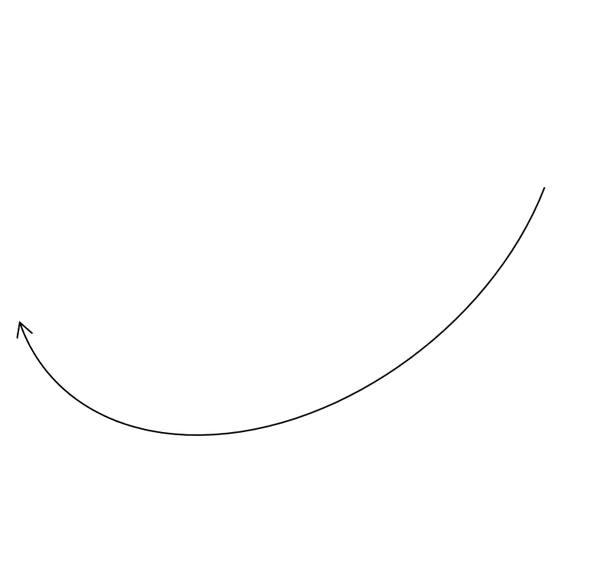
Relocatable Object Files(main.o)
Define (main)
00<main>:
00: 55 push %rbp
01: 48 89 e5 mov %rsp,%rbp
04: b8 00 00 00 00 mov $0x0,%eax
09: e8 00 00 00 00 callq e <main+0xe>
0e: b8 00 00 00 00 mov $0x0,%eax
13: 5d pop %rbp
14: c3 retq
Reference
(swap)

Slide 17
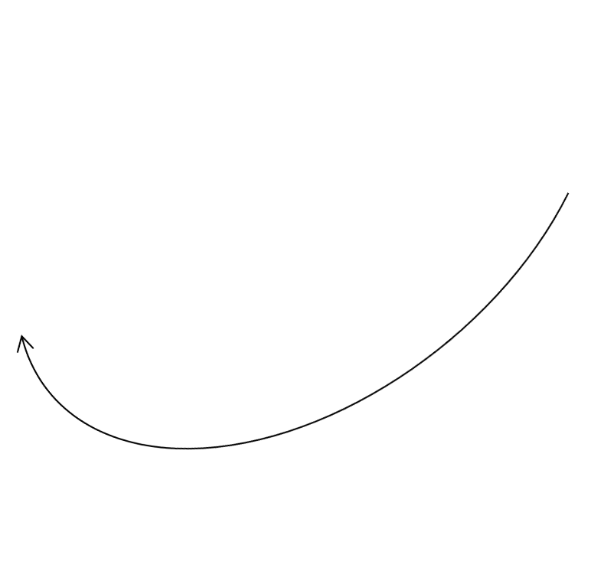
Relocatable Object Files(main.o)
Define (buf)
00 <buf>:
00: 01 00 00 00 02 00 00 00

Slide 18

Relocatable Object Files(swap.o)
bufp1
References
buf[1]
00<swap>:
00: 55 push %rbp
01: 48 89 e5 mov %rsp,%rbp
04: 48 c7 05 00 00 00 00 movq $0x0,0x0(%rip)
0b: 00 00 00 00 bufp1= &buf[1]
0f: 48 8b 05 00 00 00 00 mov 0x0(%rip),%rax get bufp0
16: 8b 00 mov (%rax),%eax
18: 89 45 fc mov %eax,-0x4(%rbp)
1b: 48 8b 05 00 00 00 00 mov 0x0(%rip),%rax get bufp0
22: 48 8b 15 00 00 00 00 mov 0x0(%rip),%rdx get bufp1
29: 8b 12 mov (%rdx),%edx
2b: 89 10 mov %edx,(%rax) *bufp0 = *bufp1
2d: 48 8b 05 00 00 00 00 mov 0x0(%rip),%rax get bufp1
34: 8b 55 fc mov -0x4(%rbp),%edx
37: 89 10 mov %edx,(%rax)

Slide 19
Relocatable Object Files(swap.o)
39: 90 nop
3a: 5d pop %rbp
3b: c3 retq
00<bufp0>:
00: 00 00 00 00 00 00 00 00
00<bufp1>:
Reference
(buf)

Slide 20
Relocatable Object Files
Relocatable object file
  Contain binary code and data in a form that can be combined with other relocatable object files to create an executable file
Sections
  Various code and data sections
  Instructions are in one section
  Initialized global variables are in one section
  Uninitialized global variables are in one section

Slide 21
Linking (Symbol resolution)
External reference:
  Reference to a symbol defined in another object file
  The external references are values close to 0 in the relocatable object files in the previous example
Symbol resolution
  Resolves external references

Slide 22
Executable Object Files
4004d6 <main>:
4004d6: 55 push %rbp
4004d7: 48 89 e5 mov %rsp,%rbp
4004da: b8 00 00 00 00 mov $0x0,%eax
4004df: e8 07 00 00 00 callq 4004eb <swap>
4004e4: b8 00 00 00 00 mov $0x0,%eax
4004e9: 5d pop %rbp
4004ea: c3 retq

Slide 23
Executable Object Files
00000000004004eb <swap>:
4004eb: 55 push %rbp
4004ec: 48 89 e5 mov %rsp,%rbp
4004ef: 48 c7 05 4e 0b 20 00 movq $0x601034,0x200b4e(%rip)
4004f6: 34 10 60 00 bufp1= &buf[1]
4004fa: 48 8b 05 37 0b 20 00 mov 0x200b37(%rip),%rax get bufp0
400501: 8b 00 mov (%rax),%eax
400503: 89 45 fc mov %eax,-0x4(%rbp)
400506: 48 8b 05 2b 0b 20 00 mov 0x200b2b(%rip),%rax get bufp0
40050d: 48 8b 15 34 0b 20 00 mov 0x200b34(%rip),%rdx get bufp1
400514: 8b 12 mov (%rdx),%edx
400516: 89 10 mov %edx,(%rax) *bufp0 = *bufp1
400518: 48 8b 05 29 0b 20 00 mov 0x200b29(%rip),%rax get bufp0
40051f: 8b 55 fc mov -0x4(%rbp),%edx
400522: 89 10 mov %edx,(%rax)

Slide 24
Executable Object Files
400524: 90 nop
400525: 5d pop %rbp
400526: c3 retq
601030<buf>:
601030: 01 00 00 00 02 00 00 00
601038<bufp0>:
601038: 30 10 60 00 00 00 00 00
601048<bufp1>:

Slide 25
Executable object file
Contains binary code and data in a form that can be copied directly into memory and executed

Slide 26
Relocation
Relocates symbols
  from their relative locations in the .o files
  to new absolute positions in the executable
    main in the 0 pos of the .txt section in main.o to 4004d6 in p
    buf in the 0 pos of the .data section in main.o to 601030 in p
    swap in the 0 pos of the .txt section in swap.o to 4004eb in p
    bufp0 in the 0 pos of the .data section in swap.o to 601038 in p
    bufp1 in the 0 pos of the .bss section in swap.o to 601048 in p

Slide 27
Relocation
Updates all references to these symbols to reflect their new positions
  e8 00 00 00 00 → e8 07 00 00 00 call 4004eb <swap>
  48 8b 05 00 00 00 00 → 48 8b 05 37 0b 20 00
  mov 0x200b37(%rip),%rax
  00<bufp0>:
  00: 00 00 00 00 00 00 00 00
  ↓
  601038<bufp0>:
  601038: 30 10 60 00 00 00 00 00

Slide 28
Object files
Relocatable object file
Executable object file
Shared object file
  A special type of relocatable object file that can be loaded into memory and linked dynamically, at either load time or run time

Slide 29
Executable and Linkable Format (ELF)
Standard binary format for object files
Derives from AT&T System V Unix
  later adopted by BSD Unix variants and Linux
One unified format for relocatable object files (.o), executable object files, and shared object files (.so)
  generic name: ELF binaries
Better support for shared libraries than old a.out formats.

Slide 30
ELF object file format
ELF header
Program header table
(required for executables)
.text section
.data section
.bss section
.symtab
.rel.txt
.rel.data
.debug
.line
.strtab
Section header table
(required for relocatables)

