Slide 1
Archive files and Loading

Slide 2
Outline
Multiple Defined Global Symbol
Archive Files (static libraries)
Executable Object Files
Loading
Suggested reading: 7.6, 7.8, 7.9

Slide 3
Multiply Defined Global Symbols
Strong:
  Functions and initialized global variables
Weak:
  Uninitialized global variables
Rules:
  Multiple strong symbols are not allowed
  Given a strong symbol and multiple weak symbols, choose the strong symbol
  Given multiple weak symbols, choose any of the weak symbol

Slide 4
Multiply Defined Global Symbols
/*foo1.c*/
int main()
{
return 0;
}
/*bar1.c*/
int main()
{
return 0;
}
/*foo2.c*/
int x=15213;
int main()
{
return 0;
}
/*bar2.c*/
int x=15213;
void f()
{
}

Slide 5
Multiply Defined Global Symbols
/*foo3.c*/
#include <stdio.h>
void f();
int x=15213;
int main()
{
f();
printf(“x=%d\n”,x)
return 0;
}
/*bar3.c*/
int x ;
void f()
{
x = 15212 ;
}

Slide 6
Multiply Defined Global Symbols
/*foo4.c*/
#include <stdio.h>
void f();
int x;
int main()
{
x=15213
f();
printf(“x=%d\n”,x)
return 0;
}
/*bar4.c*/
int x ;
void f()
{
x = 15212 ;
}

Slide 7
Multiply Defined Global Symbols
/*foo5.c*/
#include <stdio.h>
void f();
int x=15213;
int y=15212;
int main()
{
f();
printf(“x=0x%x y=0x%x \n”,
x, y) ;
return 0;
}
/*bar5.c*/
double x ;
void f()
{
x = -0.0 ;
}
gcc –fno-common

Slide 8
Packaging commonly used functions
How to package functions commonly used by programmers?
  math, I/O, memory management, string manipulation, etc.

Slide 9
Packaging commonly used functions
Awkward, given the linker framework so far:
  Option 1: Put all functions in a single source file
    programmers link big object file into their programs
    space and time inefficient
  Option 2: Put each function in a separate source file
    programmers explicitly link appropriate binaries into their programs
    more efficient, but burdensome on the programmer

Slide 10
Packaging commonly used functions
Solution: static libraries (.a archive files)
  concatenate related relocatable object files into a single file with an index (called an archive)
  enhance linker so that it tries to resolve unresolved external references by looking for the symbols in one or more archives
  If an archive member file resolves reference, link into executable
gcc main.c /usr/lib/libm.a /usr/libc.a
gcc main.c -lm

Slide 11
Example (1/3)
(a) addvec.o
int addcnt = 0 ;
void addvec(int *x, int *y, int *z, int n)
{
int i;
addcnt++;
for (i = 0; i < n; i++)
z[i] = x[i] + y[i];
}

Slide 12
Example (2/3)
(b) multvec.o
int multcnt = 0 ;
void multvec(int *x, int *y, int *z, int n)
{
int i;
multcnt++;
for (i = 0; i < n; i++)
z[i] = x[i] * y[i];
}
unix> gcc -c addvec.c multvec.c
unix> ar rcs libvector.a addvec.o multvec.o

Slide 13
Example (3/3)
/* main2.c */
#include <stdio.h>
#include "vector.h“
int x[2] = {1, 2};
int y[2] = {3, 4};
int z[2];
int main()
{
addvec(x, y, z, 2);
printf("z = [%d %d]\n", z[0], z[1]);
return 0;
}

Slide 14
Static Linked Libraries
main2.c
vector.h
libc.a
Translators(cc1, as)
libvector.a
printf.o and any other modules called by printf.o
main2.o
addvec
Linker (ld)
p2
Fully linked executable object code file
unix> gcc -O2 -c main2.c
unix> gcc -static -o prog2 main2.o ./libvector.a
Or unix> gcc -static -o prog2 main2.o -L. -lvector

Slide 15
Creating static libraries
atoi.c
printf.c
random.c
Translator
Translator
...
Translator
atoi.o
printf.o
random.o
Archiver (ar)
libc.a
C standard library
Archiver allows incremental updates:
  recompile function that changes and replace .o file in archive.
ar rcs libc.a atoi.o printf.o … random.o

Slide 16
Using static libraries
E:
  relocatable object files that will be merged to form the executable
U:
  Unresolved symbols
D:
  Symbols that have been defined in previous input files
Initially all are empty

Slide 17
Using static libraries
Scan .o files and .a files in the command line order.
When scan an object file f,
  Add f to E
  Updates U, D
When scan an archive file f,
  Resolve U
  If m is used to resolve symbol, m is added to E
  Update U, D using m

Slide 18
Using static libraries
If any entries in the unresolved list at end of scan, then error
Problem:
  command line order matters!
  Moral: put libraries at the end of the command line.

Slide 19
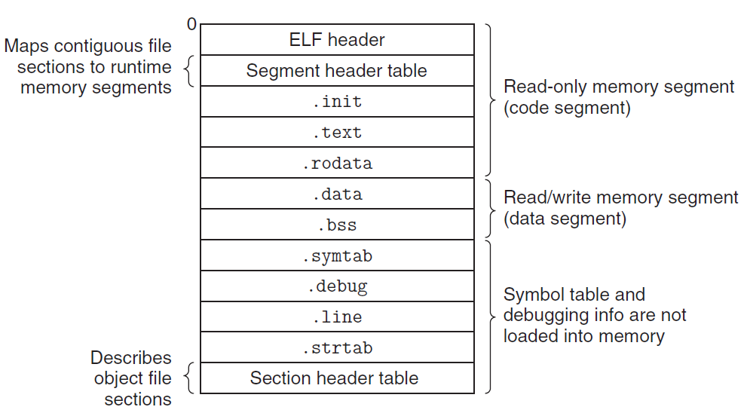
Executable Object Files

Slide 20
ELF Header
typedef struct{
unsigned char e_ident[16]; /* ELF identification */
Elf64_Half e_type; /* Object file type */
Elf64_Half e_machine; /* Machine type */
Elf64_Word e_version; /* Object file version */
Elf64_Addr e_entry; /* Entry point address */
Elf64_Off e_phoff; /* Program header offset */
Elf64_Off e_shoff; /* Section header offset */
Elf64_Word e_flags; /* Processor-specific flags */
Elf64_Half e_ehsize; /* ELF header size */
Elf64_Half e_phentsize; /* Size of program header entry */
Elf64_Half e_phnum; /* Number of program header entries */
Elf64_Half e_shentsize; /* Size of section header entry */
Elf64_Half e_shnum; /* Number of section header entries */
Elf64_Half e_shstrndx; /* Section name string table index */
} Elf64_Ehdr;

Slide 21
Executable Object File Header
ELF header
  Overall information
  Entry point
  Program (Segment) header table information
    Starting point
    Size
    Size of each entry
    Number of entries

Slide 22
Executable Object File Segment Header Table
typedef struct {
Elf64_Word p_type; /* Entry type. */
Elf64_Word p_flags; /* Access permission flags. */
Elf64_Off p_offset; /* File offset of contents. */
Elf64_Addr p_vaddr; /* Virtual address in memory image. */
Elf64_Addr p_paddr; /* Physical address (not used). */
Elf64_Xword p_filesz; /* Size of contents in file. */
Elf64_Xword p_memsz; /* Size of contents in memory. */
Elf64_Xword p_align; /* Alignment in memory and file. */
} Elf64_Phdr;

Slide 23
Executable Object File Segment Header Table
p_type
  PT_LOAD (1): loadable segment
p_offset
  Offset from the beginning of the file to the first byte in the segment
p_vaddr
  The virtual address of the first byte in the segment
p_paddr
  Not very useful

Slide 24
Executable Object File Segment Header Table
p_filesz
  Segment size in the object file (≤p_memsz)
p_memsz
  Segment size in the memory (≥p_filesz)
p_flags
  Run time permissions (rwx)
p_align
  Alignment requirement for the beginning address of the segment
  Usually 2**12 or 2**21(2M)

Slide 25
Executable Object Files

Slide 26
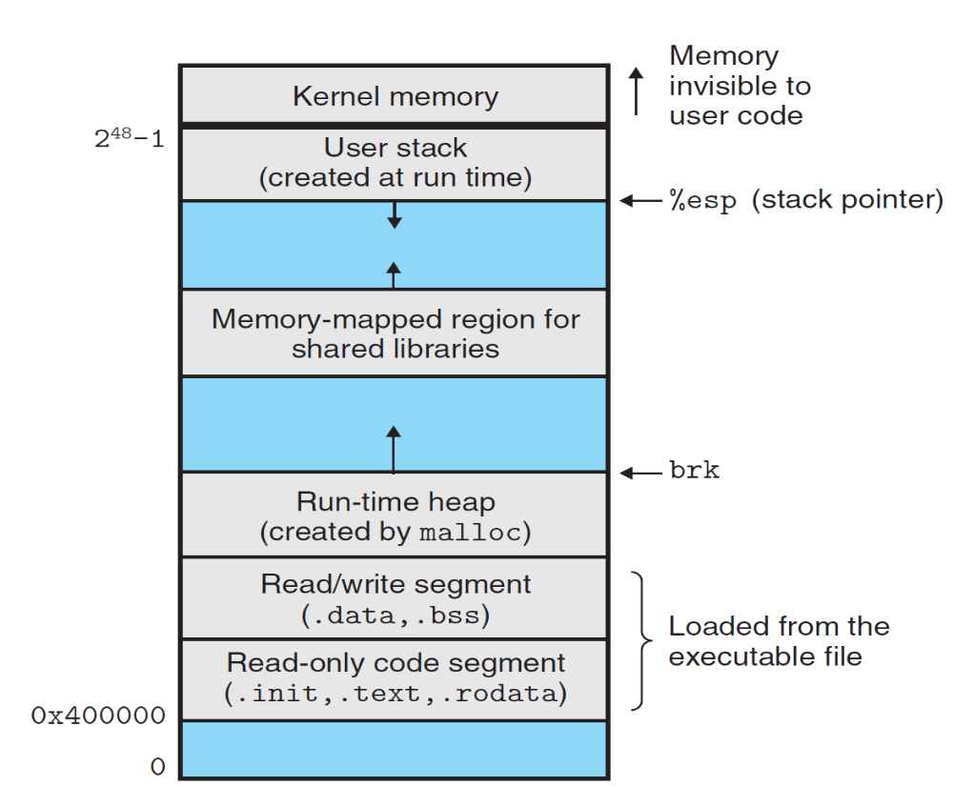
2⁴⁷-1
%rsp

Slide 27
ELF format
Read only code segment
LOAD off 0x0000000000000000 vaddr 0x0000000000400000
paddr 0x0000000000400000 align 2**21
filesz 0x000000000000069c memsz 0x000000000000069c
flags r-x
Read/write data segment
LOAD off 0x0000000000000df8 vaddr 0x0000000000600df8
paddr 0x0000000000000df8 align 2**21
filesz 0x0000000000000228 memsz 0x0000000000000230
flags rw
Difference between filesz and memsz means the uninitialized data in .bss
.init section contains a small function _init called by program’s initialization code

Slide 28
Startup code
_start
  the entry point of the program
  Defined in the crt1.o
  Same for all C program
  Calls
    system startup function
    __libc_start_main
      Defined in libc.so
      Initializes the execution environment
      Calls the main function
      Handles return value
      Returns control to OS (if necessary)

Slide 29
Loading
Unix> ./p
Loader
  Memory-resident operating system code
  Invoked by call the execve function
  Copy the code and data in the executable object file from disk into memory
  Jump to the entry point
  Run the program

