Slide 1
Loading & Dynamic Link

Slide 2
Outline
Dynamic Linking
Position Independent Code (PIC)
Loading and Linking Shared Libraries from applications
Suggested reading: 7.8~7.12

Slide 3
Disadvantages of Static Libraries
Minor bug fixes of system libraries require each application to explicitly relink
Duplicate lots of common code in the executable files
  e.g., every C program needs the standard C library
Duplicate lots of code in the memory

Slide 4
Shared Libraries
Synonym
  Shared object on Linux, denoted by .so suffix
  DLL (dynamic link libraries) on Windows
What sharing means
  Only one .so file for a particular library
  Code and data in the .so file are shared by all of the executable object files that reference the library

Slide 5
Shared Libraries
Generate the shared libraries
Unix> gcc –shared –fPIC –o libvector.so addvec.c multvec.c
    –shared: creating a shared object
    –fPIC: crating the position independent code

Slide 6
Partially Linking
main2.c
vector.h
libc.so
libvector.so
Translators(cc1, as)
main2.o
Relocation and symbol table info
Linker (ld)
p2
Partially linked executable object code file
Partially link with shared libraries
Unix>gcc –o p2 main2.c ./libvector.so

Slide 7
Partially Linking
Which parts in libvector.so are copied into p2
  The code and data sections No
  Relocation and symbol table information Some

Slide 8
Dynamically linking
p2
Partially linked executable object code file
libc.so
libvector.so
Loader(execve)
Code and data
Dynamic Linker(ld-linux.so)
Fully linked executable in memory

Slide 9
Dynamically linking
Done by execve() & ld-linux.so
  Copy code and data of libc.so and libvector.so into to memory segment
  Relocate any references in p2 to symbols defined by libc.so and libvector.so
After linking, the locations of the shared libraries are fixed and do not change during the execution time
How to find the ld-linux.so
  The pathname of the ld-linux.so is contained in the .interp segment of p2

Slide 10
Executable Object File Segment Header Table
typedef struct {
Elf64_Word p_type; /* Entry type. */
Elf64_Word p_flags; /* Access permission flags. */
Elf64_Off p_offset; /* File offset of contents. */
Elf64_Addr p_vaddr; /* Virtual address in memory image. */
Elf64_Addr p_paddr; /* Physical address (not used). */
Elf64_Xword p_filesz; /* Size of contents in file. */
Elf64_Xword p_memsz; /* Size of contents in memory. */
Elf64_Xword p_align; /* Alignment in memory and file. */
} Elf64_Phdr;

Slide 11
Dynamically linking
.interp segment
  p_type = PT_INTERP (3)
  the location and size of a null-terminated path name to invoke as an interpreter
  It may not occur more than once in a file
  It must precede any loadable segment entry

Slide 12
ELF Section Header Table
typedef struct {
Elf64_Word sh_name; /* Section name (index into the
section header string table). */
Elf64_Word sh_type; /* Section type. */
Elf64_Xword sh_flags; /* Section flags. */
Elf64_Addr sh_addr; /* Address in memory image. */
Elf64_Off sh_offset; /* Offset in file. */
Elf64_Xword sh_size; /* Size in bytes. */
Elf64_Word sh_link; /* Index of a related section. */
Elf64_Word sh_info; /* Depends on section type. */
Elf64_Xword sh_addralign; /* Alignment in bytes. */
Elf64_Xword sh_entsize; /* Size of each entry in section. */
} Elf64_Shdr;

Slide 13
Dynamically linking
.interp segment
  p_type = PT_INTERP (3)
  the location and size of a null-terminated path name to invoke as an interpreter
  It may not occur more than once in a file
  It must precede any loadable segment entry
.dynamic section
  sh_type = SHT_DYNAMIC
  Holds various data
  The structure residing at the beginning of the section holds the addresses of other dynamic linking information

Slide 14
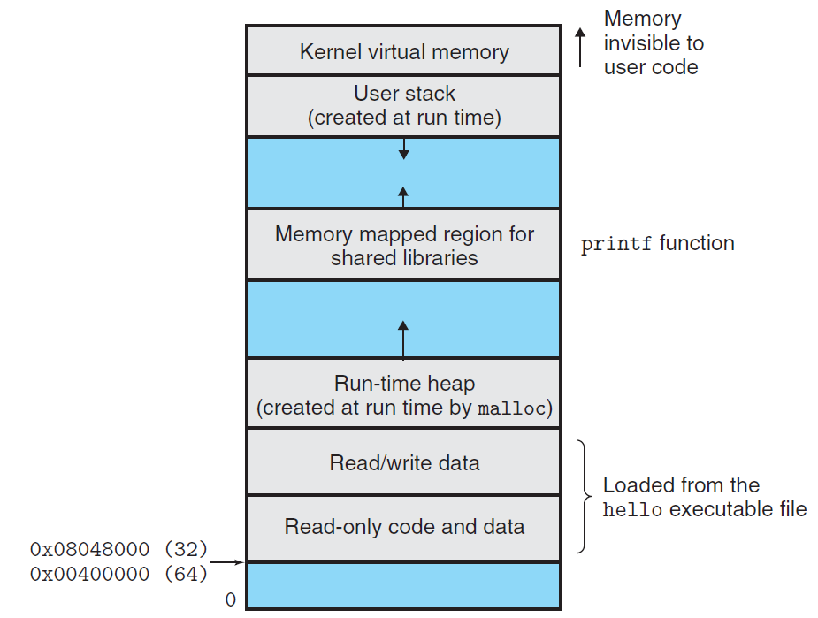
Memory mapped region for shared libraries

Slide 15
Linking at Running Time
Loading and Linking Shared Libraries from Applications
  Done explicitly by user with dlopen() in Linux
Unix>gcc –rdynamic –O2 –o p3 dll.c -ldl

Slide 16
Linking at Running Time
#include <dlfcn.h>
void *dlopen(const char *filename, int flag) ;
returns: ptr to handle if OK, NULL on error
void *dlsym(void *handle, char *symbol) ;
returns: ptr to symbol if OK, NULL on error
int dlclose(void *handle) ;
returns: 0 if OK, -1 on error
const char dlerror(void) ;
returns: errormsg if previous call to
dlopen, dlysym, or dlclose failed,
NULL if previous call was OK

Slide 17
#include <stdio.h>
#include <dlfcn.h>
int x[2] = { 1, 2} ;
int y[2] = { 3, 4} ;
int z[2];
int main()
{
void *handle;
void (*addvec)(int *, int *, int *, int ) ;
char *error ;

Slide 18
/*dynamically load the shared library that contains addvec() */
handle = dlopen(“./libvector.so”, RTLD_LAZY) ;
if (!handle) {
fprintf(stderr, “%s\n”, dlerror()) ;
exit(1) ;
}
/*get a pointer to the addvec() function we just loaded */
addvec = dlsym(handle, “addvec”) ;
if ( (error = dlerror()) != NULL ) {
fprintf(stderr, “%s\n”, error) ;
exit(1) ;
}

Slide 19
/* Now we can call addvec() just like any other function */
addvec(x, y, z, 2)
printf(“z=[%d, %d]\n”, z[0], z[1]) ;
/* unload the shared library */
if (dlclose(handle) <0) {
fprintf(stderr, “%s\n”, dlerror()) ;
exit(1) ;
}
return 0 ;
}

Slide 20
Position-Independent Code (PIC)
Allow multiple running processes to share the same library code
  Save precious memory resource
Naïve: assign a dedicated address
  Inefficient use of the address space
  Difficult to manage
Better: load and execute at any address
  Position-independent code (PIC)
  gcc with -fPIC

Slide 21
Position-Independent Code (PIC)
Position-Independent Code (PIC)
  Internally-defined procedures (OK)
    PC-relative reference
  Externally-defined procedures and reference to global variable (NO)
    Indirect reference
    Global offset table (GOT)
      Private
      At the beginning of .data

Slide 22
Position-Independent Code (PIC)
PIC Data References
Data segment
Global offset table (GOT)
GOT[0] : …
GOT[1] : …
GOT[2] : …
GOT[3] : &addcnt
Fixed distance of 0x2008b9 bytes at run time between GOT[3] and addl instruction
Code segment
addvec:
mov 0x2008b9(%rip), %rax #%rax=*GOT[3]=&addcnt
addl $0x1, (%rax) # addcnt++

Slide 23
Position-Independent Code (PIC)
Lazy Binding
  Global Offset Table (GOT)
    .data
  Procedure Linkage Table (PLT)
    .text

Slide 24
Data segment
Global offset table (GOT)
GOT[0] : .addr od .dynamic
GOT[1] : .addr of reloc entries
GOT[2] : .addr of dynamic linker
GOT[3] : 0x4005b6 #sys startup
GOT[4] : 0x4005c6 #addvec()
GOT[5]: 0x4005d6 #printf()
Code segment
callq 0x4005c0 # call addvec
Procedure linkage table (PLT)
addvec:
# PLT[0] : call dynamic linker
4005a0: pushq *GOT[1]
4005a6: jmpq *GOT[2]
…
# PLT[2]: call addvec()
4005c0: jmpq *GOT[4]
4005c6: pushq $0x1
4005cb: jmpq 4005a0

Slide 25
Data segment
Global offset table (GOT)
GOT[0] : .addr od .dynamic
GOT[1] : .addr of reloc entries
GOT[2] : .addr of dynamic linker
GOT[3] : 0x4005b6 #sys startup
GOT[4] : 0x4005c6 #addvec()
GOT[5]: 0x4005d6 #printf()
Code segment
callq 0x4005c0 # call addvec
Procedure linkage table (PLT)
addvec:
1
# PLT[0] : call dynamic linker
4005a0: pushq *GOT[1]
4005a6: jmpq *GOT[2]
…
# PLT[2]: call addvec()
4005c0: jmpq *GOT[4]
4005c6: pushq $0x1
4005cb: jmpq 4005a0

Slide 26
Data segment
Global offset table (GOT)
GOT[0] : .addr od .dynamic
GOT[1] : .addr of reloc entries
GOT[2] : .addr of dynamic linker
GOT[3] : 0x4005b6 #sys startup
GOT[4] : 0x4005c6 #addvec()
GOT[5]: 0x4005d6 #printf()
Code segment
callq 0x4005c0 # call addvec
Procedure linkage table (PLT)
addvec:
# PLT[0] : call dynamic linker
4005a0: pushq *GOT[1]
4005a6: jmpq *GOT[2]
…
# PLT[2]: call addvec()
4005c0: jmpq *GOT[4]
4005c6: pushq $0x1
4005cb: jmpq 4005a0
2

Slide 27
Data segment
Global offset table (GOT)
GOT[0] : .addr od .dynamic
GOT[1] : .addr of reloc entries
GOT[2] : .addr of dynamic linker
GOT[3] : 0x4005b6 #sys startup
GOT[4] : 0x4005c6 #addvec()
GOT[5]: 0x4005d6 #printf()
Code segment
callq 0x4005c0 # call addvec
Procedure linkage table (PLT)
addvec:
# PLT[0] : call dynamic linker
4005a0: pushq *GOT[1]
4005a6: jmpq *GOT[2]
…
# PLT[2]: call addvec()
4005c0: jmpq *GOT[4]
4005c6: pushq $0x1
4005cb: jmpq 4005a0
3

Slide 28
Data segment
Global offset table (GOT)
GOT[0] : .addr od .dynamic
GOT[1] : .addr of reloc entries
GOT[2] : .addr of dynamic linker
GOT[3] : 0x4005b6 #sys startup
GOT[4] : 0x4005c6 #addvec()
GOT[5]: 0x4005d6 #printf()
Code segment
callq 0x4005c0 # call addvec
Procedure linkage table (PLT)
addvec:
# PLT[0] : call dynamic linker
4005a0: pushq *GOT[1]
4005a6: jmpq *GOT[2]
…
# PLT[2]: call addvec()
4005c0: jmpq *GOT[4]
4005c6: pushq $0x1
4005cb: jmpq 4005a0
4

Slide 29
Data segment
Global offset table (GOT)
GOT[0] : .addr od .dynamic
GOT[1] : .addr of reloc entries
GOT[2] : .addr of dynamic linker
GOT[3] : 0x4005b6 #sys startup
GOT[4] : 0x4005c6 #addvec()
GOT[5]: 0x4005d6 #printf()
Code segment
callq 0x4005c0 # call addvec
Procedure linkage table (PLT)
addvec:
# PLT[0] : call dynamic linker
4005a0: pushq *GOT[1]
4005a6: jmpq *GOT[2]
…
# PLT[2]: call addvec()
4005c0: jmpq *GOT[4]
4005c6: pushq $0x1
4005cb: jmpq 4005a0
5

Slide 30
Data segment
Global offset table (GOT)
GOT[0] : .addr od .dynamic
GOT[1] : .addr of reloc entries
GOT[2] : .addr of dynamic linker
GOT[3] : 0x4005b6 #sys startup
GOT[4] : &addvec()
GOT[5]: 0x4005d6 #printf()
Code segment
callq 0x4005c0 # call addvec
Procedure linkage table (PLT)
addvec:
# PLT[0] : call dynamic linker
4005a0: pushq *GOT[1]
4005a6: jmpq *GOT[2]
…
# PLT[2]: call addvec()
4005c0: jmpq *GOT[4]
4005c6: pushq $0x1
4005cb: jmpq 4005a0

Slide 31
Data segment
Global offset table (GOT)
GOT[0] : .addr od .dynamic
GOT[1] : .addr of reloc entries
GOT[2] : .addr of dynamic linker
GOT[3] : 0x4005b6 #sys startup
GOT[4] : &addvec()
GOT[5]: 0x4005d6 #printf()
Code segment
callq 0x4005c0 # call addvec
Procedure linkage table (PLT)
addvec:
# PLT[0] : call dynamic linker
4005a0: pushq *GOT[1]
4005a6: jmpq *GOT[2]
…
# PLT[2]: call addvec()
4005c0: jmpq *GOT[4]
4005c6: pushq $0x1
4005cb: jmpq 4005a0

