Slide 1
Virtual Memory

Slide 2
Outline
Garbage Collection
Common Memory-Related Bugs in C Programs
Suggested reading: 9.10, 9.11

Slide 3
Implicit Memory Management
Garbage collection
automatic reclamation of heap-allocated storage
application never has to free
void foo() {
int *p = malloc(128);
return; /* p block is now garbage */
}

Slide 4
Garbage Collection
Common in many dynamic languages:
Python, Ruby, Java, Perl, ML, Lisp, Mathematica
“conservative” garbage collectors
Variants
Exist for C and C++
However, cannot necessarily collect all garbage

Slide 5
Garbage Collection
How does the memory manager know when memory can be freed?
In general we cannot know what is going to be used in the future since it depends on conditionals
But we can tell that certain blocks cannot be used if there are no pointers to them

Slide 6
Garbage Collection
Must make certain assumptions about pointers
Memory manager can distinguish pointers from non-pointers
All pointers point to the start of a block
Cannot hide pointers (e.g., by coercing them to an int, and then back again)

Slide 7
Example
typedef struct list_{
struct list_ *link;
int key;
} *list ;
typedef struct tree_ {
int key;
struct tree_ *left;
struct tree_ *right;
} *tree;
tree maketree( ) ;
void showtree( ) ;

Slide 8
Example
void func( )
{
list x = malloc(sizeof(struct list_));
list y = malloc(sizeof(struct list_));
x->link = y ; x->key = 7;
y->link = x; y->key = 9;
}
Garbage
after func
●
7
●
9

Slide 9
Example
12
●
●
main( )
{
tree p, r ;
int q;
func();
p = maketree();
r = p.right;
q = r.key;
showtree(r); /* garbage collection here */
}
15
●
●
p
q
r
37
●
7
37
●
●
59
●
●
●
9
20
●
●

Slide 10
Memory as a Graph
12
●
●
We view memory as a directed graph
Each block is a node in the graph
Each pointer is an edge in the graph
Locations not in the heap that contain pointers into the heap are called root nodes (e.g. local and global variables)
15
●
●
p
q
r
37
37
●
●
●
7
59
●
●
●
9
20
●
●

Slide 11
Memory as a Graph
Root nodes
Heap nodes
reachable
Not-reachable (garbage)
A node (block) is reachable if there is a path from any root to that node.
Non-reachable nodes are garbage (cannot be needed by the application)

Slide 12
Mark and Sweep Collecting
Can build on top of malloc/free package
Allocate using malloc until you “run out of space”
When out of space:
Use extra mark bit in the head of each block
Mark: Start at roots and set mark bit on each reachable block
Sweep: Scan all blocks and free blocks that are not marked

Slide 13
Mark and Sweep Collecting
root
Note: arrows here denote memory refs, not free list ptrs.
Before mark
After mark
Mark bit set
After sweep
free
free

Slide 14
Assumptions For a Simple Implementation
Application
new(n): returns pointer to new block with all locations cleared
read(b,i): read location i of block b into register
write(b,i,v): write v into location i of block b
Each block will have a header word
addressed as b[-1], for a block b
Used for different purposes in different collectors

Slide 15
Assumptions For a Simple Implementation
Instructions used by the Garbage Collector
is_ptr(p): determines whether p is a pointer
length(b): returns the length of block b, not including the header
get_roots(): returns all the roots

Slide 16
Mark and Sweep (cont.)
Mark using depth-first traversal of the memory graph
ptr mark(ptr p)
{
if (!is_ptr(p)) return; // do nothing if not pointer
if (markBitSet(p)) return; // check if already marked
setMarkBit(p); // set the mark bit
for (i=0; i < length(p); i++) // call mark on all words
mark(p[i]); // in the block
return;
}

Slide 17
Mark and Sweep (cont.)
Sweep using lengths to find next block
ptr sweep(ptr p, ptr end)
{
while (p < end) {
if markBitSet(p) clearMarkBit();
else if (allocateBitSet(p))
free(p);
p += length(p);
}

Slide 18
Dereferencing bad pointers
The classic scanf bug
scanf(“%d”, val);

Slide 19
Reading uninitialized memory
Assuming that heap data is initialized to zero
/* return y = Ax */
int *matvec(int **A, int *x)
{
int *y = malloc(N*sizeof(int));
int i, j;
for (i=0; i<N; i++)
for (j=0; j<N; j++)
y[i] += A[i][j]*x[j];
return y;
}

Slide 20
Overwriting memory
Allocating the (possibly) wrong sized object
int i, **p;
p = (int **)malloc(N*sizeof(int));
for (i=0; i<N; i++) {
p[i] = malloc(M*sizeof(int));
}

Slide 21
Overwriting memory
Off-by-one
int i, **p;
p = (int **)malloc(N*sizeof(int *));
for (i=0; i<=N; i++) {
p[i] = malloc(M*sizeof(int));
}

Slide 22
Overwriting memory
Stack Buffer Overflow
void bufoverflow()
{
char buf[64];
gets(buf); /* Here is the stack buffer overflow bug */
return;
}

Slide 23
Overwriting memory
Referencing a pointer instead of the object it points to
int *binheapDelete(int **binheap, int *size)
{
int *packet;
packet = binheap[0];
binheap[0] = binheap[*size - 1];
*size--;
heapify(binheap, *size, 0);
return(packet);
}

Slide 24
Overwriting memory
Misunderstanding pointer arithmetic
int *search(int *p, int val)
{
while (*p && *p != val)
p += sizeof(int); /* Should be p++ */
return p;
}

Slide 25
Referencing nonexistent variables
Forgetting that local variables disappear when a function returns
int *foo ()
{
int val;
return &val;
}

Slide 26
Freeing blocks multiple times
Nasty!
x = malloc(N*sizeof(int));
<manipulate x>
free(x);
y = malloc(M*sizeof(int));
<manipulate y>
free(x);

Slide 27
Referencing freed blocks
Evil!
x = malloc(N*sizeof(int));
<manipulate x>
free(x);
...
y = malloc(M*sizeof(int));
for (i=0; i<M; i++)
y[i] = x[i]++;

Slide 28
Failing to free blocks(memory leaks)
slow, long-term killer!
foo()
{
int *x = malloc(N*sizeof(int));
...
return; /* x is garbage at this point */
}

Slide 29
Replacement Policy

Slide 30
New Textbooks
Operating Systems: Three Easy Pieces
http://pages.cs.wisc.edu/~remzi/OSTEP/

Slide 31
Outline
Cache Management
The Optimal Replacement Policy
The FIFO Policy
The Random Policy
The LRU Policy
Workload Studies
Implementation Issues
Suggested reading: 22

Slide 32
Cache Management
Terminologies
AMAT：Average memory access time
T_{M}：cost of accessing memory, around 100ns
T_{D}：cost of accessing disk, around 10ms
P_{hit}： hit rate
P_{miss}: miss rate
AMAT = (P_{Hit} · T_{M}) + (P_{Miss} · T_{D})
Miss rate means a lot
AMAT = 100ns*0.9 + 10ms*0.1= 1.00009 ms
AMAT = 100ns*0.999 + 10ms*0.001= 10.0999 μs
The cost of disk access is so high
A tiny miss rate will quickly dominate the AMAT

Slide 33
The Optimal Replacement Policy
The best possible replacement policy
developed by Belady many years ago
replacing the page that will be accessed furthest in the future
hard to implement
incredibly useful as a comparison point in simulation or other studies

Slide 34
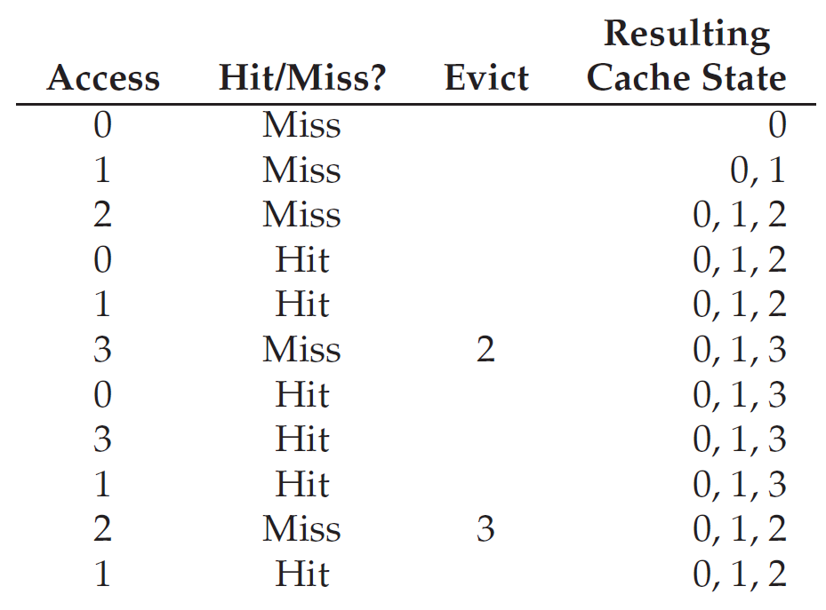
Example
Trace:0, 1, 2, 0, 1, 3, 0, 3, 1, 2, 1
Hit rate = 6/11 = 54.5%

Slide 35
First-In, First-Out Replacement Policy
Hate rate = 4/11 =36.4%

Slide 36
Belady’s Anomaly
The reference trace is 0,1,2,3,0,1,4,0,1,2,3,4
Time | 1 | 2 | 3 | 4 | 5 | 6 | 7 | 8 | 9 | 10 | 11 | 12
reference string | 0 | 1 | 2 | 3 | 0 | 1 | 4 | 0 | 1 | 2 | 3 | 4
primary device contents | - - - | 0 - - | 0 1 - | 0 1 2 | 1 2 3 | 2 3 0 | 3 0 1 | 0 1 4 | 0 1 4 | 0 1 4 | 1 4 2 | 4 2 3 | pages brought in
remove | - | - | - | 0 | 1 | 2 | 3 | - | - | 0 | 1 | -
bring in | 0 | 1 | 2 | 3 | 0 | 1 | 4 | - | - | 2 | 3 | - | 9

Slide 37
Belady’s Anomaly
The reference trace is 0,1,2,3,0,1,4,0,1,2,3,4
Time | 1 | 2 | 3 | 4 | 5 | 6 | 7 | 8 | 9 | 10 | 11 | 12
reference string | 0 | 1 | 2 | 3 | 0 | 1 | 4 | 0 | 1 | 2 | 3 | 4
primary device contents | - - - - | 0 - - - | 0 1 - - | 0 1 2 3 | 0 1 2 3 | 0 1 2 3 | 0 1 2 3 | 1 2 3 4 | 2 3 4 0 | 3 4 0 1 | 4 0 1 2 | 0 1 2 3 | pages brought in
remove | - | - | - | - | - | - | 0 | 1 | 2 | 3 | 4 | 0
bring in | 0 | 1 | 2 | 3 | - | - | 4 | 0 | 1 | 2 | 3 | 4 | 10

Slide 38
Random Replacement Policy
Hate rate = 5/11 =45.5%

Slide 39
Random Replacement Policy
How many hits Random achieves
over 10,000 trials
each with a different random seed
over 40% of the time Random is as good as optimal

Slide 40
LRU Replacement Policy
Lean on the past and use history as our guide
Frequency
if a page has been accessed many times, perhaps it should not be replaced as it clearly has some value
Least-Frequently-Used (LFU)
Replace the least-frequently used page
Recency of access
the more recently a page has been accessed, perhaps the more likely it will be accessed again
Least-Recently-Used (LRU)
Replace the least-recently-used page

Slide 41
LRU Replacement Policy
Hate rate = 6/11 =54.5%

Slide 42
Stack Algorithms
Subset property
For the optimal policy, always
the pages it keeps in the 3-page memory
is a subset of that it keeps in the 4-page memory
No Belady’s anomaly if subset property holds
At all times and
For every possible capacity of primary device
It creates a total ordering for pages at a given time

Slide 43
Stack Algorithms for LRU
Time | 1 | 2 | 3 | 4 | 5 | 6 | 7 | 8 | 9 | 10 | 11 | 12
reference string | 0 | 1 | 2 | 3 | 0 | 1 | 4 | 0 | 1 | 2 | 3 | 4
stack contents after reference | 0 - - - - | 1 0 - - - | 2 1 0 - - | 3 2 1 0 - | 0 3 2 1 - | 1 0 3 2 - | 4 1 0 3 2 | 0 4 1 3 2 | 1 0 4 3 2 | 2 1 0 4 3 | 3 2 1 0 4 | 4 3 2 1 0 | number of moves in
size 1 in/out | 0/- | 1/0 | 2/1 | 3/2 | 0/3 | 1/0 | 4/1 | 0/4 | 1/0 | 2/1 | 3/2 | 4/3 | 12
size 2 in/out | 0/- | 1/- | 2/0 | 3/1 | 0/2 | 1/3 | 4/0 | 0/1 | 1/4 | 2/0 | 3/1 | 4/2 | 12
size 3 in/out | 0/- | 1/- | 2/- | 3/0 | 0/1 | 1/2 | 4/3 | -/- | -/- | 2/4 | 3/0 | 4/1 | 10
size 4 in/out | 0/- | 1/- | 2/- | 3/- | -/- | -/- | 4/2 | -/- | -/- | 2/3 | 3/4 | 4/0 | 8
size 5 in/out | 0/- | 1/- | 2/- | 3/- | -/- | -/- | 4/2 | -/- | -/- | -/- | -/- | -/- | 5

Slide 44
Random Access Workload
the workload
accesses 100 unique pages over time
choosing the next page to refer to at random
overall 10,000 pages are accessed

Slide 45
Random Access Workload
It doesn’t matter much which realistic policy you are using
LRU, FIFO, and Random all perform the same
the hit rate exactly determined by the size of the cache
When the cache is large enough to fit the entire workload
it also doesn’t matter which policy you use
all policies (even Random) converge to a 100% hit rate when all the referenced blocks fit in cache

Slide 46
Random Access Workload
Optimal performs noticeably better than the realistic policies
peeking into the future if it were possible
does a much better job of replacement

Slide 47
“80-20” Workload
Hot pages
80% of the references
is about to 20% of the pages
Cold pages
the remaining 20% of the references
is about the remaining 80% of the pages
Example
there are a total 100 unique pages
“hot” pages are referred to most of the time
“cold” pages the remainder.

Slide 48
“80-20” Workload

Slide 49
“80-20” Workload
both random and FIFO do reasonably well
LRU does better
it is more likely to hold onto the hot pages
those pages have been referred to frequently in the past
they are likely to be referred to again in the near future
Optimal does best
showing that LRU’s historical information is not perfect
Does LRU do better than random or FIFO?
It depends

Slide 50
“Looping Sequential” Workload
Refer to 50 pages in sequence
start at 0, then 1, ..., up to page 49,
repeat those accesses
for a total of 10,000 accesses to 50 unique pages

Slide 51
“Looping Sequential” Workload
Common in many applications such as databases
A worst case for both LRU and FIFO
kick out older pages
these older pages are going to be accessed sooner than the pages that the policies prefer to keep in cache
even with a cache of size 49, hit rate remains 0%
Random fares notably better
not quite approaching optimal, but at least achieving a non-zero hit rate
not having weird corner-case behaviors
used as TLB replacement policy

Slide 52
How to implement LRU?
Hardware should put a time stamp on each physical page whenever it is accessed
When evicting, it should sort the pages by their time stamps
It may be too many pages to be sorted
One million pages for 4GB memory with 4KB page-size

Slide 53
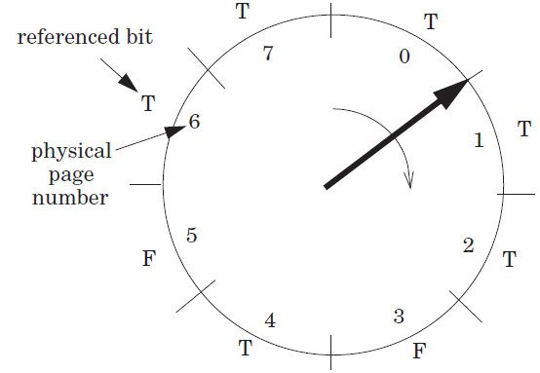
Clock Algorithm
Access bit
a hardware bit for each page
Set to true when accessed
Pages are organized as a clock
Start from a position
Move clockwise and checks the bit page-wise
If T, clear to F
Otherwise, choose as the victim and stop

Slide 54
Clock Algorithm
It doesn’t do quite as well as perfect LRU
It does better than approaches that don’t consider history at all
It can use dirty bit to reduce disk writing furthur

Slide 55
Page Selection Policies
When to bring pages into memory?
Demand paging
Prefetching
the OS could
guess a page is about to be used
and bring it in ahead of time
Clustering (grouping)
Set two numbers as low/high water mark
when available page number is less than the low water mark,
OS begins to evict pages
until the number of available pages reaches the high water mark

Slide 56
Control Thrashing
admission control
not to run some processes
hope to reduce working sets (the pages that they are using actively) to fit in memory
out-of-memory killer
A daemon
choose a memory intensive process and kill it
thus reducing memory
it kills the X server and thus renders any applications requiring the display unusable

Slide 57
Level 1, Level 2 and Level 3 Page Table Entry
63
62
52
51
12
11
9
8
7
6
5
4
3
2
1
0
XD
Unused
Page table physical base addr
Unused
G
PS
A
CD
WT
U/S
R/W
P=1
Available for OS (page table location in secondary storage)
P=0
XD Disable or enable instruction fetches
Base addr 40 most significant bits of base address of child page table (forces page tables to be 4KB aligned)
G global page (don’t evict from TLB on task switch)
PS Page size either 4K or 2M or 1G(may set to 1 only for
Level 2 or level 3 PTEs)
A Reference bit (set by MMU on reads and writes, cleared by software)
CD Cache disabled(1) or enabled(0) for child page table
WT Write-through or write-back cache policy
U/S User or supervisor(kernel) mode access permission
R/W Read-only or read-write access permissiom
P Child page table present in memory(1) or not(0)

Slide 58
Level 4 Page Table Entry
63
62
52
51
12
11
9
8
7
6
5
4
3
2
1
0
XD
Unused
Page table physical base addr
Unused
G
D
A
CD
WT
U/S
R/W
P=1
Available for OS (page table location in secondary storage)
P=0
XD Disable or enable instruction fetches
Base addr 40 most significant bits of base address of child page table (forces page tables to be 4KB aligned)
G global page (don’t evict from TLB on task switch)
D Dirty bit (Set by MMU on writes, cleared by software)
A Reference bit (set by MMU on reads and writes, cleared by software)
CD Cache disabled(1) or enabled(0) for child page table
WT Write-through or write-back cache policy
U/S User or supervisor(kernel) mode access permission
R/W Read-only or read-write access permissiom
P Child page table present in memory(1) or not(0)

Slide 59
Level 2 and Level 3 Page Table Entry
63
62
52
51
12
11
9
8
7
6
5
4
3
2
1
0
XD
Unused
Page table physical base addr
Unused
G
D
A
CD
WT
U/S
R/W
P=1
Available for OS (page table location in secondary storage)
P=0
XD Disable or enable instruction fetches
Base addr 40 most significant bits of base address of child page table (forces page tables to be 4KB aligned)
G global page (don’t evict from TLB on task switch)
D Dirty bit (used in Level 2 or level 3 PTEs for page
size 2M or 1G respectively)
A Reference bit (set by MMU on reads and writes, cleared by software)
CD Cache disabled(1) or enabled(0) for child page table
WT Write-through or write-back cache policy
U/S User or supervisor(kernel) mode access permission
R/W Read-only or read-write access permissiom
P Child page table present in memory(1) or not(0)

Slide 60
Linux Virtual Memory System
Process-specific data structures (e.g. task and mm structs,
page tables, kernel stack)
Different for each process
Kernel virtual memory
Physical memory
Identical for each process
Kernel code and data
User stack
%esp
Memory mapped region for shared libraries
Process virtual memory
brk
Run-time heap (via malloc)
Uninitialized data (.bss)
Initialized data (.data)
Program text (.text)
x08048000 (32) x40000000 (64)

Slide 61
How to Evict Page Table
20
12
It is physical address accessed
Each physical address has a virtual counter part
VPN
VPO
VPN1
VPN2
Mem
PDE
p=0
PDBR
Page directory
Disk
PTE
p=0
data
Page table
Data page

Slide 62
Questions
How does the clock algorithm get the reference bit for Physical Pages?
MMU only sets the access bit in VP.
DMA does not set the A bit; how does the lock algorithm handle these Physical Pages?

