Slide 1
Exceptional Control FlowⅢ

Slide 2
Outline
Reaping Child Processes
Putting Processes to Sleep
Loading and Running Programs
Suggested reading 8.4

Slide 3
Reap Child Processes

Slide 4
Zombie
The kernel does not remove a terminated process from the system immediately after the process terminates
The process is kept around in a terminated state until it is reaped by its parent.

Slide 5
Zombie
When the parent reaps the terminated child
the kernel passes the child’s exit status to the parent,
and then discards the terminated process, at which point it ceases to exist.
A terminated process that has not yet been reaped is called a zombie.

Slide 6
Zombie
If the parent process
terminates without reaping its zombie children,
the kernel arranges for the init process to reap them.
The init process
has a PID of 1
and is created by the kernel during system initialization.

Slide 7
Zombie
Long-running programs such as shells or servers should always reap their zombie children.
Even though zombies are not running, they still consume system memory resources.

Slide 8
Wait_pid Function
#include <sys/types.h> #include <sys/wait.h> pid_t waitpid(pid_t pid, int *status, int options); pid_t wait(int *status); Returns: PID of child if OK, 0 (if WNOHANG) or -1 on error

Slide 9
Wait_pid Function
pid_t waitpid(pid_t pid, int *status, int options);
pid > 0
The wait set is the singleton child process
whose process ID is equal to pid
pid = -1
The wait set consists of all of the parent’s child processes

Slide 10
Wait_pid Function
The waitpid function
If the calling process has no children
returns –1
sets errno to ECHILD
If interrupted by a signal
returns –1
sets errno to EINTR

Slide 11
Wait_pid Function
pid_t waitpid(pid_t pid, int *status, int options);
options = 0
waitpid suspends execution of the calling process until a child process in its wait-set terminates
If a process in the wait set has already terminated at the time of the call, then waitpid returns immediately
waitpid returns the PID of the terminated child that caused waitpid to return
the terminated child is removed from the system

Slide 12
Wait_pid Function
pid_t waitpid(pid_t pid, int *status, int options);
options
WNOHANG: Return immediately (with a return value of 0 ) if none of the child processes in the waiting set has terminated yet
WUNTRACED: Suspended execution of the calling process until a process terminated or stopped child that caused the return

Slide 13
Wait_pid Function
pid_t waitpid(pid_t pid, int *status, int options);
options
WUNTRACED | WNOHANG : Return immediately (with a return value of 0) if none of the children in the waiting set has stopped or terminated, or with a return value equal to the PID of one of the stopped or terminated children.

Slide 14
Wait_pid Function
pid_t waitpid(pid_t pid, int *status, int options);
Checking the exit status of a reaped child
The status argument is non-NULL
waitpid encodes status information about the child
that caused the return in the status argument.
The wait.h include file defines several macros
for interpreting the status argument

Slide 15
Wait_pid Function
pid_t waitpid(pid_t pid, int *status, int options);
WIFEXITED(status)
Returns true if the child terminated normally
via a call to exit or a return.
WEXITSTATUS(status)
Returns the exit status of a normally terminated child.
This status is only defined if WIFEXITED returned true.

Slide 16
Wait_pid Function
pid_t waitpid(pid_t pid, int *status, int options);
WIFSIGNALED(status)
Returns true if the child process terminated because of a signal that was not caught
WTERMSIG(status)
Returns the number of the signal that caused the child process to terminate.
This status is only defined if WIFSIGNALED returned true.

Slide 17
Wait_pid Function
pid_t waitpid(pid_t pid, int *status, int options);
WIFSTOPPED(status)
Returns true if the child that caused the return is currently stopped.
WSTOPSIG(status)
Returns the number of the signal that caused the child to stop.
This status is only defined if WIFSTOPPED returned true.

Slide 18
Wait_pid Function (Nondeterministic)
1 #include "csapp.h"
2 #define N 2
3
4 int main()
5 {
6 int status, i;
7 pid_t pid;
8
9 /* Parent creates N children */
10 for (i = 0; i < N; i++)
11 if ((pid = Fork()) == 0) /* child */
12 exit(100+i);
13

Slide 19
Wait_pid Function (Nondeterministic)
14 /* Parent reaps N chds. in no particular order */
15 while ((pid = waitpid(-1, &status, 0)) > 0) {
16 if (WIFEXITED(status))
17 printf("child %d terminated normally with exit
18 status=%d\n", pid, WEXITSTATUS(status));
19 else
20 printf("child %d terminated abnormally\n", pid);
21 }
22
23 /* The only normal term. is if there no more chds. */
24 if (errno != ECHILD)
25 unix_error("waitpid error");
26
27 exit(0);
28}

Slide 20
Wait_pid Function (Nondeterministic)
unix>./waitpid1
child 22966 terminated normally with exit status=100
child 22967 terminated normally with exit status=101
There is no reaping order, every one is equally correct
Nondeterministic behavior for concurrency

Slide 21
Wait_pid Function (Deterministic)
1 #include "csapp.h"
2 #define N 2
3
4 int main()
5 {
6 int status, i;
7 pid_t pid[N+1], retpid;
8
9 /* Parent creates N children */
10 for (i = 0; i < N; i++)
11 if ((pid[i] = Fork()) == 0) /* Child */
12 exit(100+i);
13
14 /* Parent reaps N children in order */
15 i = 0;

Slide 22
Wait_pid Function (Deterministic)
15 while ((retpid = waitpid(pid[i++], &status, 0)) > 0) {
16 if (WIFEXITED(status))
18 printf("child %d terminated normally with exit
19 status=%d\n", retpid, WEXITSTATUS(status));
20 else
21 printf("child %d terminated abnormally\n", retpid);
22 }
23
24 /* The only normal term. is if there are no more chds. */
25 if (errno != ECHILD)
26 unix_error("waitpid error");
27
28 exit(0);
29}

Slide 23
Putting Process to Sleep
#include <unistd.h> unsigned int sleep(unsigned int secs); Returns: seconds left to sleep int pause(void); Always returns -1
Suspends a process for some period of time.
Returns zero if the requested amount of time has elapsed
Returns the number of seconds still left to sleep otherwise.

Slide 24
Load and Run Processes

Slide 25
Loading and Running
#include <unistd.h> int execve(const char *filename, const char *argv[], const char *envp[]); does not return if OK, returns -1 on error
Loads and runs
the executable object file filename
with the argument list argv
the environment variable list envp.
returns to the calling program only if there is an error
such as not being able to find filename.
The Execve is called once and never returns

Slide 26
Loading and Running
int execve(const char *filename, const char *argv[], const char *envp[]);
argv[]
argv
argv[0]
"ls"
argv[1]
"-lt"
...
argv[argc-1]
NULL
"/usr/include"
envp[]
envp
envp[0]
"PWD=/usr/droh"
envp[1]
"PRINTER=iron"
...
envp[n-1]
NULL
"USER=droh"

Slide 27
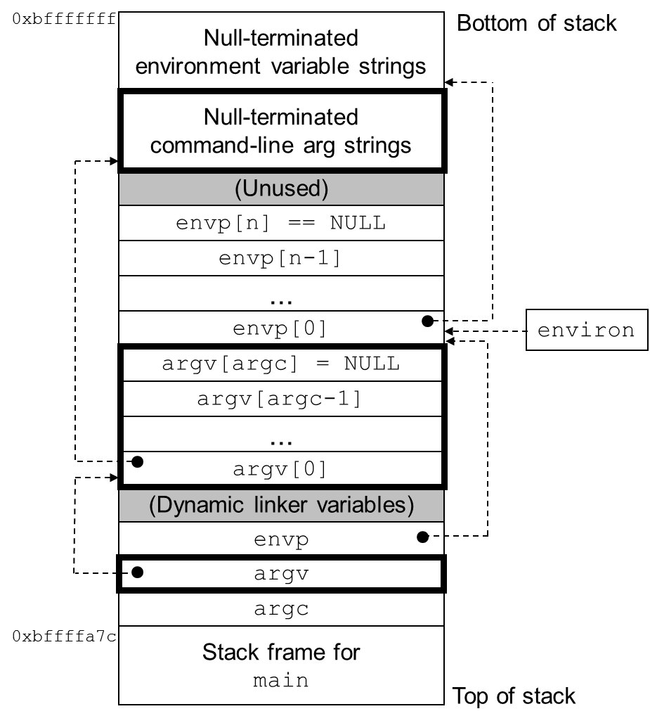
The user stack when a new program starts
0x7fffffffffff
environ
(global var)
envp
(in %rdx)
argv
(in %rsi)
argc
(in %rdi)
Stack frame for libc_start_main
0x7fffffffe840

Slide 28
Loading and Running
#include <unistd.h> char *getenv(const char *name); Returns: ptr to name if exists, NULL if no match. int setenv(const char *name, const char *newvalue, int overwrite); Returns: 0 on success, -1 on error. void unsetenv(const char *name); Returns: nothing.

Slide 29
Write your Own Shell

Slide 30
Unix Shell
An interactive application-level program that
runs other program on behalf of the user
Variants: sh, csh, tcsh, ksh, bash
Performs a sequence of read/evaluate steps and terminate
Read: reads a command line from the user
Evaluate: parses the command line and runs programs on behalf of the user

Slide 31
/* The main routine for a simple shell program */
1 #include "csapp.h"
2 #define MAXARGS 128
3
4 /* function prototypes */
5 void eval(char*cmdline);
6 int parseline(const char *cmdline, char **argv);
7 int builtin_command(char **argv);
8

Slide 32
9 int main()
10 {
11 char cmdline[MAXLINE]; /* command line */
12
13 while (1) {
14 /* read */
15 printf("> ");
16 Fgets(cmdline, MAXLINE, stdin);
17 if (feof(stdin))
18 exit(0);
19
20 /* evaluate */
21 eval(cmdline);
22 }
23 }

Slide 33
1 /* eval - evaluate a command line */
2 void eval(char *cmdline)
3 {
4 char *argv[MAXARGS]; /* argv for execve() */
5 char buf[MAXLINE]; /* holds modified cmd line */
6 int bg; /* should the job run in bg or fg? */
7 pid_t pid; /* process id */
8
9 strcpy(buf, cmdline);
10 bg = parseline(buf, argv);
11 if (argv[0] == NULL)
12 return; /* ignore empty lines */
13

Slide 34
Parsing command line
Parse the space separated command-line arguments
Builds the argv vector
which will eventually be passed to execve

Slide 35
1 /* parse the cmd line and build the argv array */
2 int parseline(const char *cmdline, char **argv)
3 {
4 char *delim; /* first space delimiter */
5 int argc; /* number of args */
6 int bg; /* background job? */
7
8 buf[strlen(buf)-1] = ’ ’; /* replace trailing ’\n’ with space */
12 while (*buf && (*buf == ’ ’)) /* ignore spaces */
13 buf++;
14

Slide 36
12 /* build the argv list */
13 argc = 0;
14 while ((delim = strchr(buf, ’ ’))) {
15 argv[argc++] = buf;
16 *delim = ’\0’; /* replace space with ’\0’*/
17 buf = delim + 1;
18 while (*buf && (*buf == ’ ’)) /* ignore spaces */
19 buf++;
20 }
21 argv[argc] = NULL; /* set the end of argv list */
22
23 if (argc == 0) /* ignore blank line */
24 return 1;
25
26 /* should the job run in the background? */
27 if ((bg = (*argv[argc-1] == ’&’)) != 0)
28 argv[--argc] = NULL;
29 return bg;
30 }

Slide 37
Parsing command line
The first argument is assumed to be
either the name of a built-in shell command
that is interpreted immediately
or an executable object file
that will be loaded and run in the context of a new child process

Slide 38
14 if (!builtin_command(argv)) {
15 if ((pid = Fork()) == 0) { /* execute in child */
16 if (execve(argv[0], argv, environ) < 0) {
17 printf("%s: Command not found.\n", argv[0]);
18 exit(0);
19 }
20 }
21

Slide 39
14 if (!builtin_command(argv)) {
15 if ((pid = Fork()) == 0) { /* execute in child */
16 if (execve(argv[0], argv, environ) < 0) {
17 printf("%s: Command not found.\n", argv[0]);
18 exit(0);
19 }
20 }
21
34 /* if 1st arg is a builtin command, run it and return true */
35 int builtin_command(char **argv)
36 {
37 if (!strcmp(argv[0], "quit")) /* quit command */
38 exit(0);
39 if (!strcmp(argv[0], "&")) /* ignore singleton & */
40 return 1;
41 return 0; /* not a builtin command */
42 }

Slide 40
Foreground and Background
If the last argument is a “&” character
parseline returns 1
indicating the program should be executed in the background
(the shell returns to the top of the loop and waits for the next command)
Otherwise
parseline returns 0
indicating the program should be run in the foreground
(the shell waits for it to complete)

Slide 41
14 if (!builtin_command(argv)) {
15 if ((pid = Fork()) == 0) { /* execute in child */
16 if (execve(argv[0], argv, environ) < 0) {
17 printf("%s: Command not found.\n", argv[0]);
18 exit(0);
19 }
20 }
21
22 /* parent waits for foreground job to terminate */
23 if (!bg) { /* foreground */
24 int status;
25 if (waitpid(pid, &status, 0) < 0)
26 unix_error("waitfg: waitpid error");
27 }
28 else
29 printf("%d %s", pid, cmdline);
30 }
31 return;
32 }

