Slide 1
Dynamic Memory Allocation

Slide 2
Outline
The allocation functions
Suggested reading: 9.9

Slide 3
Dynamic Memory Allocation
Explicit vs. Implicit Memory Allocator
Explicit: application allocates and frees space
E.g., malloc and free in C
Implicit: application allocates, but does not free space
E.g. garbage collection in Java, ML or Lisp

Slide 4
Dynamic Memory Allocation
Allocation
In both cases the memory allocator provides an abstraction of memory as a set of blocks
Doles out free memory blocks to application

Slide 5
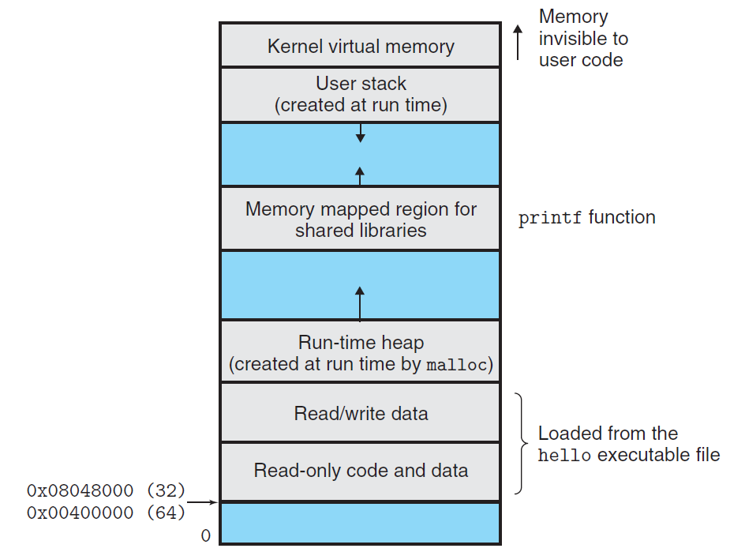
Run-time heap (created at run time by malloc)

Slide 6
Malloc package
#include <stdlib.h>
void *malloc(size_t size)
if successful:
returns a pointer to a memory block of at least size bytes, aligned to 8-byte boundary. (the memory is not cleared)
if size==0, returns NULL
if unsuccessful: returns NULL
void free(void *p)
returns the block pointed at by p to pool of available memory
p must come from a previous call to malloc, calloc or realloc.

Slide 7
Why Dynamic Memory Allocation
#define MAXN 15213
int array[MAXN];
int main(void)
{
int i, n;
scanf("%d", &n);
if (n > MAXN)
app_error("Input file too big");
for (i = 0; i < n; i++)
scanf("%d", &array[i]);
exit(0);
}

Slide 8
Why Dynamic Memory Allocation
#include "csapp.h"
int main(void)
{
int *array, i, n;
scanf("%d", &n);
array = (int *)Malloc(n * sizeof(int));
for (i = 0; i < n; i++)
scanf("%d", &array[i]);
exit(0);
}

Slide 9
sbrk() Function
#include <unistd.h>
void *sbrk(int incr)
If successful
It returns the old value of brk
If unsuccessful
It returns –1
It sets errno to ENOMEM
If incr is zero
It returns the current value
incr can be a negative number

Slide 10
sbrk
Run-time heap (created at run time by malloc)

Slide 11
sbrk
Run-time heap (created at run time by malloc)

Slide 12
sbrk
Run-time heap (created at run time by malloc)

Slide 13
Assumptions
In the following, memory is word addressed (each word holds 4 bytes)
Enforce double-word alignment
Free word
Allocated block
(4 words)
Free block
(3 words)
Allocated word

Slide 14
Allocation examples
p1 = malloc(4*sizeof(long))
p2 = malloc(5*sizeof(long))
p3 = malloc(6*sizeof(long))
free(p2)
p4 = malloc(2*sizeof(long))

Slide 15
Requirements
Handle arbitrary sequence of requests
Making immediate responses to requests
Using only the heap
Aligning blocks
Not modifying allocated blocks

Slide 16
Goals
Given some sequence of malloc and free requests:
R₀, R₁, ..., R_{k}, ... , R_{n-1}
Want to maximize throughput and peak memory utilization.
These goals are often conflicting

Slide 17
Performance goals: throughput
Number of completed requests per unit time
Example:
5,000 malloc calls and 5,000 free calls in 1 seconds
throughput is 10,000 operations/second.

Slide 18
Performance goals: peak memory utilization
Given some sequence of malloc and free requests:
R₀, R₁, ..., R_{k}, ... , R_{n-1}
Def: aggregate payload P_{k}
malloc(n) results in a block with a payload of n bytes.
After request R_{k} has completed, the aggregate payload P_{k} is the sum of currently allocated payloads.

Slide 19
Performance goals: peak memory utilization
Def: current heap size is denoted by H_{k}
Note that H_{k} is monotonically nondecreasing (can be relaxed)
Def: peak memory utilization:
After k requests, peak memory utilization is:
U_{k} = ( max_{i<=k} P_{i} ) / H_{k}

Slide 20
Fragmentation
Poor memory utilization caused by fragmentation
Two forms of fragmentation
Internal fragmentation
External fragmentation

Slide 21
Internal Fragmentation
Internal fragmentation
For some block, internal fragmentation is the difference between the block size and the payload size
block
Internal
fragmentation
payload
Internal
fragmentation

Slide 22
Internal Fragmentation
Internal fragmentation
Is caused by overhead of maintaining heap data structures, padding for alignment purposes, or explicit policy decisions (e.g., not to split the block).
Depends only on the pattern of previous requests, and thus is easy to measure.

Slide 23
External Fragmentation
Occurs when there is enough aggregate heap memory, but no single free block is large enough
p4 = malloc(6*sizeof(long))

Slide 24
External Fragmentation
External fragmentation depends on
the pattern of future requests
and thus is difficult to measure

Slide 25
Implementation Issues
How do we know how much memory to free just given a pointer?
How do we keep track of the free blocks?
p0
free(p0)
p1 = malloc(1)

Slide 26
Implementation Issues
How do we pick a block to use for allocation
many might fit?
What do we do with the extra space when allocating a structure that is smaller than the free block it is placed in?
How do we reinsert freed block?

Slide 27
Knowing how Much to Free
Standard method
keep the length of a structure in the word preceding the structure
This word is often called the header field or header
requires an extra word for every allocated structure

Slide 28
Knowing how Much to Free
p0 = malloc(4*sizeof(long))
p0
5
free(p0)
block size
data

Slide 29
Implicit List
Need to identify whether each block is free or allocated
Can use extra bit
Bit can be put in the same word as the size if block sizes are always multiples of 8 (mask out low order bit when reading size).

Slide 30
Implicit list
1 word
size
0
0
a
a = 1: allocated block
a = 0: free block
size: block size
payload: application data
(allocated blocks only)
payload
Format of
allocated and
free blocks
optional
padding
4
4
6
2
p

Slide 31
Finding a Free Block
First fit:
Search list from beginning, choose first free block that fits
Can take linear time in total number of blocks (allocated and free)
In practice it can cause “splinters” at beginning of list

Slide 32
Finding a Free Block
Next fit:
Like first-fit, but search list from location of end of previous search
Research suggests that fragmentation is worse
Best fit:
Search the list, choose the free block with the closest size that fits
Keeps fragments small --- usually helps fragmentation
Will typically run slower than first-fit

Slide 33
Allocating in a free block
Allocating in a free block - splitting
Since allocated space might be smaller than free space, we might want to split the block
4
4
6
2
p
4
4
4
2
2

Slide 34
Freeing a block
Simplest implementation:
Only need to clear allocated flag
But can lead to “false fragmentation”
There is enough free space, but the allocator won’t be able to find it
4
4
4
2
2
free(p)
p
4
4
4
2
2
malloc(5)

Slide 35
Coalescing
Join with next and/or previous block if they are free
Coalescing with next block
But how do we coalesce with previous block?
4
4
4
2
2
free(p)
p
4
4
6
2

Slide 36
Bidirectional
Boundary tags [Knuth73]
replicate size/allocated word at bottom of free blocks
Allows us to traverse the “list” backwards, but requires extra space
Important and general technique!

Slide 37
Bidirectional
1 word
header
size
0
0
a
a = 1: allocated block
a = 0: free block
size: block size
payload: application data
(allocated blocks only)
Format of
allocated and
free blocks
payload and
padding
boundary tag
(footer)
size
0
0
a
4
4
4
4
6
6
4
4

Slide 38
Constant Time Coalescing
Case 1
Case 2
Case 3
Case 4
block being
freed
allocated
allocated
free
free
allocated
free
allocated
free

Slide 39
Constant Time Coalescing (Case 1)
m1
1
m1
1
m1
1
m1
1
n
1
n
0
n
1
n
0
m2
1
m2
1
m2
1
m2
1

Slide 40
Constant Time Coalescing (Case 2)
m1
1
m1
1
m1
1
m1
1
n
1
n+m2
0
n
1
m2
0
m2
0
n+m2
0

Slide 41
Constant Time Coalescing (Case 3)
m1
0
n+m1
0
m1
0
n
1
n
1
n+m1
0
m2
1
m2
1
m2
1
m2
1

Slide 42
Constant Time Coalescing (Case 4)
m1
0
n+m1+m2
0
m1
0
n
1
n
1
m2
0
m2
0
n+m1+m2
0

