Slide 1
Exceptional Control Flow

Slide 2
Outline
Suggested reading Signals
Writing Signal Handlers
Nasty Concurrency Bugs
Explicitly waiting for signals
Suggested reading 8.5

Slide 3
Safe Signal Handling

Slide 4
Main Program and Signal Handlers are Concurrent
(1) Program catches signal s
(2) Control passes
to handler S
I_{curr}
(3) Program catches signal t
(4) Control passes
to handler T
I_{next}
(5) Handler T
returns to handler S
(7) Main program resumes
(6) Handler S
returns to main programm
s ≠ t

Slide 5
Concurrent Bugs
Concurrent bugs
Tricky and subtle
A program works correctly most the time
When it fails, it fails in unpredictable and unrepeatable ways that are horrendously difficult to debug

Slide 6
Guidlines
G0 keep handlers as simple as possible
Might simply set a global flag and return immediately
all processing associated with the receipt of the signal is performed by the main program
which periodically checks (and reset) the flag

Slide 7
Guidlines
G1 call only asyn-signal-safe functions in your handler
Reentrant or cannot be interrupted
printf, sprintf, malloc, exit are not safe

Slide 8
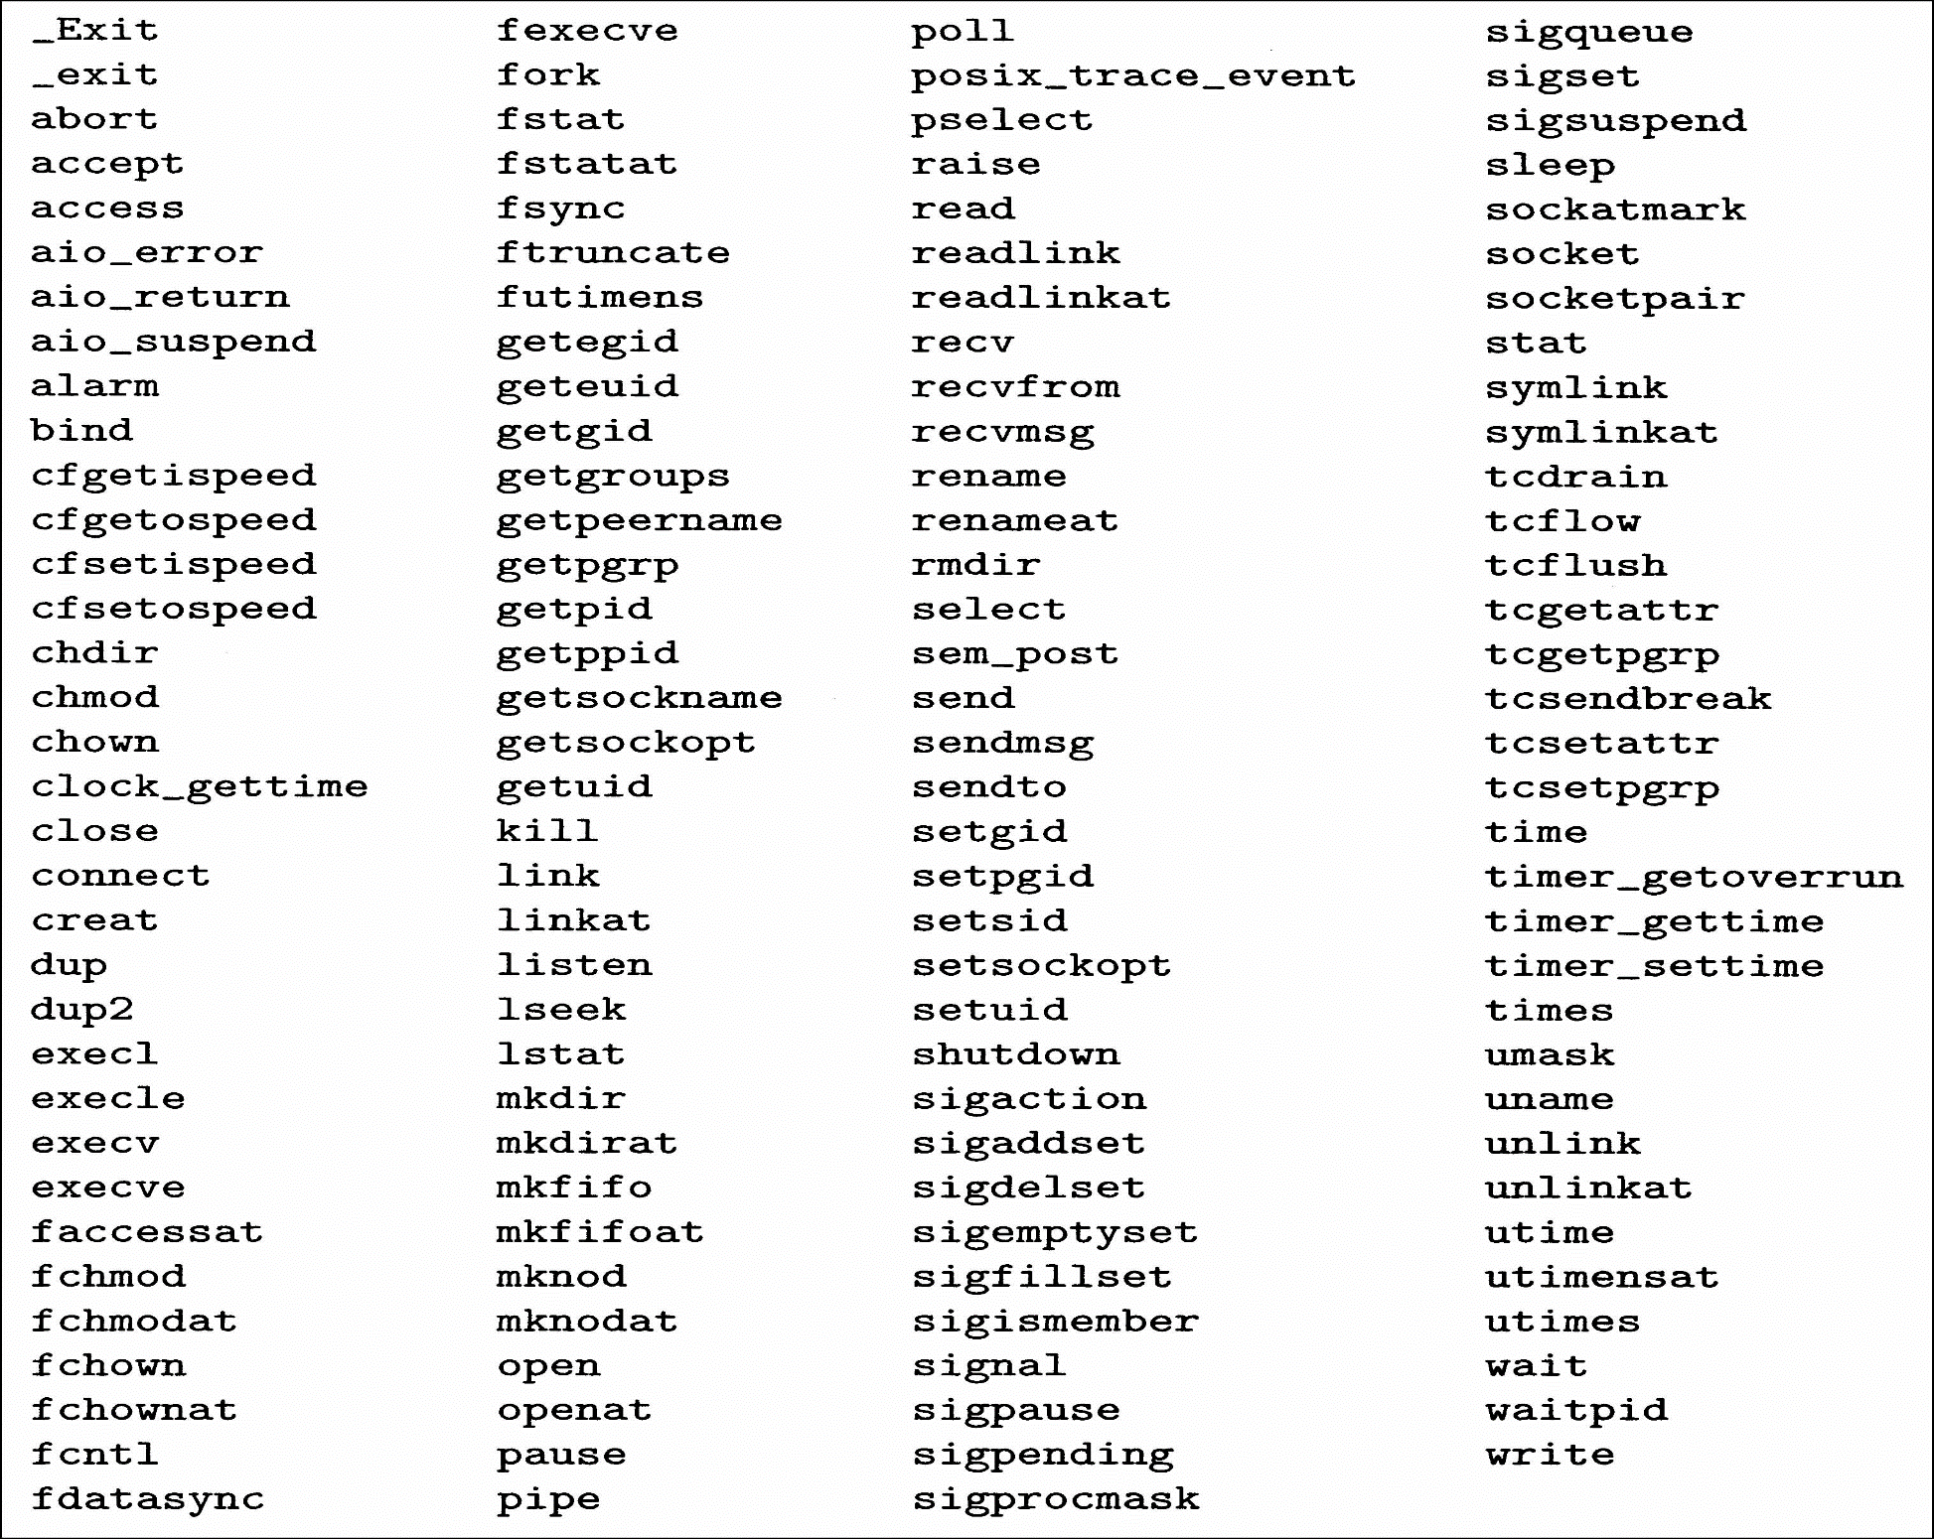
Guidlines

Slide 9
Safe I/O Package
#include <csapp.h> ssize_t sio_putl(long v); ssize_t sio_puts(char s[]); Returns: number of bytes transferred if OK, -1 on error void sio_error(long v); Returns: nothing
_exit is an asyn_signal_safe variant of exit

Slide 10
Safe I/O Package
ssize_t sio_puts(char s[]) /* Put string */
{
return write(STDOUT_FILENO, s, sio_strlen(s));
}
ssize_t sio_putl(long v) /* Put long */
{
char s[128];
sio_ltoa(v, s, 10); /* Based on K&R itoa() */
return sio_puts(s);
}
void sio_error(char s[]) /*Put error message and exit */
{
sio_puts(s);
_exit(1);
}

Slide 11
Guidlines
G2 Save and restore errno
Many async_signal_safe functions set errno when they return with an error
Calling such functions inside a handler might interfere with other parts of the program that rely on errno

Slide 12
Correct Signal Handling

Slide 13
14 int main()
15 {
16 int i, n; char buf[MAXBUF];
17 if (signal(SIGCHLD, handler1) == SIG_ERR)
18 unix_error("signal error");
19
20 /* parent creates children */
21 for (i = 0; i < 3; i++) {
22 if (Fork() == 0) {
23 printf("Hello from child %d\n", (int)getpid());
25 exit(0);
26 }
27 }
28 /* parent waits for term. input and then processes it */
29 if ((n = read(STDIN_FILENO, buf, sizeof(buf))) < 0)
30 unix_error("read");
31
32 printf("Parent processing input\n");
33 while (1) ;
34
35 exit(0);
36 }

Slide 14
1 #include "csapp.h"
2
3 void handler1(int sig)
4 {
5 int olderrno = errno;
6
7 if ((pid = waitpid(-1, NULL, 0)) < 0)
8 sio_error("waitpid error");
9 sio_puts("Handler reaped child %d\n");
sleep(1);
errno = olderrno ;
12 }
13

Slide 15
Q
linux> ./signal1
Hello from child 14073
Hello from child 14074
Hello from child 14075
Handler reaped child
Handler reaped child
<cr>
Parent processing input
<ctrl-z>
Suspended
linux> ps t
PID TTY STAT TIME COMMAND
...
14072 pts/3 T 0:02 ./signal1
14075 pts/3 Z 0:00 [signal1] <defunct>
14076 pts/3 R 0:00 ps t
Notes:
Why?

Slide 16
Signal Handling Issues
Pending signals can be blocked
Unix signal handlers typically block pending signals of the type currently being processed by the handler
Pending signals are not queued
There can be at most one pending signal of any particular type
then the second same type of pending signal is simply discarded

Slide 17
1 void handler2(int sig)
2 {
3 int olderrno = errno;
4
5 while ((pid = waitpid(-1, NULL, 0)) > 0) {
6 sio_puts("Handler reaped child %d\n");
7 }
8 if (errno != ECHILD)
9 sio_error("waitpid error");
10 sleep(1);
11 errno = olderrno ;
12 }

Slide 18
linux> ./signal2
Hello from child 10378
Hello from child 10379
Hello from child 10380
Handler reaped child
Handler reaped child
Handler reaped child
<cr>
Parent processing input

Slide 19
Portable Signal Handling

Slide 20
Different Signal-handling Semantics
Slow system calls
read, write, wait, accept
can potentially block the process for a long period of time
Some older Unix systems
restore the action for signal k to its default after signal k has been caught by a handler
return to the user immediately after a slow system call is interrupted (do not return to slow system call itself)

Slide 21
solaris> ./signal2
Hello from child 18906
Hello from child 18907
Hello from child 18908
Handler reaped child
Handler reaped child
Handler reaped child
read: Interrupted system call

Slide 22
15 int main()
16 {
17 int i, n; char buf[MAXBUF];
18 if (signal(SIGCHLD, handler2) == SIG_ERR)
19 unix_error("signal error");
20
21 /* parent creates children */
22 for (i = 0; i < 3; i++) {
23 if (Fork() == 0) {
24 printf("Hello from child %d\n", (int)getpid());
25 Sleep(1);
26 exit(0);
27 }
28 }
29 /* Manually restart the read if it is interrupted */
30 while ((n = read(STDIN_FILENO, buf, sizeof(buf))) < 0)
31 if (errno != EINTR)
32 unix_error("read");
33
34 printf("Parent processing input\n");
35 while (1) ;
36 exit(0);
37 }

Slide 23
solaris> ./signal3
Hello from child 19571
Hello from child 19572
Hello from child 19573
Handler reaped child 19571
Handler reaped child 19572
Handler reaped child 19573
<cr>
Parent processing input

Slide 24
sigaction Function
#include <signal.h> int sigaction(int signum, struct sigaction *act, struct sigaction *oldact); returns: 0 if OK, -1 on error struct sigaction { void (*sa_handler)(); /* addr of signal handler, or SIG_IGN, or SIG_DFL */ sigset_t sa_mask; /* additional signals to block */ int sa_flags; /* signal options */ } ;

Slide 25
1 handler_t *Signal(int signum, handler_t *handler)
2 {
3 struct sigaction action, old_action;
4
5 action.sa_handler = handler;
/* block sigs of type being handled */
6 sigemptyset(&action.sa_mask);
/* restart syscalls if possible */
7 action.sa_flags = SA_RESTART;
8
9 if (sigaction(signum, &action, &old_action) < 0)
10 unix_error("Signal error");
11 return (old_action.sa_handler);
12 }

Slide 26
Signal Function
Only signals of the type currently being processed by the handler are blocked
As with all signal implementations, signals are not queued
Interrupted system calls are automatically restarted whenever possible
Once the signal handler is installed, it remains installed until Signal is called with a handler argument of either SIG_IGN or SIG_DEF

Slide 27
A Nasty Concurrency Bug

Slide 28
Nasty Concurrency Bugs
1 /* WARNING: This code is buggy */
2 void handler(int sig)
3 {
4 int olderrno = errno ;
5 pid_t pid ;
6
7 while ( (pid = waitpid(-1, NULL, 0) > 0)) > 0) { /*reap a zombie child */
8 deletejob(pid); /*delete the child from the job list*/
9 }
10 if (errno != ECHILD)
11 sio_error(“waitpid error”) ;
12 errno = olderrno ;
13 }

Slide 29
A Nasty Concurrency Bug
14 int main(int argc, char **argv)
15 {
16 int pid;
17
18 Signal(SIGCHLD, handler);
19 initjobs(); /* initialize the job list */
20
21 while(1) {
22 if ((pid = Fork()) == 0) { /*Child process */
23 Execve(“/bin/ls”, argv, NULL);
24 }
25 addjob(pid) ; /* Parent process adds the child to the job list */
26 }
27 exit(0)
28 }

Slide 30
Guidlines
G3 Protect accesses to shared global data structures by blocking all signals

Slide 31
A Nasty Concurrency Bug
19 int main(int argc, char **argv)
20 {
21 int pid;
sigset_t mask_all, prev_all ;
Sigfillset(&mask_all);
Signal(SIGCHLD, handler);
26 initjobs(); /* initialize the job list */
27
28 while(1) {
29 if ((pid = Fork()) == 0) { /*Child process */
30 Execve(“/bin/ls”, argv, NULL);
}
/* parent process */
32 Sigprocmask(SIG_BLOCK, &mask_all, &prev_all);
33 addjob(pid) ; /* Add the child to the job list */
34 Sigprocmask(SIG_SETMASK, &prev_all, NULL);
35 }
36 exit(0)
37 }

Slide 32
Nasty Concurrency Bugs
1 /* WARNING: This code is still buggy */
2 void handler(int sig)
3 {
4 int olderrno = errno ;
5 sigsret_t mask_all, prev_all;
6 pid_t pid ;
7
8 Sigfillset(&mask_all) ;
/*reap a zombie child */
9 while ( (pid = waitpid(-1, NULL, 0) > 0)) > 0) {
10 SigProcmask(SIG_BLOCK, &mask_all, &prev_all);
11 deletejob(pid); /*delete the child from the job list*/
12 SigProcmask(SIG_SETMASK, &prev_all, NULL);
13 }
14 if (errno != ECHILD)
15 sio_error(“waitpid error”) ;
16 errno = olderrno ;
17 }

Slide 33
Nasty Concurrency Bugs
Incorrectly sequence of events
Parent executes fork and kernel schedules the newly created child
Child terminates and kernel delivers a SIGCHLD signal to parent
Parent receives the SIGCHLD signal and runs the signal handler
Signal handler calls deletejob
Parent return from fork and calls addjob

Slide 34
A Nasty Concurrency Bug
18 int main(int argc, char **argv)
19 {
20 int pid;
21 sigset_t mask_all, mask_one, prev_one ;
22
23 Sigfillset(&mask_all);
24 Sigemptyset(&mask_one);
25 Sigaddset(&mask_one, SIGCHLD);
26 Signal(SIGCHLD, handler);
27 initjobs(); /* initialize the job list */
28
29 while(1) {
30 Sigprocmask(SIG_BLOCK, &mask_one, &prev_one)/*
31 if ((pid = Fork()) == 0) { /*Child process */
32 Sigprocmask(SIG_SETMASK, &prev_one, NULL);
33 Execve(“/bin/ls”, argv, NULL);
34 }
Block SIGCHLD
Unblock SIGCHLD

Slide 35
A Nasty Concurrency Bug
/* parent process */
35 Sigprocmask(SIG_BLOCK, &mask_all, NULL);
36 addjob(pid) ; /* Add the child to the job list */
37 Sigprocmask(SIG_SETMASK, &prev_one, NULL);
38 }
38 exit(0)
40 }

Slide 36
Explicitly Waiting for Signals

Slide 37
Guidlines
G4 Declare global variables with volatile
Not to put the global into a register
G5 Declare flags with sig_atomic_t
atomic read/write is guaranteed among the main program and signal handlers
Compound operations are not guaranteed to be atomic such as flag++ or flag+=10

Slide 38
A Nasty Concurrency Bug
1 #include "csapp.h"
2
3 volatile sig_atomic_t pid;
4
5 void sigchld_handler(int s)
6 {
7 int olderrno = errno;
8 pid = waitpid(-1, NULL, 0);
9 errno = olderrno;
10 }
11
12 void sigint_handler(int s)
13 {
14 }
15

Slide 39
A Nasty Concurrency Bug
16 int main(int argc, char **argv)
17 {
18 sigset_t mask, prev;
19
20 Signal(SIGCHLD, sigchld_handler);
21 Signal(SIGINT, sigint_handler);
22 Sigemptyset(&mask);
23 Sigaddset(&mask, SIGCHLD);
24
25 while (1) {
26 Sigprocmask(SIG_BLOCK, &mask, &prev); /* Block SIGCHLD */
27 if (Fork() == 0) /* Child */
28 exit(0);
29

Slide 40
A Nasty Concurrency Bug
30 /* Parent */
31 pid = 0;
32 Sigprocmask(SIG_SETMASK, &prev, NULL);/* Unblock SIGCHLD */
33
34 /* Wait for SIGCHLD to be received (wasteful) */
35 while (!pid)
36 ;
37
38 /* Do some work after receiving SIGCHLD */
39 printf(".");
40 }
41 exit(0);
42 }

Slide 41
Eliminate the Spin Loop
The spin loop is wasteful for CPU resources
inserting a pause in the body of the spin loop:
while (!pid) /* Race! */
pause();
Still need a loop because pause might be interrupted by the receipt of one or more SIGINT signals
This code has a serious race condition:
if the SIGCHLD is received after the while test but before the pause
the pause will sleep forever

Slide 42
Eliminate the Spin Loop
Replace the pause with sleep:
while (!pid) /* Too slow! */
sleep(1);
This code is too slow
If the signal is received after the while and before the sleep
the program must wait a (relatively) long time before it can check the loop termination condition again

Slide 43
Eliminate the Spin Loop
Using a higher-resolution sleep function such as nanosleep isn’t acceptable
because there is no good rule for determining the sleep interval.
Make it too small
the loop is too wasteful.
Make it too high
the program is too slow.

Slide 44
signalsuspend Function
#include <signal.h> int sigsuspend(const sigset_t *mask); returns: −1
temporarily replaces the current blocked set with mask
suspends the process until the receipt of a signal whose action is either to run a handler or to terminate the process
If the action is to terminate, then the process terminates without returning from it.
If the action is to run a handler, then it returns after the handler returns, restoring the blocked set to its state when it was called.

Slide 45
Eliminate the Spin Loop
The sigsuspend function is equivalent to an atomic version of the following:
1 sigprocmask(SIG_SETMASK, &mask, &prev);
2 pause();
3 sigprocmask(SIG_SETMASK, &prev, NULL);
The atomic (uninterruptible) property guarantees that
the calls to sigprocmask (line 1) and pause (line 2) occur together, without being interrupted

Slide 46
A Nasty Concurrency Bug
1 #include "csapp.h"
2
3 volatile sig_atomic_t pid;
4
5 void sigchld_handler(int s)
6 {
7 int olderrno = errno;
8 pid = waitpid(-1, NULL, 0);
9 errno = olderrno;
10 }
11
12 void sigint_handler(int s)
13 {
14 }
15

Slide 47
A Nasty Concurrency Bug
16 int main(int argc, char **argv)
17 {
18 sigset_t mask, prev;
19
20 Signal(SIGCHLD, sigchld_handler);
21 Signal(SIGINT, sigint_handler);
22 Sigemptyset(&mask);
23 Sigaddset(&mask, SIGCHLD);
24
25 while (1) {
26 Sigprocmask(SIG_BLOCK, &mask, &prev); /* Block SIGCHLD */
27 if (Fork() == 0) /* Child */
28 exit(0);
29

Slide 48
A Nasty Concurrency Bug
30 /* Wait for SIGCHLD to be received */
31 pid = 0;
32 while (!pid)
33 sigsuspend(&prev);
34
35 /* Optionally unblock SIGCHLD */
36 Sigprocmask(SIG_SETMASK, &prev, NULL);
37
38 /* Do some work after receiving SIGCHLD */
39 printf(".");
40 }
41 exit(0);
42 }

