Slide 1
C Programming Language (1)

Slide 2
Outline
Compiler drivers
Assembly code and object code
Suggested reading
1.2

Slide 3
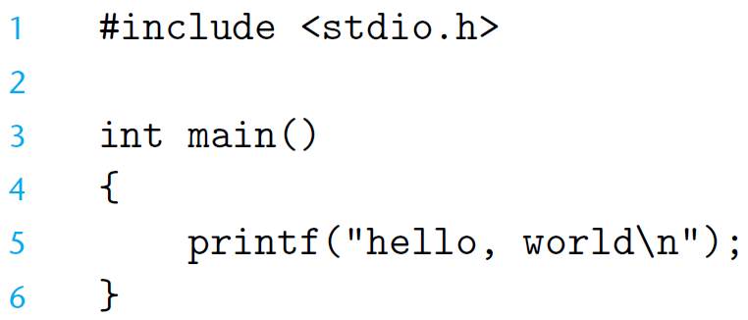
The Hello Program

Slide 4
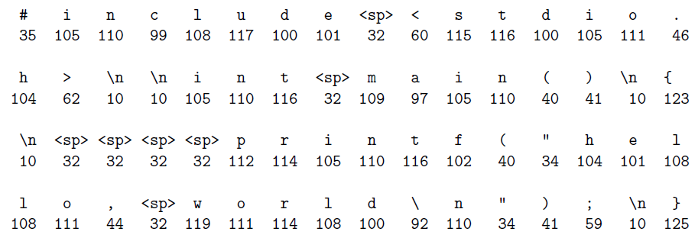
The Hello Program

Slide 5
The Hello Program
Source program
Created by editor and saved as a text file (Consists exclusively of ASCII characters)
Binary file
Not text file
Begins life as a high-level C program
Can be read and understand by human beings
The individual C statements must be translated by compiler drivers
So that the hello program can run on a computer system

Slide 6
The Hello Program
The C programs are translated into
A sequence of low-level machine-language instructions
These instructions are then packaged in a form
called an object program
Object program are stored as a binary disk file
Also referred to as executable object files

Slide 7
The Context of a Compiler (gcc)
hello.c
Source program (text)
Preprocessor (cpp)
hello.i
Modified source program (text)
Compiler (cc1)
hello.s
Assembly program (text)
Assembler (as)
hello.o
Relocatable object program (binary)
Linker (ld)
hello
Executable object program (binary)

Slide 8
Preprocessor
Macro Substitution
a.c #include “b.h” main() { return i+j ; } | b.h #define i 100 int j ;
# 1 "a.c"
# 1 "<built-in>"
# 1 "<command-line>"
# 1 "a.c"
# 1 "b.h" 1
int j;
# 2 "a.c" 2
main()
{
return 100 +j ;
}
Obtain with command
gcc -E a.c
Source file a.i

Slide 9
Source Code and Assembly Code
//C code long mult2(long, long); void multstore(long x, long y, long *dest) { long t = mult2(x, y); *dest = t; }
Obtain with command gcc –Og -S mstore.c | Assembly file mstore.s multstore: pushq %rbx movq %rdx,%rbx call mult2 movq %rax, (%rbx) popq %rbx ret

Slide 10
Relocatable Object Code
53 48 89 d3 e8 00 00 00 00 48 89 03 5b c3 | Obtain with command gcc –Og -c mstore.c Relocatable object file mstore.o

Slide 11
Executable Object Code
#include <stdio.h> void mulstore(long, long, long*) int main() { long d; multstore(2, 3, &d); printf(“2 * 3 --> %d\n”, d); return 0; } long mult2(long a, long b) { long s = a * b ; return s; } | 53 48 89 d3 e8 42 00 00 00 48 89 03 5b c3
 | Obtain with command gcc –Og –o prog main.c mstore.c

Slide 12
Manipulating Information

Slide 13
Outline
Bit-level operations
Suggested reading
2.1.6~2.1.9

Slide 14
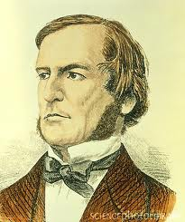

Boolean Algebra
Developed by George Boole(1815-1864)
Algebraic representation of logic
Encode “True” as 1
Encode “False” as 0
Claude Shannon(1916–2001)founded the information theory
made the connection between Boolean algebra and digital logic
Plays a central role in the design and analysis of digital systems

Slide 15
Boolean Algebra
And
A&B = 1 when both A=1 and B=1
Or
A|B = 1 when either A=1 or B=1
Not
~A = 1 when A=0
Exclusive-Or (Xor)
A^B = 1 when either A=1 or B=1, but not both

Slide 16
General Boolean Algebras
Operate on Bit Vectors
Operations applied bitwise
01101001
& 01010101
01000001
01101001
| 01010101
01111101
01101001
^ 01010101
00111100
~ 01010101
10101010

Slide 17
General Boolean Algebras
Representation of Sets
Width w bit vector represents subsets of {0, …, w–1}
a_{j} = 1 if j ∈ A
01101001 { 0, 3, 5, 6 }
01010101 { 0, 2, 4, 6 }
& Intersection 01000001 { 0, 6 }
| Union 01111101 { 0, 2, 3, 4, 5, 6 }
^ Symmetric difference 00111100 { 2, 3, 4, 5 }
~Complement 10101010 { 1, 3, 5, 7 }

Slide 18
Bit-Level Operations in C
Operations &, |, ~, ^ Available in C
Apply to any “integral” data type
long, int, short, char
View arguments as bit vectors
Arguments applied bit-wise

Slide 19
Bit-Level Operations in C
~0x41 | 0xBE
~0x00 | 0xFF
0x69 & 0x55 | 0X41
0x69 | 0x55 | 0x7D
~0100 0001
1011 1110
~0000 0000
1111 1111
0110 1001 & 0101 0101
0100 0001
0110 1001 | 0101 0101
0111 1101

Slide 20
Cool Stuff with Xor
Bitwise Xor is form of addition
With extra property that every value is its own additive inverse
A ^ A = 0

Slide 21
Cool Stuff with Xor
int inplace_swap(int *x, int *y)
{
*x = *x ^ *y; /* #1 */
*y = *x ^ *y; /* #2 */
*x = *x ^ *y; /* #3 */
}

Slide 22
Cool Stuff with Xor
1 void reverse_array(int a[], int cnt) {
2 int first, last;
3 for (first = 0, last = cnt-1;
4 first <= last;
5 first++,last--)
6 inplace_swap(&a[first], &a[last]);
7 }

Slide 23
Mask Operations
Bit pattern
0xFF
Having 1s for the least significant eight bits
Indicates the lower-order byte of a word
Mask Operation
X = 0x89ABCDEF
X & 0xFF =?
Bit Pattern ~0
Why not 0xFFFFFFFF?

Slide 24
Mask Operations
Write C expressions that work for any word size w ≥ 8
For x = 0x87654321, with w = 32
The least significant byte of x, with all other bits set to 0
[0x00000021]
x & 0xFF

Slide 25
Mask Operations
All but the least significant byte of complemented, with the least significant byte left unchanged
[0x789ABC21]
The least significant byte set to all 1s, and all other bytes of x left unchanged.
[0x876543FF].
x ^ ~0xFF
x | ~0xFF

Slide 26
Logical Operations in C
Logical Operators
&&, ||, !
View 0 as “False”
Anything nonzero as “True”
Always return 0 or 1
Early termination (short cut)

Slide 27
Logical Operations in C
Examples (char data type)
!0x41 --> 0x00
!0x00 --> 0x01
!!0x41 --> 0x01
0x69 && 0x55 --> 0x01
0x69 || 0x55 --> 0x01

Slide 28
Short Cut in Logical Operations
a && 5/a
If a is zero, the evaluation of 5/a is stopped
avoid division by zero
p && *p
Never cause the dereferencing of a null pointer
Using only bit-level and logical operations
Implement x == y
it returns 1 when x and y are equal, and 0 otherwise
!(x^y)

Slide 29
Shift Operations in C
Left Shift: x << y
Shift bit-vector x left y positions
Throw away extra bits on left
Fill with 0’s on right
Argument x
01100010
<< 3
00010000
Argument x
10100010
<< 3
00010000

Slide 30
Shift Operations in C
Right Shift: x >> y
Shift bit-vector x right y positions
Throw away extra bits on right
Logical shift
Fill with 0’s on left
Arithmetic shift
Replicate most significant bit on right
Useful with two’s complement integer representation (especially for the negative number )
Argument x
01100010
Log. >> 2
00011000
Arith. >> 2
00011000
Argument x
10100010
Log. >> 2
00101000
Arith. >> 2
11101000

Slide 31
Shift Operations in C
What happens ?
int lval = 0xFEDCBA98 << 32;
int aval = 0xFEDCBA98 >> 36;
unsigned uval = 0xFEDCBA98u >> 40;
It may be
lval 0xFEDCBA98 (0)
aval 0xFFEDCBA9 (4)
uval 0x00FEDCBA (8)
Be careful about
1<<2 + 3<<4 means 1<<(2 + 3)<<4

Slide 32
bitCount
Returns number of 1's a in word
Examples: bitCount(5) = 2, bitCount(7) = 3
Legal ops: ! ~ & ^ | + << >>
Max ops: 40

Slide 33
Sum 8 groups of 4 bits each
int bitCount(int x) {
int m1 = 0x11 | (0x11 << 8);
int mask = m1 | (m1 << 16);
int s = x & mask;
s += x>>1 & mask;
s += x>>2 & mask;
s += x>>3 & mask;

Slide 34
Combine the sums
/* Now combine high and low order sums */
s = s + (s >> 16);
/* Low order 16 bits now consists of 4 sums.
Split into two groups and sum */
mask = 0xF | (0xF << 8);
s = (s & mask) + ((s >> 4) & mask);
return (s + (s>>8)) & 0x3F;
}

Slide 35
Information Storage

Slide 36
Outline
Pointers and word size
Suggested reading
The first paragraph of 2.1
2.1.2
1.7.3

Slide 37
Computer Hardware - Von Neumann Architecture
Instructions / Program
Main
Memory
Arithmetic
Unit
Control
Unit
PC
AC
IR
SR
Addresses
Input/Output
Unit
E.g. Storage

Slide 38
Storage
The system component that remembers data values for use in computation
A wide-ranging technology
RAM chip
Flash memory
Magnetic disk
CD
Abstract model
READ and WRITE operations

Slide 39
READ/WRITE operations
Tow important concepts
Name and value
WRITE(name, value) value ← READ(name)
WRITE operation specifies
a value to be remembered
a name by which one can recall that value in the future
READ operation specifies
the name of some previous remembered value
the memory device returns that value

Slide 40
Memory
Bytes
Addr.
One kind of storage device
Value has only fixed size (usually byte)
Name belongs to a set consisting of consecutive integers started from 0
The integer number is called address
The set is called address space
0000
0001
0002
0003
0004
0005
0006
0007
0008
0009
0010
0011
0012
0013
0014

Slide 41
Word Size
A virtual address is encoded by
a word with fixed size
Word size indicates the size of such kind of the word
Which defines the maximum size of the virtual address space
the most important system parameter determined by the word size

Slide 42
Word Size
For machine with n-bit word size
Virtual address can range from 0 to 2^{n}-1
Most current machines are 64 bits (8 bytes)
Potentially address  1.8 X 10¹⁹ bytes
Most current machines also support 32 bits (4 bytes)
Limits addresses to 4GB
Becoming too small for memory-intensive applications
Unfortunately
it also used to indicate the normal size of integer

Slide 43
Data Size
Machines support multiple data formats
Always integral number of bytes

Slide 44
Data Size
C Declaration |  | Bytes
Signed | Unsigned | 32-bit | 64-bit
char | unsigned char | 1 | 1
short | unsigned short | 2 | 2
int | unsigned | 4 | 4
long | unsigned long | 4 | 8
int32_t | uint_32 | 4 | 4
int64_t | uint_64 | 8 | 8
char * |  | 4 | 8
float |  | 4 | 4
double |  | 8 | 8

Slide 45
intN_t and uintN_t
Another class of integer types
specifying N-bit signed and unsigned integers
Introduced by the ISO C99 standard
In the file stdint.h.
Typical values
int8_t, int16_t, int32_t, int64_t
unit8_t, uint16_t, uint32_t, uint64_t
N are implementation dependent

Slide 46
Data Size Related Bugs
Difficulty to make programs portable across different machines and compilers
The program is sensitive to the exact sizes of the different data types
The C standard sets lower bounds on the numeric ranges of the different data types
but there are no upper bounds

Slide 47
Data Size Related Bugs
32-bit machines have been the standard from 1990s to 2010s
Many programs have been written
assuming the allocations listed as “32-bit” in the table
With the increasing of 64-bit machines
many hidden word size dependencies show up as
bugs in migrating these programs to new machines

Slide 48
Example
At the time 32-bit dominated, many programmers assumed that
a program object declared as type int can be used to store a pointer
This works fine for most 32-bit machines
But leads to problems on an 64-bit machine

Slide 49
Address issues
IBM S/360: 24-bit address
PDP-11: 16-bit address
Intel 8086: 16-bit address
X86 (80386): 32-bit address
X86 32/64: 32/64-bit address

Slide 50
64-bit data models
Processors
4-bit | 8-bit | 12-bit | 16-bit | 18-bit | 24-bit | 31-bit | 32-bit | 36-bit | 48-bit | 64-bit | 128-bit
Applications
 |  |  | 16-bit |  |  |  | 32-bit |  |  | 64-bit
Data Sizes
nibble octet byte word dword qword

Slide 51
64-bit data models
Data model | short | int | long | long long | pointers | Sample operating systems
LLP64 | 16 | 32 | 32 | 64 | 64 | Microsoft Win64 (X64/IA64)
LP64 | 16 | 32 | 64 | 64 | 64 | Most Unix and Unix-like systems (Solaris, Linux, etc.)
ILP64 | 16 | 64 | 64 | 64 | 64 | HAL(Fujitsu subsidiary)
SILP64 | 64 | 64 | 64 | 64 | 64 | ?

