Slide 1
Dynamic Link

Slide 2
Outline
Dynamic Linking
Position Independent Code (PIC)
Loading and Linking Shared Libraries from applications
Suggested reading: 7.8~7.12

Slide 3
Disadvantages of Static Libraries
Minor bug fixes of system libraries require each application to explicitly relink
Duplicate lots of common code in the executable files
e.g., every C program needs the standard C library
Duplicate lots of code in the memory

Slide 4
Shared Libraries
Synonym
Shared object on Linux, denoted by .so suffix
DLL (dynamic link libraries) on Windows
What sharing means
Only one .so file for a particular library
Code and data in the .so file are shared by all the executable object files that reference the library

Slide 5
Shared Libraries
Generate the shared libraries
Unix> gcc –shared –fPIC –o libvector.so addvec.c multvec.c
–shared: creating a shared object
–fPIC: crating the position independent code

Slide 6
Partially Linking
main2.c
vector.h
libc.so
libvector.so
Translators(cc1, as)
main2.o
Relocation and symbol table info
Linker (ld)
p2
Partially linked executable object code file
Partially link with shared libraries
Unix>gcc –o p2 main2.c ./libvector.so

Slide 7
Partially Linking
Which parts in libvector.so are copied into p2
The code and data sections No
Relocation and symbol table information Some

Slide 8
Dynamically linking
p2
Partially linked executable object code file
libc.so
libvector.so
Loader(execve)
Code and data
Dynamic Linker(ld-linux.so)
Fully linked executable in memory

Slide 9
Dynamically linking
Done by execve() & ld-linux.so
Copy code and data of libc.so and libvector.so into some memory segments
Relocate any references in p2 to symbols defined by libc.so and libvector.so
After linking, the locations of the shared libraries are fixed and do not change during the execution time
How to find the ld-linux.so
The pathname of the ld-linux.so is contained in the .interp segment of p2

Slide 10
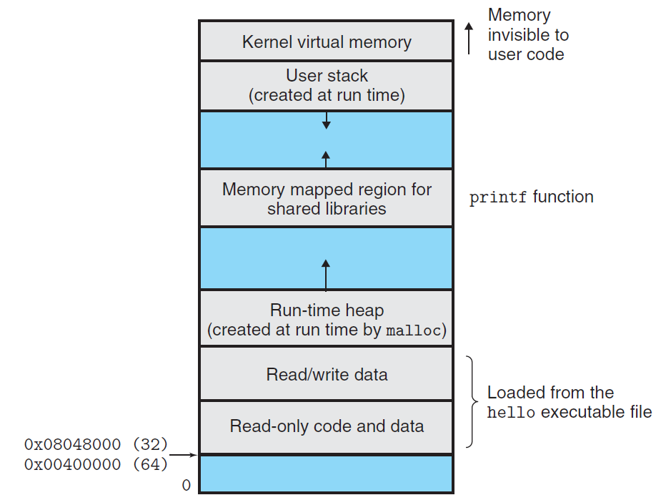
Memory mapped region for shared libraries

Slide 11
Linking at Running Time
Loading and Linking Shared Libraries from Applications
Done explicitly by user with dlopen() in Linux
Unix>gcc –rdynamic –O2 –o p3 dll.c -ldl

Slide 12
Linking at Running Time
#include <dlfcn.h>
void *dlopen(const char *filename, int flag) ;
returns: ptr to handle if OK, NULL on error
void *dlsym(void *handle, char *symbol) ;
returns: ptr to symbol if OK, NULL on error
int dlclose(void *handle) ;
returns: 0 if OK, -1 on error
const char dlerror(void) ;
returns: errormsg if previous call to
dlopen, dlysym, or dlclose failed,
NULL if previous call was OK

Slide 13
#include <stdio.h>
#include <dlfcn.h>
int x[2] = { 1, 2} ;
int y[2] = { 3, 4} ;
int z[2];
int main()
{
void *handle;
void (*addvec)(int *, int *, int *, int ) ;
char *error ;

Slide 14
/*dynamically load the shared library that contains addvec() */
handle = dlopen(“./libvector.so”, RTLD_LAZY) ;
if (!handle) {
fprintf(stderr, “%s\n”, dlerror()) ;
exit(1) ;
}
/*get a pointer to the addvec() function we just loaded */
addvec = dlsym(handle, “addvec”) ;
if ( (error = dlerror()) != NULL ) {
fprintf(stderr, “%s\n”, error) ;
exit(1) ;
}

Slide 15
/* Now we can call addvec() just like any other function */
addvec(x, y, z, 2)
printf(“z=[%d, %d]\n”, z[0], z[1]) ;
/* unload the shared library */
if (dlclose(handle) <0) {
fprintf(stderr, “%s\n”, dlerror()) ;
exit(1) ;
}
return 0 ;
}

Slide 16
Why Linking at Running Time
Distributing software
Developers of Microsoft Windows applications frequently use shared libraries to distribute software updates.
They generate a new copy of a shared library; which users can then download and use as a replacement for the current version.
The next time they run their application, it will automatically link and load the new shared library.

Slide 17
Why Linking at Running Time
Building high-performance Web servers.
Modern high-performance Web servers can generate dynamic content using a more efficient and sophisticated approach based on dynamic linking.
package each function that generates dynamic content in a shared library.
When a request arrives from a Web browser, the server dynamically loads and links the appropriate function and then calls it directly.

Slide 18
Why Linking at Running Time
Building high-performance Web servers.
The function remains cached in the server’s address space, so subsequent requests can be handled at the cost of a simple function call.
This can have a significant impact on the throughput of a busy site.
Further, existing functions can be updated and new functions can be added at run time, without stopping the server.

Slide 19
Position-Independent Code (PIC)
Allow multiple running processes to share the same library code
Save precious memory resource
Naïve: assign a dedicated address
Inefficient use of the address space
Difficult to manage
Better: load and execute at any address
Position-independent code (PIC)
gcc with -fPIC

Slide 20
Position-Independent Code (PIC)
Position-Independent Code (PIC)
Internally-defined procedures (OK)
PC-relative reference
Externally-defined procedures and reference to global variable (NO)
Indirect reference
Global offset table (GOT)
Private
At the beginning of .data

Slide 21
Position-Independent Code (PIC)
PIC Data References
Data segment
Global offset table (GOT)
GOT[0] : …
GOT[1] : …
GOT[2] : …
GOT[3] : &addcnt
Fixed distance of 0x2008b9 bytes at run time between GOT[3] and addl instruction
Code segment
addvec:
mov 0x2008b9(%rip), %rax #%rax=*GOT[3]=&addcnt
addl $0x1, (%rax) # addcnt++

Slide 22
Position-Independent Code (PIC)
Lazy Binding
Global Offset Table (GOT)
.data
Procedure Linkage Table (PLT)
.text

Slide 23
Data segment
Global offset table (GOT)
GOT[0] : .addr of .dynamic
GOT[1] : .addr of reloc entries
GOT[2] : .addr of dynamic linker
GOT[3] : 0x4005b6 #sys startup
GOT[4] : 0x4005c6 #addvec()
GOT[5] : 0x4005d6 #printf()
Code segment
callq 0x4005c0 # call addvec
Procedure linkage table (PLT)
addvec:
# PLT[0] : call dynamic linker
4005a0: pushq *GOT[1]
4005a6: jmpq *GOT[2]
…
# PLT[2]: call addvec()
4005c0: jmpq *GOT[4]
4005c6: pushq $0x1
4005cb: jmpq 4005a0

Slide 24
Data segment
Global offset table (GOT)
GOT[0] : .addr of .dynamic
GOT[1] : .addr of reloc entries
GOT[2] : .addr of dynamic linker
GOT[3] : 0x4005b6 #sys startup
GOT[4] : 0x4005c6 #addvec()
GOT[5] : 0x4005d6 #printf()
Code segment
callq 0x4005c0 # call addvec
Procedure linkage table (PLT)
addvec:
1
# PLT[0] : call dynamic linker
4005a0: pushq *GOT[1]
4005a6: jmpq *GOT[2]
…
# PLT[2]: call addvec()
4005c0: jmpq *GOT[4]
4005c6: pushq $0x1
4005cb: jmpq 4005a0

Slide 25
Data segment
Global offset table (GOT)
GOT[0] : .addr of .dynamic
GOT[1] : .addr of reloc entries
GOT[2] : .addr of dynamic linker
GOT[3] : 0x4005b6 #sys startup
GOT[4] : 0x4005c6 #addvec()
GOT[5] : 0x4005d6 #printf()
Code segment
callq 0x4005c0 # call addvec
Procedure linkage table (PLT)
addvec:
# PLT[0] : call dynamic linker
4005a0: pushq *GOT[1]
4005a6: jmpq *GOT[2]
…
# PLT[2]: call addvec()
4005c0: jmpq *GOT[4]
4005c6: pushq $0x1
4005cb: jmpq 4005a0
2

Slide 26
Data segment
Global offset table (GOT)
GOT[0] : .addr of .dynamic
GOT[1] : .addr of reloc entries
GOT[2] : .addr of dynamic linker
GOT[3] : 0x4005b6 #sys startup
GOT[4] : 0x4005c6 #addvec()
GOT[5] : 0x4005d6 #printf()
Code segment
callq 0x4005c0 # call addvec
Procedure linkage table (PLT)
addvec:
# PLT[0] : call dynamic linker
4005a0: pushq *GOT[1]
4005a6: jmpq *GOT[2]
…
# PLT[2]: call addvec()
4005c0: jmpq *GOT[4]
4005c6: pushq $0x1
4005cb: jmpq 4005a0
3

Slide 27
Data segment
Global offset table (GOT)
GOT[0] : .addr of .dynamic
GOT[1] : .addr of reloc entries
GOT[2] : .addr of dynamic linker
GOT[3] : 0x4005b6 #sys startup
GOT[4] : 0x4005c6 #addvec()
GOT[5] : 0x4005d6 #printf()
Code segment
callq 0x4005c0 # call addvec
Procedure linkage table (PLT)
addvec:
# PLT[0] : call dynamic linker
4005a0: pushq *GOT[1]
4005a6: jmpq *GOT[2]
…
# PLT[2]: call addvec()
4005c0: jmpq *GOT[4]
4005c6: pushq $0x1
4005cb: jmpq 4005a0
4

Slide 28
Data segment
Global offset table (GOT)
GOT[0] : .addr of .dynamic
GOT[1] : .addr of reloc entries
GOT[2] : .addr of dynamic linker
GOT[3] : 0x4005b6 #sys startup
GOT[4] : 0x4005c6 #addvec()
GOT[5] : 0x4005d6 #printf()
Code segment
callq 0x4005c0 # call addvec
Procedure linkage table (PLT)
addvec:
# PLT[0] : call dynamic linker
4005a0: pushq *GOT[1]
4005a6: jmpq *GOT[2]
…
# PLT[2]: call addvec()
4005c0: jmpq *GOT[4]
4005c6: pushq $0x1
4005cb: jmpq 4005a0
5

Slide 29
Data segment
Global offset table (GOT)
GOT[0] : .addr of .dynamic
GOT[1] : .addr of reloc entries
GOT[2] : .addr of dynamic linker
GOT[3] : 0x4005b6 #sys startup
GOT[4] : &addvec()
GOT[5] : 0x4005d6 #printf()
Code segment
callq 0x4005c0 # call addvec
Procedure linkage table (PLT)
addvec:
# PLT[0] : call dynamic linker
4005a0: pushq *GOT[1]
4005a6: jmpq *GOT[2]
…
# PLT[2]: call addvec()
4005c0: jmpq *GOT[4]
4005c6: pushq $0x1
4005cb: jmpq 4005a0

Slide 30
Data segment
Global offset table (GOT)
GOT[0] : .addr of .dynamic
GOT[1] : .addr of reloc entries
GOT[2] : .addr of dynamic linker
GOT[3] : 0x4005b6 #sys startup
GOT[4] : &addvec()
GOT[5] : 0x4005d6 #printf()
Code segment
callq 0x4005c0 # call addvec
Procedure linkage table (PLT)
addvec:
# PLT[0] : call dynamic linker
4005a0: pushq *GOT[1]
4005a6: jmpq *GOT[2]
…
# PLT[2]: call addvec()
4005c0: jmpq *GOT[4]
4005c6: pushq $0x1
4005cb: jmpq 4005a0

