Slide 1


Instructor
臧斌宇
Email: byzang@sjtu.edu.cn
Office phone: 13917124245
Office hour: make an appointment
Room: 1312 software Bld.
陈榕
Email: rongchen@sjtu.edu.cn
Office phone: 13616861826

Slide 2
助教
刘年、易纪非、吴新月、宋小牛
  软件楼4号楼4层（3-403）
周三（地点待定）
  习题：18:00～20:00
  小测验
  期中考试

Slide 3
Text Books & Web Site
Randy Bryant and David O’Hallaron,
  Computer Systems: A Programmer’s Perspective
  3rd Edition
  Prentice Hall, 2016.
http://ipads.se.sjtu.edu.cn/courses/ics/

Slide 4
Grading
Exams(70%)
  Middle Exam (32%)
  Final Exam (32%)
  Quiz (6%, 2% each)
  All exams are open books/open notes.
Labs (30%)
  Five labs

Slide 5
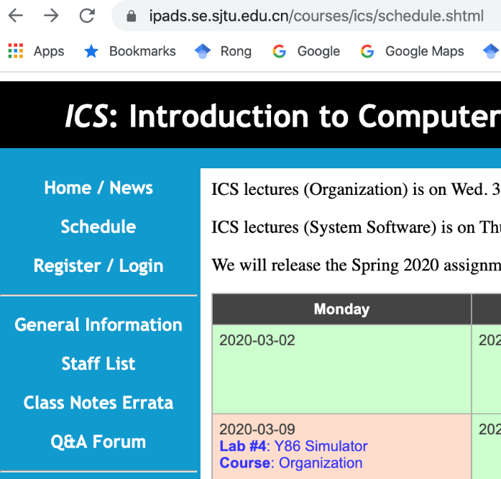

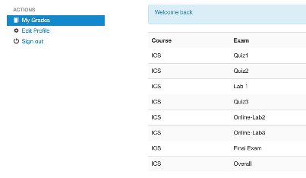
计算机系统基础（组成）
主页：https://ipads.se.sjtu.edu.cn/courses/ics/
  上学期没有选《计算机系统基础（汇编）》的学生，3月1日前完成注册
  账号：学号； 初始密码：111111（登录后修改）
学号
111111
初始密码
修改密码保存

Slide 6
计算机系统基础（组成）
温馨提示：
  进入Zoom课堂后请将昵称改为真实姓名
  提问发言请先“举手”
  如遇系统卡顿，主动反馈并耐心等待
  可在Zoom聊天室或微信群内留下与教学有关的问题或建议
  请尽快熟悉Zoom、Canvas的操作方式
  不迟到、不早退，按时完成作业
尊重并保护知识产权，不随意传播视频等课程资料

Slide 7
计算机系统基础课程结构
计算机系统基础（汇编）
2+1学分
计算机系统基础（组成）
3学分
4、5、6、7、9、补充
计算机系统基础（系统软件）
2+1学分
8、10、11、12、补充
Notes:
This is the modern division. There are other kinds besides superscalar, VLIW and EPIC, e.g. vector machine, stack machine (example is X87)
We will cover some of these topics in the last lesson of cpu design.

Slide 8
计算机系统基础（组成）
三类学生
  原本专业学生
  新转入本专业的学生
    自学计算机系统基础（汇编）
  其它专业的学生
    建议退课

Slide 9
RISC vs. CISC
(ch 4.1.3)

Slide 10
Instruction Set Architecture #1
What is instruction set architecture
  Instructions supported by a particular processor
    Assemble Language Abstraction
  Their byte-level encodings
    Machine Language Abstraction

Slide 11
Instruction Set Architecture #2
Layer of Abstraction
  Above: how to program machine
    Processor executes instructions in a sequence
  Below: what needs to be built
    Use tricks to make it run fast
    E.g., execute multiple instructions simultaneously
Application
Program
Compiler
OS
ISA
CPU
Design
Circuit
Design
Chip
Layout

Slide 12
Instruction Set Architecture #3
What does ISA provide?
  An abstraction of the real computer
    The syntax of computer instructions
    Programmer-visible computer status
    The semantics of instructions
    The execution model
  Hide the details of implementation
CISC (Complex instruction set computer)
RISC (Reduced instruction set computer)

Slide 13
Instruction Set Architecture #4
ISA define the processor family
  Two main kind: RISC and CISC
    RISC: ARM, MIPS, PowerPC, SPARC
    CISC: X86 (or called IA32)
Under same ISA, there are many different processors
  From different manufacturers
    X86 from Intel, AMD and VIA
  Different models
    atom, core i5, core i7
Notes:
This is the modern division. There are other kinds besides superscalar, VLIW and EPIC, e.g. vector machine, stack machine (example is X87)
We will cover some of these topics in the last lesson of cpu design.

Slide 14
CISC
Involved from the earliest computers
Mainframe and Minicomputers
  By the early 1980s
  their instruction sets had grown quite large
    Manipulating circular buffers
    performing decimal arithmetic
    evaluating polynomials
Microcomputer
  Appeared in 1970s, had limited instruction sets
    constrained by number of transistors on a single chip
  By the early 1980s, followed the path to increase their instruction sets

Slide 15



RISC
Developed in the early 1980s
  philosophy
    One could generate efficient code for a simpler form of instruction set
    Complex instructions are hard to generated with a compiler and seldom used
John Cocke (1925-2002)
  1987 ACM Turing Award
David Patterson(UC Berkeley), John Hennessy (Stanford )
  2017 ACM Turing Award

Slide 16
RISC
IBM | Power
IBM and Motorola | PowerPC
Sun Microsystems | SPARC
Digital Equipment Corporation | Alpha
Hewlett Pack | Pa-risc
MIPS Technologies | MIPS
Acorn Computers Ltd | ARM(Acorn RISC Machine)

Slide 17
RISC vs. CISC
CICS | Early RISC
A large number of instructions | Many fewer instructions (<100)
Some instructions with long execution times | No instruction with a long execution time
Variable-length encodings. (x86-64 1~15 bytes) | Fixed-length encodings
Multiple formats for specifying operands | Simple addressing formats
Arithmetic and logical operations can be applied to both memory and register operands | Arithmetic and logical operations only use register operands. load/store Architecture

Slide 18
RISC vs. CISC
CICS | Early RISC
Implementation artifacts hidden from machine level programs | Implementation artifacts exposed to machine level programs
Condition codes | explicit test instructions store the test results in normal registers for use in conditional evaluation
Stack-intensive procedure linkage | Registers are used for procedure arguments and return addresses

Slide 19
RISC
Cons for early RISC
  More instructions
  Not multiple cycles
  Exposing implementation artifacts to machine level programs
Pros for RISC
  Well suited for pipeline (high efficient implementation)
  Advanced compiler technology
  More computing power for a given amount of hardware
In the early 1990s, the debate diminished
  neither RISC nor CISC in their purest forms are better than designs that incorporated the best ideas of both

Slide 20
RISC
Evolved and introduced more instructions
  many of which take multiple cycles to execute
  Have hundreds of instructions
Exposing implementation artifacts to machine-level programs
  proved to be shortsighted
  As new processor models were developed
    using more advanced hardware structures,
    many of these artifacts became irrelevant,
    but they still remained part of the instruction set

Slide 21
RISC
RISC processors have done very well in the market for embedded processors
In these applications, saving on cost and power is more important than maintaining backward compatibility
In terms of the number of processors sold
  this is a very large and growing market
RISC processors do very well in the market for smart phone processors

Slide 22
CISC
Intel made it easy to keep moving from one generation of processor to the next
  By maintaining compatibility with its existing processors
As integrated-circuit technology improved
  x86 processor manufacturers could overcome the inefficiencies created by the original 8086 instruction set design
  using RISC techniques to produce performance comparable to the best RISC machines.

Slide 23
CISC
The core of RISC design
  is well suited to execution on a pipelined machine
X86 incorporates RISC features
  Dynamic translating CISC instructions to RISC-like ops and taking pipeline architectures
  X86-64 introduces more RISC features
Marketing issues determine the success of the ISAs
  X86 wins in high-end server, desktop, laptop machines
  RISC win in market of embedded processors and the smart phone

Slide 24
Y86-64
The Y86-64 instruction set
  taking a CISC instruction set (x86-64)
  simplifying it by applying some of the principles of RISC
On the CISC side
  condition codes, variable-length instructions
  uses the stack to store return addresses.
On the RISC side,
  a load/store architecture
  a regular instruction encoding
  passes procedure arguments through registers

