Slide 1
Modern Processors

Slide 2
Outline
Understanding Modern Processor
  Super-scalar
  Out-of –order execution
Suggested reading
  5.7

Slide 3
Instruction Control
Fetch
Control
Address
Instruction
Cache
Retirement
Unit
Instruction
Decode
Instructions
Register
File
Operations
Register Updates
Prediction OK?
Execution
Functional
Units
Branch
Arithmetic
operations
Arithmetic
operations
Load
Store
Operation Results
Addr.
Addr.
Data
Data
Data
Cache

Slide 4
Execution Unit
Multi-functional Units
  Receive operations from ICU
  Execute a number of operations on each clock cycle
  Handle specific types of operations
Execution
Functional
Units
Branch
Arithmetic
operations
Arithmetic
operations
Load
Store
Operation Results
Addr.
Addr.
Data
Data
Data
Cache

Slide 5
Multi-functional Units
Multiple Instructions Can Execute in Parallel
  Haswell CPU (Core i7)
      0. Integer arithmetic, FP multiplication, integer and FP division, branches
      1. Integer arithmetic, FP addition, integer multiplication, FP multiplication
      2. Load, address computation
      3. Load, address computation
      4. Store
      5. Integer arithmetic(basic operations)
      6. Integer arithmetic, branches
      7. Store address computation
Integer arithmetic: addition, bitwise operations, shifting

Slide 6
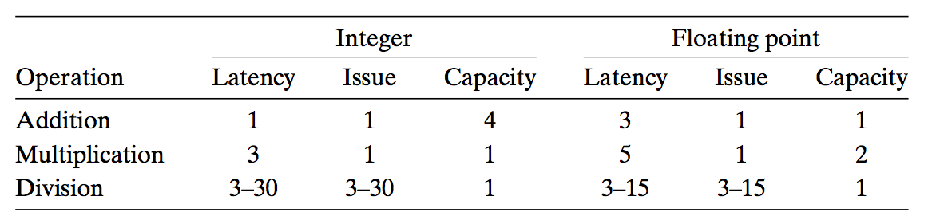
Multi-functional Units
Some Instructions Take > 1 Cycle, but Can be Pipelined
  Haswell (Core i7)

Slide 7
Execution Unit
Operation is dispatched to one of multi-functional units, whenever
  All the operands of an operation are ready
  Suitable functional units are available
Execution results are passed among functional units

Slide 8
Execution Unit
Data Cache
  Load and store units access memory via data cache
  A high speed memory containing the most recently accessed data values
Execution
Functional
Units
Branch
Arithmetic
operations
Arithmetic
operations
Load
Store
Operation Results
Addr.
Addr.
Data
Data
Data
Cache

Slide 9
Data-Flow Graphs
Data-Flow Graphs
  Visualize how the data dependencies in a program dictate its performance
  Example: combine4 (data_t = float, OP = *)
void combine4(vec_ptr v, data_t *dest)
{
long i;
long length = vec_length(v);
data_t *data = get_vec_start(v);
data_t x = IDENT;
for (i = 0; i < length; i++)
x = x OP data[i];
*dest = x;
}

Slide 10
Assembly Code vs. μ Code
.L25: # Loop:
vmulsd (%rdx),%xmm0,%xmm0 # t *= data[i]
addq $8, %rdx # Increment data+i
cmpq %rax,%rdx # Comp to data+len
jne .L25 # if !=, goto Loop
load (%rdx.0) ➔ t.1
mulq t.1, %xmm0.0 ➔ %xmm0.1
addq $8, %rdx.0 ➔ %rdx.1
cmpq %rax, %rdx.1 ➔ cc.1
jne-taken cc.1

Slide 11
Graphical Representation
%rax
%rdx
%xmm0
load
vmulsd (%rdx), %xmm0, %xmm0
mul
add
t
addq $8,%rdx
cmp
cmpq %rax,%rdx
jne
jne loop
cc
%rax
%rdx
%xmm0
Registers
  read-only: %rax
  write-only: -
  Loop: %rdx, %xmm0
  Local: t, cc
load (%rdx.0) ➔ t.1
mulq t.1, %xmm0.0 ➔ %xmm0.1
addq $8, %rdx.0 ➔ %rdx.1
cmpq %rax, %rdx.1 ➔ cc.1
jne-taken cc.1

Slide 12
Refinement of Graphical Representation
%rax
%rdx
%xmm0
Data Dependencies
load
mul
add
t
cmp
%xmm0
%rax
%rdx
jne
cc
load
%rax
%rdx
%xmm0
add
mul
cmp
jne
%xmm0
%rdx

Slide 13
Refinement of Graphical Representation
%xmm0
%rdx
Data Dependencies
load
data[i]
add
mul
%xmm0
%rax
%rdx
%xmm0
%rdx
load
add
mul
cmp
jne
%xmm0
%rdx

Slide 14
Refinement of Graphical Representation
%xmm0
%rdx
%xmm0.0
%rdx.0
load
data[i]
load
data[0]
add
add
mul
mul
%xmm0
%rdx
%xmm0.1
%rdx.1
load
data[1]
add
mul
%xmm0.2
%rdx.2

Slide 15
Execution Unit
Operation Results
  Functional units can send results directly to each other
  A elaborate form of data forwarding techniques
Execution
Functional
Units
Integer/
Branch
General
Integer
FP
Add
FP
Mult/Div
Load
Store
Operation Results
Addr.
Addr.
Data
Data
Data
Cache

Slide 16
Refinement of Graphical Representation
load
data[0]
%xmm0.0
%rdx.0
add
mul
load
data[0]
add
mul
load
data[1]
add
%xmm0.1
%rdx.1
mul
load
data[1]
..
..
add
mul
load
data[n-1]
add
%xmm0.2
%rdx.2
mul

Slide 17
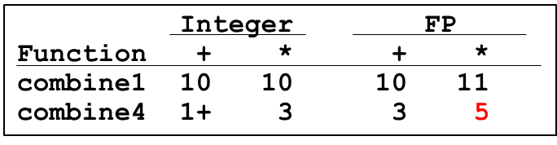
Refinement of Graphical Representation
data[0]
Two chains of data dependencies
  Update x by mul
  Update i by add
Critical path
  Latency of mul is 5
  Latency of add is 1
The latency of combine4 is 5
load
add
mul
load
data[1]
add
mul
..
..
load
data[n-1]
add
mul

Slide 18
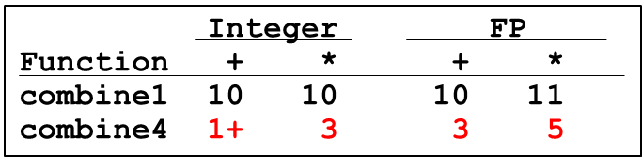
Performance-limiting Critical Path
  Nehalem (Core i7)

Slide 19
Other Performance Factors
Data-flow representation provide only a lower bound
  e.g. Integer addition, CPE = 1.2
  Total number of functional units available
  The number of data values can be passed among functional units
Next step
  Enhance instruction-level parallelism
  Goal: CPEs close to 1.0

Slide 20
More Code Optimization

Slide 21
Outline
More Code Optimization techniques
Optimization Limiting Factors
Suggested reading
  5.8 ~ 5.11

Slide 22
Loop Unrolling
void combine5(vec_ptr v, int *dest)
{
int i;
int length = vec_length(v);
int limit = length - 2;
data_t *data = get_vec_start(v);
data_t acc = IDENT;
/* combine 2 elements at a time */
for (i = 0; i < limit; i+=2)
acc = acc OPER data[i] OPER data[i+1];
/* finish any remaining elements */
for (; i < length; i++)
acc = acc OPER data[i];
*dest = acc ;
}
2*1 loop unrolling

Slide 23
Translation
Loads can parallel, since don’t have dependencies
Only one set of loop control operations
load (%rax,%rdx.0,4) ➔ d.1a
vmuld d.1a, %xmm0.0 ➔ %xmm0.1a
load 4(%rax,%rdx.0,4) ➔ d.1b
vmuld d.1b, %xmm0.1a ➔ %xmm0.1b
addq $2,%rdx.0 ➔ %rdx.1
cmpq %rdx.1, %rbp ➔ cc.1
jg-taken cc.1

Slide 24
Graphical Representation
%rax
%rbp
%rdx
%xmm0
load
vmulsd (%rax,%rdx,4), %xmm0
mul
load
d.a
vmulsd 4(%rax,%rdx,4), %xmm0
mul
d.b
add
addq $3,%rdx
cmp
cmpq %rdx,%rbp
jg
jg loop
cc
%rax
%rbp
%rdx
%xmm0

Slide 25
Graphical Representation
%xmm0
%rax
%rbp
%rdx
%xmm0
%rdx
load
load
data[i]
mul
mul
load
data[i+1]
load
mul
mul
add
add
%xmm0
%rdx
cmp
jg
%xmm0
%rdx

Slide 26
Effect of Unrolling 3*1
load
data[i]
load
data[i]
mul
add
load
data[i+1]
load
data[i+1]
add
load
data[i+2]
mul
add
add
load
data[i+2]
Critical path
  Latency of integer add is 1
  Latency of double mul is 5
mul
add

Slide 27
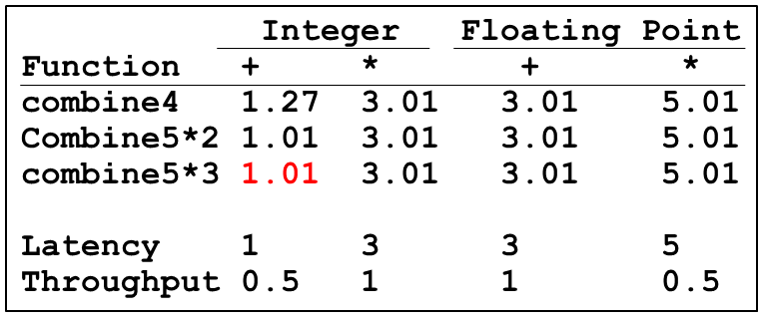
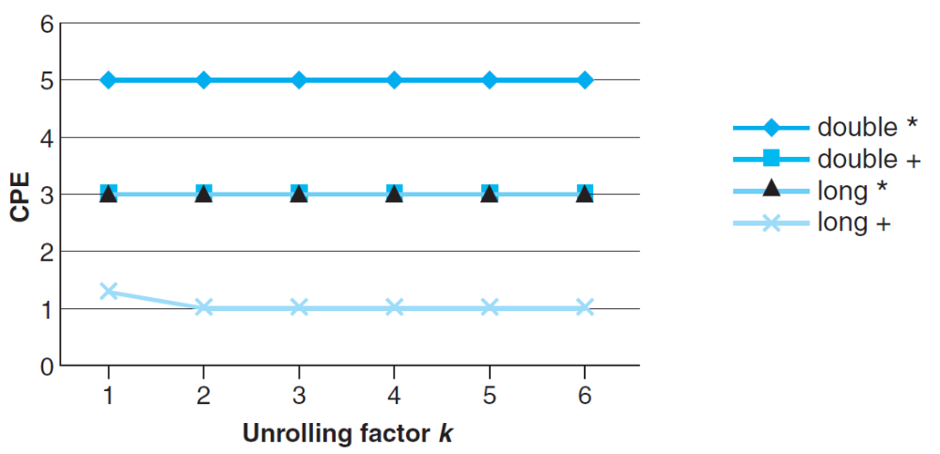
Graphical Representation
load
data[0]
mul
load
data[1]
add
mul
load
data[2]
mul
load
data[4]
add
mul

Slide 28
Loop Unrolling
Improve performance
  Reduces the number of operations
  (e.g. loop indexing and conditional branching)
  Transform the code to reduce the number of operations in the critical paths
Only helps integer sum for our examples
  Other cases constrained by functional unit latencies
Effect is nonlinear with degree of unrolling
  Many subtle effects determine exact scheduling of operations

Slide 29
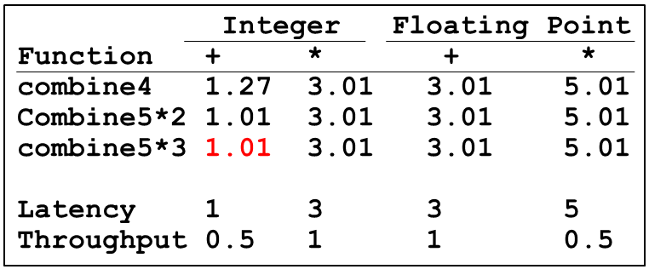
Practice Problem
The throughput bound for floating point multiplication is 0.5. Why?
There are four integer units, the throughput bound for integer addition is also 0.5. Why?

Slide 30
Enhance Parallelism
Multiple Accumulators
  Accumulate in two different sums
    Can be performed simultaneously
  Combine at end

Slide 31
Multiple Accumulator
void combine6(vec_ptr v, int *dest)
{
int i;
int length = vec_length(v), limit = length-1;
data_t *data = get_vec_start(v);
data_t acc0 = IDENT, acc1 = IDENT;
/* combine 2 elements at a time */
for (i = 0; i < limit; i+=2){
acc0 = acc0 OPER data[i];
acc1 = acc1 OPER data[i+1];
}
/* finish any remaining elements */
for (; i < length; i++)
acc0 = acc0 OPER data[i];
*dest = acc0 OPER acc1;
}

Slide 32
Translation
Two multiplies within loop no longer have data dependency
Allows them to pipeline
load (%rax,%rdx.0,4) ➔ d.1a
mulq d.1a, %xmm0.0 ➔ %xmm0.1
load 4(%rax,%rdx.0,4) ➔ d.1b
mulq d.1b, %xmm1.0 ➔ %xmm1.1
addq $2,%rdx.0 ➔ %rdx.1
cmpq %rdx.1, %rbp ➔ cc.1
jg-taken cc.1

Slide 33
Graphical Representation
%rax
%rbp
%rdx
%xmm0
%xmm1
load
mulsd (%rax,%rdx,4), %xmm0
mul
d.a
load
mulsd 4(%rax,%rdx,4), %xmm1
mul
add
d.b
addq $2,%rdx
cmp
cmpq %rdx,%rbp
jg
jg loop
cc
%rax
%rbp
%rdx
%xmm0
%xmm1

Slide 34
Graphical Representation
%xmm0
%rax
%xmm1
%rbp
%rdx
%xmm0
%xmm1
%rdx
load
data[i]
load
load
load
mul
mul
add
data[i+1]
add
mul
mul
cmp
%xmm0
%xmm1
%rdx
jg
%xmm0
%xmm1
%rdx

Slide 35
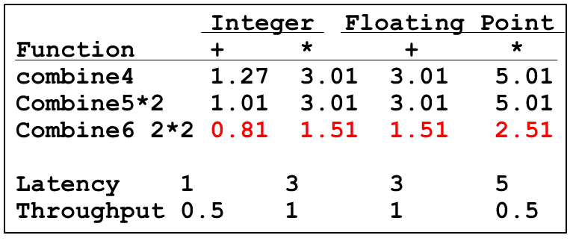
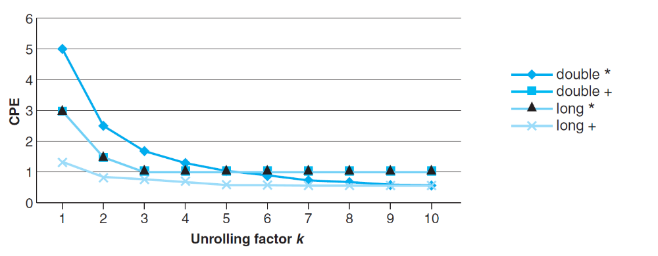
Graphical Representation
load
data[0]
load
mul
add
data[1]
mul
load
data[2]
load
mul
add
data[3]
mul
..
..
..
load
data[n-2]
load
mul
add
data[n-1]
mul

Slide 36
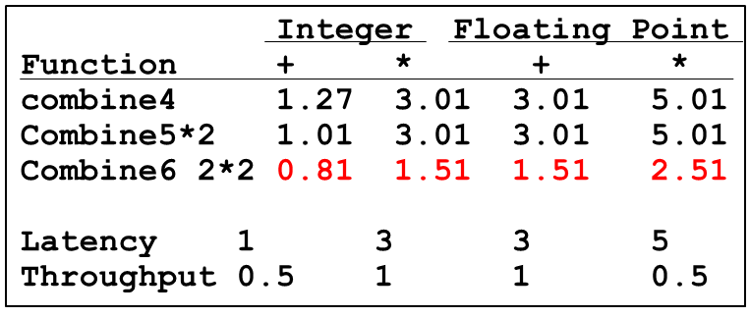
Practice Problem
There are two functional units for floating point multiplication, therefore it is obvious that its CPE improved from 5 to 2.5.
However, there is only one functional unit for either integer multiplication and floating point addition. Why their CPE improved?

Slide 37
Enhance Parallelism
Multiple Accumulators
  Accumulate in two different sums
    Can be performed simultaneously
  Combine at end
Re-association Transformation
  Exploits property that integer addition & multiplication are associative & commutative
  FP addition & multiplication not associative, but transformation usually acceptable

Slide 38
Re-association Transformation
void combine7(vec_ptr v, int *dest)
{
int i;
int length = vec_length(v), limit = length-1;
data_t *data = get_vec_start(v);
data_t acc = IDENT;
/* combine 2 elements at a time */
for (i = 0; i < limit; i+=2){
acc = acc OPER (data[i] OPER data[i+1]);
}
/* finish any remaining elements */
for (; i < length; i++)
acc = acc OPER data[i];
*dest = acc ;
}

Slide 39
Translation
Two multiplies within loop no longer have data dependency
Allows them to pipeline
load (%rax,%rdx.0,4) ➔ xmm0.0
load 4(%rax,%rdx.0,4) ➔ t.1
mulq t.1, %xmm0.0 ➔ xmm0.1
mulq %xmm0.1, %xmm1.0 ➔ xmm1.1
addq $2,%rdx.0 ➔ %rdx.1
cmpq %rdx.1, %rbp ➔ cc.1
jg-taken cc.1

Slide 40
Graphical Representation
%rax
%rbp
%rdx
%xmm0
%xmm1
load
movsd (%rax,%rdx,4), %xmm0
load
mulsd 4(%rax,%rdx,4), %xmm0
mul
t
mul
mulsd %xmm0, %xmm1
add
addq $2,%rdx
cmp
cmpq %rdx,%rbp
jg
jg loop
cc
%rax
%rbp
%rdx
%xmm0
%xmm1

Slide 41
Graphical Representation
%xmm1
%rax
%rbp
%rdx
%xmm1
%rdx
load
load
load
load
data[i]
mul
add
mul
add
data[i+1]
cmp
mul
mul
jg
%xmm0
%rdx
%xmm0
%rdx

Slide 42
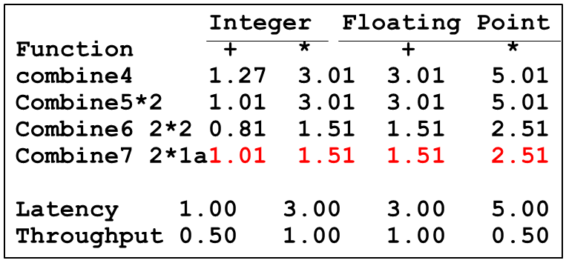
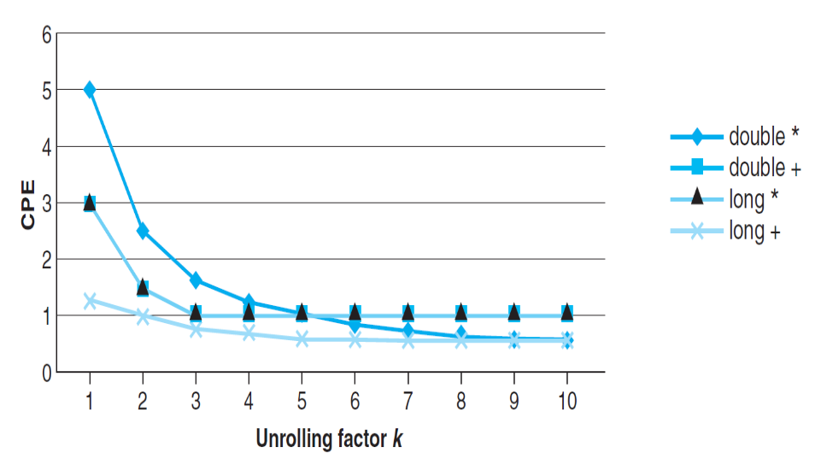
Graphical Representation
load
load
data[0]
mul
add
data[1]
mul
load
load
data[2]
mul
add
data[3]
mul

Slide 43
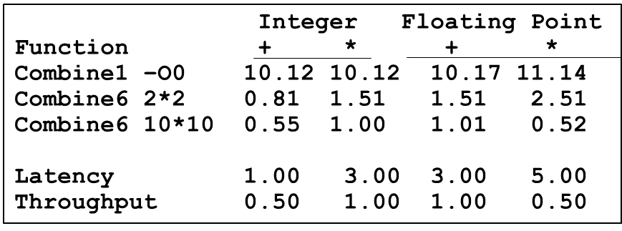
Summary of Results
Machine Indep. Opts
Eliminating loop inefficiencies
Reducing procedure calls
Eliminating unneeded memory references
Machine dep. Opts
Loop Unrolling
Multiple Accumulator
Reassociation

Slide 44
Summary of Results
Optimization Results for Combining
  Archive a CPE close to throughput bound for all combinations
  Performance improvement of over 10X

Slide 45
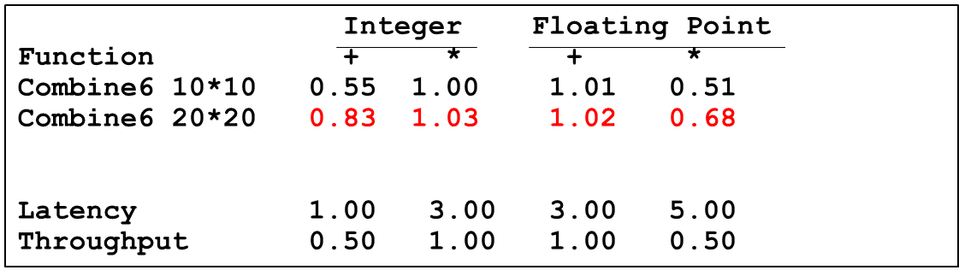
Optimization Limiting Factors
Register spilling
  When no enough registers available
  Using stack(memory) as storage

Slide 46
Optimization Limiting Factors
10*10 unrolling
  vmulsd (%rdx), %xmm0, %xmm0 acc0 *= data[i]
20*20 unrolling
  vmovsd 40(%rsp), %xmm0
  vmulsd (%rdx), %xmm0, %xmm0
  vmovsd %xmm0, 40(%rsp)

Slide 47
Optimization Limiting Factors
Register Spilling
  When no enough registers available
  Using stack(memory) as storage
Branch Prediction
  Speculative Execution
  Misprediction Panelties

Slide 48
Branch Prediction
Challenges
  Instruction Control Unit must work well ahead of Exec. Unit
  To generate enough operations to keep EU busy
Speculative Execution
  Guess which way branch will go
  Begin executing instructions at predicted position
    But don’t actually modify register or memory data

Slide 49
Example: Loop
80488b1: movl (%ecx,%edx,4),%eax
80488b4: addl %eax,(%edi)
80488b6: incl %edx
80488b7: cmpl %esi,%edx
80488b9: jl 80488b1
80488be: movl (%ecx,%edx,4),%eax
Branch Not-Taken
Branch Taken
80488b1: movl (%ecx,%edx,4),%eax
80488b4: addl %eax,(%edi)
80488b6: incl %edx
80488b7: cmpl %esi,%edx
80488b9: jl 80488b1

Slide 50
Branch Prediction Through Loop
80488b1: movl (%ecx,%edx,4),%eax
80488b4: addl %eax,(%edi)
80488b6: incl %edx
80488b7: cmpl %esi,%edx
80488b9: jl 80488b1
Assume vector length = 100
i = 98
Predict Taken (OK)
80488b1: movl (%ecx,%edx,4),%eax
80488b4: addl %eax,(%edi)
80488b6: incl %edx
80488b7: cmpl %esi,%edx
80488b9: jl 80488b1
i = 99
Predict Taken
(Oops)
80488b1: movl (%ecx,%edx,4),%eax
80488b4: addl %eax,(%edi)
80488b6: incl %edx
80488b7: cmpl %esi,%edx
80488b9: jl 80488b1
Executed
Read invalid location
i = 100
Fetched
80488b1: movl (%ecx,%edx,4),%eax
80488b4: addl %eax,(%edi)
80488b6: incl %edx
80488b7: cmpl %esi,%edx
80488b9: jl 80488b1
i = 101

Slide 51
Branch Misprediction Invalidation
80488b1: movl (%ecx,%edx,4),%eax
80488b4: addl %eax,(%edi)
80488b6: incl %edx
80488b7: cmpl %esi,%edx
80488b9: jl 80488b1
Assume vector length = 100
i = 98
Predict Taken (OK)
80488b1: movl (%ecx,%edx,4),%eax
80488b4: addl %eax,(%edi)
80488b6: incl %edx
80488b7: cmpl %esi,%edx
80488b9: jl 80488b1
i = 99
Predict Taken
(Oops)
80488b1: movl (%ecx,%edx,4),%eax
80488b4: addl %eax,(%edi)
80488b6: incl %edx
80488b7: cmpl %esi,%edx
80488b9: jl 80488b1
i = 100
Invalidate
80488b1: movl (%ecx,%edx,4),%eax
80488b4: addl %eax,(%edi)
80488b6: incl %edx
80488b7: cmpl %esi,%edx
80488b9: jl 80488b1
i = 101

Slide 52
Instruction Control Unit
Retirement Unit
  Keep track of the ongoing processing
  Obey the sequential semantics of the machine-level program (misprediction & exception)
Instruction Control
Fetch
Control
Address
Instruction
Cache
Retirement
Unit
Instruction
Decode
Instructions
Register
File
Operations
Register Updates
Prediction OK?

Slide 53
Branch Misprediction Invalidation
80488b1: movl (%ecx,%edx,4),%eax
80488b4: addl %eax,(%edi)
80488b6: incl %edx
80488b7: cmpl %esi,%edx
80488b9: jl 80488b1
Assume vector length = 100
i = 98
Predict Taken (OK)
80488b1: movl (%ecx,%edx,4),%eax
80488b4: addl %eax,(%edi)
80488b6: incl %edx
80488b7: cmpl %esi,%edx
80488b9: jl 80488b1
80488be: movl (%ecx,%edx,4),%eax
i = 99
Definitely not taken

Slide 54
Instruction Control Unit
Instruction Retired/Flushed
  Place instructions into a first-in, first-out queue
  Retired: any updates to the registers being made
    Operations of the instruction have completed
    Any branch prediction to the instruction are confirmed correctly
  Flushed: discard any results have been computed
    Some branch prediction was mispredicted
    Mispredictions can’t alter the program state

Slide 55
Instruction Control Unit
Register File
  Integer, floating-point and other registers
  Controlled by Retirement Unit
Instruction Control
Fetch
Control
Address
Instruction
Cache
Retirement
Unit
Register
File
Instruction
Decode
Instructions
Operations
Register Updates
Prediction OK?

Slide 56
Branch Misprediction Recovery
Performance Cost
  Misprediction on Core i7 wastes ~19 clock-cycle
  Don’t be overly concerned about predictable branches
    E.g. loop-closing branches would typically be predicted as being taken, and only incur a misprediction penalty on the last time around
    If an inner loop is computational bound, branch prediction may not be in the critical path

Slide 57
void minmax1(int a[],
int b[], int n)
{
int i;
for (i = 0; i < n; i++) {
if (a[i] > b[i]) {
int t = a[i];
a[i] = b[i];
b[i] = t;
}
}
}
Write Suitable Code
Function random predictable
minmax1 14.5 2.5-3.5

Slide 58
void minmax1(int a[],
int b[], int n)
{
int i;
for (i = 0; i < n; i++) {
if (a[i] > b[i]) {
int t = a[i];
a[i] = b[i];
b[i] = t;
}
}
}
Write Suitable Code
void minmax2(int a[],
int b[], int n)
{
int i;
for (i = 0; i < n; i++) {
int min = a[i]<b[i]?a[i]:b[i];
int max = a[i]<b[i]?b[i]:a[i];
a[i] = min;
b[i] = max;
}
}
Function random predictable
minmax1 14.5 2.5-3.5
minmax2 4.0 4.0

