Slide 1
计算机系统基础（系统软件）
老师：陈榕、臧斌宇
助教：刘年、易纪非、吴新月、宋小牛
主页：https://ipads.se.sjtu.edu.cn/courses/ics/
  上学期没有选《计算机系统基础（汇编）》 学生3月1日前完成注册
  账号：学号；密码：111111（初始密码，登录后修改）
CANVAS：https://oc.sjtu.edu.cn/courses/17634
直播/上课时间：周四9-10节课（16:00-17:40）
  习题课：每周三 18:00-20:00 （第二周开始）

Slide 2

计算机系统基础（系统软件）
ZOOM直播
房间号：330931656
密码：02596530
温馨提示：
进入Zoom课堂后请将昵称改为真实姓名
提问发言请先“举手”
如遇系统卡顿，主动反馈并耐心等待
可在Zoom聊天室或微信群内留下与教学有关的问题或建议
请尽快熟悉Zoom、Canvas的操作方式
不迟到、不早退，按时完成作业
尊重并保护知识产权，不随意传播视频等课程资料
微信群二维码

Slide 3
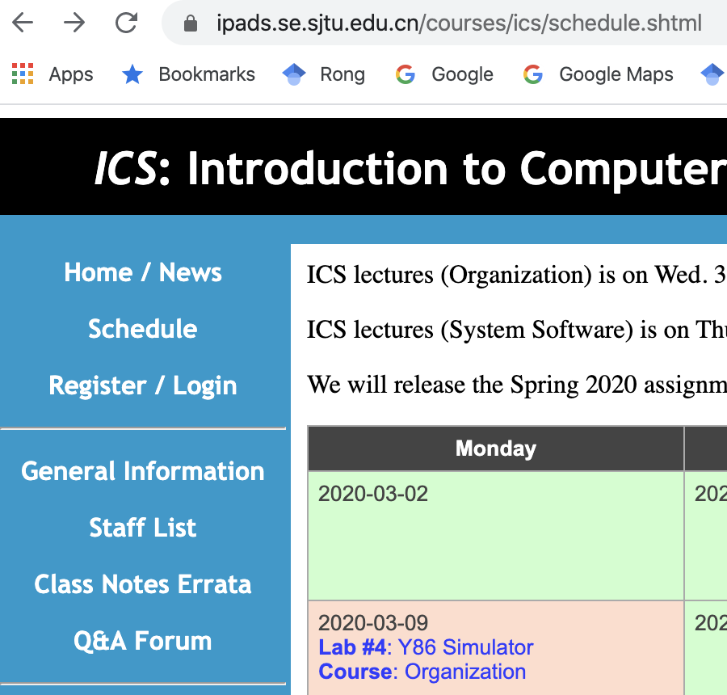
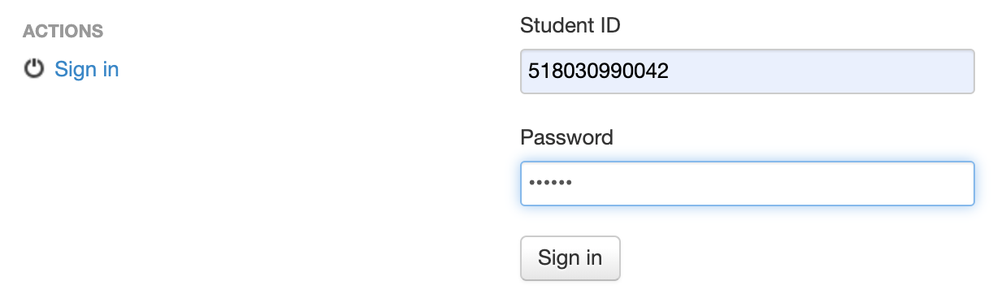
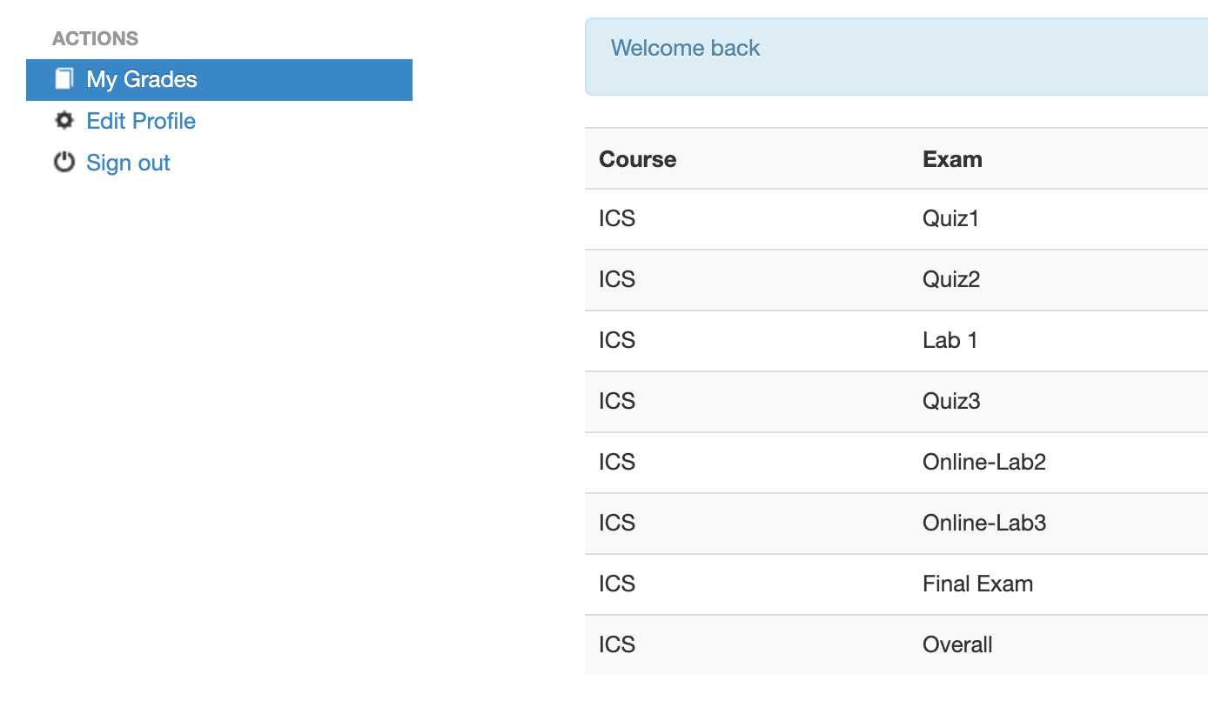
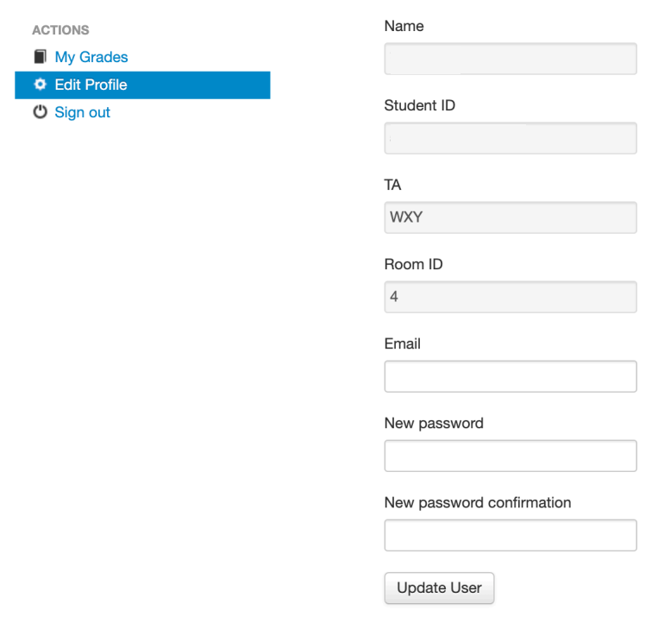
计算机系统基础（组成）
主页：https://ipads.se.sjtu.edu.cn/courses/ics/
  上学期没有选《计算机系统基础（汇编）》的学生，3月1日前完成注册
  账号：学号； 初始密码：111111（登录后修改）
学号
111111
初始密码
修改密码保存

Slide 4
Grading
Exams (75%)
  Final exam
  Open books/open notes
Quiz (5%)
  2 Times
  Open books/open notes
Labs (20%)
  Lab7: Tiny Shell
  Lab9: Proxy

Slide 5
Exceptional Control Flow I

Slide 6
Outline
Operating Systems
Processes
Exceptions
Suggested reading 1.7, 8.1

Slide 7
Operating Systems

Slide 8
Operating Systems
There are three components in computer hardware systems
  Processor, main memory and I/O devices

Slide 9
Operating Systems
application
Operating System
 | I/O Devices
Processor
Main Memory
Contemporary Applications never access I/O devices directly
They rely on the services provided by the operating system

Slide 10
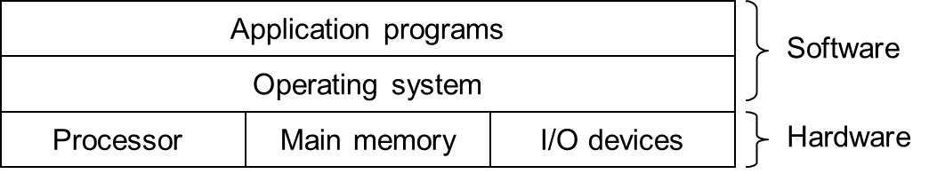
What Is an Operating System
Operating System
  is a program that manages the computer hardware
  also provides a basis for application programs
  and acts as an intermediary between a user of a computer and the computer hardware
Notes:
Hardware is complex, various, and renewable.
OS should hide hardware for applications.

Slide 11
Operating Systems
application
Operating System
 |  | I/O Devices
Processor
Main Memory
Notes:
CPU and memory are assigned by OS (fork and malloc), and directly used by application.

Slide 12
Operating Systems
application
Operating System
 |  | I/O Devices
Processor
Main Memory
Notes:
Applications rely on system call to access hardware devices indirectly

Slide 13
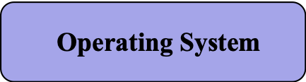
Operating Systems
Q
application
 |  | I/O Devices
Processor
Main Memory
Notes:
OS controls all of hardware devices.
Q: Why we choose different designs to access/control CPU/Memory and I/O devices? (answer later)

Slide 14
Two primary purposes
Protect hardware from misuse by applications
Provide applications with simple and uniform mechanisms for manipulating hardware devices

Slide 15
Operating Systems
Fundamental abstractions:
  Process
  Virtual memory
  files

Slide 16
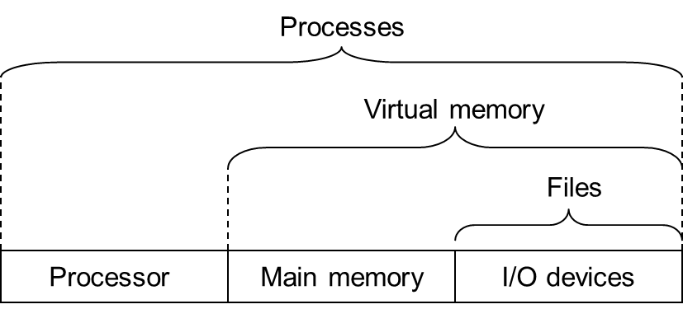
Abstractions Provided by OS

Slide 17
Process: phenomenon
When a program runs on a modern system,
  the operating system provides the illusion
    that the program is the only one running on the system

Slide 18
Process: phenomenon
The program appears to have exclusive use of all the processor, main memory, and I/O devices
The program appears to execute the instructions in the program, one after the other, without interruption
The code and data of the program appear to the only objects in the system’s memory

Slide 19
Processes
Def: A process is an instance of a running program.
Process is one of the most profound ideas in computer science.
Each program in the system runs in the context of some process

Slide 20
Process
There are two parts in a process
  The user code
  The OS code
The OS code
  called kernel
  shared by all the processes
OS Code
User Code
Process

Slide 21
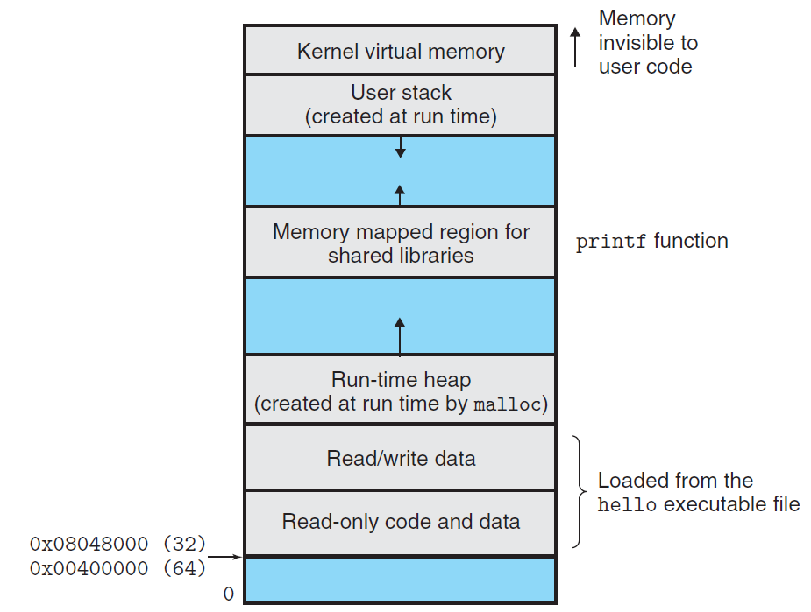
Kernel virtual memory
2⁴⁷

Slide 22
User and Kernel Modes
Process running in kernel mode can
  execute any instructions in the instruction set
  can access any memory locations in the system
Process running in user mode can
  neither execute privileged instructions
  nor directly reference code or data in the kernel area of the address space
  only do above indirectly via system call interface

Slide 23
Distinguish User and Kernel Modes
There typically is a mode bit in some control registers
  if the bit is set
    it is in the kernel (supervisor) mode
  if the bit is clear
    it is in the user mode

Slide 24
Virtual Memory

Slide 25
Virtual Memory
An abstraction
  Each process appears to have exclusive use of the main memory
  Virtual address space
    Program code and data (global variables)
    Heap
    Shared libraries (standard and math libraries)
    Stack (function calls)
    Kernel (operating system)
  Hardware supports to translate the virtual address

Slide 26
Private address spaces
Each process has its own private address space
kernel virtual memory
(code, data, heap, stack)
memory
invisible to
user code
user stack
(created at runtime)
%esp (stack pointer)
memory mapped region for
shared libraries
brk
run-time heap
(managed by malloc)
read/write segment
(.data, .bss)
loaded from the
executable file
read-only segment
(.init, .text, .rodata)
0x00400000(64)
0
unused

Slide 27
Files

Slide 28
Files
A sequence of bytes
Each I/O device is modeled as a file
Unix I/O
  using a small set of system calls reading and writing files
  All input and output in the system is performed by Unix I/O

Slide 29
Exception

Slide 30
Altering the Control Flow
A process running application code
  initially in user mode
How can we change the control flow from user mode to kernel mode?
  We’ve discussed two mechanisms for changing the control flow:
    jumps
    call and return using the stack discipline
  However, both can only alter control flow in the same mode
  New instructions are introduced
    syscall / sysret

Slide 31
System Calls
The pair of instructions syscall/sysret are a hardware mechanism transfer of control between user and kernel mode
System Calls
  A procedure-like interface between user programs and operating systems
  Controlled access to kernel services
Code in user mode
Kernel mode
syscall
I _{next}
System call codes
sysret

Slide 32
System Call Example
# hello world
1 int main()
2 {
3 write(1, "hello, world\n", 13);
4 _exit(0);
5 }

Slide 33
Typical system calls in Linux X86-64 systems
Number | Name | Desc. | Number | Name | Desc.
0 | read | Read a file | 33 | pause | Wait for signal
1 | write | Write a file | 37 | alarm | Set an alarm clock
2 | open | Open a file | 39 | getpid | Get process ID
3 | close | Close a file | 57 | fork | Create a process
4 | stat | Get file status | 59 | execve | Execute a program
9 | mmap | Map a file into memory | 60 | _exit | Terminate the process
12 | brk | Set the top of heap | 61 | wait4 | Wait for process to stop
32 | dup2 | Duplicate a file descriptor | 62 | kill | Send signal to a process

Slide 34
System Call Example
1 .section .data
2 string:
3 .ascii "hello, world\n"
4 string_end:
5 .equ len, string_end - string
6 .section .text
7 .globl main
main:

Slide 35
System Call Example
First, call write(1, "hello, world\n", 13)
9 movq $1, %rax write is system call 1
10 movq $1, %rdi Arg1:stdout has descriptor 1
11 movq $string, %rsi Arg2:Hello world string
12 movq $len, %rdx Arg3:string length
13 syscall Make the system call
Next, call exit(0)
14 movq $60, %rax _exit is system call 60
15 movq $0, %rdi Arg1:exit status is 0
16 syscall Make the system call

Slide 36
Parameter Passing for System Calls
Q
Up to 6 parameters are passed between two modes
  %rdi,%rsi,%rdx,%r10,%r8,%r9
Caller saved registers must be saved in user mode if necessary
  %rcx and %r11 are destroyed
Returns integer in %rax whether it is succeeded
Code in user mode
Kernel mode
syscall
I _{next}
System call codes
sysret
Notes:
Q: why we use register to pass parameter for system calls

Slide 37
Event & Exception
Processor‘s state
  encoded in various bits and signals inside the processor, such as kernel bit inside the processor
Events
  Significant changes in the processor ‘s state
    Results of execution of syscall/sysret instructions
    data arrives from a disk or a network adapter.
    instruction doing divides by zero
Exception
  A hardware mechanism transfers control to the kernel in response to some event

Slide 38
Event & Exception
User Process
OS
I _{curr}
exception
event
I _{next}
exception processing
by exception handler
exception
return (optional)
Event may be related or unrelated to the execution of the current instruction
  syscall, sysret (related)
  page fault, arithmetic overflow (related)
  a system timer goes off, an I/O request completes (unrelated)

Slide 39
Exception handler
Codes in kernel mode (OS)
When the exception handler finishes processing, handler does one of the following:
  returns control to the current instruction Icurr
  returns control to the next instruction Inext
  aborts the interrupted program

Slide 40
Exception Table
Exception
numbers
1. Each type of event has a unique exception number k
2. Exception table entry k points to a function (exception handler).
3. Handler k is called each time exception k occurs.
Exception table
code for
exception handler 0
code for
exception handler 1
0
1
2
code for
exception handler 2
...
n-1
...
code for
exception handler n-1

Slide 41
Exception Table
Exception number
(×8)
Exception table
0
1
2
.
.
.
n-1
Address of entry
for exception #k
Exception table
base register
×

Slide 42
Exception Handler
Exception handlers run in kernel mode
  means they have complete access to all system resources
Processor pushes onto the kernel’s stack
  Necessary information will be necessary to restart the interrupted program when the handler returns
  Such as
    Return address (either the current instruction or the next instruction)
    The current condition codes

Slide 43
Classes of Exceptions

Slide 44
Synchronous exceptions
Caused by events that occur as a result of executing an instruction
  e.g. syscall
Traps
  Intentional
  returns control to “next” instruction
  Examples: syscall, breakpoint traps

Slide 45
Synchronous exceptions
Faults
  Unintentional but possibly recoverable
  either re-executes faulting (“current”) instruction or aborts.
  Examples: page faults (recoverable), protection faults (unrecoverable)
Aborts
  Unintentional and unrecoverable
  aborts current program
  Examples: parity error, machine check
Notes:
Fault: software error
Abort: hardware error (fatal)

Slide 46
Fault Example #1
Memory Reference
  User writes to memory location
  That portion (page) of user’s memory is not ready (on disk or allocation on demand)
long a[1000];
main ()
{
a[500] = 13;
}
4004ed: 48 c7 05 08 1b 20 00 0d 00 00 00
movq $0xd, 0x201b08(%rip)

Slide 47
Fault Example #1
int a[1000];
main ()
{
a[500] = 13;
}
4004ed: 48 c7 05 08 1b 20 00 0d 00 00 00
movq $0xd, 0x201b08(%rip)
User Process
OS
event
movq
Page fault
Create page and load into memory
return

Slide 48
Fault Example #1
Memory Reference
  Page fault handler must load page into physical memory
  Returns to faulting instruction
  Successful on second try

Slide 49
Fault Example #2
Memory Reference
  User writes to memory location
  Address is not valid
int a[1000];
main ()
{
a[5000] = 13;
}
4004ed: 48 c7 05 a8 a7 20 00 0d 00 00 00
movq $0xd, 0x20a7a8(%rip)

Slide 50
Fault Example #2
int a[1000];
main ()
{
a[5000] = 13;
}
4004ed: 48 c7 05 a8 a7 20 00 0d 00 00 00
movq $0xd, 0x20a7a8(%rip)
User Process
OS
event
movq
Page fault
Detect invalid address
Signal process

Slide 51
Fault Example #2
Memory Reference
  Page fault handler detects invalid address
  Sends SIGSEG signal to user process
  User process exits with “segmentation fault”

Slide 52
Synchronous exceptions
Exceptions in x86-64 systems
Exception Number | Description | Exception class
0 | Divide error | Fault
13 | General protection fault | Fault
14 | Page fault | Fault
18 | Machine check | Abort
32~255 | OS defined exception | Interrupt or trap

Slide 53
Asynchronous exceptions (interrupts)
Caused by events external to the processor
  Indicated by setting the processor’s interrupt pin
  handler returns to “next” instruction.
Keyboard
Mouse
Printer
Processor
Interrupt
controller
Keyboard
controller
USB
controller
Local/IO Bus
Memory
Serial ATA
controller
IDE
controller
Video
adapter
Network
adapter
disk
CDROM
Display
Network

Slide 54
Asynchronous exceptions (interrupts)
Examples:
  I/O interrupts
    hitting ctl-c at the keyboard
    arrival of a packet from a network
    arrival of a data sector from a disk
  Hard reset interrupt
    hitting the reset button
  Soft reset interrupt
    hitting ctl-alt-delete on a PC

Slide 55
Interrupt
I/O devices trigger interrupts by signaling a pin on the processor chip
  network adapters, disk controllers, timer chips
I/O devices place a number onto the system bus
  identifies the device that caused the interrupt
Cause the CPU stop what it is currently working on, and jump to an operating system routine

Slide 56
CPU chip
register file
ALU
system bus
memory bus
I/O
bridge
main
memory
bus interface
I/O bus
Expansion slots for
other devices such
as network adapters
USB
controller
graphics
adapter
Host Bus
Adaptor
SCSI/SATA
mouse
keyboard
monitor
solid stat disk
disk
controller
Disk drive
disk

Slide 57
Memory-mapped I/O
I/O Port
  A reserved address in the address space
  for the CPU to communicate with an I/O device
Each device is associated with (or mapped to)
  One or more ports when it is attached to the bus

Slide 58
Reading a disk sector
CPU chip
1. CPU initiates a disk read by writing a command, logical block number, and destination memory address to a port (address) associated with disk controller
register file
ALU
main
memory
bus interface
I/O bus
USB
controller
graphics
adapter
disk
controller
mouse
keyboard
monitor
disk

Slide 59
Reading a disk sector
CPU chip
2. Disk controller reads the sector and performs a DMA (direct memory access) transfer into main memory
register file
ALU
main
memory
bus interface
I/O bus
USB
controller
graphics
adapter
disk
controller
mouse
keyboard
monitor
disk

Slide 60
DMA
Q
Direct memory access
A device performs a read or write bus transaction on its own, without any involvement of the CPU
The transfer of data is known as a DMA transfer
Notes:
Q: why we need a separate hardware device (DMA) to do the copy from disk to memory?

Slide 61
Reading a disk sector
CPU chip
3. When the DMA transfer completes, the disk controller notifies the CPU with an interrupt (i.e., asserts a special “interrupt” pin on the CPU)
register file
ALU
Interrupt
main
memory
bus interface
I/O bus
USB
controller
graphics
adapter
disk
controller
mouse
keyboard
monitor
disk

Slide 62
Asynchronous exceptions (interrupts)
User Process
OS
(2) Control passes to handler after current instruction finishes
(1)Interrupt pin goes high during execution of current instruction
I _{curr}
I _{next}
(3)Interrupt handler runs
(4)Handler returns
to next instruction

Slide 63
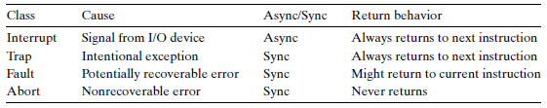
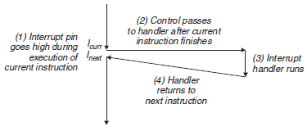
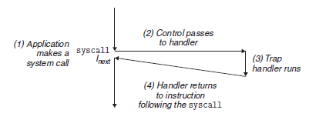
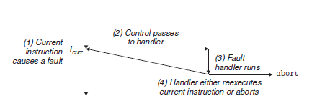
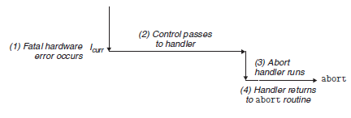
Exceptions
Q
Interrupt
Trap
Fault
Abort
Notes:
Q: For async exceptions, kernel may return to another process (e.g., finish to read disk), how/where/when to return the current process?

