Slide 1
Sockets Interface

Slide 2
Outline
Sockets Interface
  Functions
  Echo Client and Server
Suggested Reading:
  11.4

Slide 3
Berkeley Sockets Interface
Part of the Unix 4.2BSD (Berkeley software distribution)
  contained an early version of the Internet protocols
  created in the early 80’s
  Provides a user-level interface to the network
  Based on client/server programming model
Underlying basis for all Internet applications
  Protocol independent

Slide 4
Overview of the Sockets Interface
Client
Server
getaddrinfo
getaddrinfo
socket
socket
bind
open_listenfd
open_clientfd
listen
connection
request
connect
accept
Client / Server
Session
writen
readline
Await connection
request from
next client
readline
writen
close
readline
EOF
close

Slide 5
What is a socket?
From the perspective of the Linux Kernel
  an endpoint for communication
From the perspective of a Linux program
  a descriptor that lets an application read/write from/to the network.
Key idea:
  Unix uses the same abstraction for both regular file I/O and network I/O

Slide 6
What is a socket?
Clients and servers communicate with each other by reading from and writing to socket descriptors
  Using regular Unix read and write I/O functions
The main difference between file I/O and socket I/O is how the application “opens” the socket descriptors

Slide 7
Key data structures
Internet-style sockets are characterized by
  a 32-bit IP address and a port
Defined in /usr/include/netinet/in.h
/* Internet address */
struct in_addr {
uint32_t s_addr; /* 32-bit IP address */
};

Slide 8
Key data structures
/* IP socket address structure*/
struct sockaddr_in {
uint16_t sin_family; /*Address family (AF_INET) */
uint16_t sin_port; /*Port number*/
struct in_addr sin_addr; /*IP address*/
unsigned char sin_zero[8]; /*Pad to “sockaddr”*/
};
/* Generic socket address structure */
struct sockaddr {
uint16_t sin_family; /*Protocol family*/
char sa_data[14]; /*address data*/
};
typedef struct sockaddr SA;

Slide 9
Host and Service Conversion
getaddrinfo and getnameifo
  Converting between
    Binary socket address structure and the string representations of
      hostname (host addresses),
      service names (port numbers)
  Writing network programs independent of any particular version of the IP protocol
linux> ./hostinfo twitter.com
199.16.156.102
199.16.156.230
199.16.156.6
199.16.156.70

Slide 10
Hostinfo
1 #include "csapp.h"
2
3 int main(int argc, char **argv)
4 {
5 struct addrinfo *p, *listp, hints;
6 char buf[MAXLINE];
7 int rc, flags;
8
9 if (argc != 2) {
10 fprintf(stderr, "usage: %s <domain name>\n", argv[0]);
11 exit(0);
12 }
13
14 /* Get a list of addrinfo records */
15 memset(&hints, 0, sizeof(struct addrinfo));
16 hints.ai_family = AF_INET; /* IPv4 only */
17 hints.ai_socktype = SOCK_STREAM; /* Connections only */
18 if ((rc = getaddrinfo(argv[1], NULL, &hints, &listp)) != 0) {
19 fprintf(stderr, "getaddrinfo error: %s\n", gai_strerror(rc));
20 exit(1);
21 }

Slide 11
Host and Service Conversion
struct addrinfo {
int ai_flags; /* Hints argument flags */
int ai_family; /* First arg to socket function */
int ai_socktype; /* Second arg to socket function */
int ai_protocol; /* Third arg to socket function */
char *ai_canonname; /* Canonical hostname */
size_t ai_addrlen; /* Size of ai_addr struct */
struct sockaddr *ai_addr; /* Ptr to socket address structure */
struct addrinfo *ai_next; /* Ptr to next item in linked list */
};

Slide 12
Host and Service Conversion
family
  AF_INET or AF_INET6
socketype
  SOCK_STREAM, SOCK_DGRAM or SOCK_RAW
protocol
  0 means socket address with any protocol can be returned
Either host or service can be NULL but not both
14 /* Get a list of addrinfo records */
15 memset(&hints, 0, sizeof(struct addrinfo));
16 hints.ai_family = AF_INET; /* IPv4 only */
17 hints.ai_socktype = SOCK_STREAM; /* Connections only */
18 if ((rc = getaddrinfo(argv[1], NULL, &hints, &listp)) != 0) {
linux> ./hostinfo twitter.com
199.16.156.102
199.16.156.230
199.16.156.6
199.16.156.70

Slide 13
Host and Service Conversion
#include <sys/types.h>
#include <sys/socket.h>
#include <netdb.h>
int getaddrinfo(const char *host, const char *service,
const struct addrinfo *hints,
struct addinfo **result);
Returns:0 if OK, nonzero error code on error
void freeaddinfo(struct addinfo *result);
Returns:nothing
Const char *gai_strerror(int errocde);
Returns: error message

Slide 14
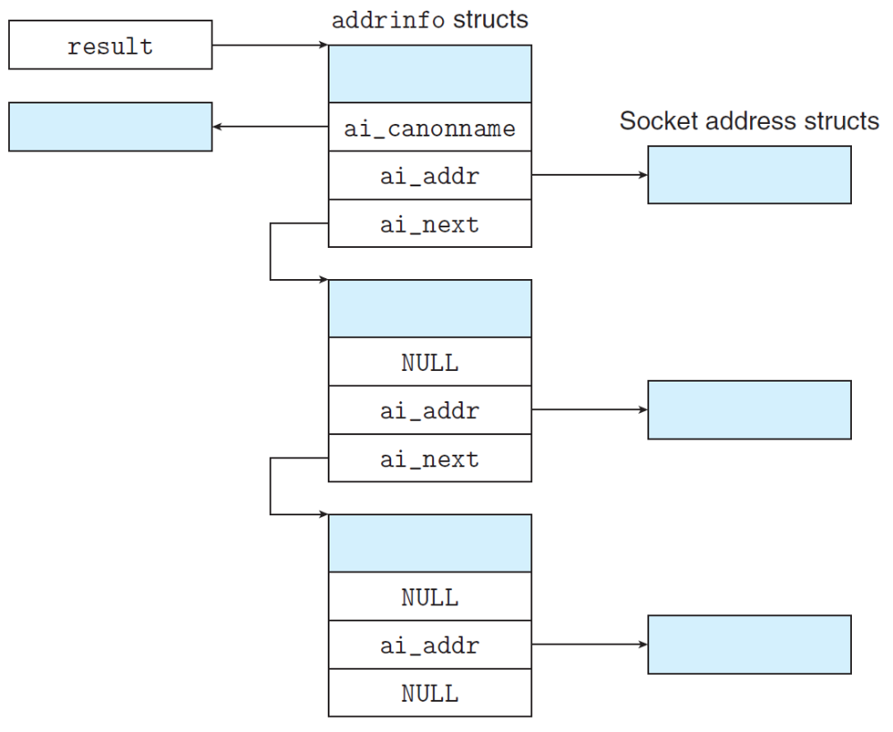
Host and Service Conversion

Slide 15
Hostinfo
22
23 /* Walk the list and display each IP address */
24 flags = NI_NUMERICHOST; /* Display address string instead of domain name */
25 for (p = listp; p; p = p->ai_next) {
26 Getnameinfo(p->ai_addr, p->ai_addrlen, buf, MAXLINE, NULL, 0, flags);
27 printf("%s\n", buf);
28 }
29
30 /* Clean up */
31 Freeaddrinfo(listp);
32
33 exit(0);
34 }
#include <sys/socket.h>
#include <netdb.h>
int getnameinfo(const struct sockaddr *sa, socklen_t salen,
char *host, size_t hostlen, char *service, size_t servlen,
int flags);
Returns:0 if OK, nonzero error code on error

Slide 16
Example: Echo Client and Server
On Client
On Server
server> ./echoserveri 15213
client> echoclient greatwhite.ics.cs.cmu.edu 15213
server connected to BRYANT-TP4.VLSI.CS.CMU.EDU (128.2.213.29)
type: hello there
server received 12 bytes
echo: HELLO THERE
type: ^D
Connection closed

Slide 17
Overview of the Sockets Interface
Client
Server
getaddrinfo
getaddrinfo
socket
socket
bind
open_listenfd
open_clientfd
listen
connection
request
connect
accept
Client / Server
Session
writen
readline
Await connection
request from
next client
readline
writen
close
readline
EOF
close

Slide 18
Echo client
int main(int argc, char **argv)
{
int clientfd;
char *host, *port, buf[MAXLINE];
rio_t rio;
if (argc != 3) {
fprintf(stderr,"usage:%s <host> <port>\n",argv[0]);
exit(0);
}
host = argv[1]; port = argv[2];
clientfd = open_clientfd(host, port);
Rio_readinitb(&rio, clientfd) ;
while (Fgets(buf, MAXLINE, stdin) != NULL) {
Rio_writen(clientfd, buf, strlen(buf));
Rio_readline(&rio, buf, MAXLINE);
Fputs(buf, stdout);
}
Close(clientfd);
}

Slide 19
Echo client:open_clientfd()
1 int open_clientfd(char *hostname, char *port) {
2 int clientfd;
3 struct addrinfo hints, *listp, *p;
4
5 /* Get a list of potential server addresses */
6 memset(&hints, 0, sizeof(struct addrinfo));
7 hints.ai_socktype = SOCK_STREAM; /* Open a connection */
8 hints.ai_flags = AI_NUMERICSERV; /* ... using a numeric port arg. */
9 hints.ai_flags |= AI_ADDRCONFIG; /* Recommended for connections */
10 Getaddrinfo(hostname, port, &hints, &listp);
11
It asks getaddrinfo to return IPv4 addresses only if the local host is configured for IPv4
The client builds the server’s Internet address.

Slide 20
Echo client
12 /* Walk the list for one that we can successfully connect to */
13 for (p = listp; p; p = p->ai_next) {
14 /* Create a socket descriptor */
15 if ((clientfd = socket(p->ai_family, p->ai_socktype, p->ai_protocol)) < 0)
16 continue; /* Socket failed, try the next */
17
18 /* Connect to the server */
19 if (connect(clientfd, p->ai_addr, p->ai_addrlen) != -1)
20 break; /* Success */
21 Close(clientfd); /* Connect failed, try another */
22 }
23

Slide 21
Echo client: open_clientfd() (socket)
The client creates a socket that will serve as the endpoint of an Internet (AF_INET) connection (SOCK_STREAM).
  socket() returns an integer socket descriptor.
int clientfd; /* socket descriptor */
clientfd = socket(p->ai_family, p->ai_socktype, p->ai_protocol)
/* clientfd = socket(AF_INET, SOCK_STREAM, 0);*/

Slide 22
Echo client
12 /* Walk the list for one that we can successfully connect to */
13 for (p = listp; p; p = p->ai_next) {
14 /* Create a socket descriptor */
15 if ((clientfd = socket(p->ai_family, p->ai_socktype, p->ai_protocol)) < 0)
16 continue; /* Socket failed, try the next */
17
18 /* Connect to the server */
19 if (connect(clientfd, p->ai_addr, p->ai_addrlen) != -1)
20 break; /* Success */
21 Close(clientfd); /* Connect failed, try another */
22 }
23

Slide 23
Echo client: open_clientfd()(connect)
The client creates a connection with the server
  The client process suspends (blocks) until the connection is created with the server
  At this point the client is ready to begin exchanging messages with the server via Unix I/O calls on the descriptor clientfd
int clientfd; /* socket descriptor */
struct addrinfo *p; /* server address */
/* establish a connection with the server */
connect(clientfd, p->ai_addr, p->ai_addrlen);

Slide 24
Echo client
24 /* Clean up */
25 Freeaddrinfo(listp);
26 if (!p) /* All connects failed */
27 return -1;
28 else /* The last connect succeeded */
29 return clientfd;
30 }

Slide 25
Overview of the Sockets Interface
Client
Server
getaddrinfo
getaddrinfo
socket
socket
bind
open_listenfd
open_clientfd
listen
connection
request
connect
accept
Client / Server
Session
writen
readline
Await connection
request from
next client
readline
writen
close
readline
EOF
close

Slide 26
Echo server
1 #include "csapp.h"
2
3 void echo(int connfd);
4
5 int main(int argc, char **argv)
6 {
7 int listenfd, connfd;
8 socklen_t clientlen;
9 struct sockaddr_storage clientaddr; /* Enough space for any address */
10 char client_hostname[MAXLINE], client_port[MAXLINE];
11
12 if (argc != 2) {
13 fprintf(stderr, "usage: %s <port>\n", argv[0]);
14 exit(0);
15 }
16

Slide 27
Echo server
17 listenfd = Open_listenfd(argv[1]);
18 while (1) {
19 clientlen = sizeof(struct sockaddr_storage);
20 connfd = Accept(listenfd, (SA *)&clientaddr, &clientlen);
21 Getnameinfo((SA *) &clientaddr, clientlen, client_hostname,
22 MAXLINE, client_port, MAXLINE, 0);
23 printf("Connected to (%s, %s)\n", client_hostname, client_port);
24 echo(connfd);
25 Close(connfd);
26 }
27 exit(0);
28 }

Slide 28
accept() illustrated
listenfd(3)
1. Server blocks in accept, waiting for connection request on listening descriptor listenfd.
client
server
clientfd
connection
request
listenfd(3)
client
server
2. Client makes connection request by
calling and blocking in connect.
clientfd
listenfd(3)
3. Server returns connfd from accept.
Client returns from connect. Connection is now established between clientfd and connfd.
client
server
clientfd
connfd(4)

Slide 29
Echo server: open_listenfd()
1 int open_listenfd(char *port)
2 {
3 struct addrinfo hints, *listp, *p;
4 int listenfd, optval=1;
5
6 /* Get a list of potential server addresses */
7 memset(&hints, 0, sizeof(struct addrinfo));
8 hints.ai_socktype = SOCK_STREAM; /* Accept connections */
9 hints.ai_flags = AI_PASSIVE | AI_ADDRCONFIG; /* ... on any IP address */
10 hints.ai_flags |= AI_NUMERICSERV; /* ... using port number */
11 Getaddrinfo(NULL, port, &hints, &listp);
12
AI_PASSIVE instructs getaddrinfo() to return socket addresses that can be used by servers as listening sockets.
In this case, the host argument should be NULL.

Slide 30
Echo server: open_listenfd()
13 /* Walk the list for one that we can bind to */
14 for (p = listp; p; p = p->ai_next) {
15 /* Create a socket descriptor */
16 if ((listenfd = socket(p->ai_family, p->ai_socktype, p->ai_protocol)) < 0)
17 continue; /* Socket failed, try the next */
18
19 /* Eliminates "Address already in use" error from bind */
20 Setsockopt(listenfd, SOL_SOCKET, SO_REUSEADDR,
21 (const void *)&optval , sizeof(int));
22
23 /* Bind the descriptor to the address */
24 if (bind(listenfd, p->ai_addr, p->ai_addrlen) == 0)
25 break; /* Success */
26 Close(listenfd); /* Bind failed, try the next */
27 }

Slide 31
Echo server: open_listenfd() (setsockopt)
Handy trick that allows us to rerun the server immediately after we kill it.
  Otherwise we would have to wait about 30 secs.
  Eliminates “Address already in use” error from bind()
  Strongly suggest you do this for all your servers to simplify debugging.
/* eliminates "Address already in use" error
from bind. */
optval = 1;
Setsockopt(listenfd, SOL_SOCKET, SO_REUSEADDR,
(const void *)&optval , sizeof(int));

Slide 32
Echo server: open_listenfd() (bind)
bind() associates the socket with the socket address we just created.
int listenfd; /* listening socket */
struct addrinfo *p; /*server’s socket addr*/
/* listenfd will be an endpoint for all requests
to port on any IP address for this host */
Bind(listenfd, p->ai_addr, p->ai_addrlen);
The address field in socket address structure is the wildcard address, which tells the kernel that this server will accept requests to any of the IP addresses for this host.

Slide 33
Echo server: open_listenfd()
28
29 /* Clean up */
30 Freeaddrinfo(listp);
31 if (!p) /* No address worked */
32 return -1;
33
34 /* Make it a listening socket ready to accept connection requests */
35 if (listen(listenfd, LISTENQ) < 0) {
36 Close(listenfd);
37 return -1;
38 }
39 return listenfd;
40 }

Slide 34
Echo server: open_listenfd (listen)
listen() indicates that this socket will accept connection (connect) requests from clients.
We’re finally ready to enter the main server loop that accepts and processes client connection requests.
int listenfd; /* listening socket */
/* make listenf it a server-side listening socket
ready to accept connection requests from clients */
Listen(listenfd, LISTENQ);

Slide 35
Echo server
17 listenfd = Open_listenfd(argv[1]);
18 while (1) {
19 clientlen = sizeof(struct sockaddr_storage);
20 connfd = Accept(listenfd, (SA *)&clientaddr, &clientlen);
21 Getnameinfo((SA *) &clientaddr, clientlen, client_hostname,
22 MAXLINE, client_port, MAXLINE, 0);
23 printf("Connected to (%s, %s)\n", client_hostname, client_port);
24 echo(connfd);
25 Close(connfd);
26 }
27 exit(0);
28 }

Slide 36
Echo server: main loop
The server loops endlessly, waiting for connection requests, then reading input from the client, and echoing the input back to the client.
main() {
/* create and configure the listening socket */
while(1) {
/* Accept(): wait for a connection request */
/* echo(): read/echo input line from client */
/* Close(): close the connection */
}
}

Slide 37
Echo server: accept()
accept() blocks waiting for a connection request
int listenfd; /* listening descriptor */
int connfd; /* connected descriptor */
socketlen_t clinetlen;
struct sockaddr_storage clientaddr;
clientlen = sizeof(clientaddr);
connfd = Accept(listenfd,
(SA *)&clientaddr, &clientlen);

Slide 38
Echo server: accept()
accept() returns a connected socket descriptor (connfd) with the same properties as the listening descriptor (listenfd)
  Returns when connection between client and server is complete.
  All I/O with the client will be done via the connected socket.
accept()also fills in client’s address.

Slide 39
Echo server: identifying the client
The server can determine the domain name and IP address of the client.
21 Getnameinfo((SA *) &clientaddr, clientlen,
22 client_hostname, MAXLINE, client_port, MAXLINE, 0);
23 printf("Connected to (%s, %s)\n", client_hostname, client_port);

Slide 40
Echo server: echo()
The server uses Unix I/O to read and echo text lines until EOF (end-of-file) is encountered.
  EOF notification caused by client calling close(clientfd).
  NOTE: EOF is a condition, not a data byte.

Slide 41
Echo server: echo()
void echo(int connfd)
{
size_t n;
char buf[MAXLINE];
rio_t rio
Rio_readinitb(&rio, connfd)
while((n = Rio_readlineb(&rio, buf, MAXLINE))!=0){
printf("server received %d bytes\n", n);
Rio_writen(connfd, buf, n);
}
}

