Slide 1
Securing MCP servers
Three demos: Filesystem MCP, Google Calendar MCP, SQLite MCP | Tomer | 2026-05-05

Slide 2
What is MCP?
Model Context Protocol, in one slide

Slide 3
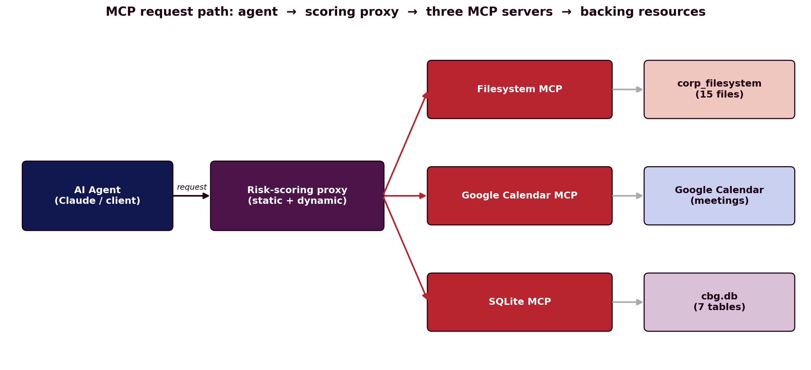
MCP at a glance
Goal: let an AI agent talk to external tools and data.
Player 1: the agent (Claude or any client).
Player 2: the MCP server (filesystem, calendar, DB...).
Threat model: agent = threat. Server = protected asset.
Our angle: score every request before the server runs it.

Slide 4
Demo 1 — Filesystem MCP
demo/corp_filesystem | 15 stub files

Slide 5
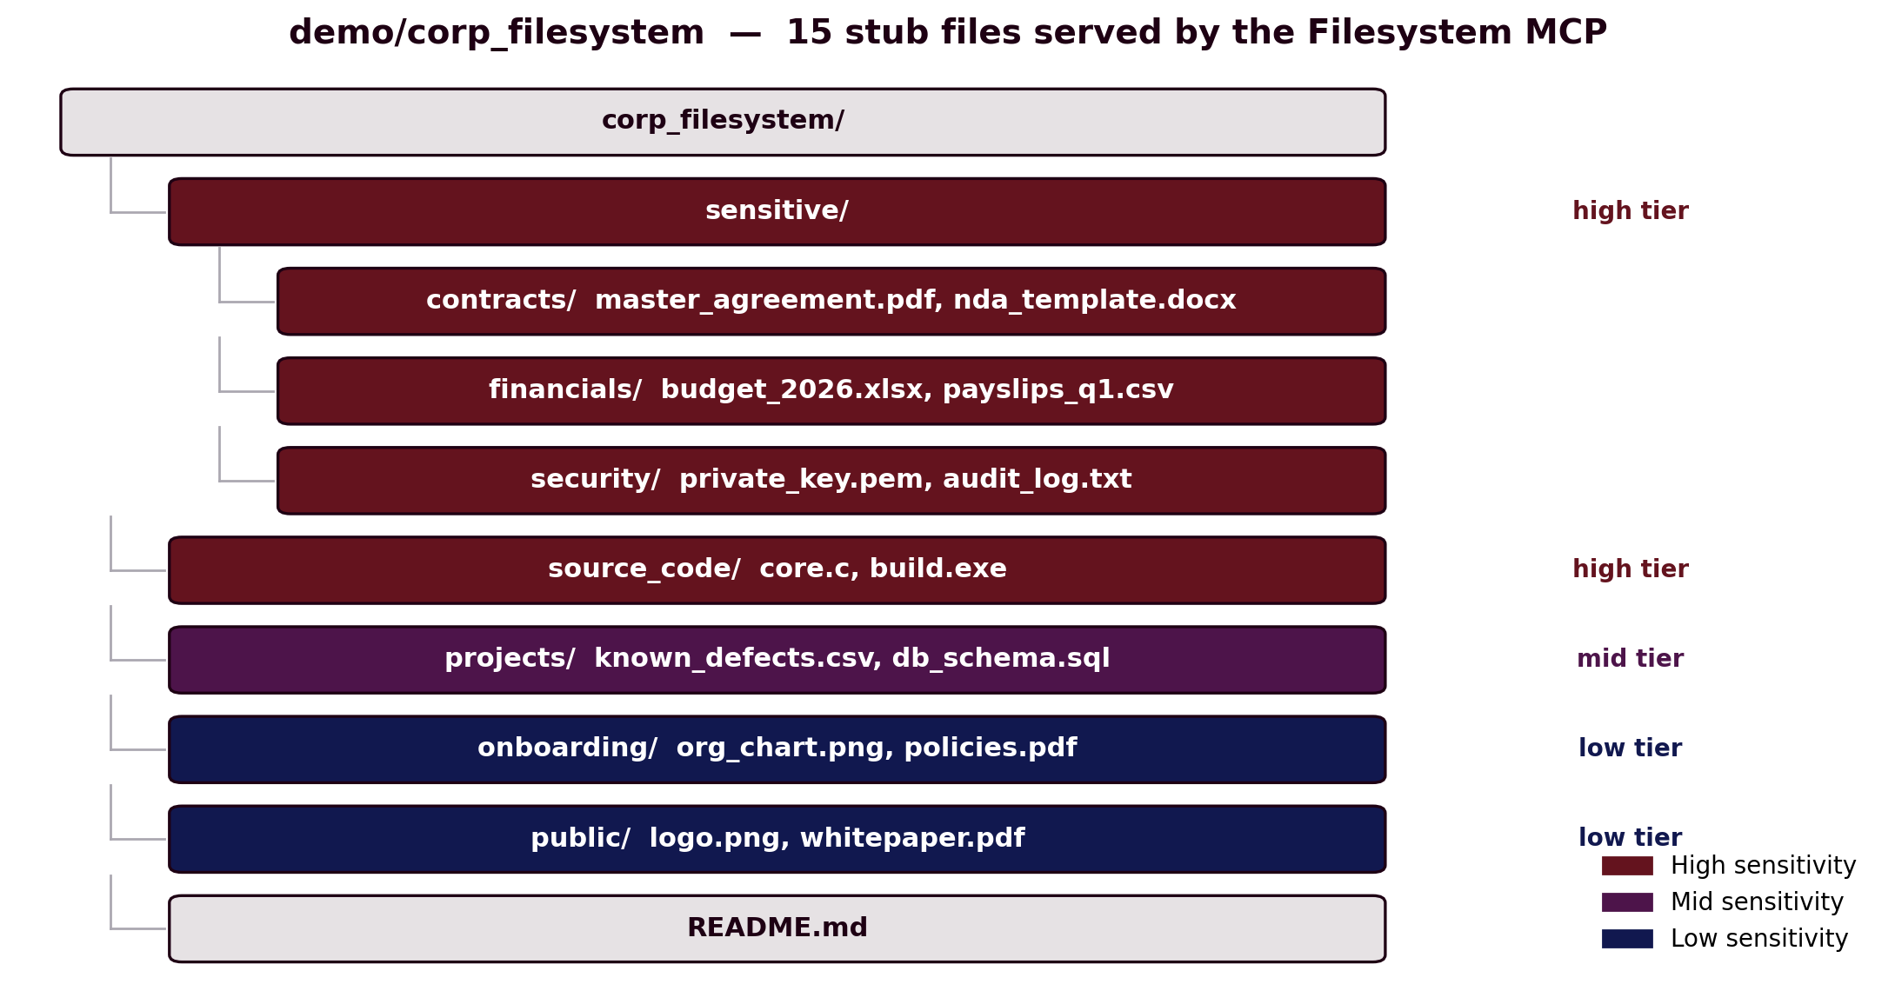
Inside demo/corp_filesystem
Tree: four top-level folders + a README.
sensitive/ contracts, financials, security keys.
source_code/ stub C + .exe with placeholder API keys.
projects/ internal SQL schema, defect lists.
onboarding/, public/ policies, logo, whitepaper.
Note: everything is fake — stub bytes only.

Slide 6
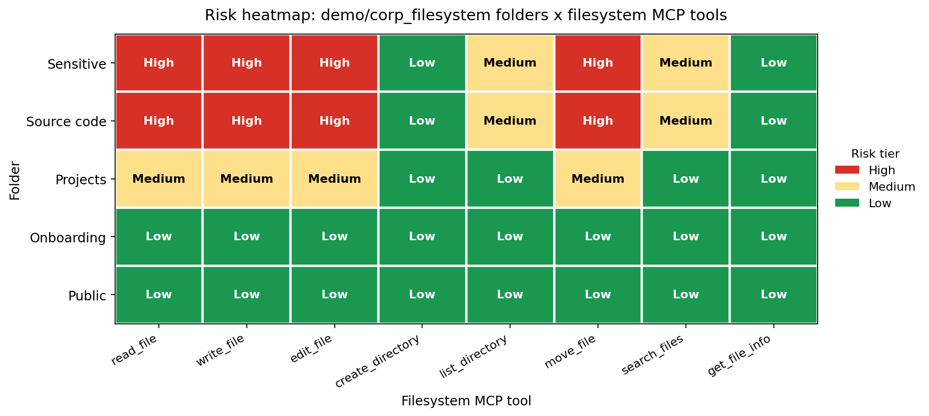
Heatmap — Filesystem MCP
Axis X: MCP tool (read_file, list_directory, …).
Axis Y: folder tier (sensitive → public).
Cells: red = High, yellow = Medium, green = Low.
Hot zone: read / write / edit on sensitive/, source_code/.
Cool zone: anything against onboarding/ and public/.
Use it as: a gating policy for the proxy.

Slide 7
Demo 2 — SQLite MCP
demo/cbg_sqlite | cbg.db | 7 tables

Slide 8
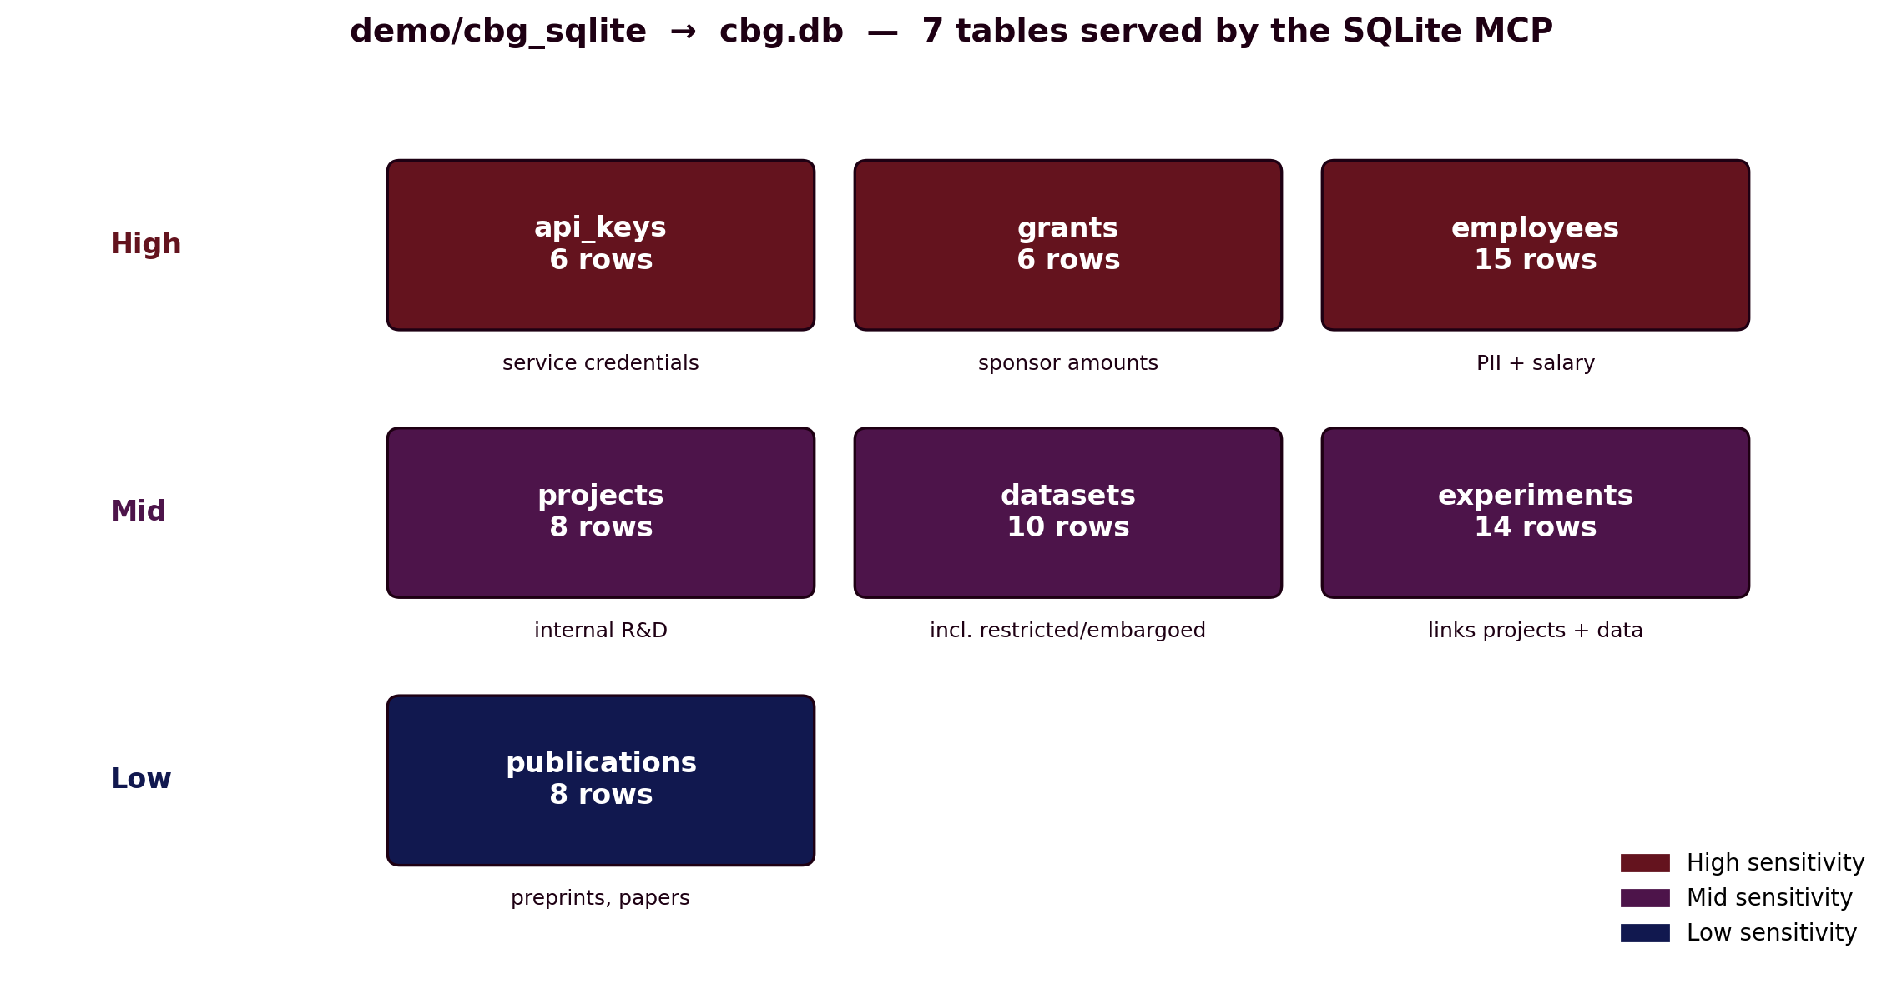
Inside demo/cbg_sqlite (cbg.db)
employees 15 rows: PII + salary.
projects 8 rows: internal R&D code names.
datasets 10 rows: incl. embargoed + licensed.
experiments 14 rows: links projects ↔ data.
publications 8 rows: papers + preprints.
grants 6 rows: sponsor + amount_usd.
api_keys 6 rows: service credentials.

Slide 9
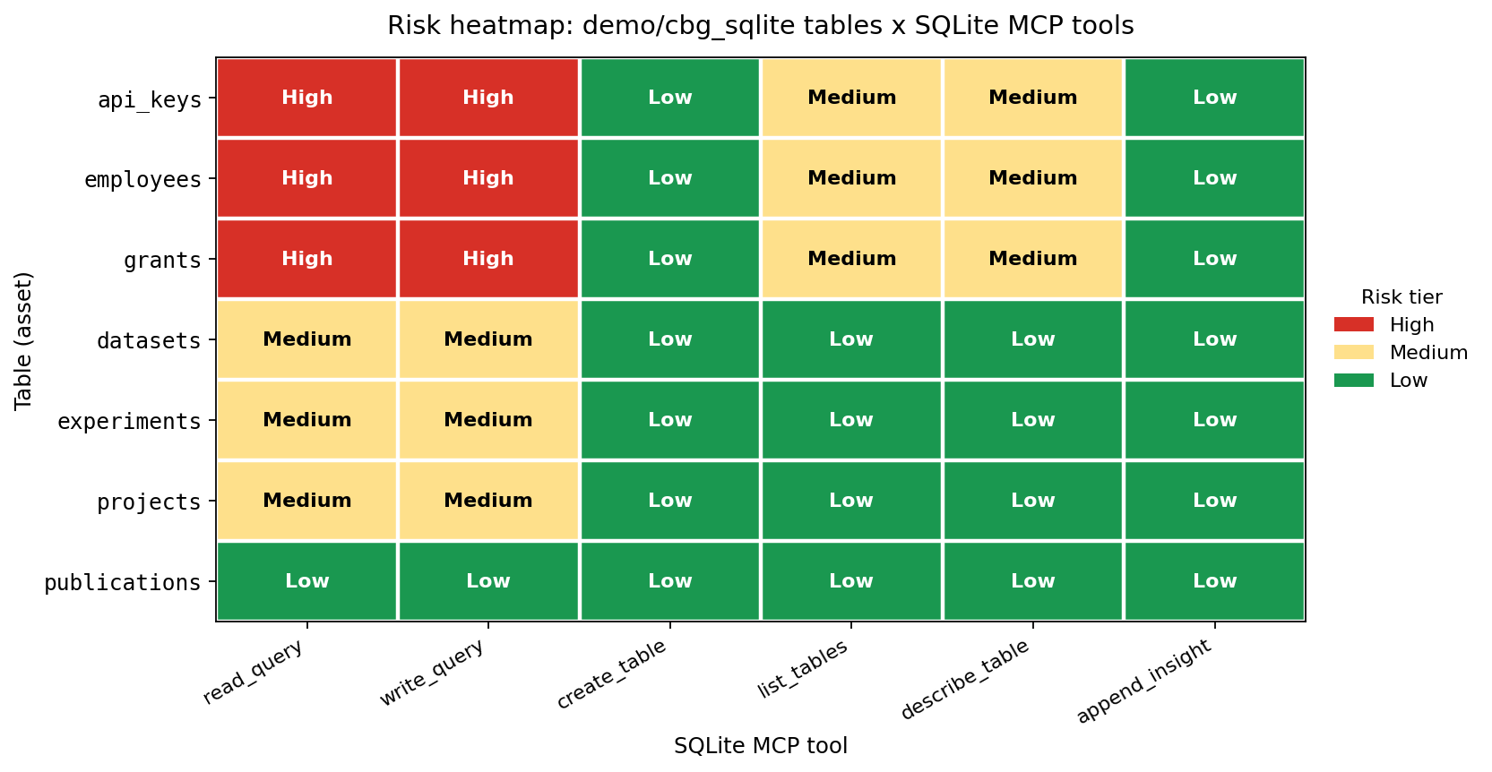
Heatmap — SQLite MCP
Axis X: tool: read_query, write_query, list_tables, …
Axis Y: table being queried.
Cells: red = High, yellow = Medium, green = Low.
Hot zone: read/write on api_keys, employees, grants.
Cool zone: list_tables, describe_table; publications row.
Lesson: the same tool is risky or safe depending on target.

Slide 10
Demo 3 — Google Calendar MCP
Live calendar — meetings, attendees, free/busy

Slide 11
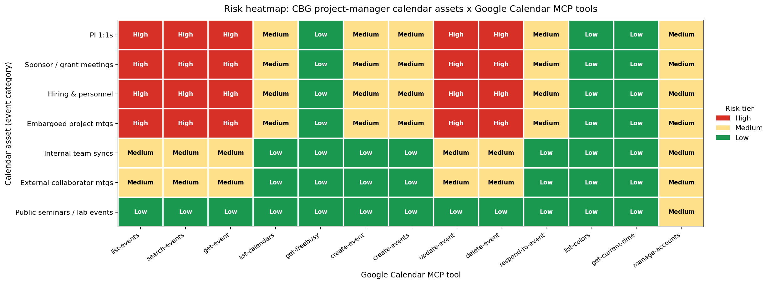
Heatmap — Calendar MCP
Axis X: tool: list_events, create_event, delete_event, …
Axis Y: event category (PI 1:1 → public seminar).
Cells: red = High, yellow = Medium, green = Low.
Hot zone: PI 1:1, sponsor, hiring, embargoed meetings.
Cool zone: public seminars / lab events; list_calendars.
Why it matters: agents can read who meets whom, and when.

Slide 12
How to read a risk heatmap
What you see
Cells one per (tool × target) pair.
Tiers red = High, yellow = Medium, green = Low.
Rows the protected asset (folder, table, calendar).
Columns the MCP tool the agent could call.
How we use it
Static score depends on tool + target.
Dynamic the actual request payload bumps the score.
Gate block / throttle when the cell is red.
Iterate tune weights from real traffic.

Slide 13
Takeaways
Three demos, one defense story
Same threat model applies across very different MCPs.
Folder hints are signal, not security.
Heatmaps make risky combinations easy to see.
Next step wire scores into the proxy and gate.
For students try adding a 4th MCP and a 4th heatmap.

