Slide 1
RISK-SCORING FRAMEWORK
Research questions
Status update | May 2026
What this thesis sets out to answer
RQ1
Can risk to an MCP server from an incoming agent tool call be quantified into a single ordinal score that supports gate / throttle / deny decisions before the call executes?
MCP-RSS
RQ2
Which signals - static (tool properties at design time) and dynamic (arguments, paths, session context at runtime) - are the most predictive of harmful outcomes?
A server-side risk scorer for agent-to-server MCP traffic
RQ3
How does a server-side, agent-aware, MCP-specific scorer compare to existing tool-safety frameworks across protected asset, granularity, and feedback dimensions?
Tomer Ovadya + Akansha
M.Sc. thesis

Slide 2
Proposed methodology
Server-side proxy in the call flow + two-mode scoring
AGENT
MCP-RSS PROXY
MCP SERVER
tool call
Scores every incoming call -> 1 to 10
if allowed
The threat source. Issues tool calls.
The protected asset. Files, DBs, APIs.
ALLOW
THROTTLE
DENY
Score = combine ( static + dynamic )
STATIC SCORE - design-time
DYNAMIC SCORE - runtime
What the tool can do, regardless of who calls it
What the specific call is touching, right now
- Read vs write vs execute - Allowed-root scope (FS) or table scope (DB) - Side-effect class (idempotent, stateful, network) - Reversibility (git-tracked, has CDC, append-only)
- Path / table / endpoint requested - Argument shape (LIMIT / WHERE / glob breadth) - Session history + chained calls - Agent identity and prior risk events
MCP Risk-Scoring Framework | Status update | May 2026
2 / 7

Slide 3
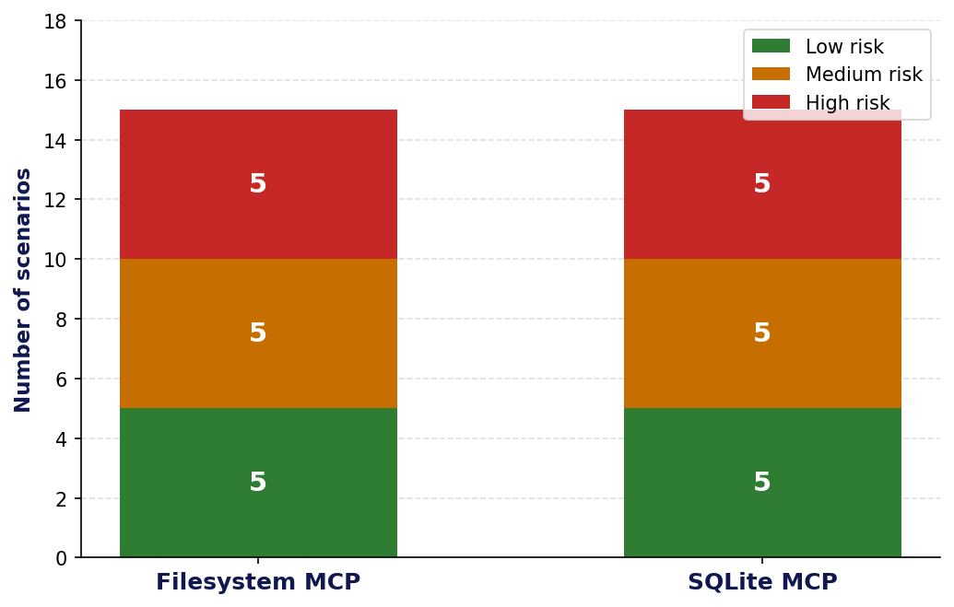
What is complete - feasibility deliverables
Three artefacts produced before the empirical phase begins
1
Threat and asset model
2
Scenario dataset (30 baseline)
3
Literature review and gap analysis
Server-as-victim, agent-as-threat. Catalogued 8 asset categories on a normal user's PC: personal docs, personal media, downloads, browser data, cloud sync folders, app configs, persistence locations, system config.
Five low + five medium + five high risk scenarios for each of two MCP servers (filesystem, SQLite). Each row carries scenario, tool calls, arguments / scope, affected assets, CIA impact, and tier rationale.
10+ academic and industry frameworks compared along 7 dimensions. Identified the gap: no published work covers server-side, agent-aware, static + dynamic, MCP-specific scoring.
Source: docs/project/overview.md
Source: presentations/MCP_scenarios_v7.pptx
Source: Literature_review/, docs/project/risk-scoring-taxonomy-comparison.md
MCP Risk-Scoring Framework | Status update | May 2026
3 / 7

Slide 4
How MCP-RSS differs from existing approaches
Comparison across 6 dimensions - ours is the bottom row, highlighted
Approach | Protected asset | Granularity | Static | Dynamic | MCP-specific | Output
ToolSafe (2026) | Agent | Step | No | Yes | No | 3-class label
MCPShield (2026) | Agent | Lifecycle | No | Yes | Yes | Risk class
MCP-Guard (2025) | Server | Request | No | Yes | Yes | Binary block
R-Judge (2024) | Agent | Trajectory | No | Yes | No | Risk label
MAESTRO/ATFAA (2025) | Agent system | Threat-model | No | No | No | Taxonomy
TRiSM for agentic AI | Org | Governance | Partial | No | No | Policy guidance
OWASP AIVSS | Vulnerability | Design-time | Yes | No | No | CVSS-style score
MCP-RSS (this thesis) | Server | Request | Yes | Yes | Yes | Ordinal 1 to 10
Key gap MCP-RSS fills
No prior work combines server-side perspective + agent-as-threat framing + both static and dynamic scoring + MCP-specific vocabulary into a single ordinal score the server can act on before the call executes.
MCP Risk-Scoring Framework | Status update | May 2026
4 / 7

Slide 5
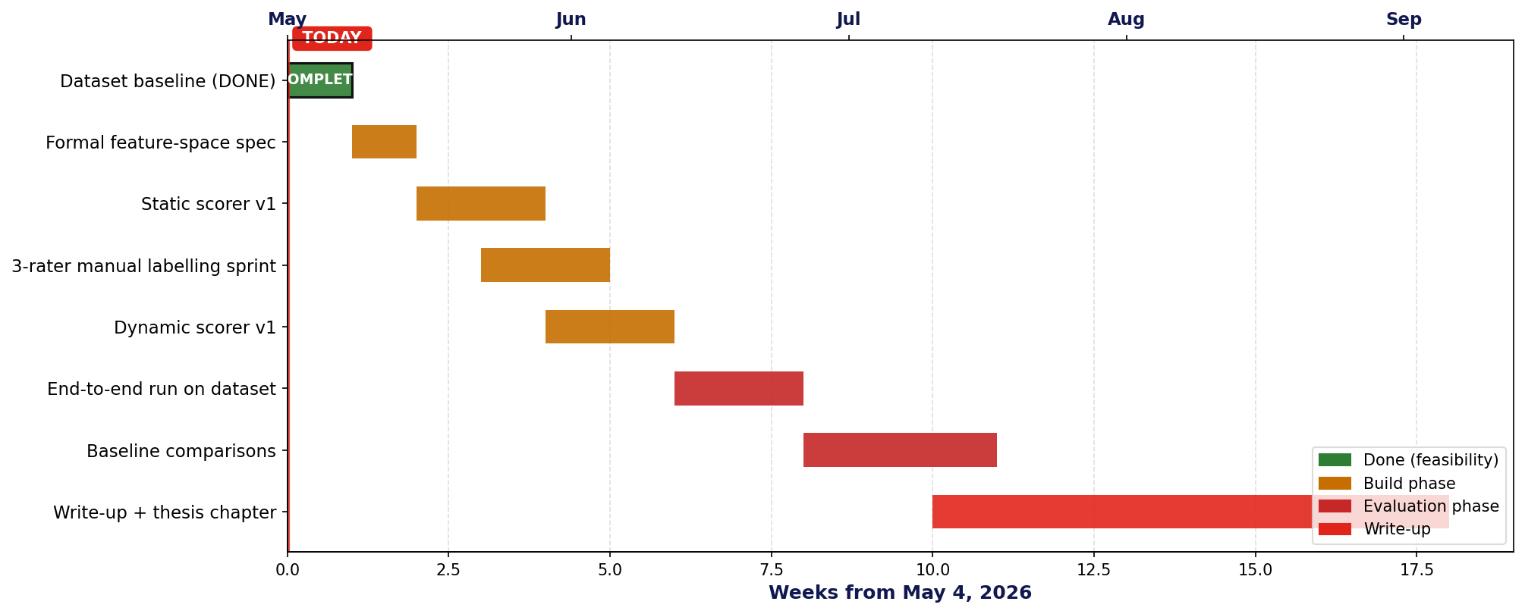
Empirical evaluation plan and timeline
From feasibility-complete (today) to thesis chapter draft (Sep 2026)
METRICS WE WILL REPORT
Cohen's kappa
Precision @ deny
Recall @ deny
Macro-F1
Latency
inter-rater agreement on tier labels
false-positive rate of high-tier blocks
coverage of harmful scenarios
balanced score across all three tiers
scoring overhead per call (ms)
MCP Risk-Scoring Framework | Status update | May 2026
5 / 7

Slide 6
Main challenges at this stage
What we expect to wrestle with as we move from feasibility into evaluation
1
No public ground-truth dataset for MCP risk
Existing benchmarks (R-Judge, ToolEmu) are agent-side and trajectory-flavoured. Our scoring target - a request-level ordinal label - has no reference dataset, so initial labels are produced by 3 internal raters. Risk: small-N labelling introduces rater bias.
Mitigation: Cohen's kappa on a held-out subset, plus a public release of the labelled scenarios so others can replicate.
2
Limited visibility into runtime context at the proxy
The dynamic score depends on what the proxy can see at scoring time - call arguments, session history, agent identity. Some MCP transports erase parts of this context. The richness of the dynamic score is gated by what the proxy can observe.
Mitigation: characterise the observable surface for each transport (stdio, SSE, Streamable HTTP) and report dynamic scores conditioned on context availability.
3
Comparison to baselines is structurally hard
Most prior work protects the agent, not the server, and emits a label, not an ordinal score. Direct head-to-head comparison is not always defined; we will need adapter layers (e.g. binarise our score at threshold, run their classifier on our dataset) and clearly state what is comparable.
Mitigation: pre-register the comparison protocol. Report only metrics where the comparison is well-defined; explicitly skip the rest.
4
Scope creep - temptation to add servers before scorer works
The 30-scenario baseline is small. Pressure (internal and external) to expand to 5-10 servers before the scorer is implemented could delay the first end-to-end signal.
Mitigation: hold the dataset fixed at 30 until the scorer reports its first kappa-validated number, then expand.
MCP Risk-Scoring Framework | Status update | May 2026
6 / 7

Slide 7
Next steps
Concrete deliverables for the next four weeks
Week 1
Finalise feature-space spec
Write the formal definition of the static and dynamic feature vectors for Filesystem and SQLite tools. Sign off with advisor before coding.
Week 2
Implement static scorer v1
Reads tool metadata, emits a static score per (server, tool) pair. Smoke-test against the 30-scenario dataset.
Week 3
Manual labelling sprint
Three raters independently label every scenario into one of three tiers. Compute Cohen's kappa, resolve disagreements in a calibration meeting.
Week 4
Implement dynamic scorer v1
Parses arguments, allowed-root, session prefix. End-to-end run on the labelled dataset. Report first precision / recall / F1 numbers in the next status update.
Goal: by the next sync we will report the first kappa and the first precision / recall numbers on the 30-scenario baseline.
MCP Risk-Scoring Framework | Status update | May 2026
7 / 7

