Slide 1


Slide 2
PACMAN
Final Project
Algorithm and Data Structure
Lecturer : Nguyễn Thanh Tùng

Slide 3
Group member
Tô Bá Thanh Tùng – Leader
Nguyễn Thiện Tuấn Ngọc
Đoàn Trọng Nhân

Slide 4
Outline
Introduction
Coding
Game Engine
Algorithm
Graphics
Game Demo

Slide 5
CODING

Slide 6


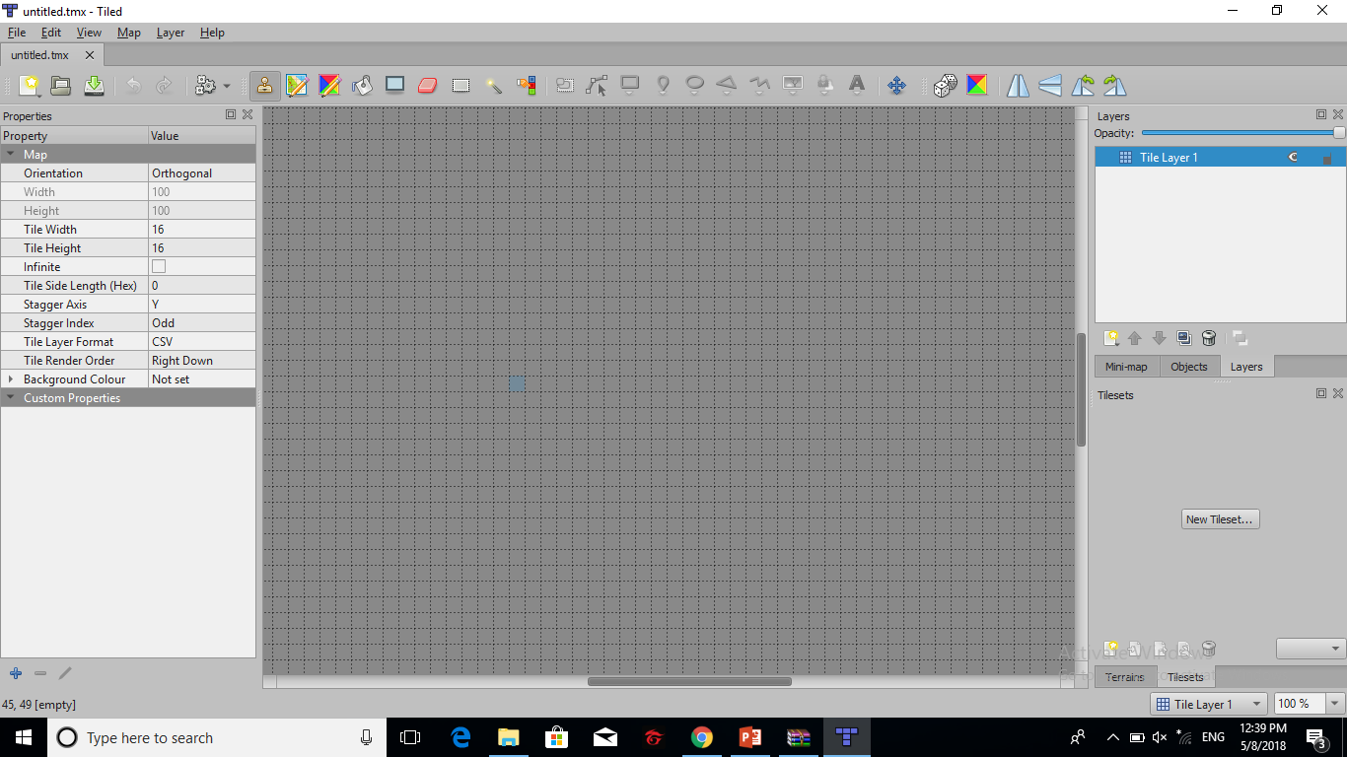
GAME ENGINE
Library GDXLib
Game 2D
Physics
Tiled Map

Slide 7
ALGORITHM
A* Path Finding
Dijkstra Algorithm
Best First Search
Binary Heap

Slide 8
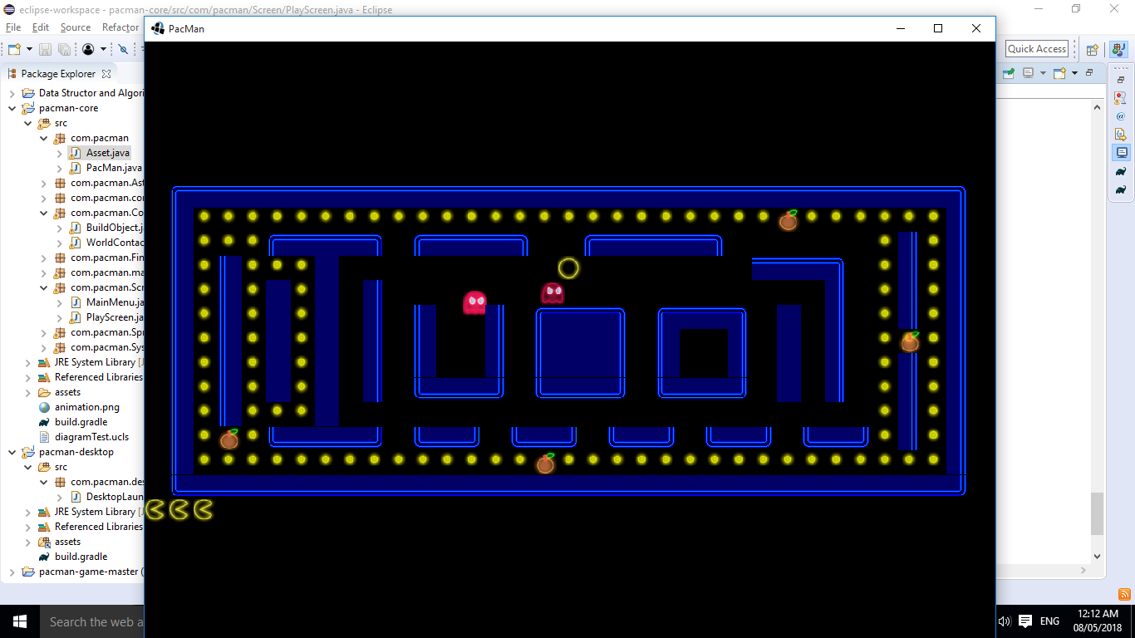

Graphics
Box2D
Tiled Map

Slide 9
GAME DEMO

Slide 10


