Slide 1
Digital forensic analysis for the Windows operating system
TeamDataAnalysis

Slide 2
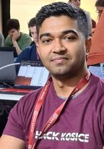
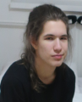
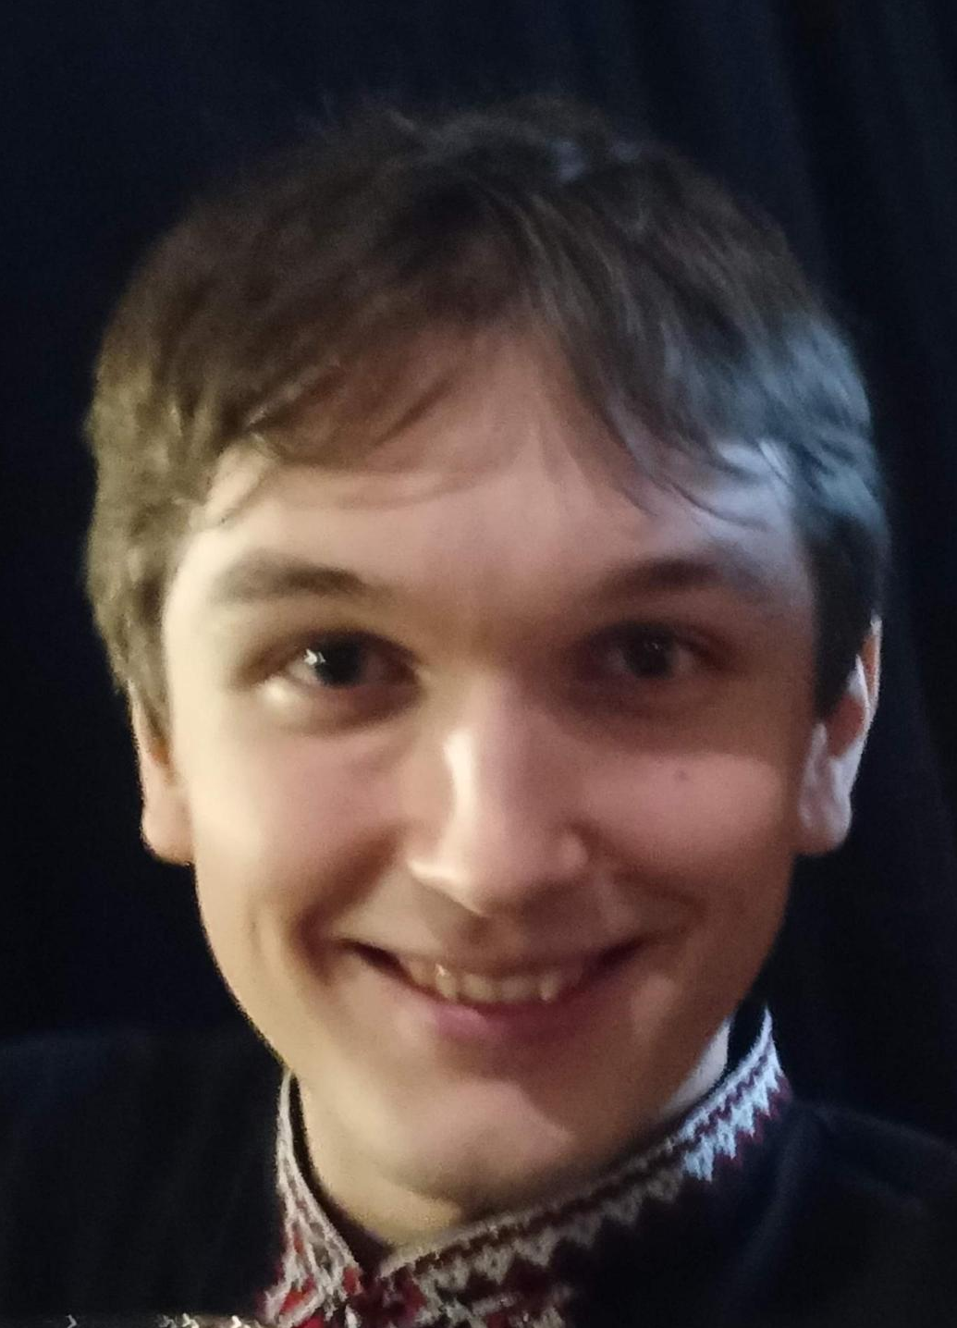
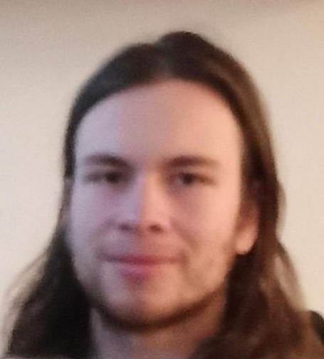
The Team
First time in in-person hackathon
Mohammad Bappy Chowdhary
Business Analyst
University of Westminster (UK)
Matej Hanus Charles University
Patrik Paľovčík Masaryk University
Tomáš Chovančák
Masaryk University

Slide 3

Get an overview into challenge

Slide 4
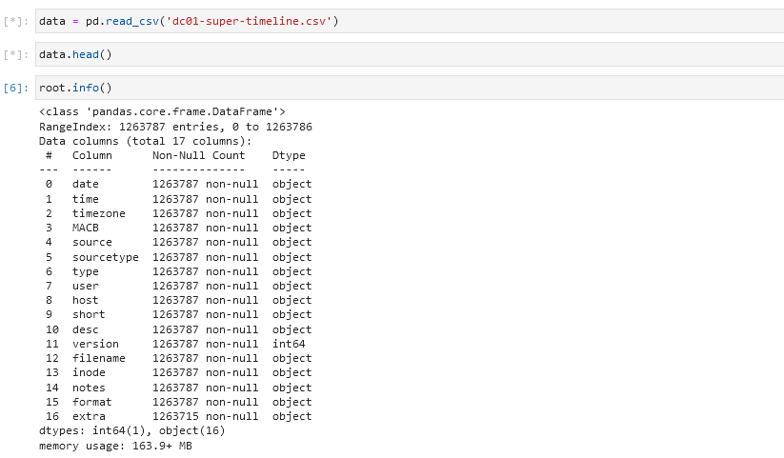

Slide 5
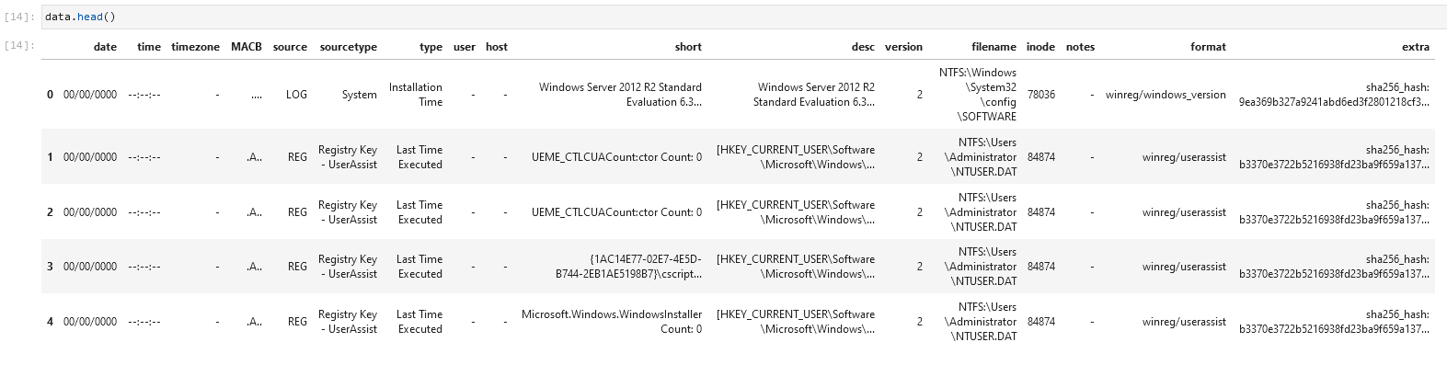
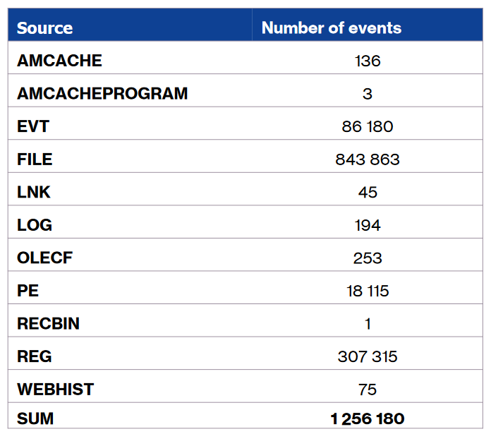
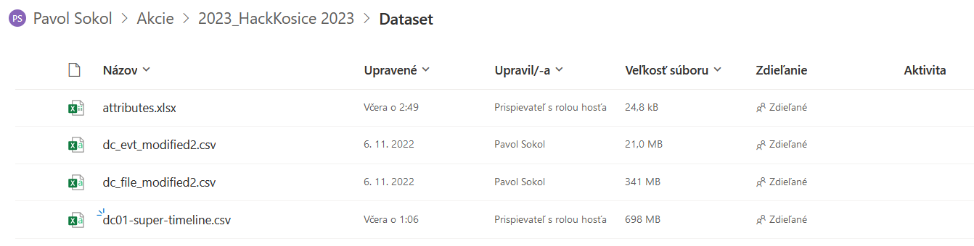

Slide 6
Anomaly detections alternatives
Local Outlier Factor (LOF)
Isolation Forest
KNN (k-Nearest Neighbors)
DBSCAN

Slide 7
Compare Anomaly detections models
Jaccard score
Confusion matrix

Slide 8
Compare Anomaly detections models
Jaccard score
Confusion matrix

Slide 9
Thank You

