Slide 1


Raspberry Pi
Dušan Stanković 3611

Slide 2
Table of contents
Introduction and history
01
Raspberry Pi today
03
Brief overview of Raspberry Pi models
02
Fun projects and ideas
04

Slide 3
Introduction and history
Before jumping into Raspberry Pi itself, I would like to take a second and talk about it’s creator Eben Upton.
Eben Upton is a British engineer, creator of the Raspberry Pi and the Raspberry Pi Foundation.
He studied physics and engineering at the Cambridge university, then he worked for prestigious companies, like Broadcom, Intel and IBM

Slide 4
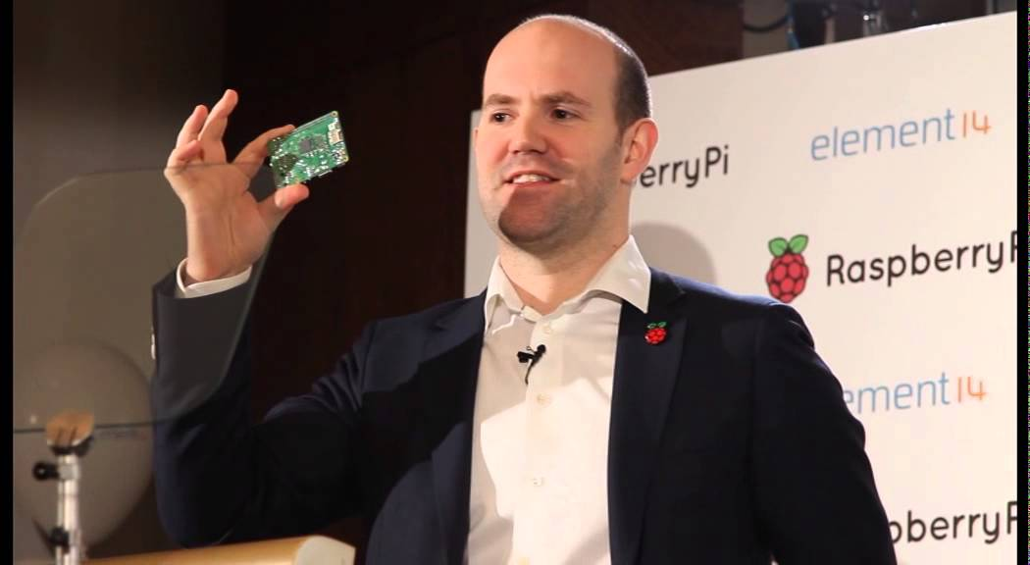

Slide 5
Introduction and history
Eben Upton worked five years from 2006 to 2011 on a single board computer project (mainly on evening and weekends, while working at Broadcom) The BBC Micro from Acorn computers he had used at school, inspired him to create his own product.
The BBC Micro from Acorn computer was sold for £350 in the UK and it was difficult for schools to buy enough for all students.
While he was creating his prototypes, he realized that there was an education problem in the UK, with high prices for computers, this implies that young students didn’t learn computer sciences, turned away from the computer professions, and companies in the UK lacked computer professionals.

Slide 6
Introduction and history
Eben’s ultimate goal was to build a computer ten times cheaper than the BBC Micro and to help young students learn the programming basis at low cost.
In 2009, Eben Upton created the Raspberry Pi Foundation to structure the Raspberry Pi development. It’s a registered educational charity foundation based in the UK.
He could have created a classic company and sell the Raspberry Pi for $100 to make money, but his main goal was to help people and solve a problem.

Slide 7
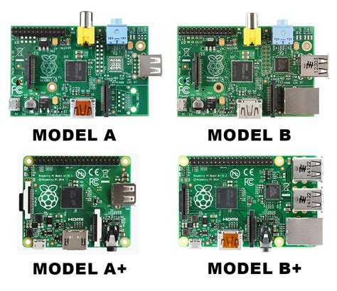
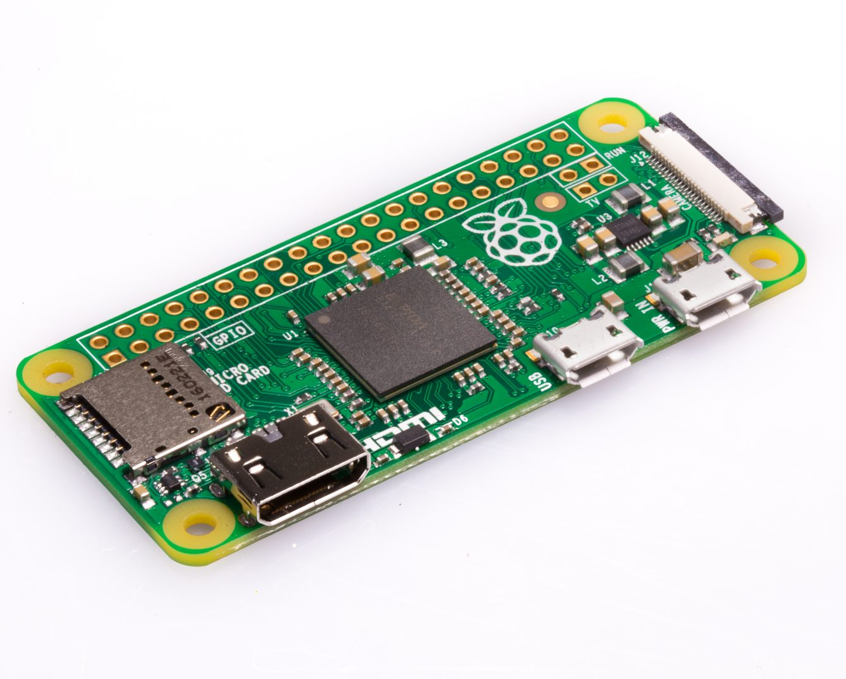
Raspberry Pi Models
Model A
Version 1
Version 2
Version 3
Model B
Version 1
Version 2
Version 3
Model Zero
Zero W
Zero WH

Slide 8
Raspberry Pi today
We already saw the amazing story of Eben Upton and the Raspberry Pi Foundation, starting from 0 to 20 million sales in six years.
Let’s take a brief moment to see how much space the Raspberry Pi took in our everyday lives intentionally, and possibly unintentionally.
Currently, the most used and newest Raspberry Pi Model is Pi 4, which has options for 1, 2, 3, 4 or 8 GB of RAM.

Slide 9
Raspberry Pi today
Raspberry Pi at school:
The main goal of the Raspberry Pi creation was to bring back computing at school, for education of young people, was it a success? Probably, is it measurable? Not sure.
Raspberry Pi at work:
There are many applications at work for a Raspberry Pi. Many companies can use it to collect data, display things or monitor something.

Slide 10
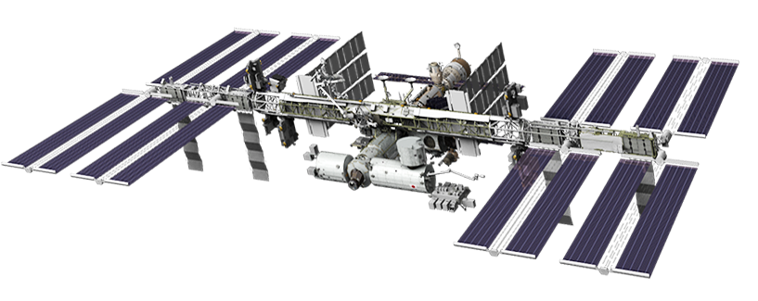
Raspberry Pi today
Raspberry Pi in space??:
There are also Raspberry Pi in space, inside the International Space Station (ISS), scientists can use them for various projects.
For example, in 2018, the Raspberry Pi foundation allowed schools to run their code in space, aboard the ISS.
True strength of the Raspberry Pi lies in it’s community, with the Internet democratization and the social networks, the fame of this product spread naturally, which brings us to our next section of the presentation.

Slide 11
Fun projects and ideas
With such a wide reach in community, it’s compatibility, processing power, versatility and compatibility with all kinds of other devices, it’s use can’t really be narrowly defined.
I have prepared a preview of a few interesting “DIY” community projects, which are actually useful and fun.

Slide 12
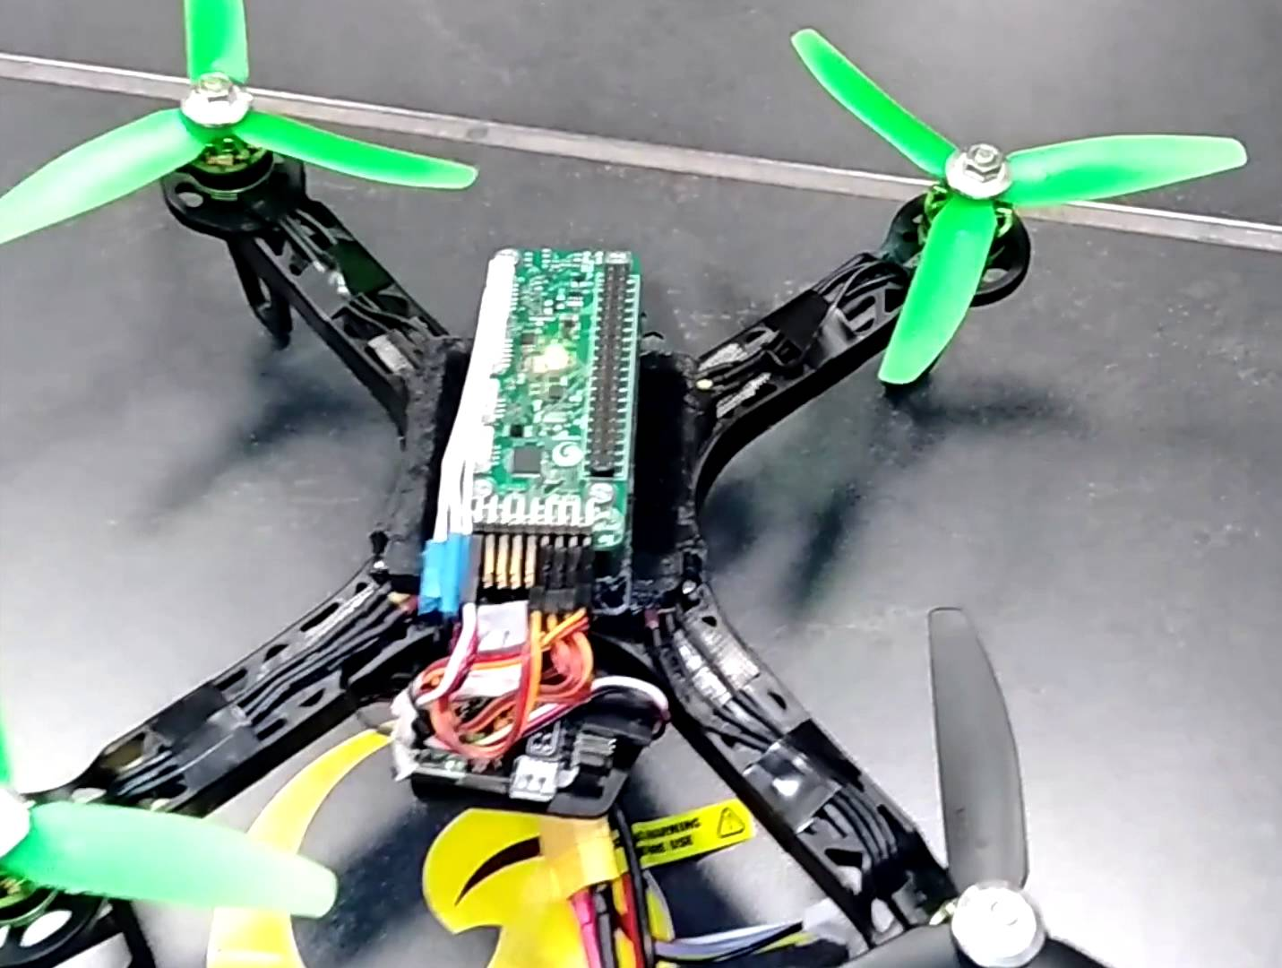
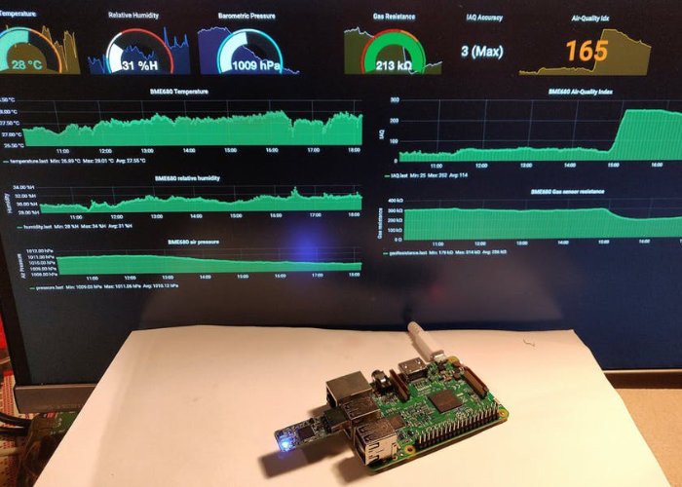
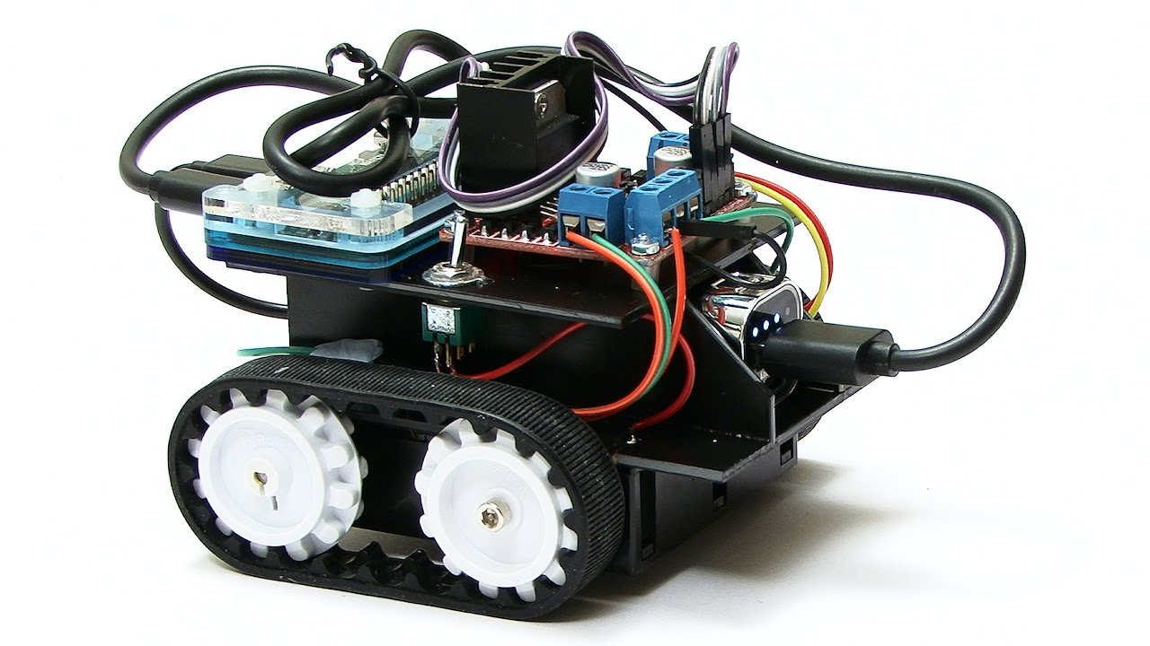
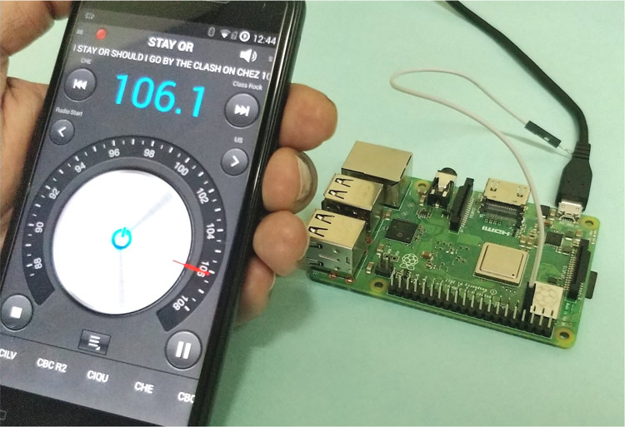
Fun projects and ideas
Raspberry Pi Zero Drone
Air quality monitor
Streaming Device
Wi-Fi Extender
Security Laser Tripwire
FM Radio Transmitter
AI Thermometer
3D Scanner
Dash Cam
Robotics
And many more…

Slide 13
Thanks for listening!

