Slide 1


DATA PREPROCESSING
Text Feature
Extraction Techniques

Slide 2




GIỚI THIỆU
Lecturer:
D.Sc. Le Cung Tuong
Students:
To Vinh Khang - 51800408
Bui Quang Khai - 51800785

Slide 3


https://tinyurl.com/ybb984oh

Slide 4


MAIN CONTENT
1
THEORETICAL BASIS OF TEXT FEATURE EXTRACTION TECHNIQUES
2
INTRODUCING SCIKIT-LEARN LIBRARY AND USING CLASSES OF TEXT SUB-MODULE
3
DEMO CODE IN PYTHON
4
CONCLUSION

Slide 5

1.
THEORETICAL BASIS OF TEXT FEATURE EXTRACTION TECHNIQUES

Slide 6
THEORETICAL BASIS OF TEXT FEATURE EXTRACTION TECHNIQUES
• Bag of words Model
- In this model, a text is represented as a bag of its words, not taking into account grammar and even word order but retaining multiple meanings.
- It encodes strings and provides an integer "id" for each possible token, for example by using spaces and punctuation as token delimiters, counting the number of token occurrences notification within each document is normalized and weighted with decreasing key tokens occurs in the majority of templates / documents.

Slide 7
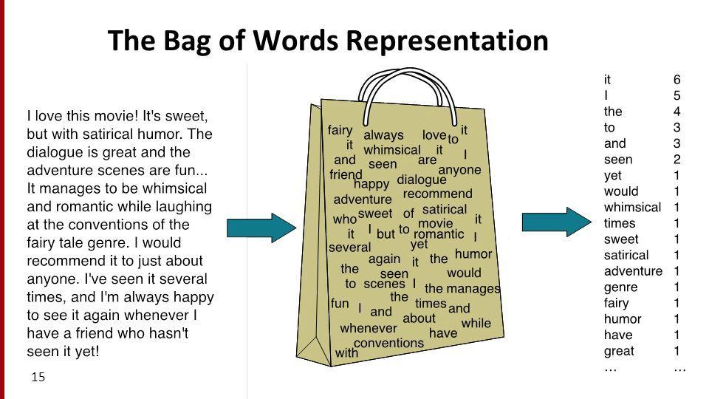
THE BAG OF WORDS
Raw document
Result

Slide 8
THEORETICAL BASIS OF TEXT FEATURE EXTRACTION TECHNIQUES
• Sparsity of Matrix
A sparse matrix is a matrix in which the majority of elements have a value of 0. Sparse matrix is indicated by the number of elements having a value of 0 divided by the total number of elements. In essence, it will be compressed more easily and thus minimizes the need to store on the computer.
1 2 0 0 0 0 0
0 1 3 0 0 0 0
0 0 2 4 0 0 0
0 0 0 1 5 2 0
0 0 0 0 0 0 3
10 values != 0
25 values = 0
=> Density = 28.5%
Sparse density = 71.5%
M =

Slide 9
THEORETICAL BASIS OF TEXT FEATURE EXTRACTION TECHNIQUES
• Vectorizer
- Common Vectorizer:
The usual vectorization is converting a text data set into a matrix of number of tokens. The occurrence frequency of each individual token is considered a feature. The vector of all token frequencies for a given document is considered a multivariable pattern.
- Hashing Vectorizer:
Hash vectorization is the conversion of a text data set into a matrix of token occurrences. It uses the hashing trick to find the token string name to highlight the mapped integer index. Great expandable memory.

Slide 10
THEORETICAL BASIS OF TEXT FEATURE EXTRACTION TECHNIQUES
• Stop Words
- Stop words are words such as "i, a, the, and, of, to,..." that are thought to have no meaning in representing the content of a text and can be deleted to avoid them being interpreted as signals for prediction. However, sometimes, similar words are useful for prediction, such as a sort of writing style or personality.
- If a data set is assumed to contain stop words, all of these words will be deleted from the result tokens.
• Decoding text files
Common encodings are ASCII, UTF-8, ..

Slide 11
THEORETICAL BASIS OF TEXT FEATURE EXTRACTION TECHNIQUES
• Stop Words
dataset
Example:
“the”, “function”, “signature”, “include”, “the”, “name”, “of”, “the”, “function”, “and”, “the”, “of”, “the”, “parameters”
stopwords
“the”, “of”, “and”
result
“function”, “signature”, “include”, “name”, “function”, “types”, “parameters”

Slide 12
THEORETICAL BASIS OF TEXT FEATURE EXTRACTION TECHNIQUES
• Tf-Idf Representation
Tf-Idf is an arithmetic statistic intended to reflect the importance of a word to a text in a set or textual object. The Tf-Idf value is calculated step-by-step as follows:
+ Tf(t,d) = n(t,d)/S(d)
+ Idf(t) = log(S/m(t))
+ Tf-Idf = Tf(t,d)*Idf(t)
With:
+ n(t,d): Number of times the term t appears in the document d;
+ S(d): Total number of terms in the document d
+ S: Total number of documents
+ m(t): Number of documents containing the term t

Slide 13

2.
SCIKIT-LEARN LIBRARY AND USING TEXT SUB-MODULE CLASSES

Slide 14

SCIKIT-LEARN MODULE & USING TEXT SUB-MODULE CLASSES
• What is Scikit-learn?
- The name Scikit stems from the notion that it is a SciPy Toolkit, a separately-developed and distributed third-party extension to SciPy.
- A free software machine learning library for the Python programming language. It features various classification, regression and clustering algorithms.
- Designed to interoperate with the Python numerical and scientific libraries NumPy and SciPy.

Slide 15

SCIKIT-LEARN MODULE & USING TEXT SUB-MODULE CLASSES
• How to use it?
Requirements:
Python(≥3.6)
NumPy(≥1.13.3)
SciPy(≥0,19,1)
Joblib(≥0.11)
Threadpoolctl (≥2.0.0)
Setting:
pip install -U scikit-learn
conda install -c conda-forge scikit-learn

Slide 16
SCIKIT-LEARN MODULE & USING TEXT SUB-MODULE CLASSES
• sklearn.feature_extraction.text
Class CountVectorizer
- input: string {‘filename’, ‘file’, ‘content’}, default=’content’ - encoding: string, default=’utf-8’ - decode_error: {‘strict’, ‘ignore’, ‘replace’}, default=’strict’ - strip_accents: {‘ascii’, ‘unicode’}, default=None - lowercase: bool, default=True - preprocessor: callable, default=None - tokenizer: callable, default=None - stop_words: string {‘english’}, list, default=None - token_pattern: str, default=r”(?u)\b\w\w+\b” - ngram_range: tuple (min_n, max_n), default=(1, 1) - analyzer: {‘word’, ‘char’, ‘char_wb’} or callable, default=’word’ - max_df: float in range [0.0, 1.0] or int, default=1.0 - min_df: float in range [0.0, 1.0] or int, default=1 - max_features: int, default=None - vocabulary: Mapping or iterable, default=None - binary: bool, default=False - dtype: type, default=np.int64
PARAMETERS
- vocabulary_: dict - fixed_vocabulary_: boolean - stop_words_: set
CUSTOM ATTRIBUTES:

Slide 17
SCIKIT-LEARN MODULE & USING TEXT SUB-MODULE CLASSES
• sklearn.feature_extraction.text
Class CountVectorizer
build_analyzer()
build_preprocessor()
build_tokenizer()
decode(doc)
fit(raw_documents, y=None)
fit_transform(raw_documents, y=None)
get_feature_names()
get_params(deep=True)
get_stop_words()
inverse_transform(X)
set_params(**params)
transform(raw_documents)
METHODS

Slide 18
SCIKIT-LEARN MODULE & USING TEXT SUB-MODULE CLASSES
• sklearn.feature_extraction.text
Class HashingVectorizer
- input: string {‘filename’, ‘file’, ‘content’}, default=’content’ - encoding: string, default=’utf-8’ - decode_error: {‘strict’, ‘ignore’, ‘replace’}, default=’strict’ - strip_accents: {‘ascii’, ‘unicode’}, default=None - lowercase: bool, default=True - preprocessor: callable, default=None - tokenizer: callable, default=None - stop_words: string {‘english’}, list, default=None - token_pattern: str, default=r”(?u)\b\w\w+\b” - ngram_range: tuple (min_n, max_n), default=(1, 1) - analyzer: {‘word’, ‘char’, ‘char_wb’} or callable, default=’word’ - n_features: int, default=(2 ** 20) - binary: bool, default=False - norm: {‘l1’, ‘l2’}, default=’l2’ - alternate_sign: bool, default=True - dtype: type, default=np.float64
PARAMETERS

Slide 19
SCIKIT-LEARN MODULE & USING TEXT SUB-MODULE CLASSES
• sklearn.feature_extraction.text
Class HashingVectorizer
build_analyzer()
build_preprocessor()
build_tokenizer()
decode(doc)
fit(X, y=None)
fit_transform(X, y=None)
get_params(deep=True)
get_stop_words()
partial_fit(X, y=None)
set_params(**params)
transform(X)
METHODS

Slide 20
SCIKIT-LEARN MODULE & USING TEXT SUB-MODULE CLASSES
• sklearn.feature_extraction.text
Class TfidfTransformer
- norm: {‘l1’, ‘l2’}, default=’l2’ - use_idf: bool, default=True - smooth_idf: bool, default=True - sublinear_tf: bool, default=False
PARAMETERS
CUSTOM ATTRIBUTES:
idf_array of shape (n_features)

Slide 21
SCIKIT-LEARN MODULE & USING TEXT SUB-MODULE CLASSES
• sklearn.feature_extraction.text
Class TfidfTransformer
fit(X, y=None)
fit_transform(X, y=None, **fit_params)
get_params(deep=True)
set_params(**params)
transform(X, copy=True)
METHODS

Slide 22
SCIKIT-LEARN MODULE & USING TEXT SUB-MODULE CLASSES
• sklearn.feature_extraction.text
Class TfidfVectorizer
- input: string {‘filename’, ‘file’, ‘content’}, default=’content’ - encoding: string, default=’utf-8’ - decode_error: {‘strict’, ‘ignore’, ‘replace’}, default=’strict’ - strip_accents: {‘ascii’, ‘unicode’}, default=None - lowercase: bool, default=True - preprocessor: callable, default=None - tokenizer: callable, default=None - stop_words: string {‘english’}, list, default=None - token_pattern: str, default=r”(?u)\b\w\w+\b” - ngram_range: tuple (min_n, max_n), default=(1, 1) - analyzer: {‘word’, ‘char’, ‘char_wb’} or callable, default=’word’ - max_df: float in range [0.0, 1.0] or int, default=1.0 - min_df: float in range [0.0, 1.0] or int, default=1 - max_features: int, default=None - vocabulary: Mapping or iterable, default=None - binary: bool, default=False - dtype: type, default=np.int64 - norm: {‘l1’, ‘l2’}, default=’l2’ - use_idf: bool, default=True - smooth_idf: bool, default=True - sublinear_tf: bool, default=False
PARAMETERS
- vocabulary_: dict - fixed_vocabulary_: bool - idf_: array of shape (n_features,) - stop_words_: set
CUSTOM ATTRIBUTES:

Slide 23
SCIKIT-LEARN MODULE & USING TEXT SUB-MODULE CLASSES
• sklearn.feature_extraction.text
Class TfidfVectorizer
build_analyzer()
build_preprocessor()
build_tokenizer()
decode(doc)
fit(raw_documents, y=None)
fit_transform(raw_documents, y=None)
get_feature_names()
get_params(deep=True)
get_stop_words()
inverse_transform(X)
set_params(**params)
transform(raw_documents)
METHODS

Slide 24
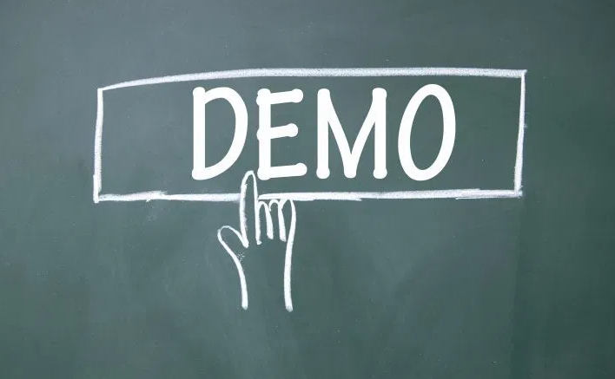

3.

Slide 25

CONCLUSION
4.
+
Introducing some popular techniques
in data preprocessing
+
Lists some outstanding features of
scikit-learn library.
+
Manual solution as well as demo
with Python3 code

Slide 26

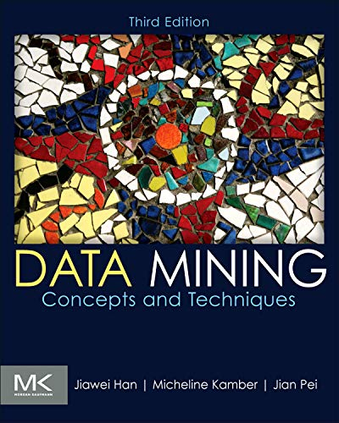
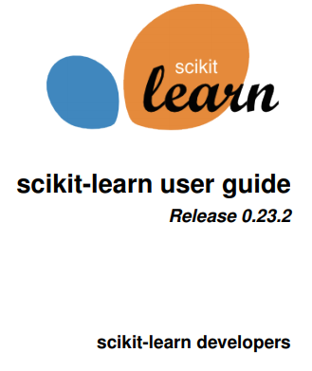
MAIN REFERENCES

Slide 27

QUESTION?

Slide 28

THANKS FOR LISTENING !!

