Slide 1

Multilingual Emotion Classification via Star-Based Product Review Analysis
Nguyen thanh toan thinh

Slide 2
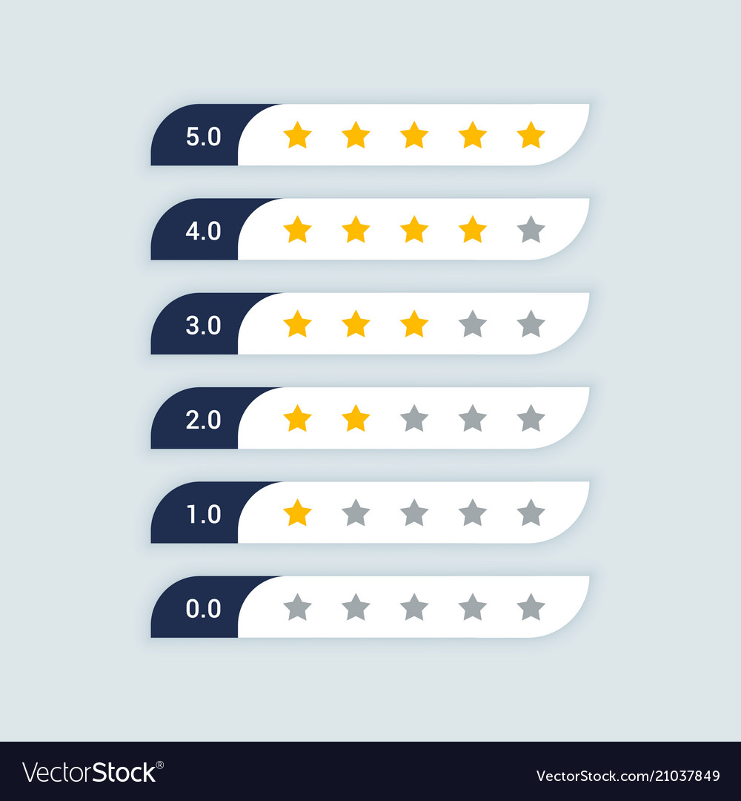
Multilingual Emotion Classification via Star-Based Product Review Analysis
In e-commerce, star ratings are crucial for product reputation, but may not always reflect true customer sentiment. This study introduces emotional intensity classification models based on customer product ratings (1-5 stars), combining Vietnamese and English reviews for a more accurate perspective. Traditional machine learning models (Naive Bayes, SVM, XGBoost) and the mBERT deep learning model were compared using a Kaggle dataset. Results showed SVM achieved 77-78% accuracy, while mBERT better classified 3 and 4-star reviews. Both models were affected by imbalanced data, which the research aims to address in future optimizations.

Slide 3

Introduction: Bridging the Gap Between Ratings and Reality
E-commerce users often rely on star ratings to assess product quality and store reputation. However, ratings can be misleading, with reviews like "The product is very bad" receiving five stars. This research aims to create a model that accurately identifies the emotional intensity of reviews, providing manufacturers with a clearer understanding of customer sentiment. This allows for better strategies to promote products and improve quality.
Star ratings reflect varying emotions—five shows satisfaction, three is neutral, and one signals strong dissatisfaction. Accurate interpretation is key to understanding customer feedback.

Slide 4
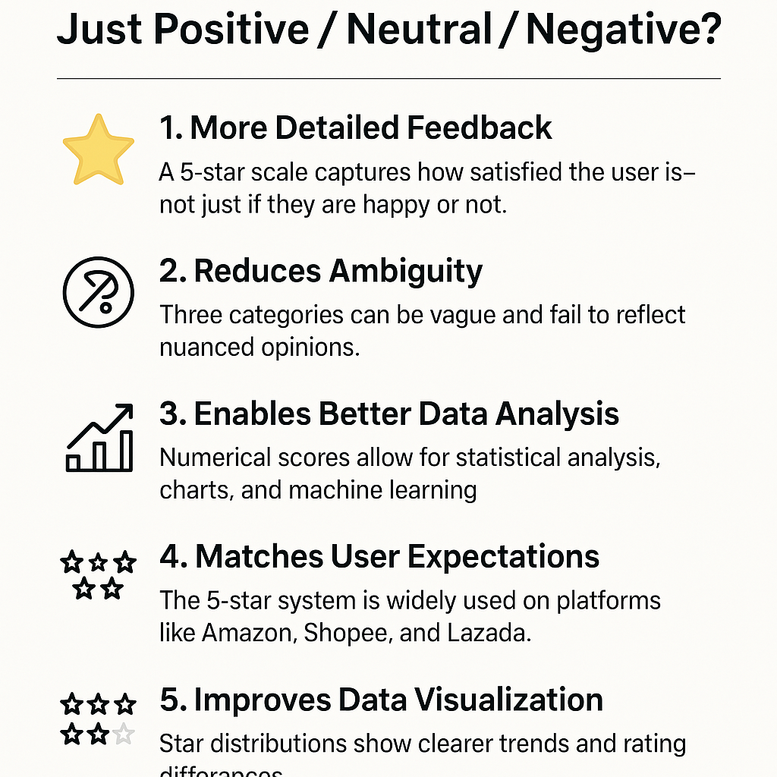
Why Choose a 1–5 Star Rating Instead of Just Positive / Neutral / Negative?
More Detailed Feedback A 5-star scale captures how satisfied the user is—not just if they are happy or not.
Reduces Ambiguity Three categories can be vague and fail to reflect nuanced opinions.
Enables Better Data Analysis Numerical scores allow for statistical analysis, charts, and machine learning.
Matches User Expectations The 5-star system is widely used on platforms like Amazon, Shopee, and Lazada.
Improves Data Visualization Star distributions show clearer trends and rating differences.

Slide 5

The Need for Multilingual Analysis in Emerging Markets
Vietnam's developing economy presents a potential market. However, analyzing customer sentiment in this market is challenging due to the limited number of Vietnamese users who review products in English on international platforms. Therefore, this research incorporates both English and Vietnamese reviews, addressing the difficulties of processing both languages simultaneously.
This research helps manufacturers better understand customer sentiment by analyzing star ratings more precisely than basic sentiment labels. It compares traditional ML models (Naïve Bayes, SVM, XGBoost) with mBERT, addressing the challenges of bilingual data.

Slide 6

Related Work: Emotion Recognition and Sentiment Analysis
Previous studies have explored various aspects of emotion recognition and sentiment analysis, including:
Recognizing emotions in Vietnamese: Vong Anh Ho et al. built the UIT-VSMEC dataset, labeling 6,927 Vietnamese sentences with six basic emotions. CNN achieved the highest performance with an F1-score of 59.74.
Sentiment analysis for mixed language data: Muhammad Kashif Nazir et al. proposed the mBERT model for sentiment analysis on mixed language datasets, showing significant improvement over other algorithms.
Sentiment analysis across multiple languages: Madushanka Perera et al. showed that Transformer models (BERT, XLM-R) outperformed RNN in Malayalam-based sentiment classification.

Slide 7

Methodology: Dataset and Data Preprocessing
The dataset used in this study is the "Amazon Product Review for Analysis" dataset from Kaggle with 30846 rows, which includes customer reviews and star ratings. The dataset features:
Review Text: Detailed customer feedback, cleaned to remove noise.
Star Ratings: Ratings on a scale of 1-5 stars, used to label emotions (1-2 stars: Negative, 3 stars: Neutral, 4-5 stars: Positive).
Cleaned Review Text: Processed version of the review text.
Sentiment Labels: Sentiment labels derived from star ratings.

Slide 8
Data Preprocessing and Model Selection
Check data: If text is not a string, return the string "".
Remove HTML tags: If the text contains HTML, use regex to remove all tags like ¡p¿, ¡br¿, ¡a¿,...
Normalize Vietnamese: If the text is Vietnamese, use textnormalize() to standardize punctuation, capitalization, spelling errors,...
Convert to lower case: To avoid distinguishing between "great" and "Great".
Remove special characters, numbers and punctuation, non-existent values: Retain letters (both English and Vietnamese) and spaces.
Tokenization: Helps the model understand individual words better.
Save the cleaned data to a new CSV file for later use.
Vectorization: Using TF-IDF to embed data helps the model learn better.

Slide 9
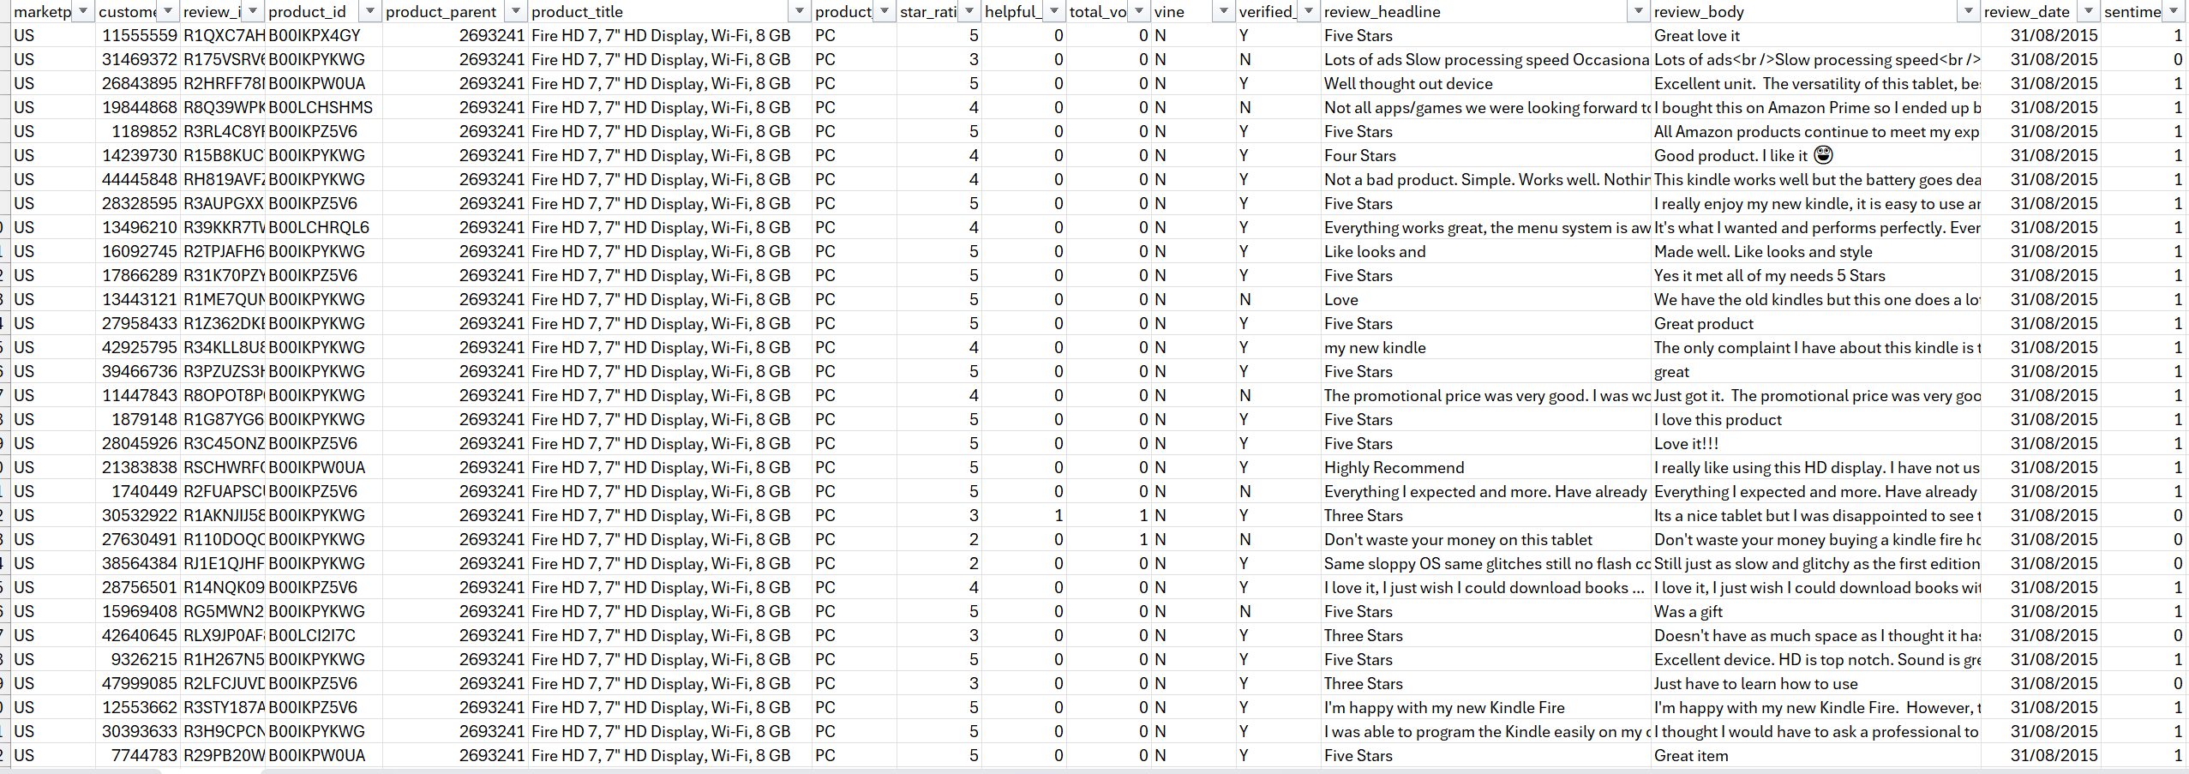
Dataset Before Cleaning

Slide 10
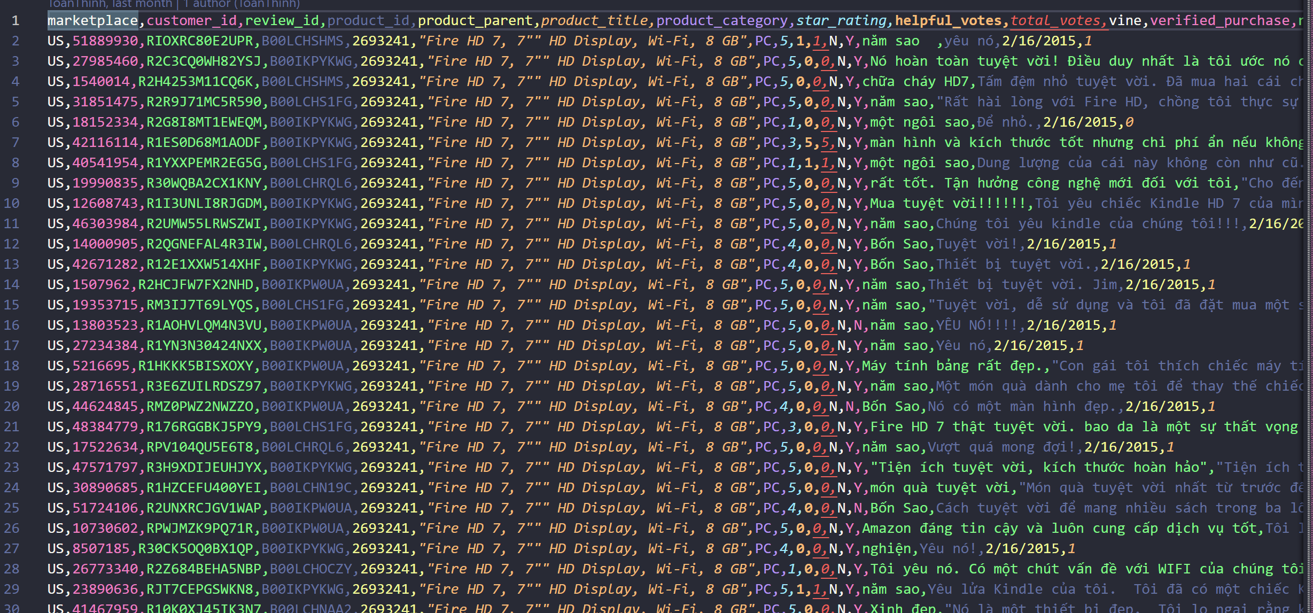
Dataset After Cleaning

Slide 11
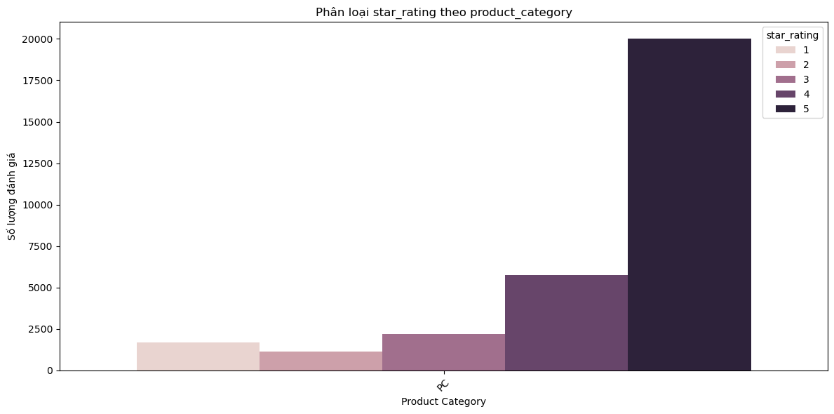
Classified star rating by product_category

Slide 12

Model Selection: Traditional Machine Learning
For emotion analysis, various traditional machine learning models were used for performance comparison:
Naïve Bayes (NB): A simple probabilistic model suitable for text classification with rich vocabulary.
Support Vector Machines (SVM): A powerful model in classification with large feature space.
XGBoost: A modern boosting model that improves prediction performance through combining many small decision trees.

Slide 13
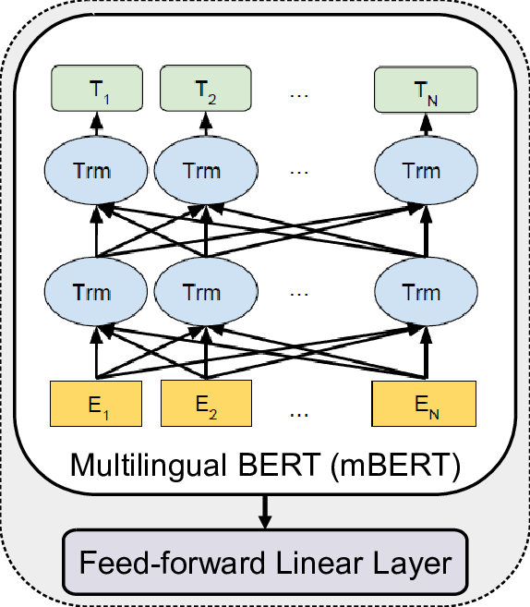
Model Selection: mBERT
We chose mBERT for multilingual emotion classification (English–Vietnamese) because it supports 104 languages, performs well, and is more efficient than LLaMa or DistilBERT.
• Encoder-based Transformer: Uses Transformer architecture with self-attention layers.
• Learn bilingual & multilingual words: Do not use separate embedding for each language, but learn together
on multilingual data.
• Pre-trained with MLM (predict masked words) and NSP (sentence relation).
• Advantage: Supports multiple languages without the need for a separate model for each language.
• Disadvantages: May be inferior to monolingual models on each specific language.
Multilingual BERT (mBERT) model by Md. Akram Hossain.

Slide 14
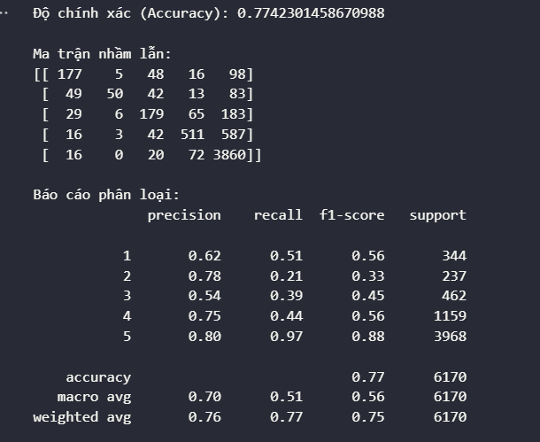
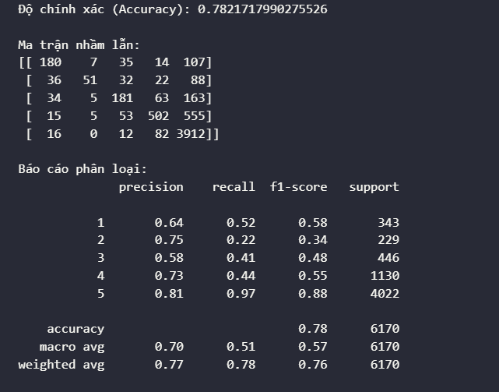
Experimental Results and Discussion: Performance Comparison BETWEEN ENGLISH AND VIETNAMESE
Classification Report Model SVM With Vietnamese.
Classification Report Model SVM With English
– SVM works better on English than on Vietnamese.
– Combining two languages does not help the model improve accuracy but also reduces the recall of classes
from 1 to 4 stars.

Slide 15
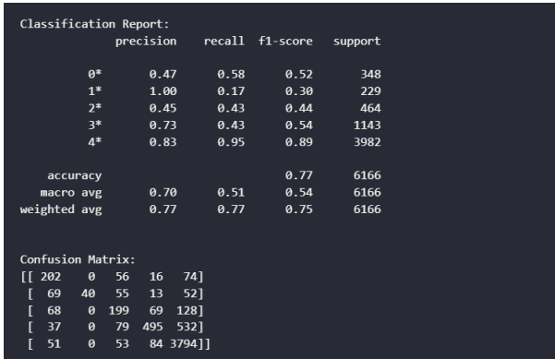
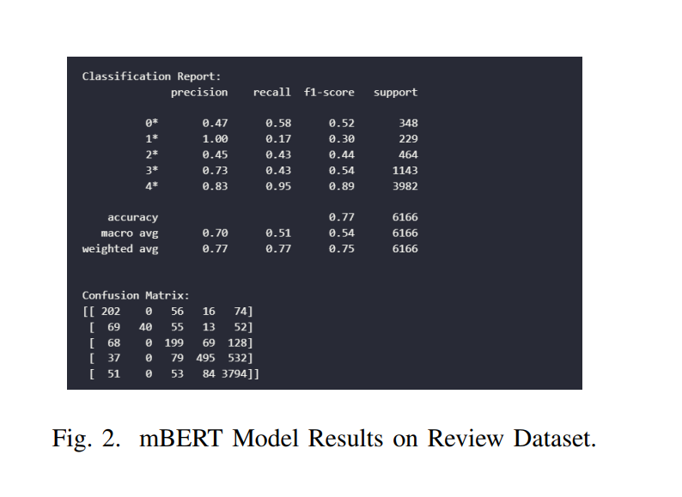
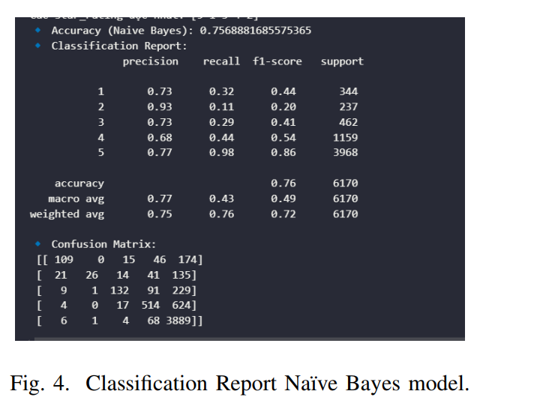
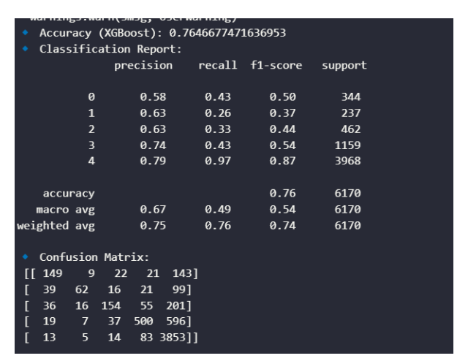
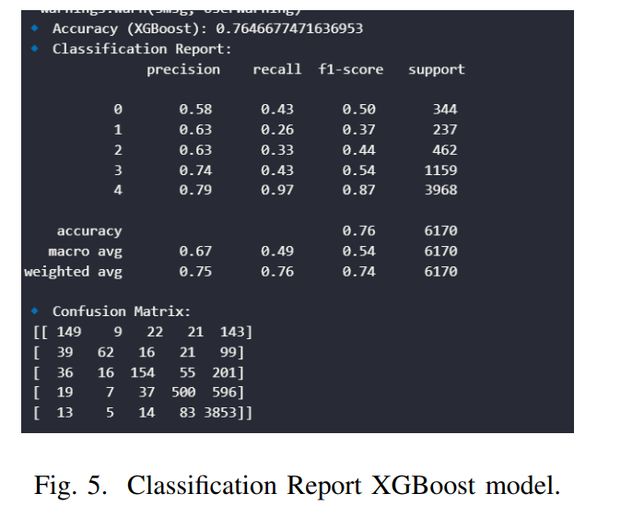
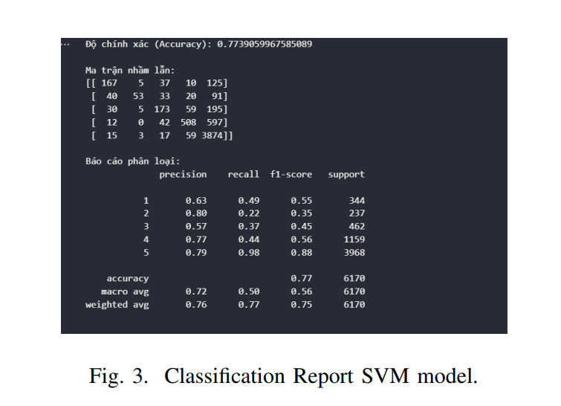
Experimental Results and Discussion: Performance Comparison

Slide 16
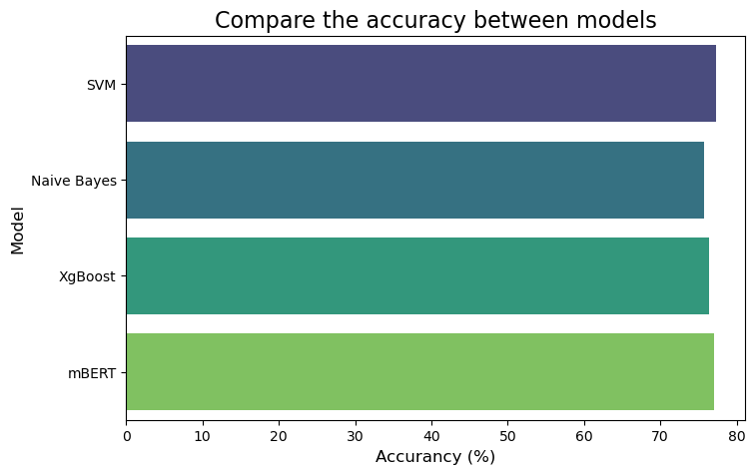
Experimental Results and Discussion: Performance Comparison
Performance Comparison: SVM is the best model overall, with the highest accuracy and best F1-score. XGBoost has performance close to SVM but recall in some classes is still not high. Naïve Bayes has the lowest accuracy, due to extremely low recall in difficult classes, especially 1-star classes.
SVM vs. mBERT: mBert has average recall of classes from 1 to 4 stars, helping the model classify underestimation better. SVM has a higher 5-star recall class, meaning the model tends to predict 5 stars more. Accuracy of SVM is slightly better than mBERT but not significantly mBERT tends to ignore 2-star classes quite a bit.

Slide 17

Conclusions and Future Directions
This study compared SVM, Naïve Bayes, XGBoost, and mBert for classifying emotional intensity based on product reviews in Vietnamese and English. Results showed that English is easier to process than Vietnamese, and SVM outperformed mBERT for low ratings. However, imbalanced data hindered performance.
Future research can explore methods to handle imbalanced data, such as oversampling or weighted loss with better parameters. Additionally, LLaMa and XLM-R can be used to compare performance and find a more suitable Deep learning model. Improving data to avoid imbalance is also crucial.

Slide 18
Thank for listening

