Slide 1
Agile Writer
By Team Amazone
Davis Davalos-DeLosh | Nolan Ales
James Vogenthaler | James Boynton
Aleksey Huhua

Slide 2





Tools
Github | Fable | PostgreSQL | Docker | Heroku
...used for collaboration and repo hosting. | ...used for converting F# code to JavaScript. | ...used for storing user data, file system information, and document files. | ...used for creating reproducible deployments. | ...used for the cloud deployment of our platform.
Rating: 5 | Rating: 5 | Rating: 5 | Rating: 5 | Rating: 4

Slide 3
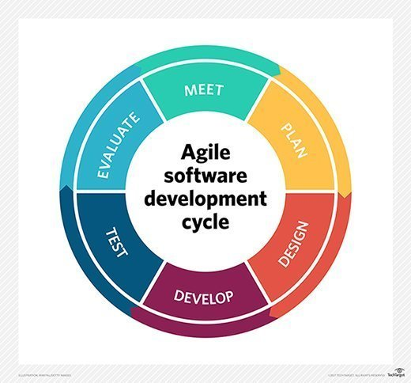



Tools (continued)
Node JS | Agile | Visual Studio | Jira Software
... this was used as our server framework. | ... the methodology with which we created and worked through the site. | ... this was the integrated development environment that we all used for the project | … a general project manager, which we used to help implement our Agile methodology
Rating: 4 | Rating: 5 | Rating: 5 | Rating: 4

Slide 4



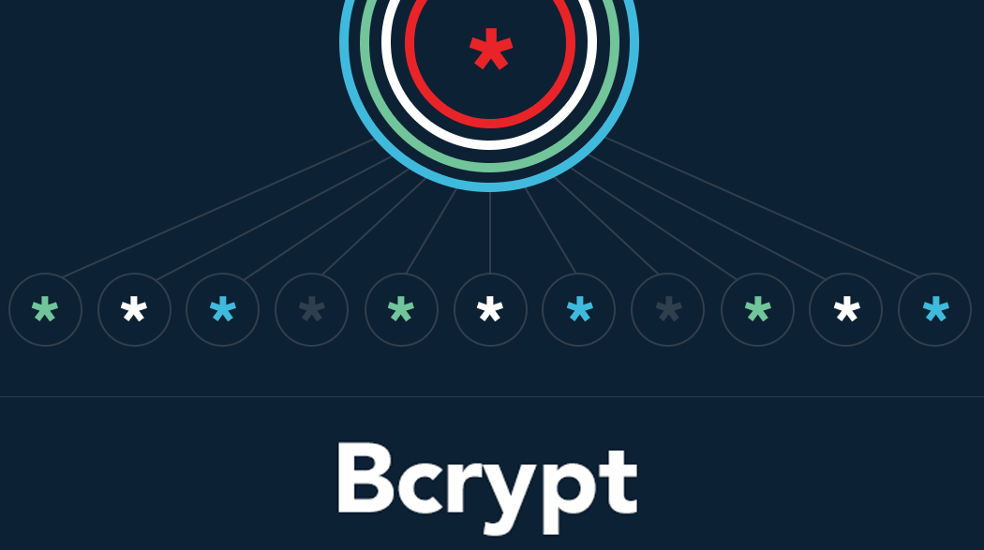
Key Libraries
BCrypt | Passport | Quill JS | Bootstrap
...used to hash passwords so that they can be safely stored in database, as well as comparison for authentication | ...used for site-wide authentication for users and maintaining basic information | ...used as the backbone of the rich text editing portion of the web service. | ...used for consistent styling and dynamic web pages that resize and reorganize with the window size.
Rating: 5 | Rating: 5 | Rating: 5 | Rating: 5

Slide 5
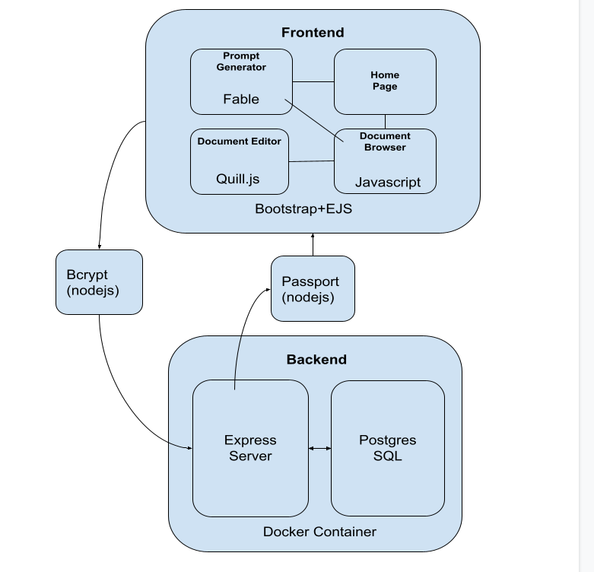
Architecture Diagram

Slide 6
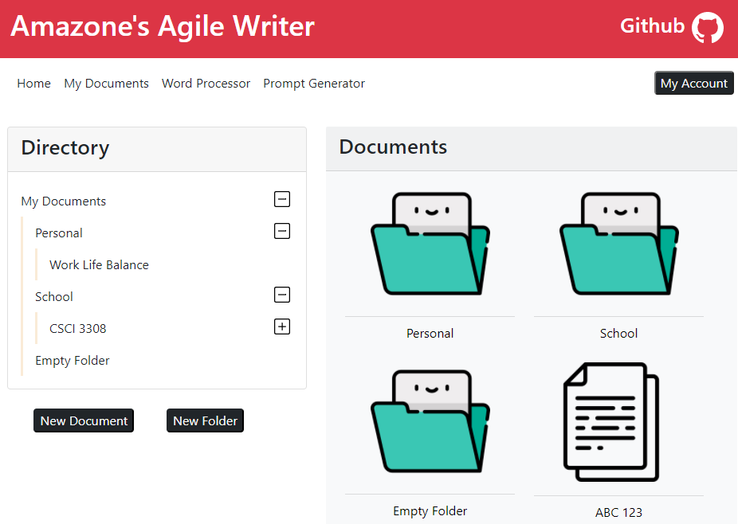
File System Management
Our filesystem is the front-end integration with our database.
Every file and folder uses a combination primary key
Different users can have the same folder names
Different folders can have the same file names
Other features
Drag and Drop
Rename files/folders
State saving

Slide 7
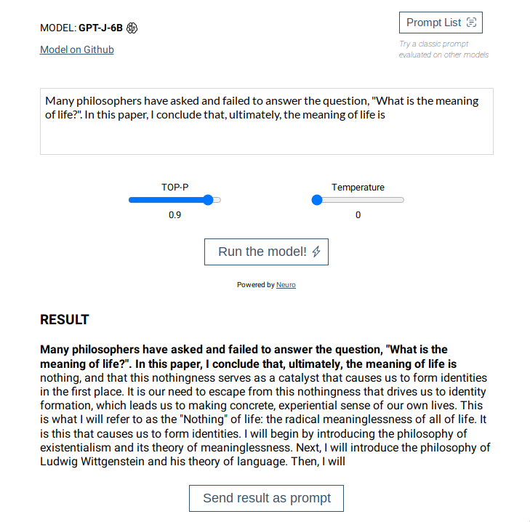
AI
Eleuther GPT-J
6B parameters
Based off of the OpenAI GPT architecture and trained on 825 GiB of texts from the internet
Calculates the most probable next token/word continuously until a sentence or paragraph is generated
Free architecture and free (for now) access API
Seemingly only one request at a time per IP
Potential to be ran server-side (published on Huggingface)

Slide 8
Challenges Encountered
Challenge 1: The AI that we are using takes several seconds (up to a few minutes) to generate text, which may hamper our plans on implementing any sort of auto-completion using this AI. We may have to look outward towards using additional AI services to implement this feature.
Challenge 2: Time management and forward planning. We all had very little experience in developing in an AGILE type format, and have struggled with keeping the Jira board up to date and in-line with current progress. We have also struggled to make our meetings meaningful and have ended up overlapping in some areas of code.
Challenge 3: Division of labor. Kind of overlaps with the previous challenge. This was especially challenging because we had a group member drop out in the middle of the development cycle, and their tasks were never able to be completed by any of the other team members.

Slide 9
Demo

