Slide 1



The Problem
The trash bin is 1 m away. The collection point is 5 minutes away.
52%
Recycling gives you nothing back: no reward, no feedback.
of Swiss municipal waste is recycled (2024)
20%+
Young people know it matters, but the habit doesn't stick.
of each trash bag could still be recycled
Our bet: rewards, challenges and friends turn recycling into a habit.
671 kg
municipal waste per person per year (2022)
Sources: Federal Office for the Environment (FOEN) via Keystone-SDA / blue News; swissinfo.ch
Notes:
[~30 s] Picture this: it's 11 pm, you're holding an empty PET bottle. The trash bin is one meter away, the collection point five minutes away. Most of us pick the bin. Switzerland recycles about 52% of its municipal waste, yet more than a fifth of every trash bag could still be recycled, and each of us produces about 671 kg of waste a year. The bins exist. What's missing is a reason to walk there. Our bet: rewards, challenges and friends can turn recycling into a habit.

Slide 2
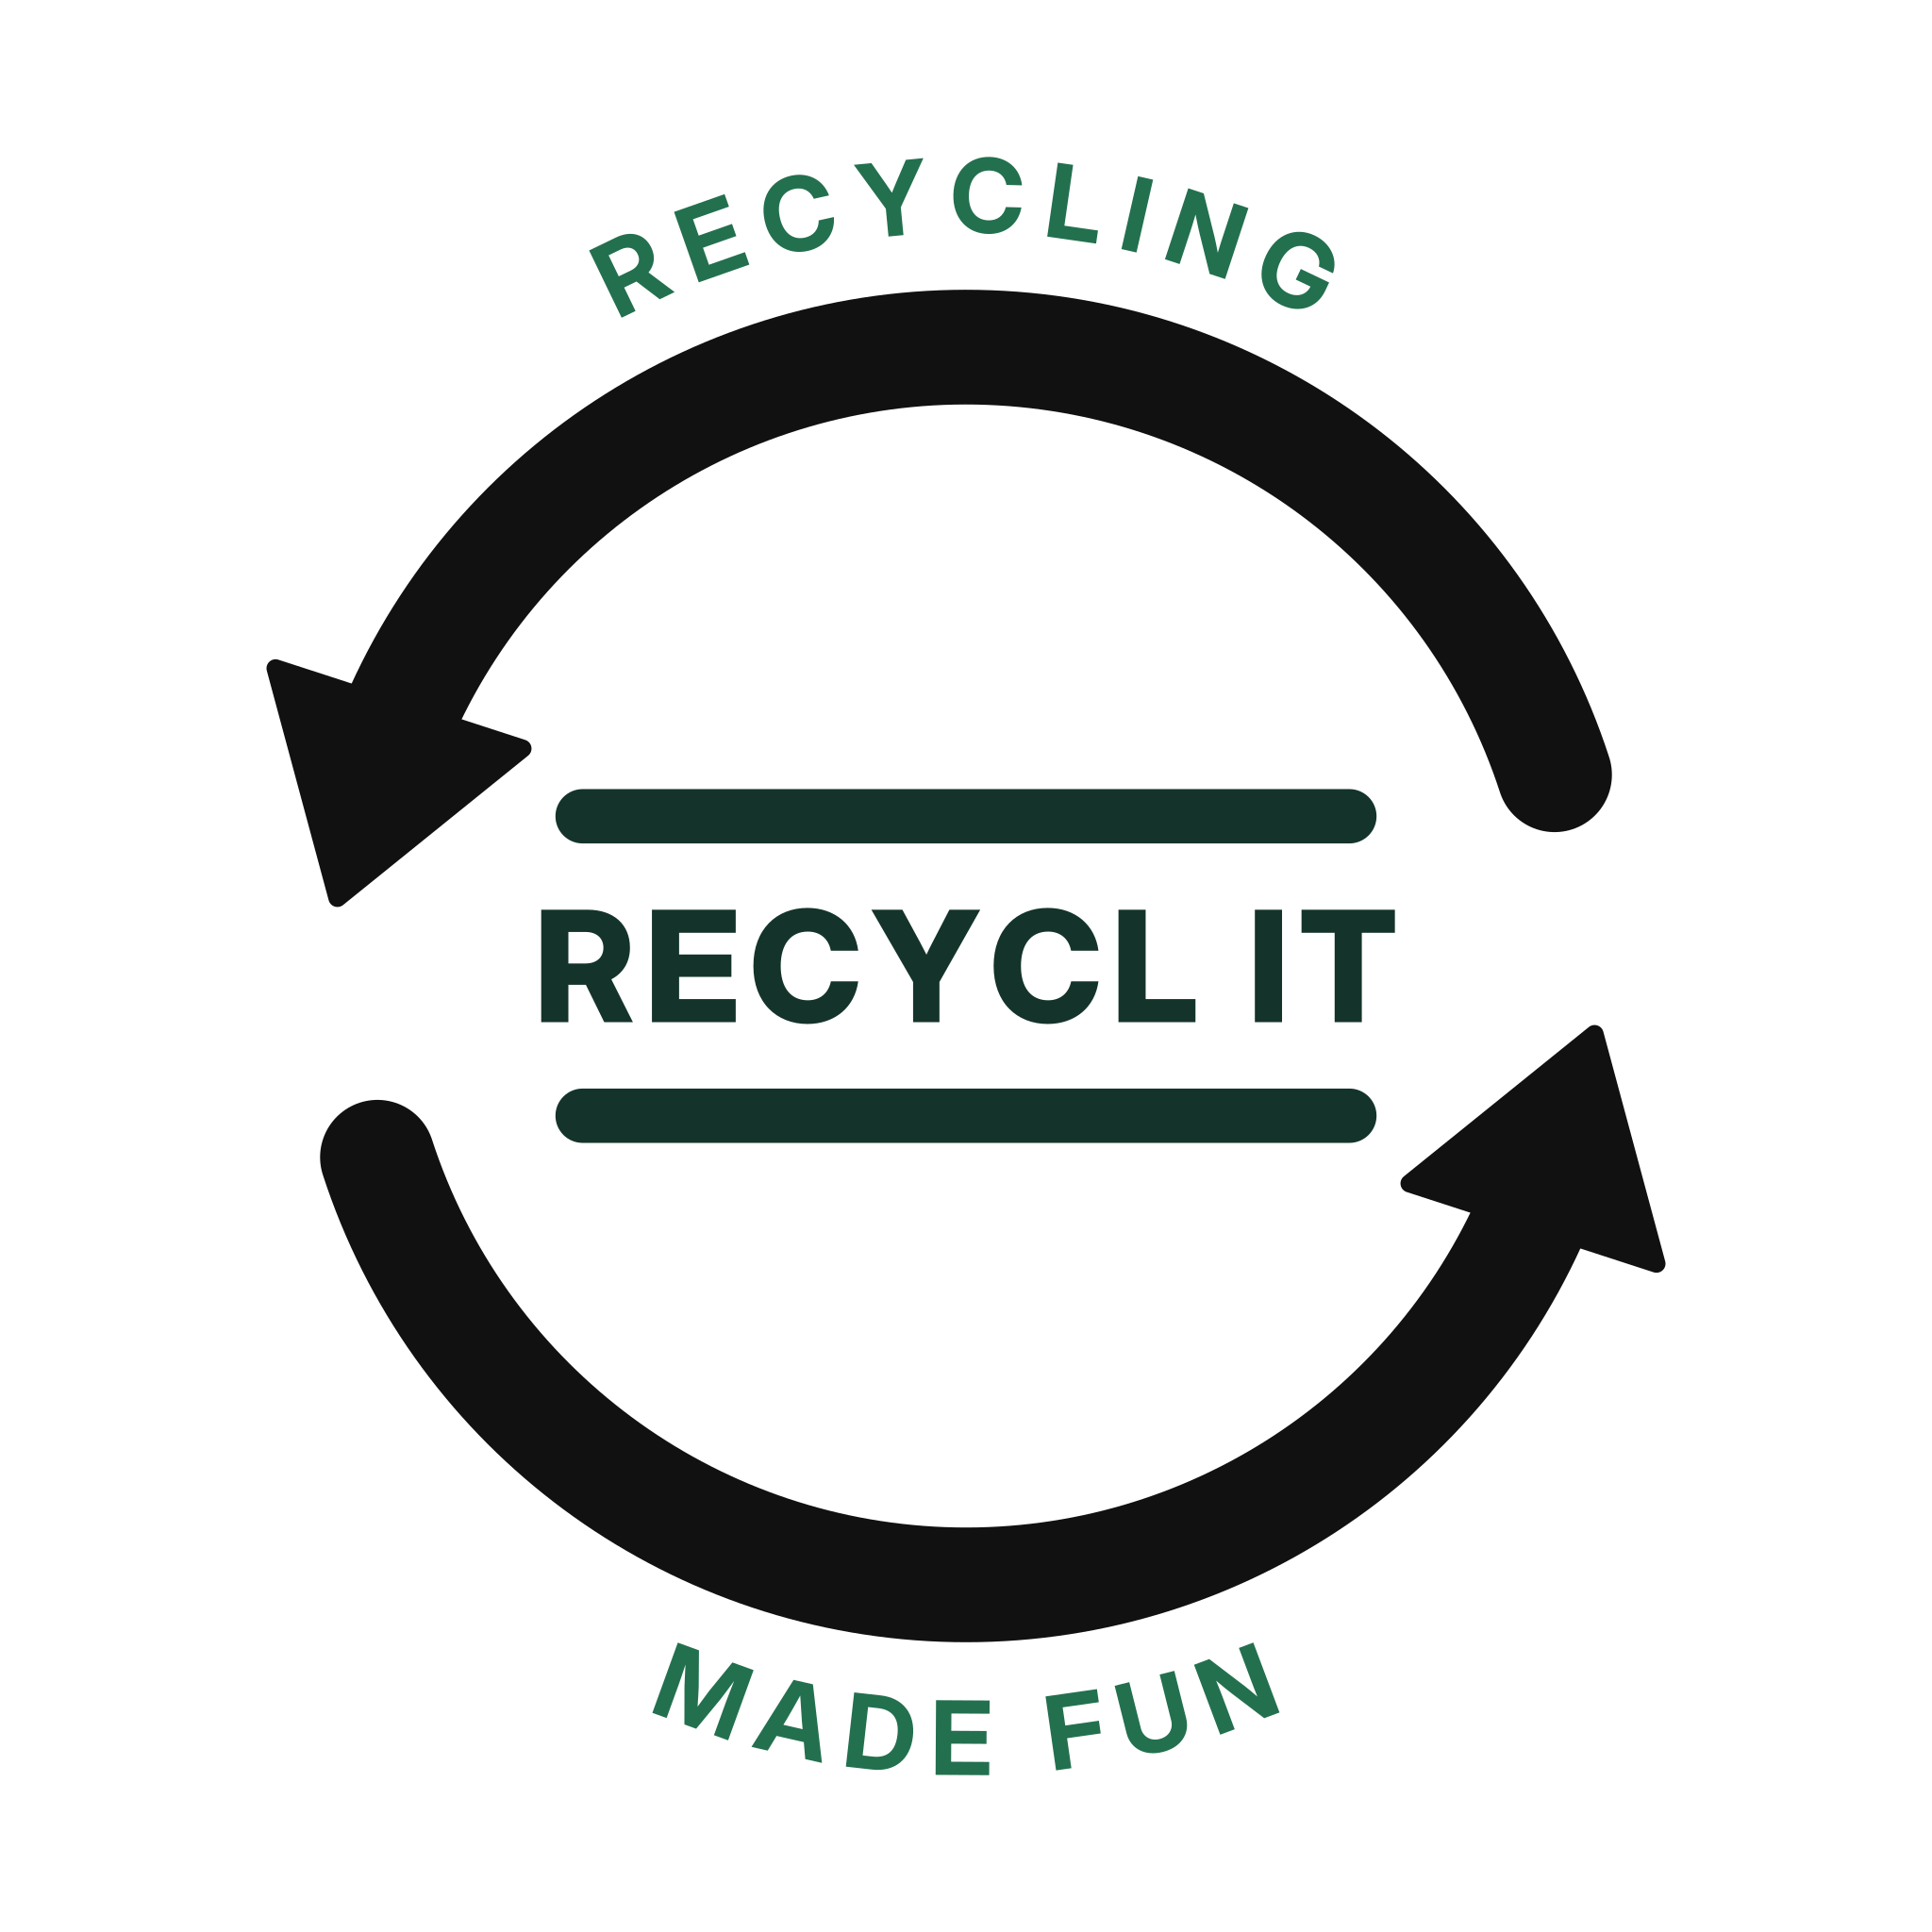
INTRODUCING
RECYCL IT!
Recycling made fun.
Turn everyday recycling into real-world rewards.
Team Arduino · SDG 11: Sustainable Cities and Communities
Notes:
[~10 s] So what if recycling was something you actually looked forward to? That's RECYCL IT: recycling made fun. We're Team Arduino.

Slide 3






Our Solution
RECYCL IT turns recycling into a game you play with your town.
1
2
3
4
5
Scan the QR code at a real collection point
Earn points and streaks
Climb the class and town leaderboard
Redeem points at local shops
Join town challenges with friends
Live demo: scan → points → leaderboard → reward
Notes:
[~70 s incl. demo] RECYCL IT turns recycling into a game. You scan the QR code at a real collection point, earn points and streaks, climb the leaderboard of your class and town, and redeem points at local shops. SWITCH TO THE DEMO — one loop only: scan → points → leaderboard → reward. If the live demo fails, play the backup video immediately.

Slide 4



Business Model
Gemeinde Risch (our first target customer): CHF 0.80 per resident a year ≈ CHF 9’000
CHF 3’200
Local shops & cafés: CHF 1’500 per sponsored quest for visibility, and they fund the rewards
pilot costs, year 1 (hosting, QR stickers, flyers)
CHF 16’500
Users: always free. No ads, no selling data.
revenue, year 1 (Risch + 5 sponsored quests)
Scale: 6 towns like Risch ≈ CHF 54’000 a year, enough for a part-time developer.
Year 1
break-even in the pilot year
All figures are our estimates. Rewards are paid by sponsors; the team works unpaid during the pilot.
Notes:
[~35 s] Who pays? Not the users — the app is always free. Our first target customer is the Gemeinde Risch: every bottle that leaves the trash bag means less incineration and a better recycling rate. We charge 80 Rappen per resident a year, about CHF 9’000 for Risch. Local shops and cafés pay CHF 1’500 per sponsored quest for visibility and fund the rewards themselves, so rewards cost us nothing. Year-1 costs are about CHF 3’200: hosting, QR stickers and flyers. With Risch and five sponsored quests we earn about CHF 16’500, so the pilot breaks even in year 1. Six towns like Risch bring about CHF 54’000 a year — enough for a part-time developer.

Slide 5

Why RECYCL IT?
The only option that is free, rewarding and social.
 | Free for users | Rewards | Community & challenges | Shows where to recycle
RECYCL IT our app | ✓ | ✓ | ✓ | ✓
Mr. Green pickup subscription, from CHF 8.95/month | ✕ | ✕ | ✕ | ✕
Kuh-Bag plastic collection bag, 130 towns | ✕ | ✕ | ✕ | ✕
IGORA Recycling Map map of 16’000+ collection points | ✓ | ✕ | ✕ | ✓
They make recycling possible. We make people want to do it, and we can partner with them instead of fighting them.
Sources: mr-green.ch, preispirat.ch (Mr. Green); Abfall-Info Appenzell I.Rh. 2026 (Kuh-Bag); App Store listing (IGORA Recycling Map)
Notes:
[~25 s] There are good recycling services in Switzerland. Mr. Green picks up your recycling for a monthly fee. Kuh-Bag is a plastic collection bag used in 130 towns. The IGORA Recycling Map shows 16’000+ collection points. They make recycling possible — but none of them makes you want to do it. We're free, we reward you, and we make it social. And we'd rather partner with them than fight them: our map could point to their collection points.

Slide 6
Go-to-Market
Target: 14–25-year-olds. First users: HSLU campus & schools in Rotkreuz.
Discover
Play
Come back
1
2
3
4
5
6
Lea (16) sees our QR poster at school
Downloads the app and joins her class team
Scans the sticker at the collection point: +10 pts
Class vs. class challenge in week 2
Redeems 100 pts: free drink at a local café
Shares it on Instagram, a friend joins
Channels: school challenges · QR stickers at collection points · TikTok & Instagram · Rischer Zeitung
Notes:
[~30 s] Our target users are 14- to 25-year-olds; we start with the HSLU campus and the schools in Rotkreuz. Meet Lea, 16. She sees our QR poster at school, downloads the app and joins her class team. She scans the sticker at the collection point and gets 10 points. In week 2 her class challenges the class next door. With 100 points she gets a free drink at a local café — and posts it, so a friend joins. Our channels cost almost nothing: school challenges, stickers at collection points, social media, and the municipal newspaper.

Slide 7

Progress & Next Steps
Built in 24 hours. Ready for a pilot in Rotkreuz.
Today
Next 3 months
Next 6 months
Working app: scan → points → leaderboard → reward. Survey: [X] of [Y] want rewards.
Pitch to Gemeinde Risch. QR stickers at 10 collection points. 100 pilot users.
5 local sponsors. Measure who comes back. Second town.
We need: a pilot town, local reward sponsors, and your feedback.
Notes:
[~20 s] In 24 hours we built a working mobile web app — the loop you just saw. We also asked [Y] people here at ZentralHack: [X] said rewards would get them to recycle more. Next three months: pitch to the Gemeinde Risch, put QR stickers on 10 collection points, reach 100 pilot users. In six months: five local sponsors, measure who keeps coming back, and start a second town. What we need now: a pilot town, local reward sponsors, and your feedback.

Slide 8
OUR TEAM
Three people. One working app in 24 hours.
TK
PN
GF
Thorben Che Koch
Pipatsakorn Namthirash
Gabriel da Fonseca
App developer & team lead
App design & slides
Research & all-round help
Use of AI: helped turn our paper idea into a working mobile web app, and helped with the slides.
Notes:
[~10 s] We are three: Thorben builds the app, Pipatsakorn designs it, Gabriel does the research. We used AI to go from a paper idea to a working app in 24 hours.

Slide 9

OUR VISION
Make sustainability rewarding. Make recycling a habit.
One action. One reward. A better community. A better future!
Help us start in Rotkreuz. Thank you!
Notes:
[~10 s] Our vision: make sustainability rewarding and make recycling a habit. One action. One reward. A better community. Help us start in Rotkreuz. Thank you!

Slide 10




Backup: Risks & Our Answers
Funding depends on partners
Three income sources; from year 2, six partner towns cover running costs
People cheat for points
QR check-in at real collection points, daily point caps, manual review first
Rewards get expensive
Rewards are sponsored by local businesses in exchange for visibility
The novelty wears off
Seasonal and team challenges plus local events keep it fresh
Privacy
No ads, no selling data; partners only see anonymised totals (Swiss nFADP)
Notes:
BACKUP — do not present. Open this slide during Q&A when the jury asks about cheating, funding, privacy or motivation.
Other likely questions:
• Why would a town pay? Less recyclable waste in the trash bag means less incineration and a better recycling rate; we also give them anonymised data on where people recycle.
• Who will be your first paying customer? We pitch the Gemeinde Risch first because we can test locally.
• How is this different from PET-Recycling's own campaigns? Those are one-off contests; we are a year-round habit.
• Minors' data? No ads, no data selling, only anonymised totals for partners, parental consent under 16.
• What if sponsors leave? Rewards scale with sponsors; points can also unlock community rewards (e.g. tree planted).

