Slide 1
Can measurements from a breast mass tell us whether it is malignant?
DATA 201 · PROJECT 1 · THE PROBLEM
False negative
False positive
A malignant mass is called benign. The patient goes home with an untreated cancer, and nothing in the process catches the mistake.
A benign mass is called malignant. The cost is a follow-up biopsy and some stress, and the biopsy corrects the mistake.
Noah Baugh · DATA 201 · Fall 2026
1 / 4
Notes:
Hi, I’m Noah. My project is about classifying breast masses as malignant or benign using measurements taken from a digitized image of the cells. The reason this matters is that the two mistakes are not equal. If the model calls a cancer benign, that is a false negative. The patient is told everything is fine, so nobody goes back to check, and the tumor keeps growing. If the model calls a benign mass malignant, that is a false positive. That person gets a biopsy, which is stressful and costs money, but the biopsy comes back negative and the mistake fixes itself. So the whole project is built around one question: which model misses the fewest cancers without flooding people with false alarms?

Slide 2
The Data: 569 breast masses
Each row is one mass sampled by fine needle aspiration
30 numeric predictors from a digitized image: the size, shape and texture of the cell nuclei
No missing values and no categorical predictors
Stratified split: 426 training masses, 143 test masses
CLASS BALANCE, NUMBER OF MASSES
Benign
357, 62.7%
Malignant
212, 37.3%
A model that calls every mass benign is 62.7% accurate and catches no cancers.
Source: Wisconsin Diagnostic Breast Cancer dataset
2 / 4
Notes:
The data is the Wisconsin Diagnostic Breast Cancer dataset. There are 569 rows, and each row is one breast mass that was sampled with a fine needle. A computer measured the cell nuclei from a digitized image, which gives 30 numeric predictors describing size, shape and texture. There are no missing values and no categorical predictors, so there was not much cleaning to do. I split it into 426 training masses and 143 test masses, keeping the same malignant share in both. The chart shows the classes: 357 benign and 212 malignant, so about 37 percent are malignant. That is a little imbalanced but not badly. The important part is the last line. If a model just called everything benign, it would be 62.7 percent accurate and would never catch a single cancer. So accuracy alone can’t be trusted here.

Slide 3
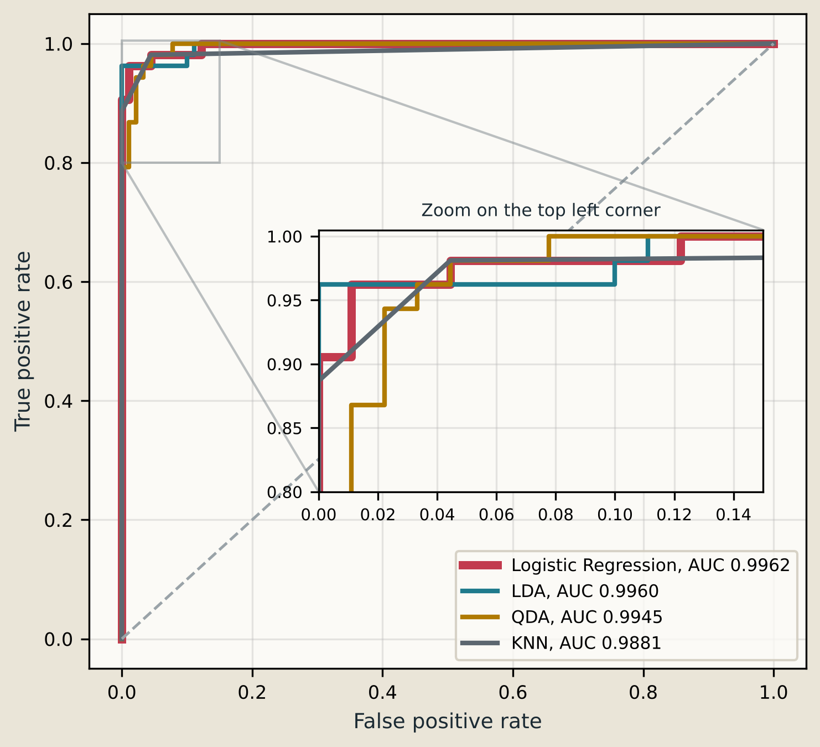
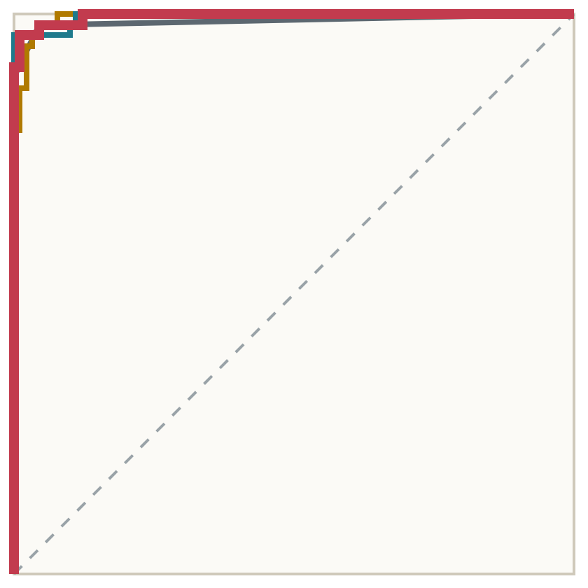
The Models: four classifiers, same test set
Metric | Logistic Regression | LDA | QDA | KNN, K=3
Accuracy | 0.9650 | 0.9650 | 0.9441 | 0.9580
Precision | 0.9800 | 1.0000 | 0.9592 | 1.0000
Recall | 0.9245 | 0.9057 | 0.8868 | 0.8868
Specificity | 0.9889 | 1.0000 | 0.9778 | 1.0000
F1 | 0.9515 | 0.9505 | 0.9216 | 0.9400
ROC-AUC | 0.9962 | 0.9960 | 0.9945 | 0.9881
ROC CURVES, TEST SET
Logistic regression and LDA tie on accuracy, but logistic regression misses 4 cancers and LDA misses 5. Recall is the row that separates them.
All metrics on the 143 test masses at a 0.50 threshold
3 / 4
Notes:
This is the comparison. I fit logistic regression, LDA, QDA and KNN on the same training data and scored all four on the same 143 test masses. For KNN I picked K by cross-validation on the training set, and K equals 3 was the best choice.
All four models do well. Accuracy runs from about 94 to 96.5 percent, and the ROC-AUCs are all above 0.988. The most important result is in the highlighted recall row. Logistic regression and LDA have the exact same accuracy, 96.5 percent, but logistic regression misses 4 cancers and LDA misses 5. QDA and KNN each miss 6.
The ROC plot shows how well each model ranks malignant masses above benign ones, and the small panel zooms into the top left corner where the curves are close together. The ROC-AUC is the chance that a random malignant mass gets a higher score than a random benign one. Logistic regression is at 0.996. KNN is lowest and the most angular, because with three neighbors it can only output four different probabilities.

Slide 4
The Decision: logistic regression, threshold 0.40
50 of 53
3
1
cancers caught, a recall of 0.943
cancers missed, down from 4 at the 0.50 threshold
false alarm among 90 benign masses
Why this model
Limitation
Recall drove the choice, because a missed cancer costs far more than an extra biopsy. Logistic regression had the best cross-validated recall and ROC-AUC on the training data, and at the threshold chosen there it raised the fewest false alarms. KNN and LDA catch more cancers on the test set, but with 4 and 9 false alarms.
The test set has only 53 malignant masses, and the gaps between the models are a handful of patients. The ranking is a good sign, not a settled result.
Results on the 143 test masses
4 / 4
Notes:
I would deploy logistic regression with the decision threshold set at 0.40 instead of the usual 0.50.
Recall drove the decision, because a missed cancer is the expensive mistake. I chose the model and the threshold using only the training data. Logistic regression had the best cross-validated recall and ROC-AUC, and 0.40 was the largest threshold that still caught at least 95 percent of cancers in cross-validation. On the test set it catches 50 of 53 cancers and misses 3, against 4 missed at 0.50, with 1 false alarm among 90 benign masses either way.
Models tuned the same way catch more cancers on the test set but raise more false alarms. KNN misses 1 and raises 4, and LDA misses 2 and raises 9.
The limitation is sample size. Only 53 test masses are malignant, so these gaps are a handful of patients and could reverse in another sample. Before real use I would want a much larger sample from different hospitals, and a real estimate of how much worse a missed cancer is than a false alarm.

