Slide 1
Neural Evolution of Augmented Topologies
Wolf Van Herreweghe

Slide 2
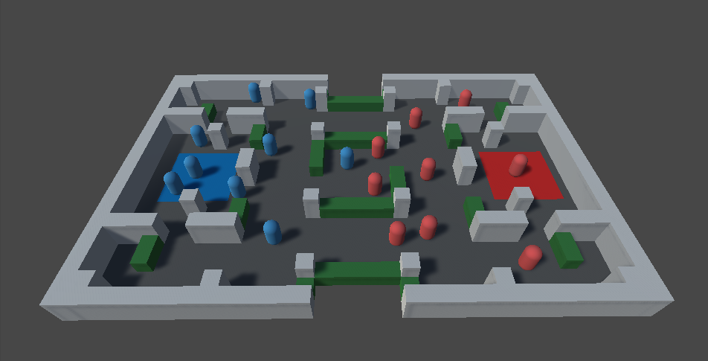
End Goal

Slide 3
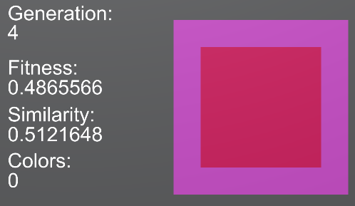
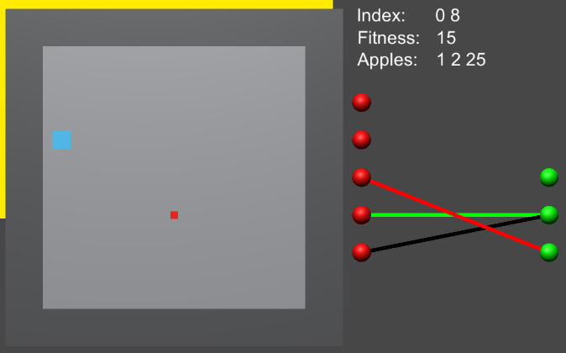
Test Projects
Color Matching
Snake

Slide 4
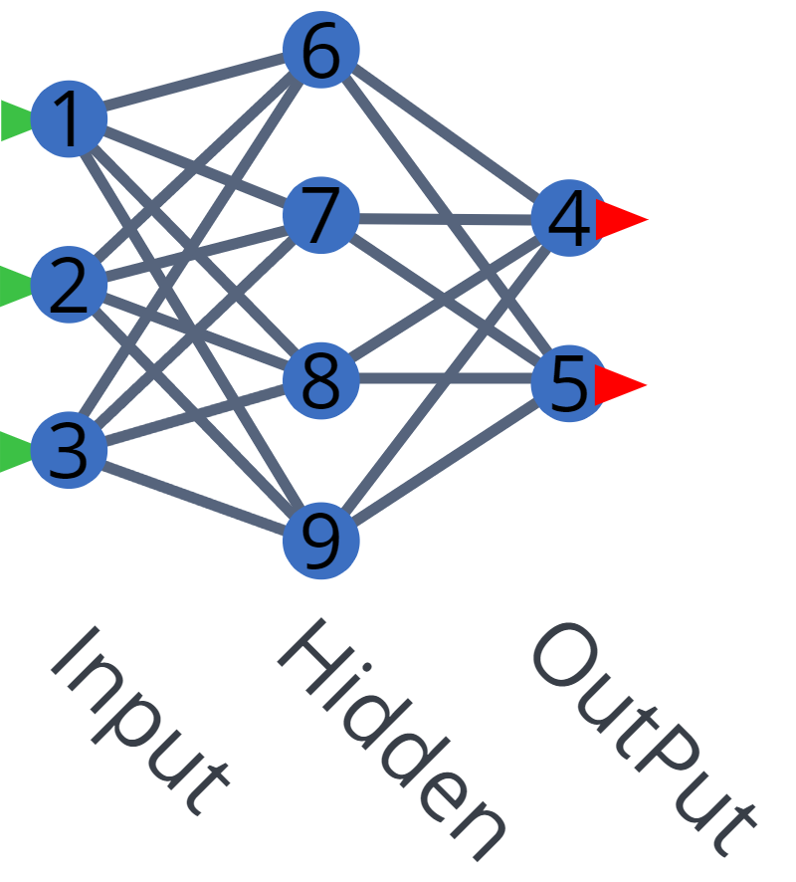
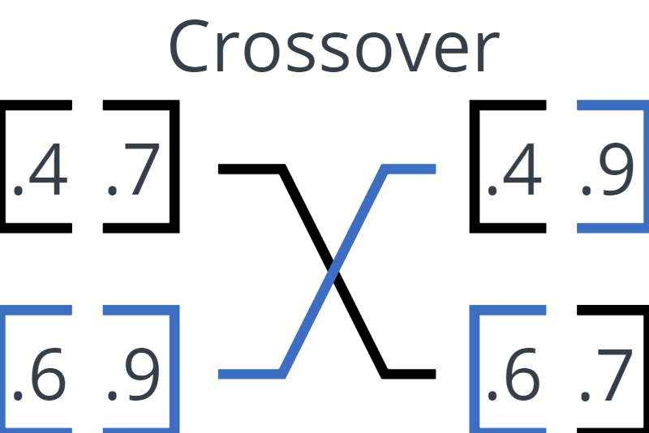
The Basics
Neural Networks
Genetic Algorithms

Slide 5
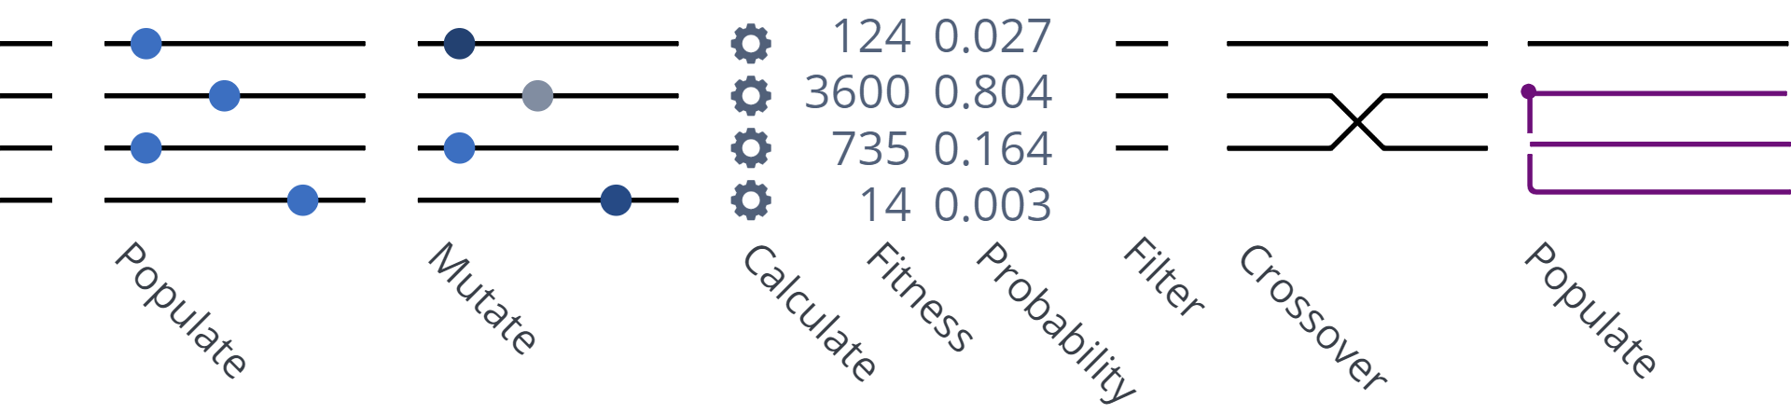
Basic Evolution steps

Slide 6
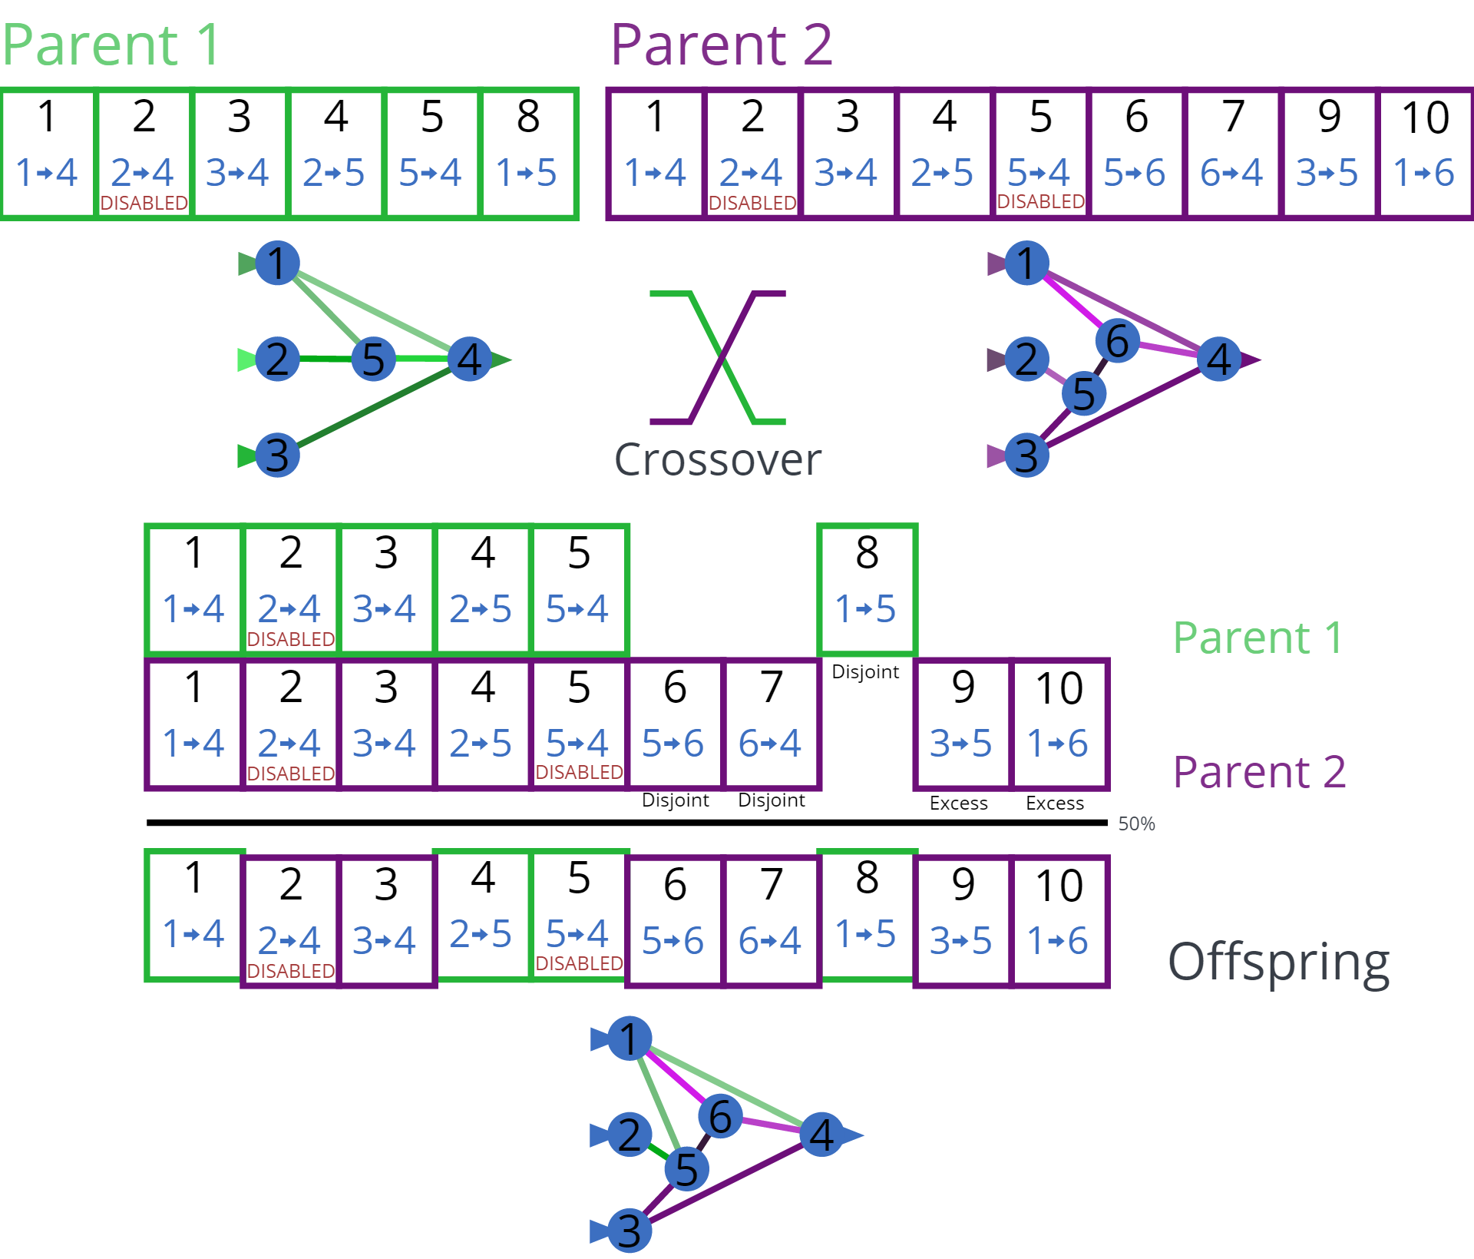
C
R
O
S
S
O
V
E
R

Slide 7
C
R
O
S
S
O
V
E
R

Slide 8
C
R
O
S
S
O
V
E
R

Slide 9
C
R
O
S
S
O
V
E
R

Slide 10
C
R
O
S
S
O
V
E
R

Slide 11
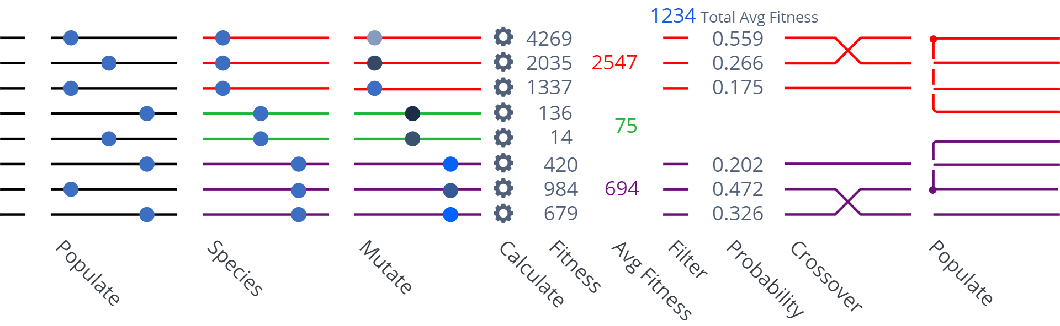
Species Based Evolution steps

Slide 12
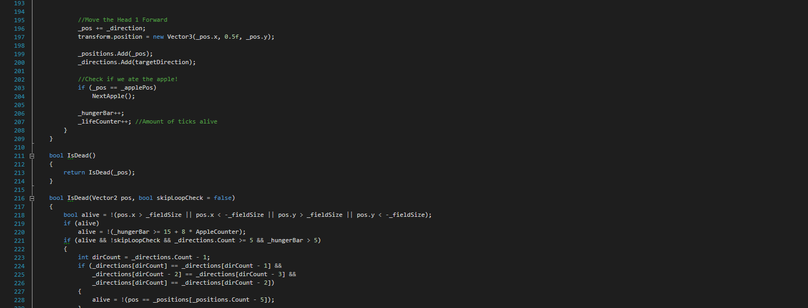
Difficulties

Slide 13

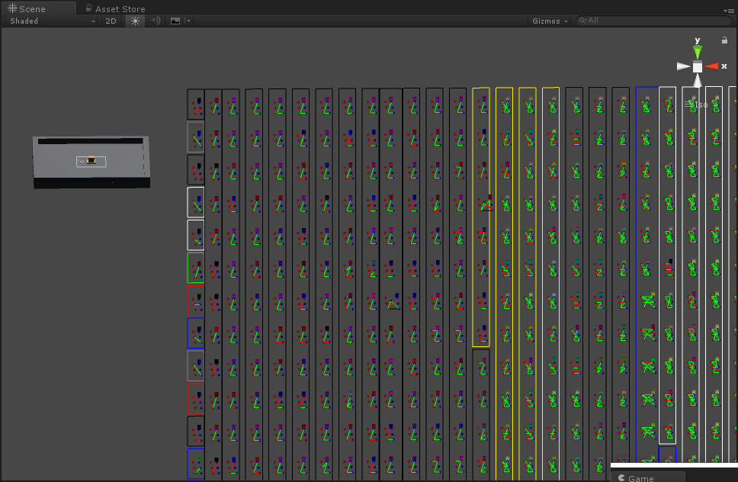


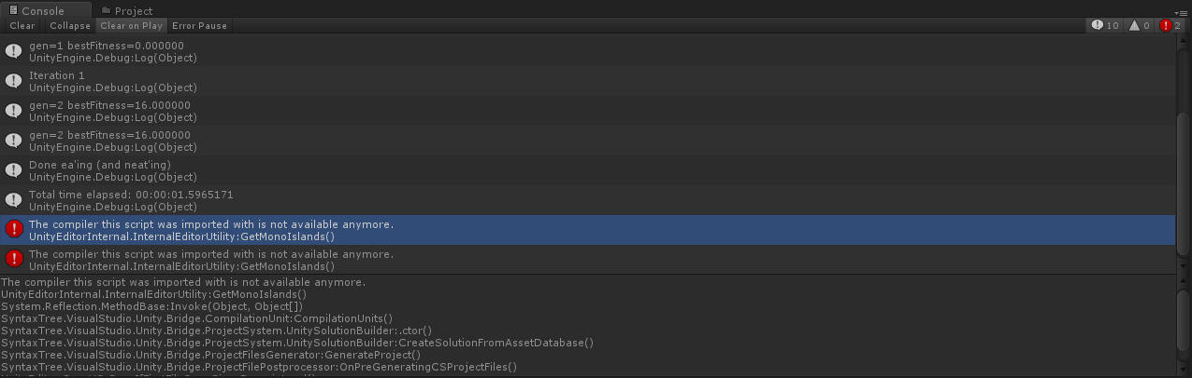
Questions
QuestionsClicktoaddtext Clicktoaddspeakernotes
HTML view of the presentation
Image Options
Re-colour
No recolour
Adjustments
Transparency
Brightness
Contrast
Reset adjustments

