Slide 1
Leptogenesis -
A non-relativistic study
Tobias Theil
25.09.2017

Slide 2
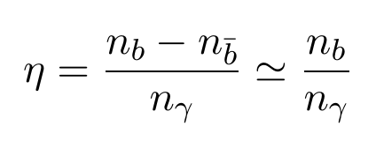


The problem
Observed matter-antimatter asymmetry:
Observed and predicted values do not coincide:
CMB measurement
BBN measurement

Slide 3
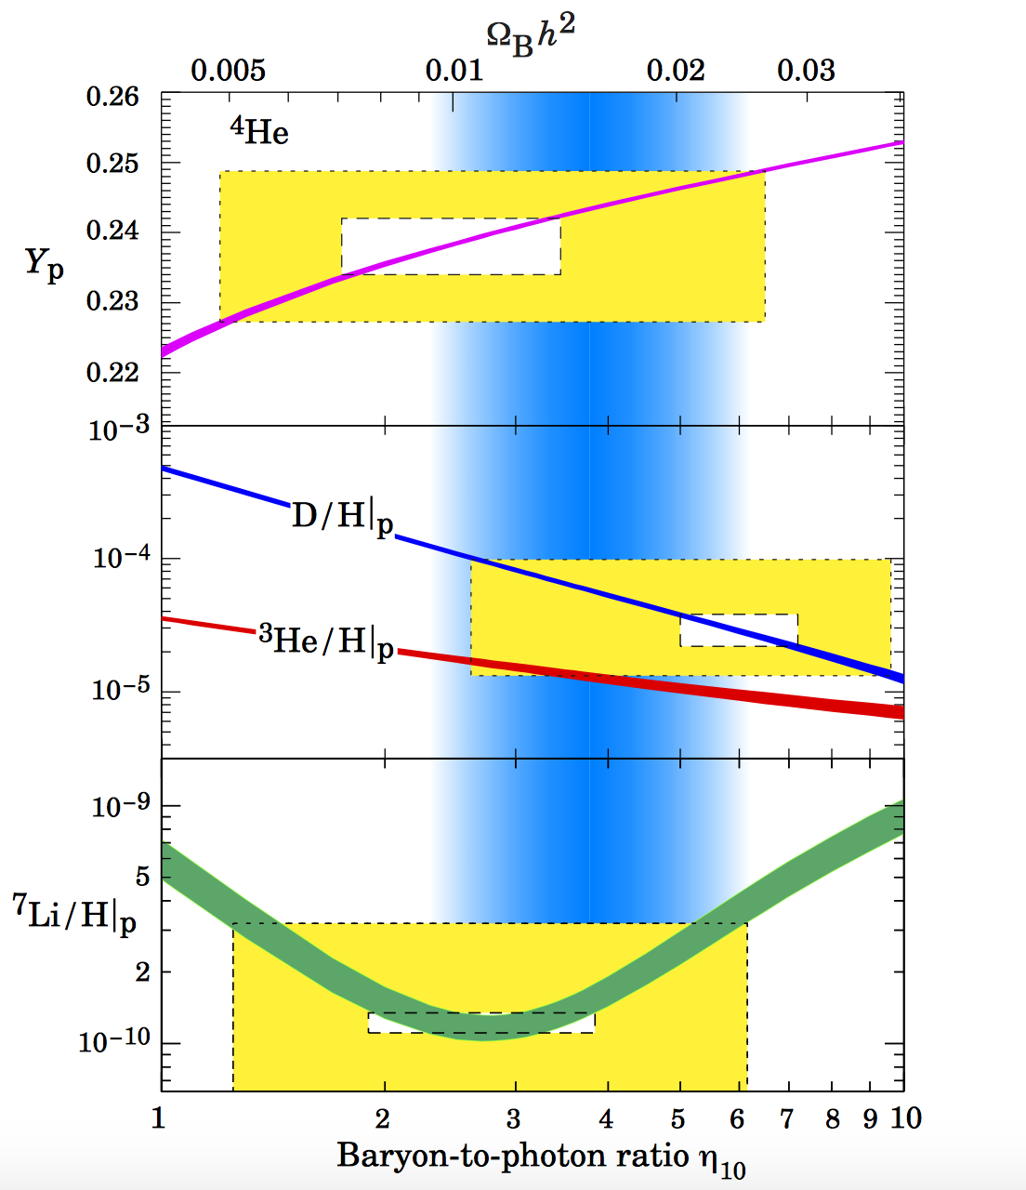
[1] S. Sarkar, Measuring the baryon content of the universe: BBN versus CMB, astro- ph/0205116.

Slide 4
Sakharov conditions
Matter-antimatter asymmetry has to arise dynamically
Three conditions have to be met:
B violation
C and CP violation
Departure from thermal equilibrium

Slide 5
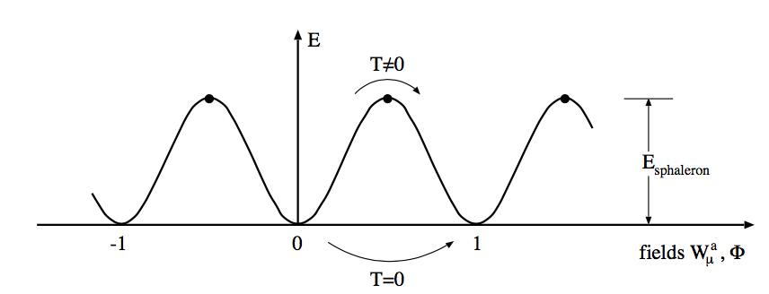
Electroweak Baryogenesis
B violation through non-perturbative effects:
instanton
sphaleron
C and CP violation in the electroweak sector
Departure from thermal equilibrium during the electroweak phase transition
[2] W. Bernreuther, CP violation and baryogenesis, Lect. Notes Phys. 591 (2002) 237 [arXiv:hep-ph/0205279].

Slide 6
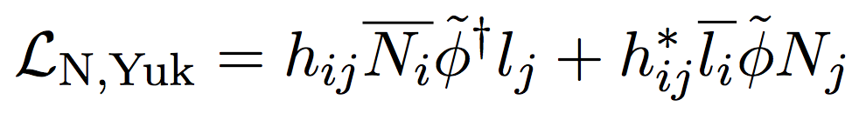
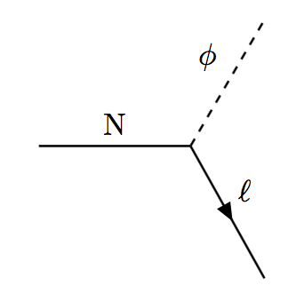
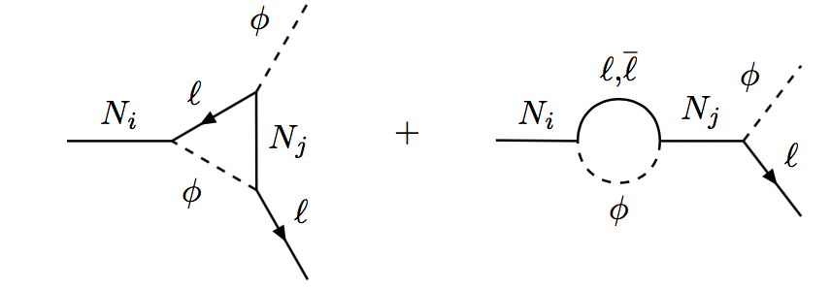
Leptogenesis solution
Introduction of heavy Majorana neutrinos and a corresponding Yukawa coupling term:
Decays of Majorana neutrinos are fermion number violating:
[3] M. Fukugita and T. Yanagida, Baryogenesis Without Grand Unification, Phys. Lett. B 174 (1986) 45.

Slide 7
Realization of the Sakharov conditions
Sphaleron processes converting net fermion number into net baryon number
Extra CP violation because of complex Yukawa couplings
Out-of-equilibrium decays for T < MN

Slide 8
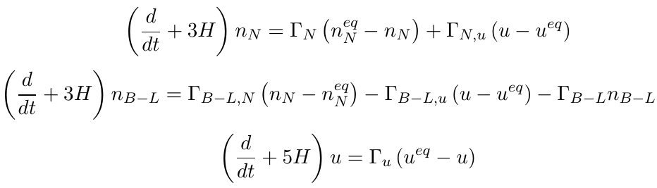
Considered model
Assumptions made:
Hierarchical neutrino masses
One flavor limit
Boltzmann equations read:
[4] D. Bödeker and M. Wörmann, Non-relativistic leptogenesis, JCAP 1402 (2014) 016 [arXiv:1311.2593 [hep-ph]]

Slide 9
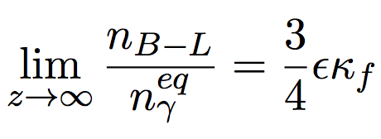

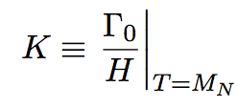
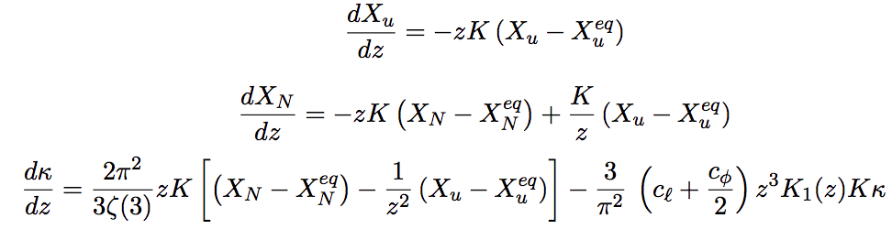
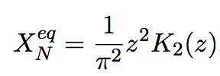

Solving the rate equations
Define:
Rewrite rate equations:
;
;

Slide 10
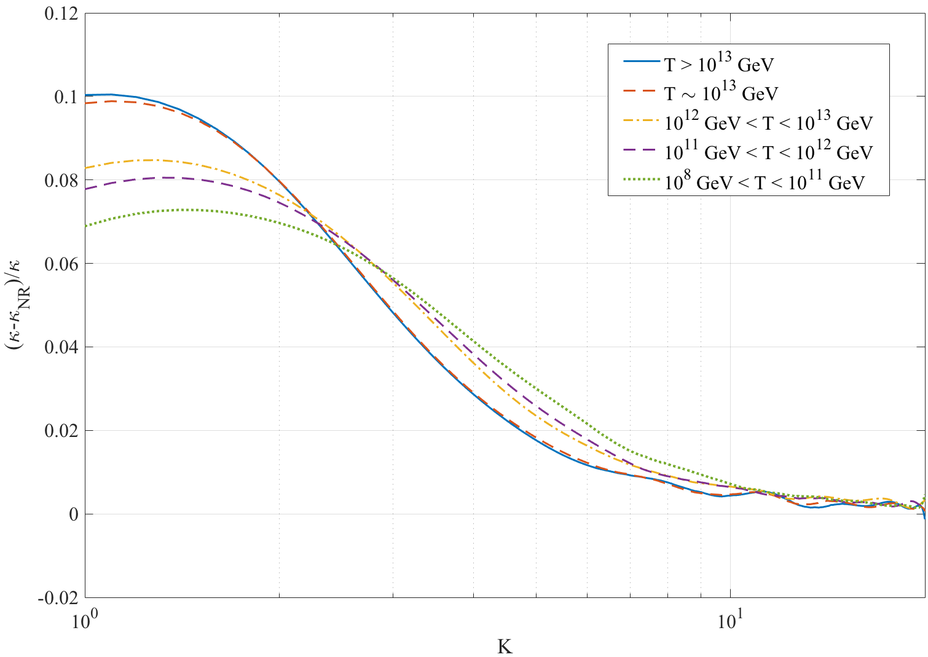
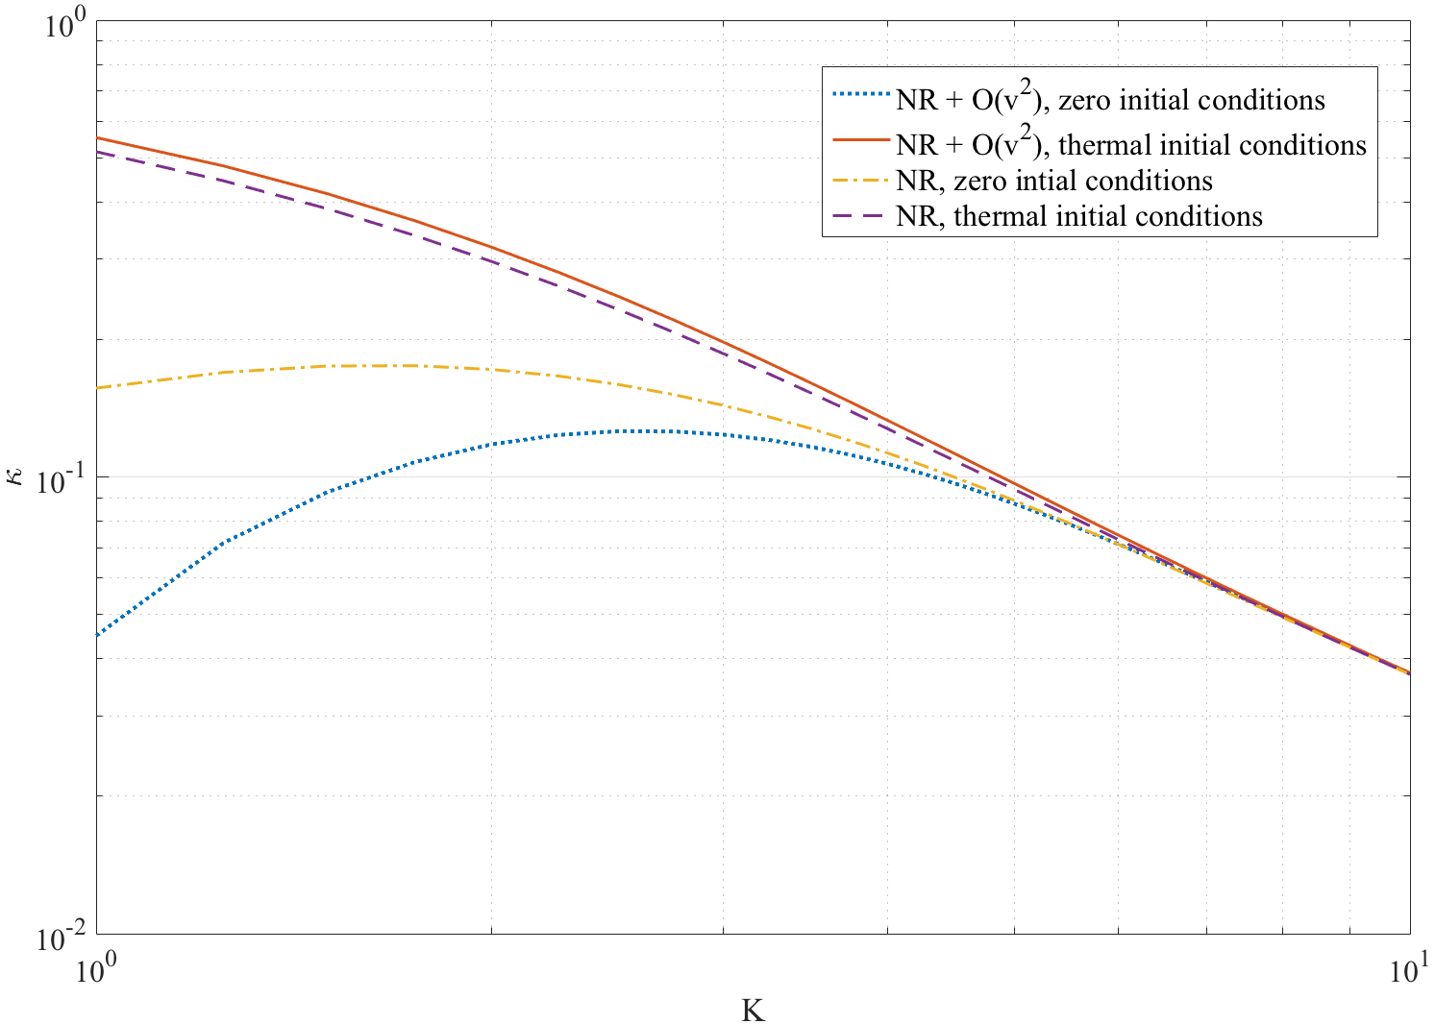
Relativistic versus non-relativistic

Slide 11
Conclusion
Leptogenesis could propose a solution to the matter-antimatter asymmetry problem
Non-relativistic approximation is viable for the strong washout regime
Experimental proof has yet to be given
0νββ-decay to show neutrinos are Majorana fermions

Slide 12
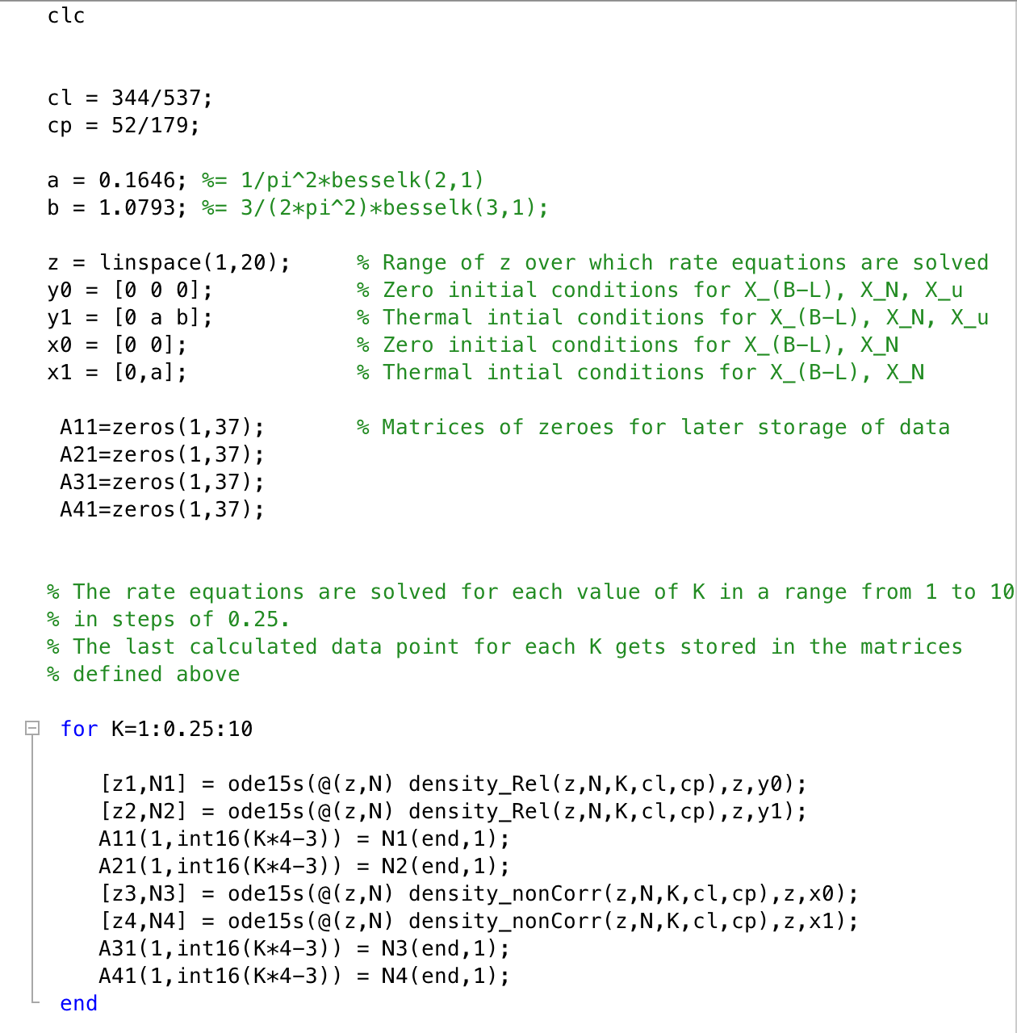
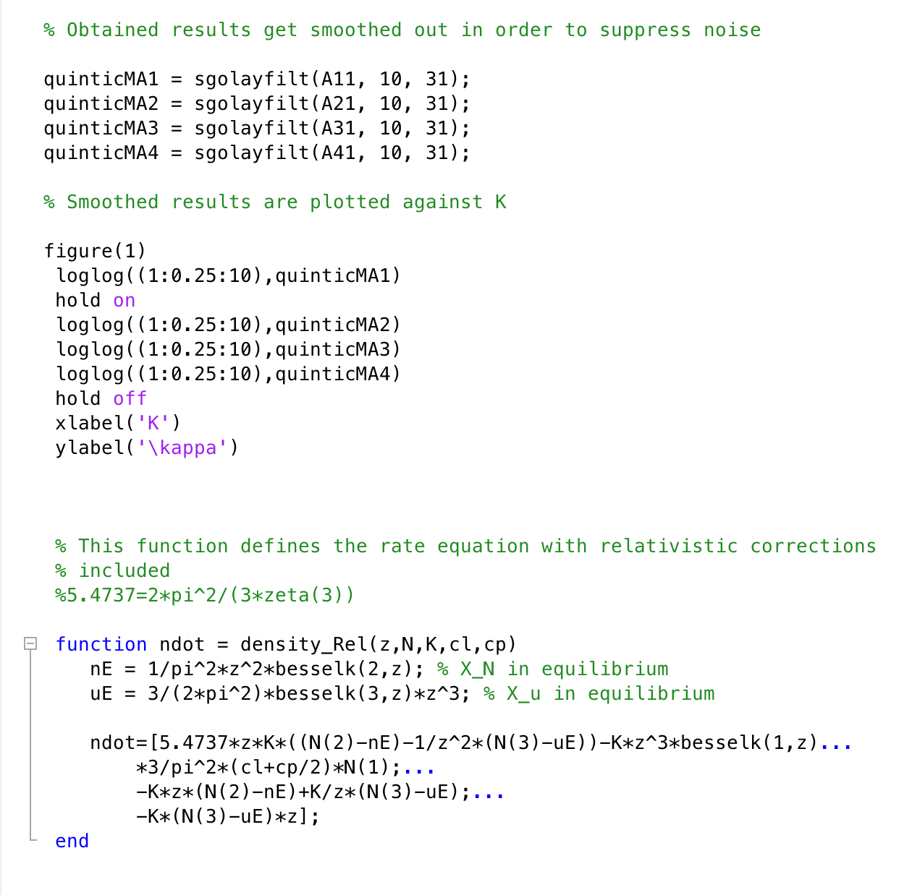
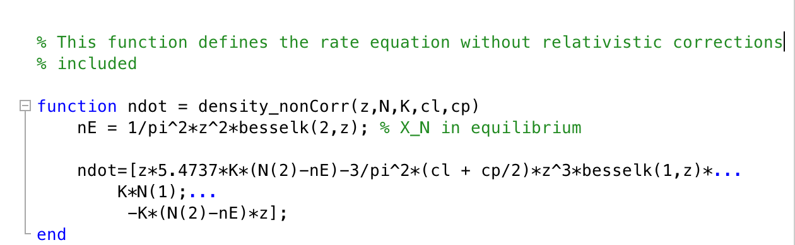
Numerical calculation

