Slide 1
C1
Case-mix-adjusted length of stay in FONASA GRD hospitals, 2023-2024
Business Intelligence IIB423T-1 · GROUP_01 · Matías López, Cristóbal Ramírez · 29 September 2026
1,719,702 inpatient stays · 72 hospitals · FONASA public GRD files

Slide 2
Decision and question
User and decision
Main question
FONASA's GRD financing team and hospital bed managers decide which hospitals and GRD groups to prioritise for a review of prolonged stays and discharge processes.
Which GRD hospitals show a stay systematically different from the network for their case mix, and how much bed use is in extreme stays? (2023-2024)
How robust is the benchmark to its choices?
Which GRDs and episodes concentrate extreme-stay bed-days?
Is the hospital signal stable between 2023 and 2024?
Which admission-time fields vary with extreme stays?
Measured now vs desired
Desired: fewer bed-days beyond what case mix explains, without worse outcomes (not observable here). Measured: IEMA with interval, % of bed-days in extreme stays, outliers observed/expected.
IIB423T-1 · C1 · GROUP_01
2

Slide 3
Data, preparation and quality
One row = one GRD-coded discharge, not a patient or a bed-day
2,125,400
1,719,702
72 / 72
0.14%
episodes in the two FONASA extracts (unchanged)
inpatient stays analysed (CMA and 113 invalid excluded)
hospital codes found in the MINSAL facilities file (71 in FONASA's); m:1 join, rows unchanged
identical rows, retained: no episode ID to prove duplication
Clean | No negative stays; same-day stays (LOS = 0) are recorded zeros and kept
Consistent | Date format and encoding differ by year (handled); same category sets; 68 common hospitals for year comparisons
Conformed | Codes match FONASA and MINSAL dictionaries (200717 missing from FONASA's sheet)
Current | Latest discharge Dec 2024; fit for annual review, not daily bed management
Comprehensive | GRD hospitals only; no bed-waiting, causes of delay, readmissions or costs
IIB423T-1 · C1 · GROUP_01
3

Slide 4
Closing the benchmark definition
Network reference per IR-GRD code, pooled 2023-2024
1
Stratum
2
Cut-off
3
Expected stay
4
IEMA
IR-GRD code; < 30 stays → base GRD (28 codes); still < 30 → excluded (5)
Q3 + 1.5·IQR of stay in the stratum; above = extreme (outlier)
Mean stay of the stratum's ordinary (inlier) cases
Σ observed ÷ Σ expected over a hospital's inliers, with 95% interval
Limits
Relative, not absolute: if the whole network stays too long, IEMA is still 1. The ministerial norm is not public
GRD and severity miss social and waiting factors: a high IEMA is a signal for review, not proof
Intervals assume independent episodes, so they are optimistic; hospitals near 1 are not ranked
IIB423T-1 · C1 · GROUP_01
4

Slide 5
Does it survive a changed assumption?
Six variants, one change each; hospital ranking 2024
Variant | Rank corr. | Class changes | % outlier
V0 Main definition | 1.000 | 0 | 6.3%
V1 Cut-off Q3 + 3.0·IQR (only far-out stays are outliers) | 0.986 | 7 | 2.5%
V2 Year-specific benchmark (2023 and 2024 separately) | 0.999 | 6 | 6.5%
V3 Exclude deaths and transfers out (reference and evaluation) | 0.978 | 5 | 6.2%
V4 Peer-group benchmark by hospital complexity level | 0.979 | 4 | 6.3%
V5 Exclude national institutes from the reference population | 1.000 | 0 | 6.2%
V6 Minimum stratum size 100 instead of 30 | 1.000 | 0 | 6.3%
≥ 0.98
rank correlation with the main definition in every variant
≤ 7
of 72 hospitals change class; all within 0.09 of IEMA = 1
The cut-off rule changes the level of the outlier KPI, not the ordering: always show the rule with the KPI.
IIB423T-1 · C1 · GROUP_01
5

Slide 6
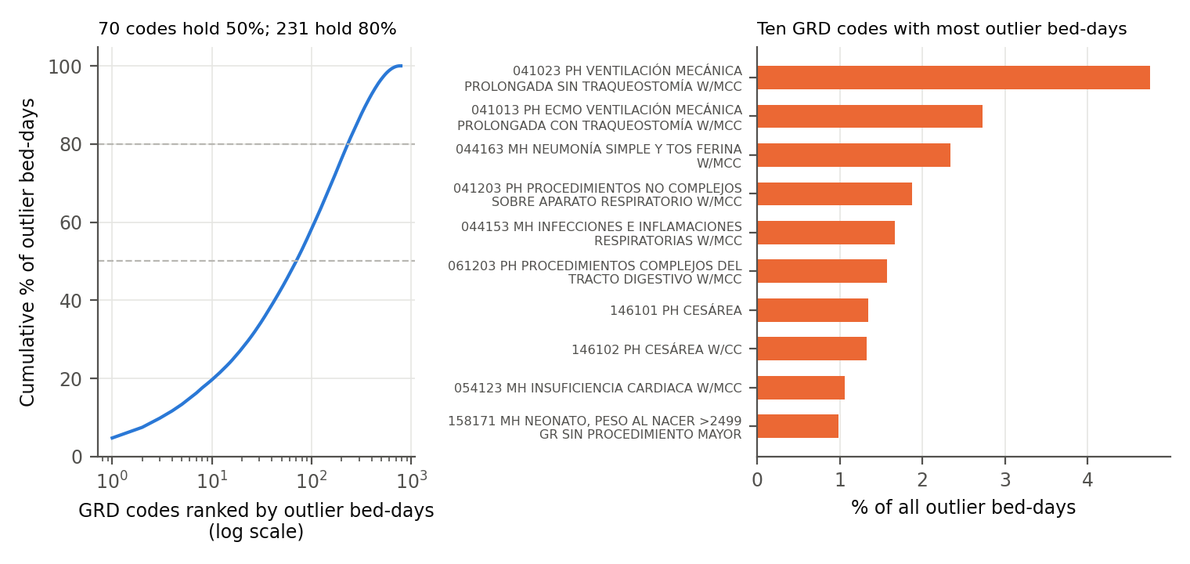
Extreme stays: few stays, a quarter of bed-days
6.3% of stays, 25.4% of bed-days in 2024 (mean 28.5 vs 5.6 days)
What we observe
70 of 764 GRD codes hold half of outlier bed-days; 231 hold 80%
Top: prolonged ventilation, pneumonia with major complications, complex digestive surgery, caesarean section
Emergency admissions exceed their cut-off more than expected (O/E 1.19); elective far less (0.45)
Stays ending in transfer out or other (11.1%) and home hospitalisation (10.4%) are the most often extreme: an association, not a cause
IIB423T-1 · C1 · GROUP_01
6

Slide 7
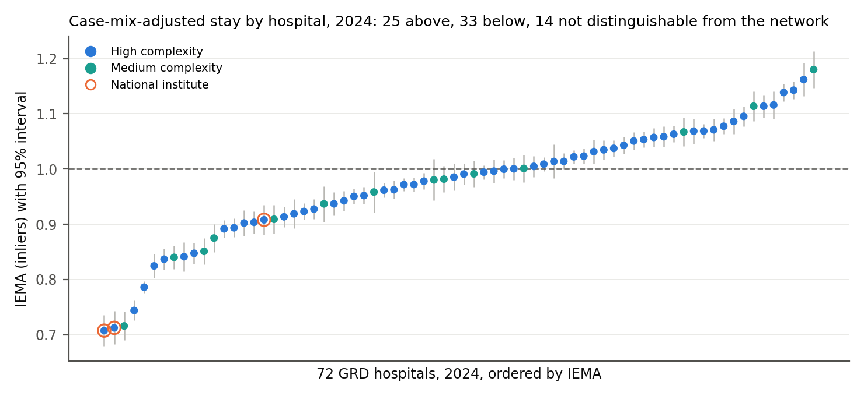
Hospitals: adjusted stay with intervals
IEMA 2024, 72 GRD hospitals; 1 = network behaviour for the same case mix
25
hospitals above the network (interval > 1)
33
below the network (interval < 1)
14
not distinguishable: not ranked
Range 0.71-1.18. Crude stay tracks case mix (r = 0.46); IEMA does not (r = -0.08). The 3 national institutes are below the network (0.71, 0.71, 0.91), the opposite of our W1 hypothesis.
IIB423T-1 · C1 · GROUP_01
7

Slide 8
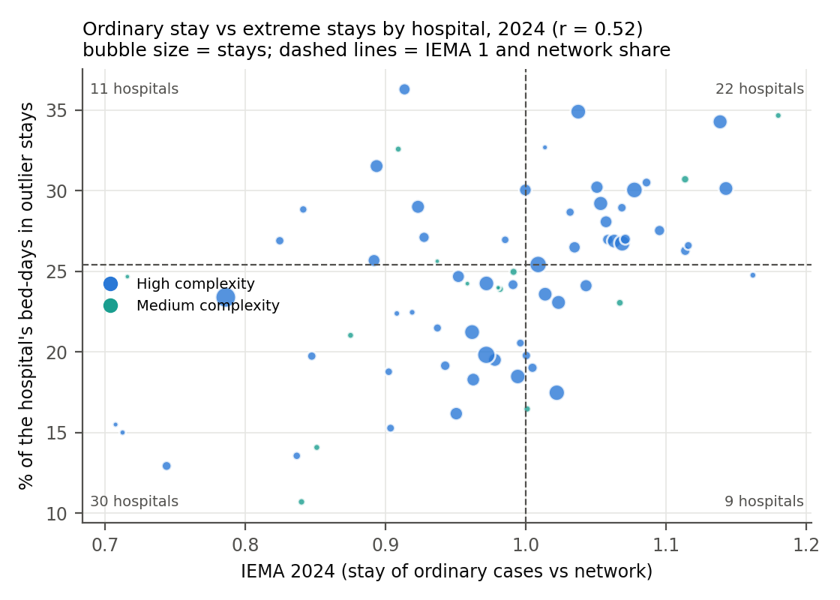
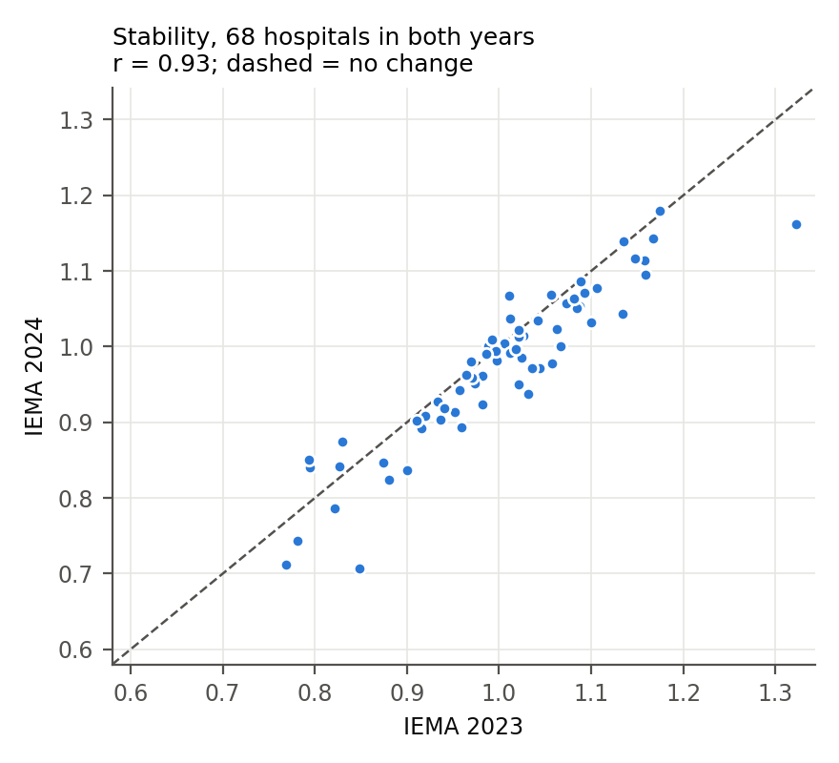
Ordinary vs extreme stays, and stability
Ordinary stay and extreme stays are related but distinct (r = 0.52)
IEMA 2023 vs 2024: r = 0.93; 58 of 68 hospitals keep their class. The two signals may call for different reviews: discharge processes for ordinary cases, case review for prolonged stays.
IIB423T-1 · C1 · GROUP_01
8

Slide 9
Conclusions within the evidence
Observed
Interpretation
Cannot establish
Implication
25 hospitals keep ordinary cases longer than the network and 33 shorter; stable and robust. Half of extreme-stay bed-days fall in 70 of 764 GRD codes.
Compatible with differences in discharge processes, post-acute access or case mix not captured by GRD. The data cannot choose.
Efficiency against a clinical standard, avoidable days, quality, causes or effects of any intervention.
Start reviews in hospitals clearly above 1 and their GRDs with most days beyond the cut-off. Next: official norm, delay causes, later 2024 extract.
IIB423T-1 · C1 · GROUP_01
9

Slide 10
Continuity: ML task and dashboard
Proposal only: no model trained, no algorithm chosen, no performance claimed
ML: flag extreme-stay risk at admission
Dashboard for bed management
Unit: inpatient episode at admission
Label: stay above its GRD cut-off (≈ 6.3%, stable)
Inputs: age, sex, admission type, origin, admitting unit, insurance, hospital, month
Excluded (leakage): GRD, severity, diagnosis, discharge fields
To review: field timing; label when GRD unknown at admission; imbalance
Intended use: start discharge planning on day one
Users: FONASA GRD team; hospital and Health Service bed managers
KPIs: IEMA with interval and class; % bed-days in extreme stays; outliers O/E; days beyond cut-off
Views: intervals, quadrant, GRD list, monthly trend, definition panel
Filters: year, month, hospital, complexity, GRD, admission and discharge type
Rules from EDA: no ranking near 1; rule shown next to outlier KPI
IIB423T-1 · C1 · GROUP_01
10

