Slide 1
Can we flag extreme hospital stays on the day of admission?
C2 · Train and explain our first model · Route: classification
GROUP_01 · Matías López, Cristóbal Ramírez
Business Intelligence IIB423T-1 · Universidad del Desarrollo · Instructor: Tomás Fontecilla · 10-11-2026

Slide 2
1. The task
Same project line since W1: extreme stays in FONASA GRD hospitals (2023-2024)
Question: at admission, which stays will become extreme, so discharge planning can start on day one?
One row = one GRD-coded inpatient stay (72 public hospitals, FONASA public GRD files)
Target = 1 if length of stay > cut-off of its GRD (Q3 + 1.5·IQR). Positive class = extreme stay (≈ 6% of stays, ≈ 25% of bed-days)
Inputs known at admission: age, sex, insurance, admission type, origin, admitting unit, hospital, month, weekday, transfer-in
Excluded: diagnoses, GRD, weight, severity, procedures, discharge fields. The GRD only builds the target
GROUP_01 · C2 · Business Intelligence IIB423T-1 · UDD

Slide 3
2. How we used the W2 feedback
Feedback | What we did | Evidence
Exclude diagnoses, classifications and results not available at admission | Inputs fixed to admission-time fields; the notebook stops if a post-admission field enters | LEAK_GUARD assertion, section 3
Define and freeze the extreme-stay thresholds inside training | GRD cut-offs fitted on train only (783 codes), frozen, applied unchanged to validation and test | Identical to W2 table; fingerprint re-checked after each transform
GROUP_01 · C2 · Business Intelligence IIB423T-1 · UDD

Slide 4
3. Data split and method
W2 chronological split reused: the model is built at T = 01-01-2024
Subset | Admissions | Stays | Use
Train | Jan-Jun 2023 | 421,352 | Fit cut-offs, encoders, model
Validation | Jul-Sep 2023 | 214,640 | Choose the threshold
Test | Jan-Sep 2024 | 655,321 | One final evaluation
Model: logistic regression · one-hot + scaled age fitted on train only · class_weight = balanced (6% positives) · C = 1, no tuning
Why: simple, fast, coefficients read as odds ratios
Baseline: “flag every emergency admission” (strongest admission signal in W2)
Threshold 0.60 chosen on validation by F1; default 0.5 would flag half of all admissions
GROUP_01 · C2 · Business Intelligence IIB423T-1 · UDD

Slide 5
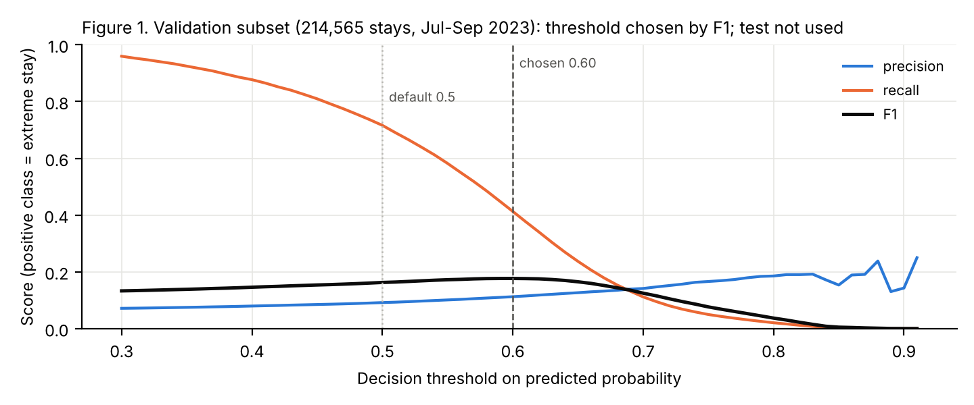
4. Threshold chosen on validation, never on test
GROUP_01 · C2 · Business Intelligence IIB423T-1 · UDD

Slide 6
5. Results on the test set
655,093 stays admitted Jan-Sep 2024 · prevalence of extreme stays 6.12%
Rule | Flagged | Precision | Recall | F1 | Accuracy
model, threshold 0.60 | 20.6% | 0.106 | 0.356 | 0.163 | 0.777
baseline: flag every emergency admission | 62.1% | 0.069 | 0.702 | 0.126 | 0.404
trivial: flag nobody | 0.0% | 0.000 | 0.000 | 0.000 | 0.939
Model: higher F1 (0.163 vs 0.126) with a third of the flags; 10.6% of its flags are extreme (1.7× base rate)
Baseline: catches more (70%) but flags 62% of admissions; its hit rate (6.9%) ≈ base rate
“Flag nobody” has the best accuracy (93.9%) and finds nothing: accuracy is not enough with 6% positives
Validation F1 0.177 vs test 0.163: stable from 2023 to 2024
GROUP_01 · C2 · Business Intelligence IIB423T-1 · UDD

Slide 7
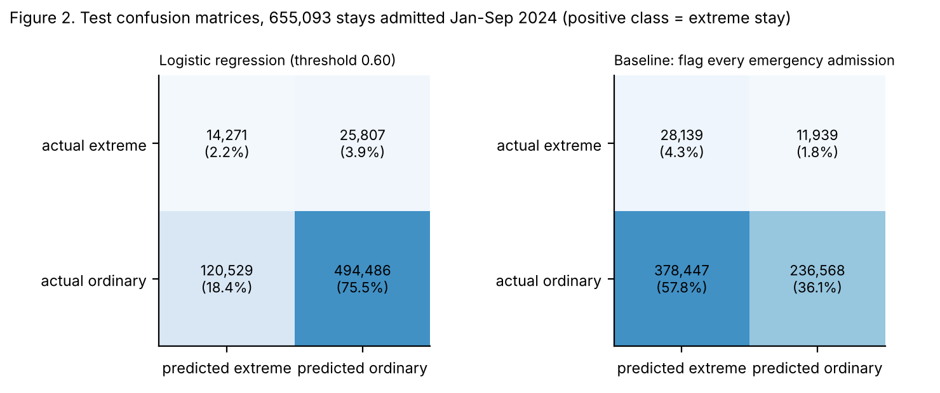
6. Test confusion matrices
False negative (25,807): extreme stay missed, planning starts late, bed blocked (costlier) · False positive (120,529): unnecessary review, costs staff time
GROUP_01 · C2 · Business Intelligence IIB423T-1 · UDD

Slide 8
7. What it means
Adds: concentrates discharge-planning effort on a smaller group with a higher hit rate; covers obstetric admissions the rule misses
Limit: admission fields carry weak signal (precision ≈ 11%); most causes of long stays appear after admission. No patient ID, so repeated patients cannot be checked
A useful flag does not prove that early planning shortens stays: that needs a trial or before/after study
Improvement: re-score at 48-72 h with information available by then (ICU/intermediate-care transfer, theatre use), same chronological validation; thresholds per hospital
Conclusion: a better first screen than the emergency rule, not accurate enough to decide on its own
GROUP_01 · C2 · Business Intelligence IIB423T-1 · UDD

