Slide 1
Design a new crypto currency for a sovereign client.
Evaluate crypto platforms for the basis of your currency.
As a substitute fiat currency, the government is mindful of certain processes and
regulations that should be supported and continue to operate flawlessly with the
new crypto currency regime as well. These include Anti-Money Laundering (AML),
know your customer (KYC), and Fraud detection.
What does your team think and would suggest as your team’s platform of choice to your client
Notes:
What’s a platform?
What it does?
What options for crypto?
Finding rules common for Crypto.
US government and their regulation
What kinds of platforms are there?
What crypto they’re using or will use?
Goals for first week:
Change slide titles to reflect topics to research
Create github repo
Watch at least one video on crypto or some topic above
Populate some of the slides with intitial thoughts and research Findings

Slide 2
Notes:
What’s a platform?
What it does?
What options for crypto?
Finding rules common for Crypto.
US government and their regulation
What kinds of platforms are there?
What crypto they’re using or will use?
Goals for first week:
Change slide titles to reflect topics to research
Create github repo
Watch at least one video on crypto or some topic above
Populate some of the slides with intitial thoughts and research Findings

Slide 3
Links of Research Sources:
Blockchain
Chainalysis
CypherTrace

Slide 4
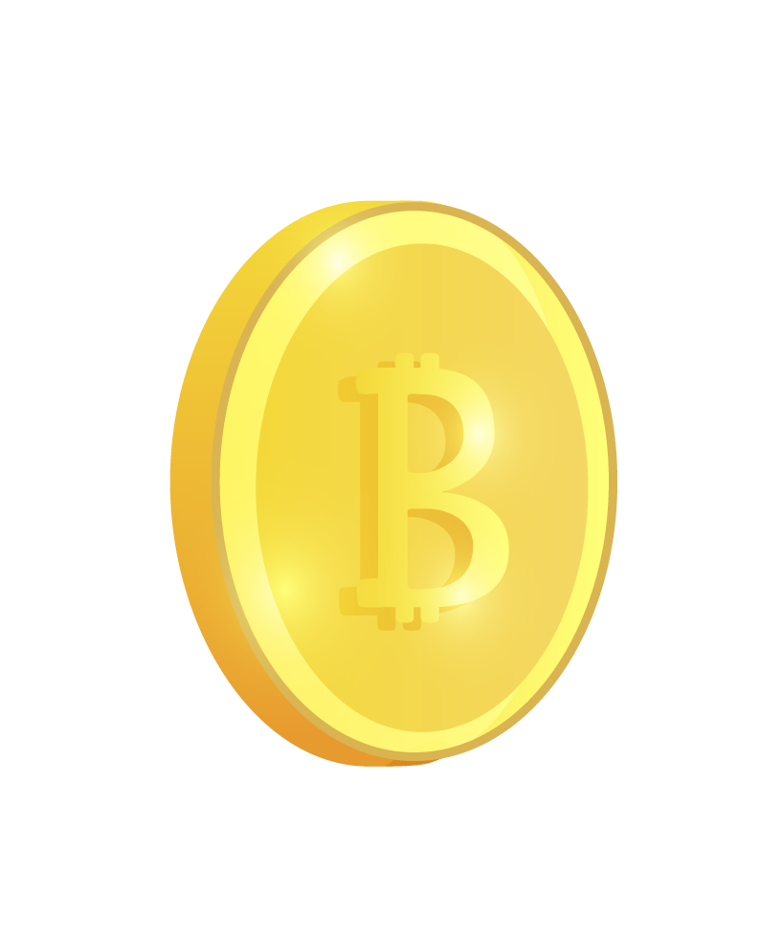







Our team
Tairi
Victoria
Sam
Xuanzhi

Slide 5

New Crypto-
Currency Design
*Name of new Crypto Here*

Slide 6
Table of Contents
01
02
03
04
05
06
Eval Crypto Platforms
AML
KYC
Anti-Money Laundering
Know Your Customer
Fraud Detection
Decision
Reflection

Slide 7
Evaluate Crypto Platforms
01
a sovereign clienta sovereign requirement

Slide 8
Project
Overview
Objective: Design a sovereign-backed cryptocurrency with secure and compliant operation.
Key Requirements:
Substitute traditional fiat currency.
Ensure regulatory adherence (AML, KYC, Fraud Detection).
Goal: Identify the best-suited cryptocurrency platform for government adoption.

Slide 9
Platform Selection
Key Considerations When Selecting Platform

Slide 10

Regulatory Compliance
Compatibility with AML, KYC, and fraud detection protocols.

Slide 11
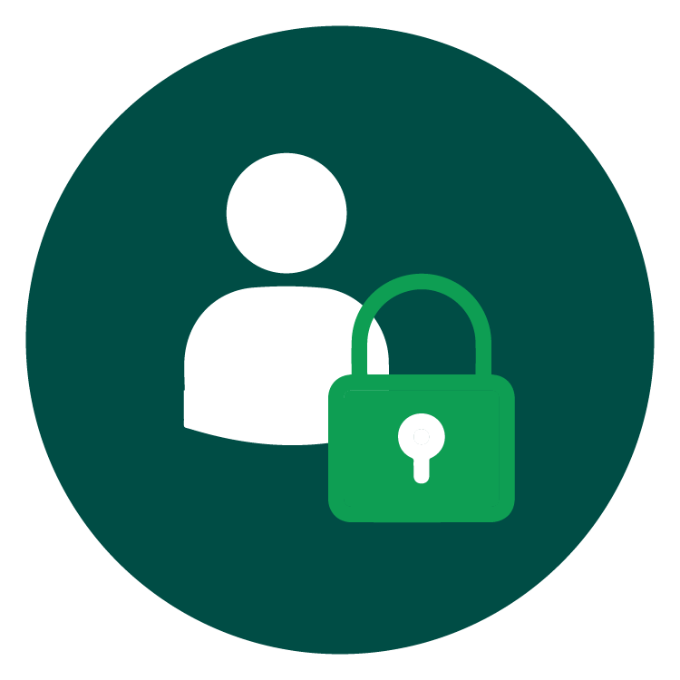
Security
High-level security features for asset protection and fraud mitigation.

Slide 12

Scalability
Ability to handle large volumes of transactions efficiently.

Slide 13

Interoperability
Integration with existing financial and government systems.

Slide 14

Transparency
Facilitate government oversight and public trust

Slide 15
Regulatory Requirements
02
AML, KYC, Fraud Detection

Slide 16
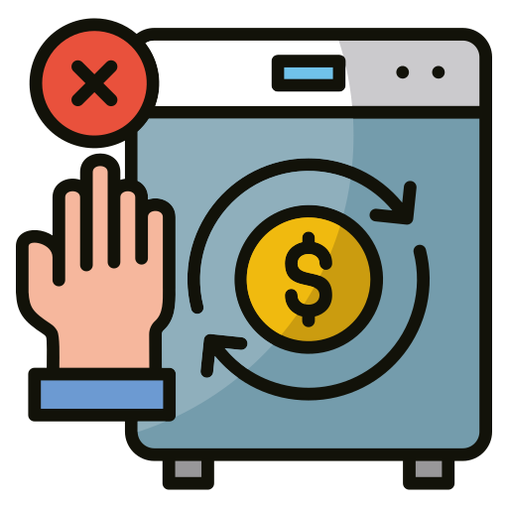
Anti-Money Laundering (AML)
Capabilities for transaction monitoring, suspicious activity reporting, and risk assessment.

Slide 17

Know Your Customer (KYC)
Enforce identity verification and onboarding processes upon registration to prevent fraud.
Notes:
Slide: Know Your Customer (KYC)
Key Concept
Purpose of KYC: KYC is the process of verifying the identity of individuals and entities that use the cryptocurrency platform. It's crucial for ensuring that only legitimate users are engaging with the system, and it helps the government comply with regulations like Anti-Money Laundering (AML) and counter-terrorism financing laws.
1. Why is KYC Important?
Regulatory Compliance: KYC is a legal requirement in most countries to prevent money laundering, fraud, and terrorism financing.
Preventing Fraud: By verifying users, the platform ensures that bad actors (e.g., criminals or identity thieves) can't misuse the cryptocurrency for illegal activities.
Trust & Transparency: It builds trust in the system, showing that the government is taking steps to ensure a safe and reliable currency.
2. How KYC Works in the Crypto System
Identity Verification: Citizens will need to submit certain information (e.g., national ID, passport) and sometimes biometric data (fingerprints, facial recognition) to prove who they are.
Example: Similar to how people set up a bank account today—providing your ID and proof of address.
Digital Identity Integration: KYC will be directly linked to the national identity system. This means when a person registers for the cryptocurrency, their government-issued ID will automatically be checked against existing records.
This process helps ensure that there is no duplication or fraud.
3. How KYC Supports the Government’s Goals
Ensures Financial Inclusion: By verifying identities, the government can make sure that all citizens—whether in urban or rural areas—can participate in the economy using the cryptocurrency.
Better Financial Monitoring: It helps track transactions and prevents illegal activities by making sure the identities of the people behind the transactions are known and traceable.
Supports AML Regulations: By combining KYC with automated transaction monitoring, suspicious activity can be flagged and investigated, which helps to identify and stop money laundering schemes.
4. User Privacy & Data Security
Protecting Citizen Data: While KYC involves collecting sensitive information, privacy is key. The system must ensure that this data is stored securely and used only for compliance purposes.
Blockchain’s Role: With a public ledger, the crypto system ensures transparency, but the personal data behind KYC processes is stored securely and not shared publicly.
Data Minimization: Only the necessary information will be collected and stored, ensuring that citizens are not burdened with excessive requirements.
5. Real-World Example of KYC in Action
Banks have been using KYC for years. When you open a bank account, they typically ask for a form of ID, proof of address, and sometimes conduct a background check.
Similar to a Bank Account Setup: The process for our cryptocurrency would be just as simple and similar to registering for online banking or digital wallets.
6. Benefits of KYC for the Citizen
Security: Citizens know that their identity and funds are secure from fraud.
Ease of Use: The KYC process will be integrated with existing government ID systems, making it as seamless as possible for citizens to onboard and access their digital wallets.
Access to Services: Once verified, users can access a wide range of services—everything from paying taxes, receiving government aid, to shopping and trading.
Conclusion
KYC is not just a regulatory hurdle, but an essential part of building a secure, trustworthy cryptocurrency for the nation. By incorporating KYC, we ensure the integrity of the system, protect against fraud, and allow the government to fulfill its obligations to both citizens and the global financial system.

Slide 18

Fraud Detection
Real-time monitoring and algorithms to detect unusual patterns and prevent fraud.

Slide 19


Is crypto secure?
Blockchain has multiple peers
Publicly auditable
Auditing tools already exist
Suspicious activity can be flagged

Slide 20
Security Concerns
Losing wallet key
Anonymous scammers
Phishing
Easier for user error to occur

Slide 21

Platform Options
04
Ethereum, Hyperledger Fabric, Corda,Stellar

Slide 22

Ethereum
Pros: Smart contract flexibility, large developer community.
Cons: High transaction fees, slower transaction speed.

Slide 23

Corda
Pros: Privacy-focused, built for regulated environments.
Cons: Primarily designed for financial institutions, not a native cryptocurrency platform.

Slide 24

Hyperledger Fabric
Pros: Permissioned network ideal for regulatory compliance.
Cons: Limited public access, not optimized for cryptocurrency.

Slide 25

Stellar
Pros: Low-cost, high-speed transactions, focuses on financial inclusion.
Cons: Limited smart contract capabilities.

Slide 26

Resources
Did you like the resources on this template? Get them for free at our other websites:
VECTORS:
Cryptocurrency concept landing page template
Cryptocurrency concept landing page template II
Cryptocurrency concept landing page template III
Realistic cryptocurrency landing page template
Cryptocurrency landing page
PHOTOS:
Still life arrangement with cryptocurrency
Still life assortment with cryptocurrency II
Still life arrangement with cryptocurrency III
Bitcoin on plain background with copy-space
Man inserting a bitcoin in a piggy bank
Young co worker spending time in office
Young co worker spending time in office II
Close up on young businessman

