Slide 1


Geothermal Heat Flow in Hercules Dome Region
- Results and Uncertainties
Tobias Stål, University of Tasmania, Australia
Earlier models disagreed, and some forward models are probably not reliable. However, recent models converge, particularly the overall pattern in Western Antarctica. (Shen et al (2020), Stål et al (2021), Lösing and Ebbing (2021))
Solid Earth models are only robust at low resolution, 20-50 km, depending on datasets and 3D architecture of the crust. Some measures can be taken to increase the resolution; however, at the expense of certainty, and additional data are needed.
Improved Antarctic heat flow estimates must include both solid Earth, and cryosphere observations and models. Horizontal heat transfer by fluids must be considered.
Aq1.hercules, the here presented model, and future updates are available here:
https://github.com/TobbeTripitaka/Aq1.hercules
Contact:
tobias.staal@utas.edu.au
Also:
We are about to form a SCAR INSTANT subcommittee
for geothermal heat flow. Please reach out if you are
interested in joining.

Slide 2
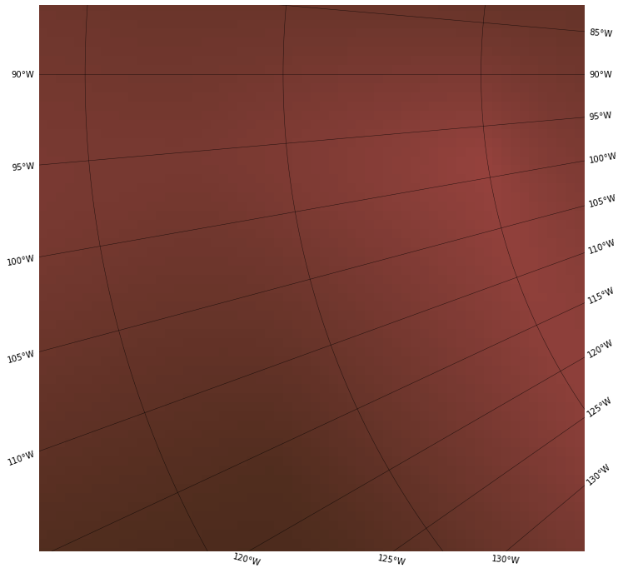
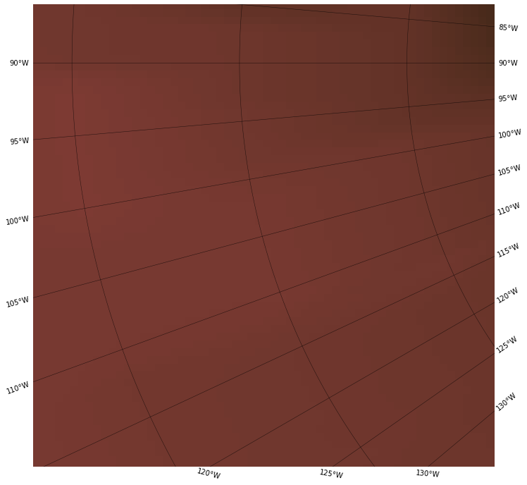
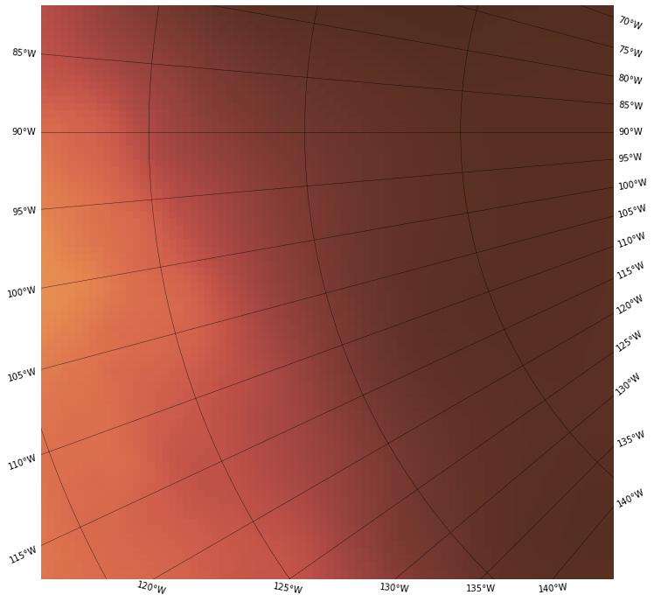
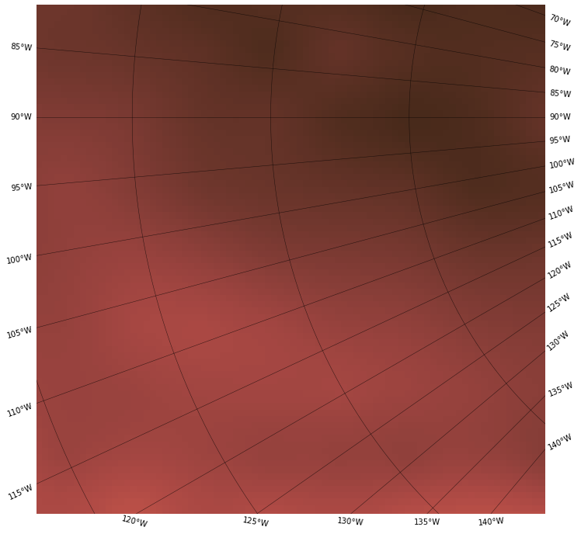
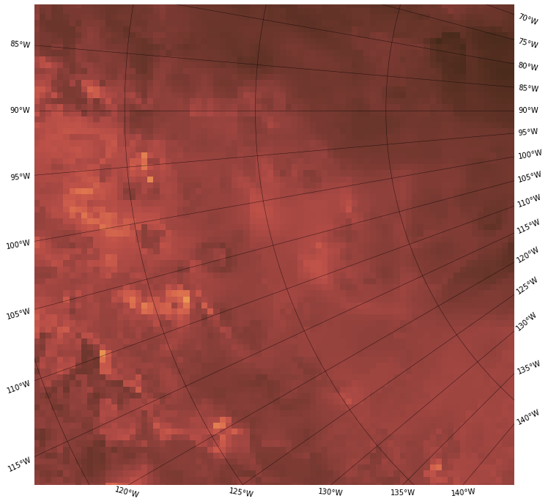

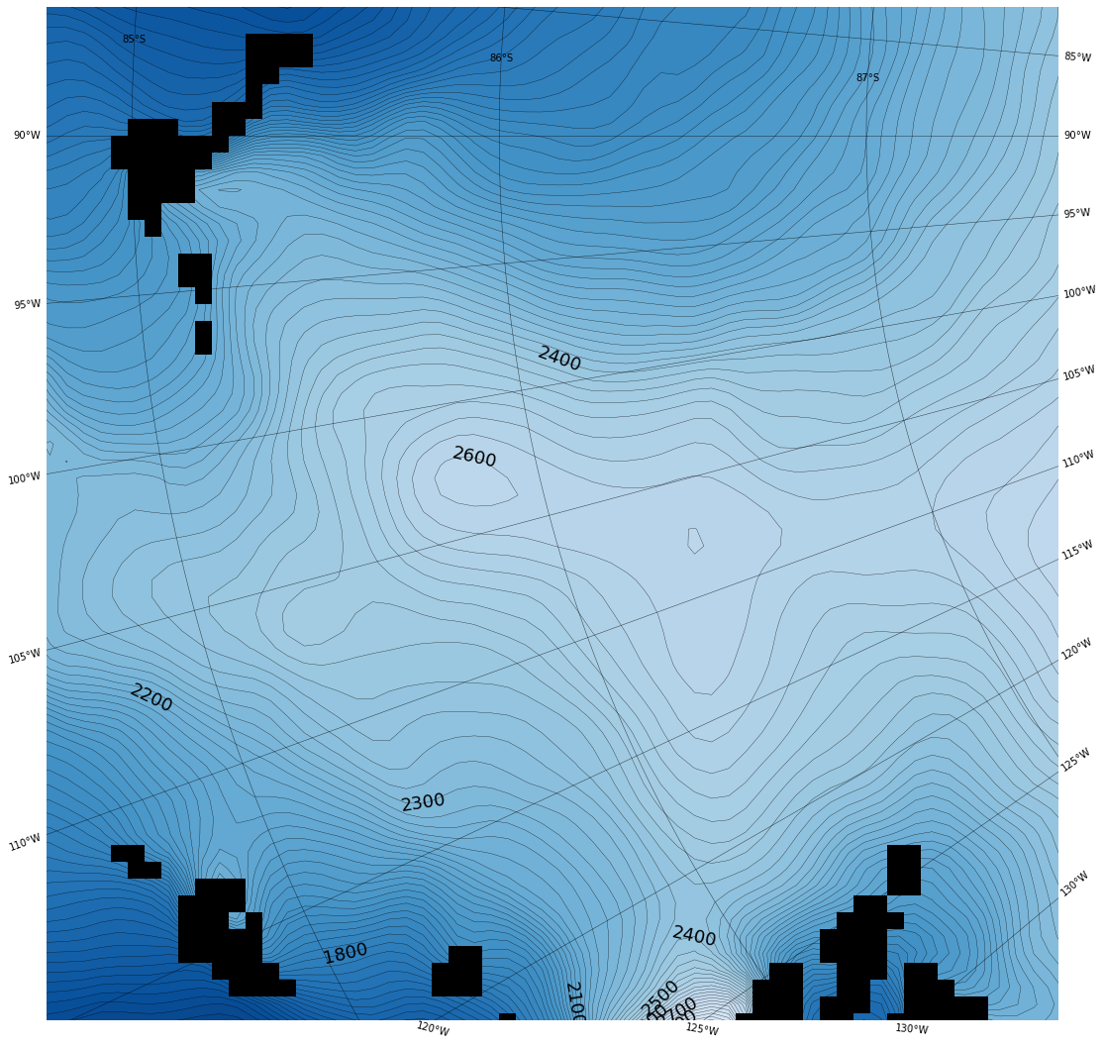
Heat flow maps of Hercules Dome region with uncertainties.
Forward models
Empiric models
Fox Maule et al (2005)
An et al (2015)
Martos et al (2017)
Shen et al (2020)
Aq1: Stål et al (2021)
59 mWm⁻²
60 mWm⁻²
62 +/- 5 mWm⁻²
63 +/- 5 mWm⁻²
72 +/- 13 mWm⁻²
Thiel Mtns
Forward models are generated from a geothermal gradient. Seismic or magnetic data are used to estimate a temperature in the upper mantle or lower crust.
Empiric models use one or many observables to link heat flow estimates in other continents to Antarctica.
Ohio Range
Surface elevation
(Morlighem et al, 2019)

Slide 3
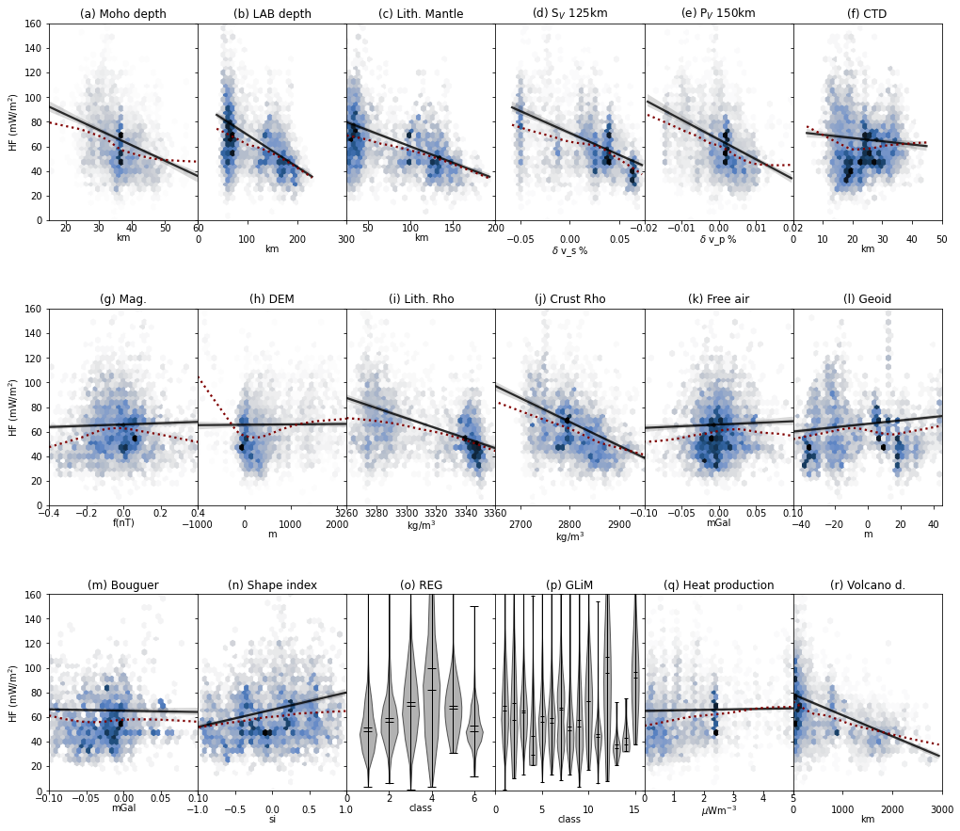
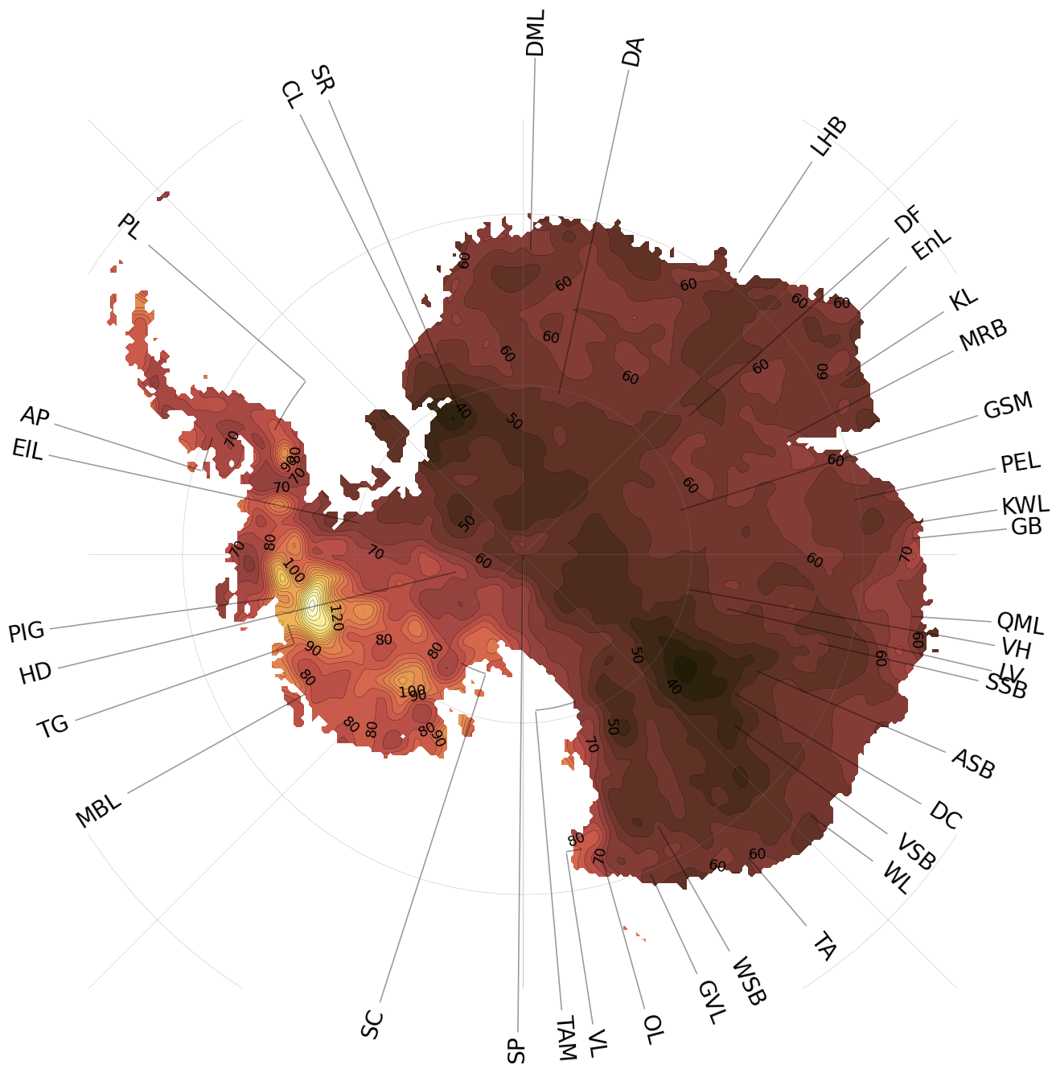
Heat flow measurements from global catalogue (Lucazeau, 2019)
Aq1(Stål et al., 2021) computes heat flow in Antarctica by detecting the similarity in tectonic setting from 18 observables. The degree of similarity is linked to heat flow measurements in a global database (Lucazeau, 2019), and the distribution of heat flow values are projected to Antarctica.
Observable values

Slide 4
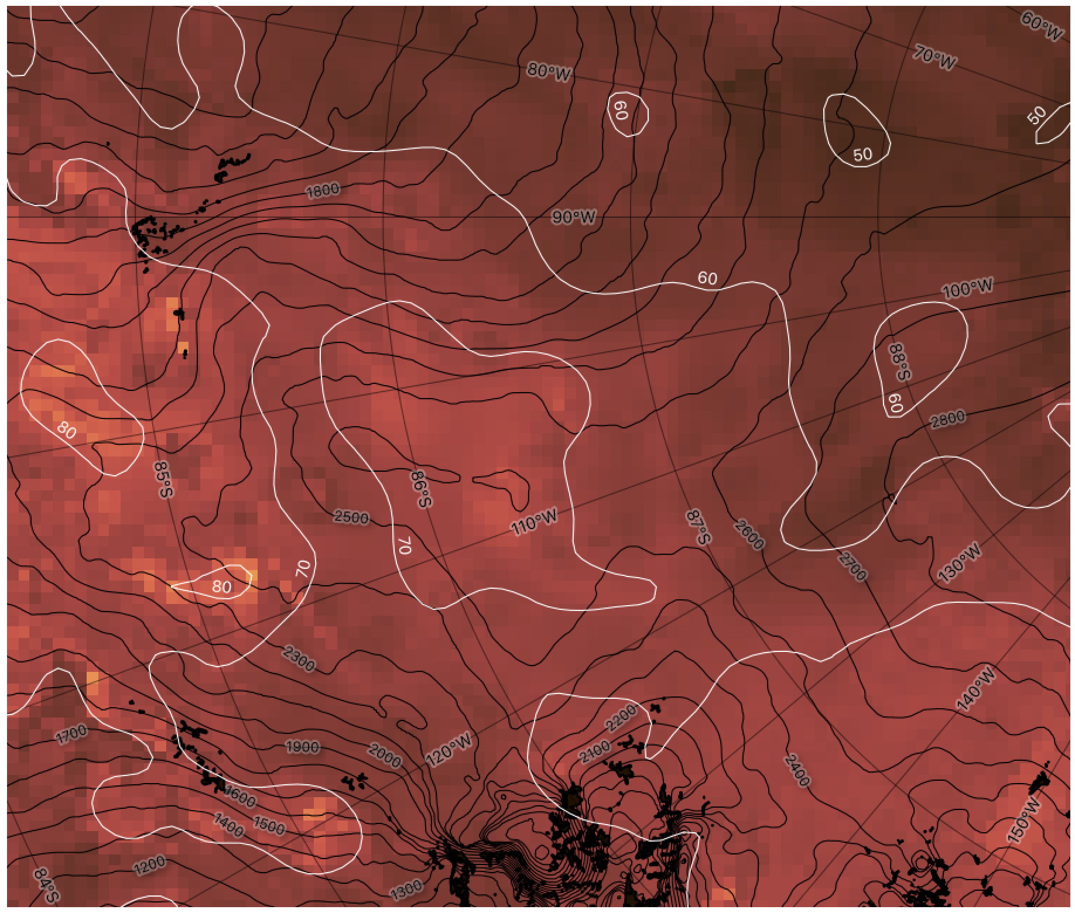
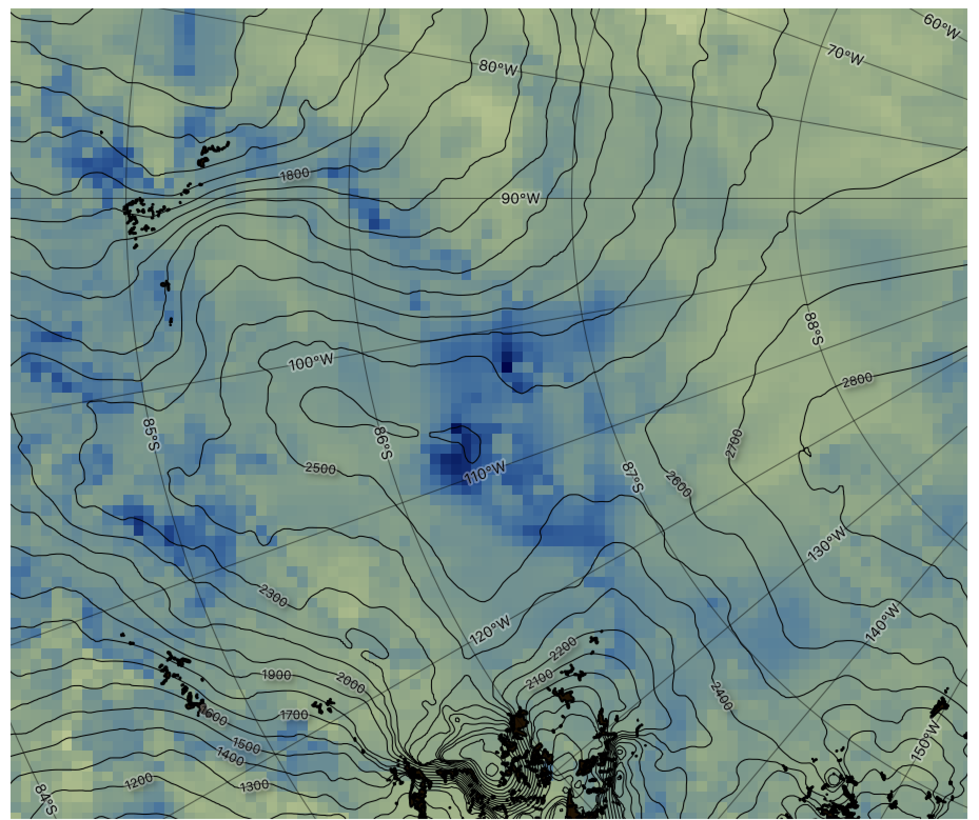

Aq1.Hercules 5x5 km grid. Covers Hercules Dome and surroundings
Standard deviation of reference distribution
Thiel Mtns
Black contours:
Surface elevation
White contours:
Heat flow (smoothened)
Ohio Range
Stål (2021)
https://github.com/TobbeTripitaka/Aq1.hercules

Slide 5
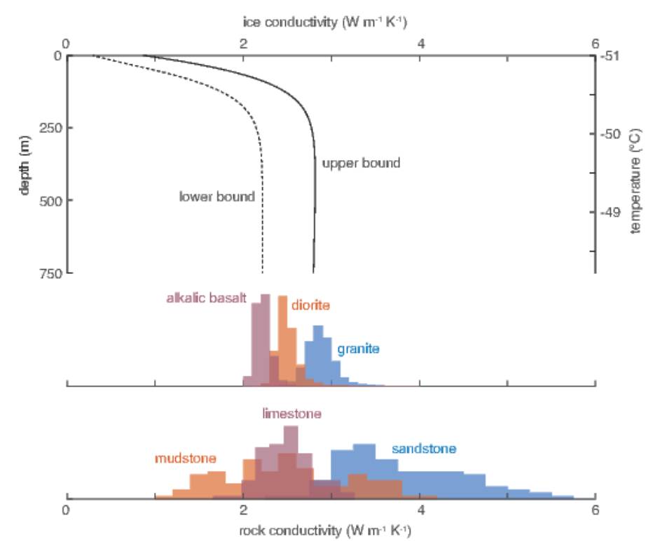
Can we increase resolution?
Resolution can only be increased with a detailed understanding of the subglacial topography, shallow geology, hydrological models and insight into the thermal properties of the ice.
We know from other regions that heat flow can vary over a large range in a short distance; however, when integrating over a larger area, those peaks are smoothened out.
The way forward is likely to jointly include observations from the cryosphere, and model subglacial hydrology.
Topographic correction (aka Lees-correction) is only useful if we know the thermal conductivity of the rocks beneath the ice, and the ice.
(Willcocks and Hasterok, 2019)

