Slide 1
Assessing Environmental Similarity Integration in Herb-Disease Association Prediction
Combining environmental factors to enhance herbal medicine research
Notes:
AI-generated content may be incorrect. ---

Slide 2
Introduction and Background
Notes:
--- This slide references information from the following file: https://vanderbilt365-my.sharepoint.com/personal/tobenna_d_udeze_vanderbilt_edu/Documents/Microsoft%20Copilot%20Chat%20Files/%5BNEW%5DNetwork_Analysis_in_Healthcare_Final__Predicting_Herb_Disease_Associations_Informed_by_Climatic_Descriptors.pdf Background & Motivation, Research Objectives

Slide 3
Background & Motivation
Integration of Disciplines
Herb-disease prediction combines traditional medicine, pharmacology, and computational science for novel insights.
Impact of Environmental Factors
Climate and stressors affect plant metabolism, influencing medicinal compound production and therapeutic effects.
Incorporating Climate Data
This study integrates climate-based similarity into computational models to improve herb-disease association predictions.
Notes:
--- This slide references information from the following file: https://vanderbilt365-my.sharepoint.com/personal/tobenna_d_udeze_vanderbilt_edu/Documents/Microsoft%20Copilot%20Chat%20Files/%5BNEW%5DNetwork_Analysis_in_Healthcare_Final__Predicting_Herb_Disease_Associations_Informed_by_Climatic_Descriptors.pdf Herb-disease association prediction lies at the intersection of traditional medicine, pharmacology, and computational science. Traditional systems like TCM have documented thousands of herb-disease relationships, but systematic validation and discovery remain challenging. Network-based computational approaches, such as HDAPM-NCP, have improved predictive accuracy by leveraging biochemical similarity measures. However, environmental factors like climate significantly influence plant secondary metabolism, which in turn affects therapeutic properties. Stressors such as temperature extremes and drought trigger biochemical pathways that produce compounds like alkaloids and phenolics. These variations suggest that herbs from similar environments may share medicinal properties. Ethnobotanical studies also show regional patterns in medicinal plant use aligned with environmental zones. Despite these insights, computational frameworks rarely incorporate environmental context. This research addresses that gap by integrating climate-based similarity into the HDAPM-NCP framework to evaluate whether environmental data enhances predictive performance.

Slide 4
Research Objectives
Climate-based Model Extension
The framework is extended to include climate-based environmental similarity measures for improved modeling.
Pipeline Development
A reproducible pipeline is developed to systematically integrate environmental and biochemical data sources.
Kernel Engineering
A climate similarity kernel is engineered based on Köppen-Geiger classifications to quantify environmental likeness.
Fusion and Performance Assessment
Fusion strategies combine environmental and biochemical kernels, with predictive improvements assessed.
Notes:
--- This slide references information from the following file: https://vanderbilt365-my.sharepoint.com/personal/tobenna_d_udeze_vanderbilt_edu/Documents/Microsoft%20Copilot%20Chat%20Files/%5BNEW%5DNetwork_Analysis_in_Healthcare_Final__Predicting_Herb_Disease_Associations_Informed_by_Climatic_Descriptors.pdf The study aims to augment the HDAPM-NCP framework with environmental similarity measures derived from climate, biome, and geographic data. Objectives include: (1) extending the model to incorporate climate-based similarity, (2) developing a reproducible pipeline for environmental data integration, (3) engineering a climate similarity kernel using Köppen-Geiger classifications, (4) implementing fusion strategies to combine environmental and biochemical kernels, (5) assessing predictive performance improvements, and (6) analyzing network restructuring caused by environmental augmentation. The hypothesis is that herbs growing in similar climates are more likely to share disease associations than those from dissimilar environments. This approach seeks to complement biochemical similarity rather than replace it, aiming for enhanced accuracy and interpretability.

Slide 5
HDAPM-NCP Framework and Environmental Integration
Notes:
--- This slide references information from the following file: https://vanderbilt365-my.sharepoint.com/personal/tobenna_d_udeze_vanderbilt_edu/Documents/Microsoft%20Copilot%20Chat%20Files/%5BNEW%5DNetwork_Analysis_in_Healthcare_Final__Predicting_Herb_Disease_Associations_Informed_by_Climatic_Descriptors.pdf HDAPM-NCP Framework Overview, Environmental Data Integration Pipeline

Slide 6
HDAPM-NCP Framework Overview
Input Data Matrices
The framework uses herb similarity, disease similarity, and herb-disease adjacency matrices as input data for prediction.
Network Similarity Projection
NSP algorithm propagates known herb-disease links through similarity networks to infer new associations accurately.
Normalization and Scoring
The formula ensures row and column normalization to produce a final score matrix predicting herb-disease associations.
Predictive Performance
The baseline model demonstrates high accuracy in predicting associations using biochemical and network data alone.
Notes:
--- This slide references information from the following file: https://vanderbilt365-my.sharepoint.com/personal/tobenna_d_udeze_vanderbilt_edu/Documents/Microsoft%20Copilot%20Chat%20Files/%5BNEW%5DNetwork_Analysis_in_Healthcare_Final__Predicting_Herb_Disease_Associations_Informed_by_Climatic_Descriptors.pdf The HDAPM-NCP framework predicts herb-disease associations using Network Similarity Projection (NSP). Inputs include a herb similarity matrix (combining target proteins, GO enrichment, chemical ingredients, KEGG pathways, and gene targets), a disease similarity matrix (based on disease-gene associations and semantic similarity), and a herb-disease adjacency matrix from the HERB database. The NSP algorithm propagates known associations through similarity networks to infer new links. The formula S = A·D·norm_row + H·A·norm_col ensures normalization and scaling, producing a score matrix for herb-disease associations. This baseline model achieves high predictive performance using biochemical features alone.

Slide 7
Environmental Data Integration Pipeline
Data Collection and Mapping
Herb occurrence data is harvested and mapped to climate zones using Köppen-Geiger codes for precise environmental context.
Climate Vector Construction
Frequency distributions of climate zones per herb are constructed into climate vectors for environmental similarity analysis.
Kernel Fusion and Similarity
Climate kernel is fused with biochemical kernel using weighted averaging; similarity is computed via cosine similarity.
Parameter Evaluation
Parameter sweeps across alpha values test the impact of integrating environmental data for network prediction accuracy.
Notes:
--- This slide references information from the following file: https://vanderbilt365-my.sharepoint.com/personal/tobenna_d_udeze_vanderbilt_edu/Documents/Microsoft%20Copilot%20Chat%20Files/%5BNEW%5DNetwork_Analysis_in_Healthcare_Final__Predicting_Herb_Disease_Associations_Informed_by_Climatic_Descriptors.pdf Environmental integration involved multiple steps: (1) harvesting herb occurrence data from GBIF, (2) mapping coordinates to Köppen-Geiger climate codes, (3) filtering herbs lacking occurrence data, (4) constructing climate vectors representing frequency distributions of climate zones per herb, and (5) computing climate similarity using cosine similarity. A climate kernel was then fused with the biochemical kernel using weighted averaging: K_fused = α·K_climate + (1−α)·K_baseline. Parameter sweeps across α values (0.0 to 0.9) evaluated the contribution of environmental similarity. This pipeline aimed to create a reproducible method for integrating climate data into network-based prediction.

Slide 8
Evaluation and Results
Notes:
--- This slide references information from the following file: https://vanderbilt365-my.sharepoint.com/personal/tobenna_d_udeze_vanderbilt_edu/Documents/Microsoft%20Copilot%20Chat%20Files/%5BNEW%5DNetwork_Analysis_in_Healthcare_Final__Predicting_Herb_Disease_Associations_Informed_by_Climatic_Descriptors.pdf Evaluation Metrics and Experimental Design, Results and Network Restructuring

Slide 9
Evaluation Metrics and Experimental Design
Performance Metrics
AUROC, AUPR, and Average Precision assess model ranking ability and precision, especially with class imbalance.
Dataset Composition
The dataset consists of 3,106 positive and 4,494 negative herb-disease associations used for model evaluation.
Model Comparison
Experiments compare baseline biochemical kernel models with climate-integrated models using various fusion weights.
Network Topology Analysis
Network topology metrics reveal structural changes introduced by climate similarity in the analyzed models.
Notes:
--- This slide references information from the following file: https://vanderbilt365-my.sharepoint.com/personal/tobenna_d_udeze_vanderbilt_edu/Documents/Microsoft%20Copilot%20Chat%20Files/%5BNEW%5DNetwork_Analysis_in_Healthcare_Final__Predicting_Herb_Disease_Associations_Informed_by_Climatic_Descriptors.pdf Performance was assessed using AUROC, AUPR, and Average Precision metrics, which measure ranking ability and precision under class imbalance. The dataset included 3,106 positive and 4,494 negative herb-disease associations. Experiments compared baseline NSP (biochemical kernels only) with climate-integrated models at various fusion weights. ROC and PR curves were generated for all α values, and network topology metrics were analyzed to understand structural changes introduced by climate similarity.

Slide 10
Results and Network Restructuring
Model | Alpha | ROC AUC | PR AUC | Avg Precision
Baseline | — | 0.93220 | 0.90331 | 0.90332
Climate-only | — | 0.93163 | 0.90234 | 0.90236
Fused (0.3) | 0.3 | 0.94565 | 0.92807 | 0.92808
Notes:
--- This slide references information from the following file: https://vanderbilt365-my.sharepoint.com/personal/tobenna_d_udeze_vanderbilt_edu/Documents/Microsoft%20Copilot%20Chat%20Files/%5BNEW%5DNetwork_Analysis_in_Healthcare_Final__Predicting_Herb_Disease_Associations_Informed_by_Climatic_Descriptors.pdf Climate integration produced negligible improvement in predictive performance. Baseline AUROC and AUPR were approximately 0.9322 and 0.9033, while climate-fused models showed similar values, with differences near zero. ROC and PR curves overlapped across all α values, confirming no measurable gain. However, network topology changed significantly: the climate kernel created modular clusters based on shared climate zones, contrasting with the dense connectivity of the biochemical kernel. Despite structural changes, these clusters did not enhance predictive accuracy, suggesting that environmental similarity either lacks discriminative power or is redundant with biochemical features.

Slide 11
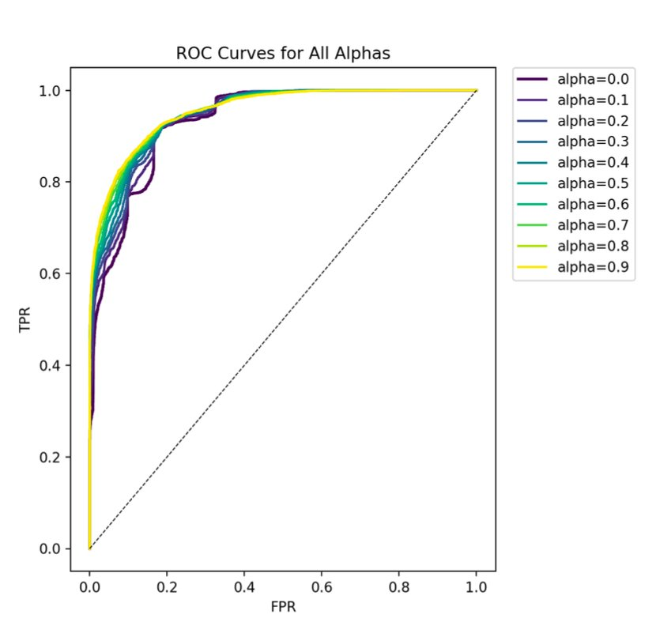
Results: Predictive Performance
Baseline Performance (α = 0.0)
Baseline kernel achieves strong predictive performance, with AUROC and AUPR scores establishing the reference benchmark.
Climate-Integrated Performance (α = 0.3)
Integrating climate similarity at moderate weight results in marginal decreases in AUROC and AUPR, indicating limited contribution from the added kernel.
Performance Across All α Values
Climate-informed kernels exhibit higher clustering coefficients, reduced overall density, and stronger modularity relative to the baseline configuration.
Overall Conclusion
Current climate-similarity representation introduces no measurable predictive benefit and does not enhance network inference accuracy.
Notes:
--- This slide references information from the following file: https://vanderbilt365-my.sharepoint.com/personal/tobenna_d_udeze_vanderbilt_edu/Documents/Microsoft%20Copilot%20Chat%20Files/%5BNEW%5DNetwork_Analysis_in_Healthcare_Final__Predicting_Herb_Disease_Associations_Informed_by_Climatic_Descriptors.pdf Environmental integration involved multiple steps: (1) harvesting herb occurrence data from GBIF, (2) mapping coordinates to Köppen-Geiger climate codes, (3) filtering herbs lacking occurrence data, (4) constructing climate vectors representing frequency distributions of climate zones per herb, and (5) computing climate similarity using cosine similarity. A climate kernel was then fused with the biochemical kernel using weighted averaging: K_fused = α·K_climate + (1−α)·K_baseline. Parameter sweeps across α values (0.0 to 0.9) evaluated the contribution of environmental similarity. This pipeline aimed to create a reproducible method for integrating climate data into network-based prediction.

Slide 12
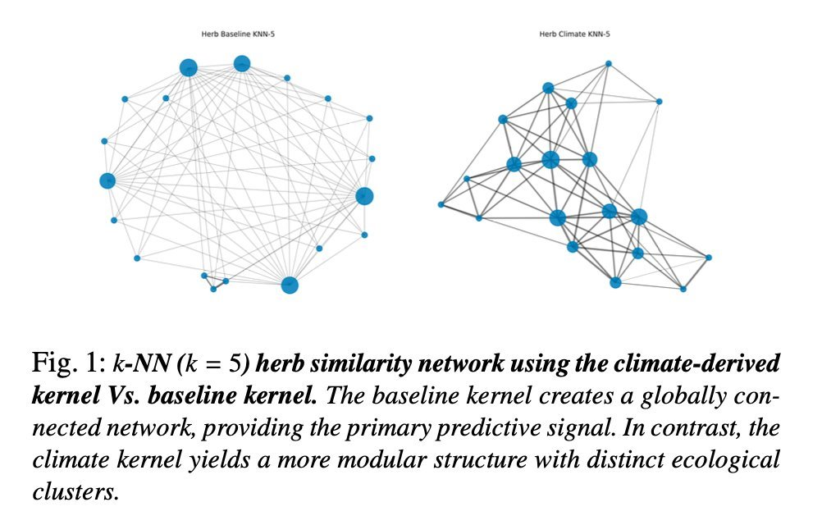
Results: Network Restructuring
Kernel Fusion Strategy
Baseline, climate-only, and fused kernel configurations are constructed to evaluate the impact of environmental integration on network structure and performance.
Network Structural Assessment
Clustering coefficients, density measures, and modularity scores are computed to quantify structural differences introduced by the climate kernel.
Comparative Structural Findings
Climate-informed kernels exhibit higher clustering coefficients, reduced overall density, and stronger modularity relative to the baseline configuration.
Predictive Performance Insight
Despite measurable structural shifts, the incorporation of climate-derived structure does not yield improvements in predictive accuracy.
Notes:
--- This slide references information from the following file: https://vanderbilt365-my.sharepoint.com/personal/tobenna_d_udeze_vanderbilt_edu/Documents/Microsoft%20Copilot%20Chat%20Files/%5BNEW%5DNetwork_Analysis_in_Healthcare_Final__Predicting_Herb_Disease_Associations_Informed_by_Climatic_Descriptors.pdf Environmental integration involved multiple steps: (1) harvesting herb occurrence data from GBIF, (2) mapping coordinates to Köppen-Geiger climate codes, (3) filtering herbs lacking occurrence data, (4) constructing climate vectors representing frequency distributions of climate zones per herb, and (5) computing climate similarity using cosine similarity. A climate kernel was then fused with the biochemical kernel using weighted averaging: K_fused = α·K_climate + (1−α)·K_baseline. Parameter sweeps across α values (0.0 to 0.9) evaluated the contribution of environmental similarity. This pipeline aimed to create a reproducible method for integrating climate data into network-based prediction.

Slide 13
Discussion and Future Directions
Notes:
--- This slide references information from the following file: https://vanderbilt365-my.sharepoint.com/personal/tobenna_d_udeze_vanderbilt_edu/Documents/Microsoft%20Copilot%20Chat%20Files/%5BNEW%5DNetwork_Analysis_in_Healthcare_Final__Predicting_Herb_Disease_Associations_Informed_by_Climatic_Descriptors.pdf Discussion and Limitations, Future Directions

Slide 14
Discussion and Limitations
Climate Kernel Sparsity
Sparsity and noise from herbs occurring in multiple climate zones reduced the model's discriminative power.
Feature Redundancy
Environmental influences may be redundant, already reflected in biochemical similarities among species.
Data Coverage Bias
Bias arises from GBIF records favoring well-documented species, limiting environmental variance in the dataset.
Coarse Climate Classification
Coarse climate categories fail to capture fine-scale environmental variations key to plant biochemistry.
Notes:
--- This slide references information from the following file: https://vanderbilt365-my.sharepoint.com/personal/tobenna_d_udeze_vanderbilt_edu/Documents/Microsoft%20Copilot%20Chat%20Files/%5BNEW%5DNetwork_Analysis_in_Healthcare_Final__Predicting_Herb_Disease_Associations_Informed_by_Climatic_Descriptors.pdf Several factors explain the neutral outcome: (1) Climate kernel sparsity and noise due to herbs occurring in multiple zones diluted discriminative power; (2) Feature redundancy, as environmental influences may already be reflected in biochemical similarities; (3) Data coverage bias from reliance on GBIF records, favoring well-documented species and reducing environmental variance. Additionally, coarse climate classifications may not capture fine-scale variations relevant to plant biochemistry. These limitations highlight the need for more nuanced environmental feature engineering.

Slide 15
Future Directions
Climate Variable Integration
Incorporate continuous climate variables like temperature and precipitation for richer environmental analysis.
Advanced Fusion Techniques
Utilize attention-based weighting and graph neural networks to enhance data fusion strategies.
Multi-scale Environmental Features
Combine soil and altitude data to capture environmental complexity at multiple scales.
Enhanced Predictive Approaches
Apply non-linear similarity measures and deep learning to better model environment-biochemistry interactions.
Notes:
--- This slide references information from the following file: https://vanderbilt365-my.sharepoint.com/personal/tobenna_d_udeze_vanderbilt_edu/Documents/Microsoft%20Copilot%20Chat%20Files/%5BNEW%5DNetwork_Analysis_in_Healthcare_Final__Predicting_Herb_Disease_Associations_Informed_by_Climatic_Descriptors.pdf Future work should explore continuous climate variables (temperature, precipitation), advanced fusion strategies like attention-based weighting or graph neural networks, multi-scale environmental features combining soil and altitude data, expanded herb coverage to reduce bias, and non-linear similarity measures or deep learning approaches. These improvements could better capture complex environment-biochemistry-therapeutic relationships and leverage ecological clustering for predictive gain.

Slide 16
Conclusion
Notes:
--- This slide references information from the following file: https://vanderbilt365-my.sharepoint.com/personal/tobenna_d_udeze_vanderbilt_edu/Documents/Microsoft%20Copilot%20Chat%20Files/%5BNEW%5DNetwork_Analysis_in_Healthcare_Final__Predicting_Herb_Disease_Associations_Informed_by_Climatic_Descriptors.pdf Key Takeaways

Slide 17
Key Takeaways
Reproducible Data Pipeline
The integration created a reproducible pipeline for environmental data, supporting consistent data processing and analysis.
Limited Predictive Improvement
Adding climate-based similarity did not enhance predictive performance, indicating challenges in current environmental data representation.
Foundation for Future Research
Methodological advances establish groundwork for further sophisticated environmental modeling in computational pharmacology.
Notes:
--- This slide references information from the following file: https://vanderbilt365-my.sharepoint.com/personal/tobenna_d_udeze_vanderbilt_edu/Documents/Microsoft%20Copilot%20Chat%20Files/%5BNEW%5DNetwork_Analysis_in_Healthcare_Final__Predicting_Herb_Disease_Associations_Informed_by_Climatic_Descriptors.pdf Integrating climate-based similarity into HDAPM-NCP did not improve predictive performance, but established a reproducible pipeline for environmental data integration. The findings suggest that current environmental representations may lack sufficient signal or overlap with biochemical features. While predictive gains were absent, the methodological contributions provide a foundation for future research aimed at more sophisticated environmental modeling in computational pharmacology.

